Slide 1
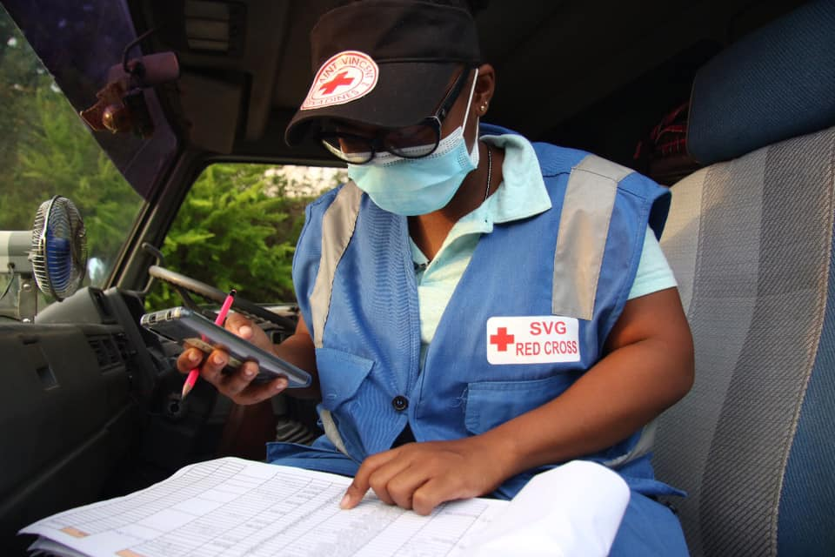


CDRTs Roles & Structure
For Community Response Teams

Slide 2
Objectives
Understand CDRT Roles and Responsibilities
How to form a CDRT and team organization
CDRT Structure and decision making
CDRTs and response
Notes:
Understand CDRT Roles and Responsibilities – learning about different types of response agencies their roles and how CDRTs fit in and fill gaps in the National Response Systems, as well as gathering what is expected of a CDRT, before, during and after an emergency.
How to form a CDRT and team organization – How to organise a CDRT team based on skills set and deploy CDRT members based on resources, as well as services needed.
CDRT Structure and decision making – Understanding the CDRT reporting lines, operating lines and how decision are made in a timely manner to prevent loss and damage.
CDRTs and response - assessing when CDRT intervention is needed, how to intervene, while prioritizing personal safety, what is required when responding and what type of reporting, as well as assessments are needed.

Slide 3
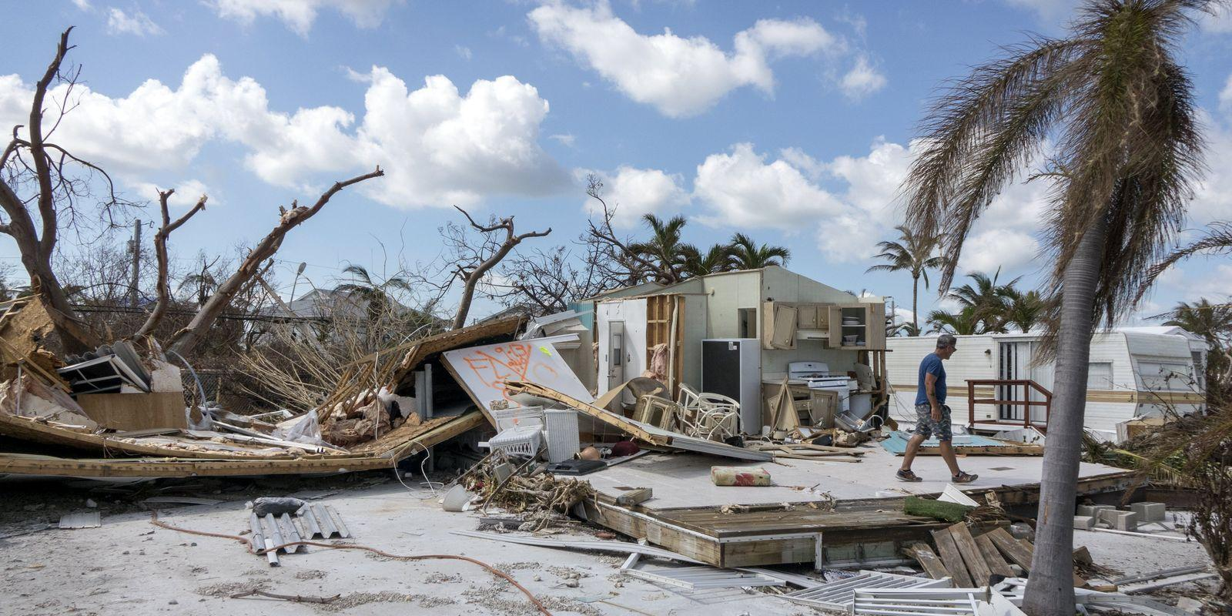
Why Be Organized?
Why Prepare?
Why Work Together?

Slide 4
The Answer
You want to have effective response
Minimize loss of life and damage to property
To be more resilient

Slide 5
The CDRT Governance Structure At A
National Level
Notes:
CDRTs as well as Community Emergency Response Teams (CERTs), collectively referred to as Community Response Teams, form part of the national response mechanism of a country.

Slide 6
Steering Committee
Resource Mobilization
Strategic Planning
Development of Annual Budget
Planning of CDRT Activities
Establishment & Training of New Teams
Notes:
Members of the Steering Committee should include the National Disaster Organization as the Chair, the National Society as the Co-chair and members of three relevant partnering agencies (fire, medical, police/military, social development ministry and/or NGOs.

Slide 7

CDRT Chair
Leads & Oversees
Builds The Team
Strategic Planning, Growth & Development
Monitoring & Evaluation
Notes:
Leads and oversees
Leads steering committee and oversees all CRT activities
Builds the team
Develops and manages relationships and communication across the assigned priority areas
Strategic planning, Growth & Development
Participates in ongoing strategic planning and seeks new opportunities for growth and development
Monitoring and Evaluation
Participates in monitoring and evaluating efforts within the priority areas

Slide 8

CDRT Secretary
Manages documentation and record keeping
Plan and record meetings
Keep updated contact list of members and stakeholders
Notes:
Ask participants what other responsibilities they believe the secretariat to handle: (full list below)
Ensure meetings are effectively organised and minutes taken
Liaise with chair to plan meetings
Receive agenda items from committee members
Circulate approved minutes
Check that agreed actions are carried out
Maintaining effective records and administration
Keeping up-to-date contact details
Filing minutes and reports
Compile list of names and addresses that are useful to the group
Keeping a list of the group’s activities and future plans
Upholding legal requirements
Acting as custodian
Checking quorum is present at meetings
Ensuring elections are in line with stipulated procedures
Ensuring group activities are in line with its objectives
Communication and correspondence
Respond to all committee correspondence
Filing all committee correspondence received and copies sent
Keeping copies of any publications (e.g. leaflets, etc.)

Slide 9

Public Relations/ Communications Officer
Share Info to the CDRT Team
Promote good work of CDRTs
Builds communication network
Public education activities
Engagement & Inclusivity

Slide 10
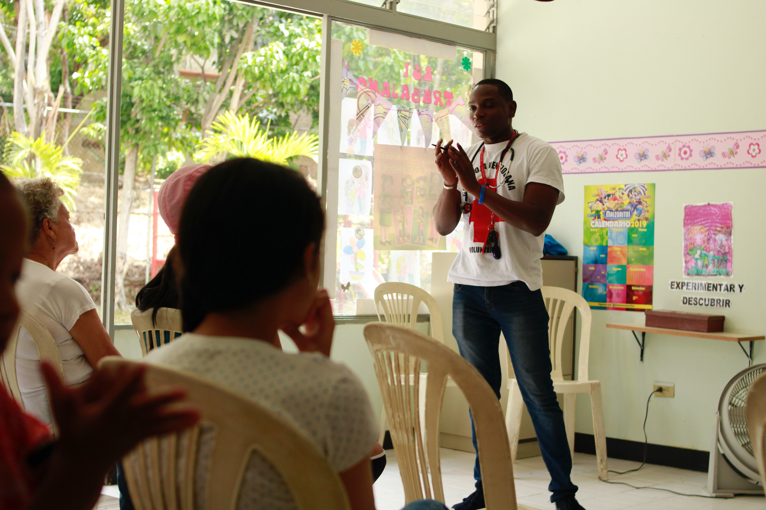
Training
Officer
Update Training Materials To The Highest Standard
Evaluate Impact Of Trainings
Assess Training Needs
Source Trainers, Equipment & Materials For CDRT members
Record CDRT Skills set
Notes:
Update
Develop and maintain training materials to the highest standard
Evaluate impact of trainings and the effectiveness of training and modify materials as appropriate
Assess Training needs - Maintain effective communication with the CDRTs to ascertain training needs
Research/Source - Assist in the procurement of materials to support the delivery of trainings
Record CDRT Skills set

Slide 11

Zonal
Coordinator
Schedule Trainings and refresher courses
Logistics & Maintenance for CDRTs
Programme Management
Update CDRT roster

Slide 12
CDRT
Governance
Structure At The Community Level

Slide 13
CDRT Organisation for Community-Based Response
Establish an operational structure specific to the community.
Appoint a Team Leader.
Assign a location for coordination.
Appoint persons to assist with logistics and planning.
Decide if sub-teams are needed with a leader for each.

Slide 14
Engaging The Community
Listen to Community Members.
Consider Language Barriers.
Consider Cultural context of the Community.
Involve all members of the community, including vulnerable groups.
Respect everyone’s beliefs and attitudes but advocate for preparedness.

Slide 15
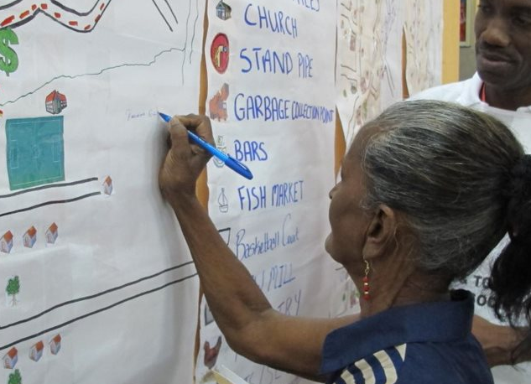
Educating The Community
Share information on potential threats in the community
Raise awareness and promote preparedness activities
Present the benefits of planning before an emergency

Slide 16
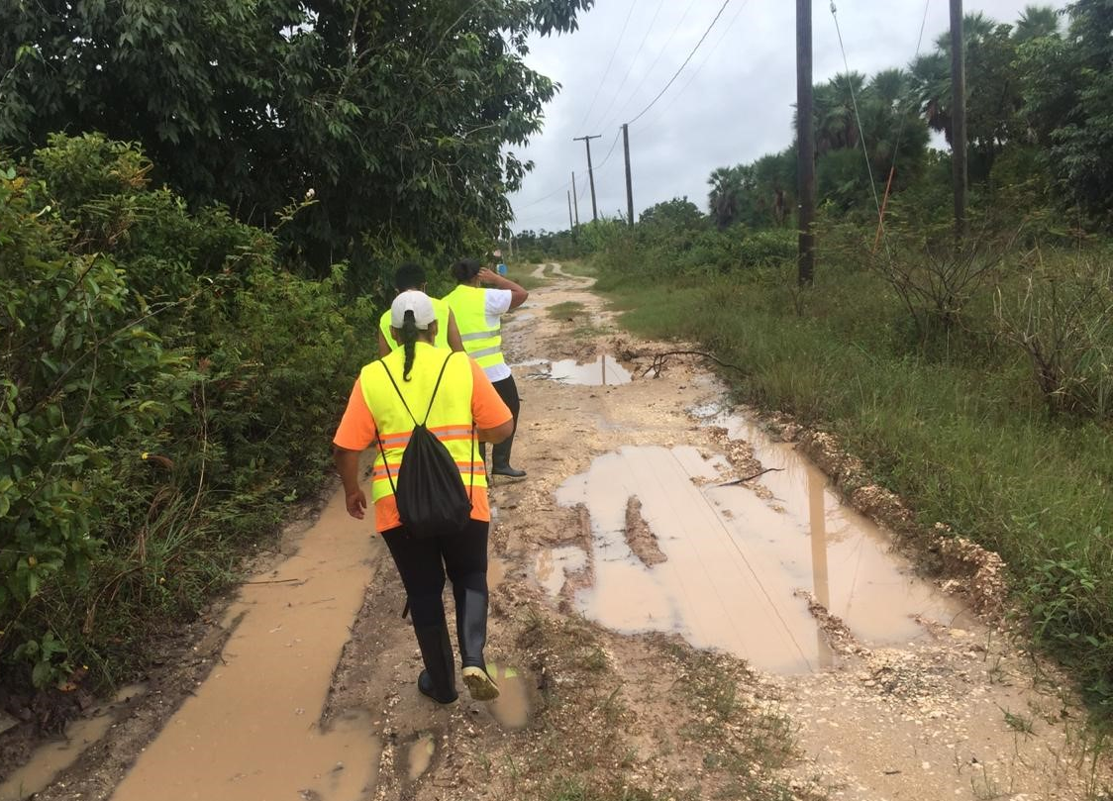
CDRT’s Preparedness Role
Discuss with community members:
Emergency Plans
Shelters in the Community
Review Evacuation Routes
Early Warning Measures
Practicing and Testing of Plans

Slide 17
Develop Community Disaster Plans
Preparedness
Mapping
Risk & Vulnerability
What hazards?
Who would be affected?
Which areas are vulnerable?
Who are the vulnerable persons?
Where are they in your community?

Slide 18
Mapping Resources
What are they?
Where are they located?
Who has access to them?
Preparedness
Mapping
Resources
& Capacities
Notes:
What are the things that your community has that can help it to be prepared or to response to a disaster. Make a list of them. These could be persons with skills, a shelter, equipment and so on.
What are they?
Where are they located?
Who has access to them?

Slide 19

Develop
Effective
Modes of Communication
Establishing effective ways to communicate with other CDRT members and the community is very important.
Test your communication plans.

Slide 20
Developing Early Warning Systems
Risk Knowledge
Good knowledge of the risk
Strong knowledge of hazard and community.
Monitoring
A reliable, consistent, systematic way of predicting the event
Warning Communication
The warning or message that informs the community
Response Action
Response capacity
Practiced actions to protect lives and property

Slide 21
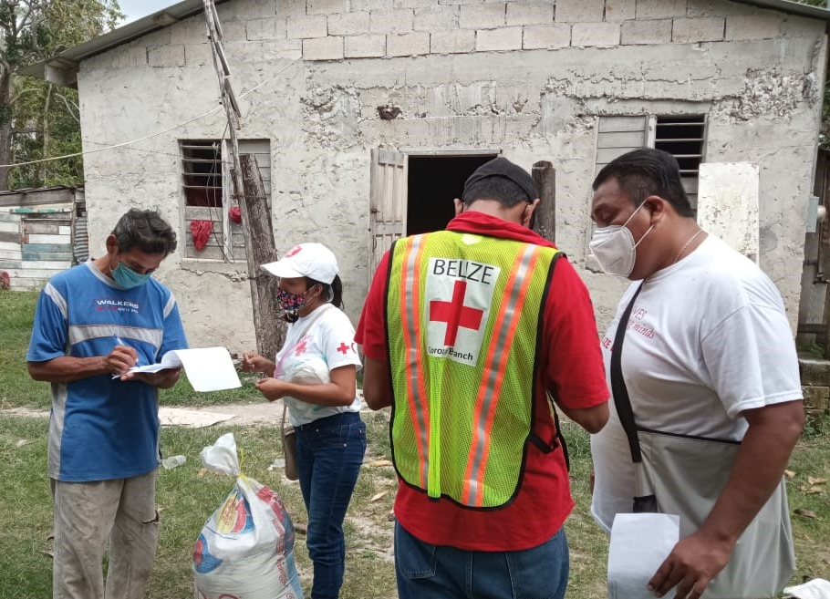
CDRT’s
Role During
A Disaster
Stay Indoors
Keep communication open if possible and share safety information with other team members
Keep boardgames or cards, books to occupy family

Slide 22
Objectives Of CDRT Teams In Response
Identifies The Scope Of The Incident
(What is the problem?)
Determines An Overall Strategy
(What can we do, and how will we do it?)
Deploys Resources
(Who is going to do what?)
Documents Actions & Results

Slide 23
CDRT Response
Role
Firstly, ensure safety of your family.
Assist with response activities as advised by CDRT lead.
Assist with clearing of debris.
Access equipment to help other community members.
Support with Shelters if needed.
Assist with Light Search and Rescue.
Ensure you are wearing proper Personal Protective Equipment.

Slide 24
Field Guide:
Reference Slide Unit 2
Ref pages in the guide for Flood, Earthquake and Hurricanes (before, during and after) currently in the guide under pages 68-75

Slide 25
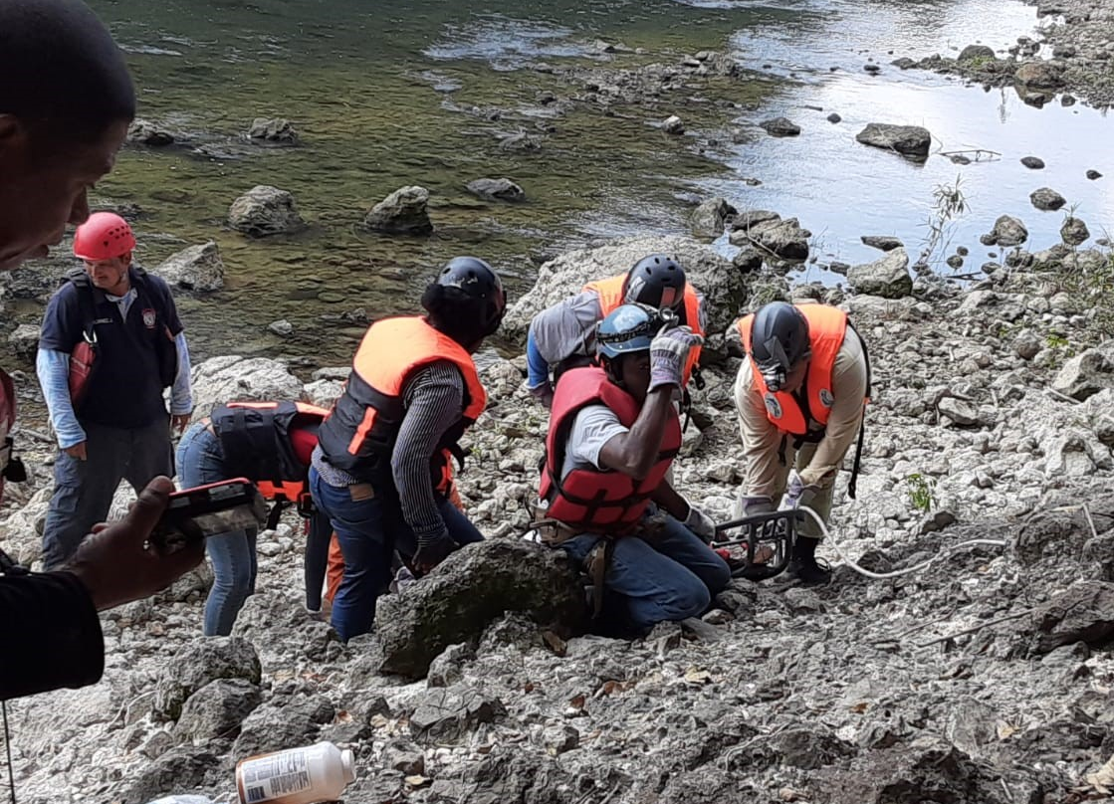
Remember:
Rescuer Safety Is Paramount
The question, “Is it safe for the CDRT members to attempt the rescue?” is very important.
The answer to this question is based mainly on the degree of damage to the structure.

Slide 26
Volunteer, Donate, Join Us In Partnership, or share
our appeals and stories on social media. Find out more about IFRC, and learn how to contact your National Red Cross or Red Crescent Society, at www.ifrc.org
Get Involved
There are many ways of becoming a part of the world’s largest humanitarian network
P.O. Box 303
CH-1211 Geneva 19
Switzerland
Telephone: +41 22 730 4222
Fax: +41 22 730 4200
Email: secretariat@ifrc.org
Website: www.ifrc.org

