Slide 1
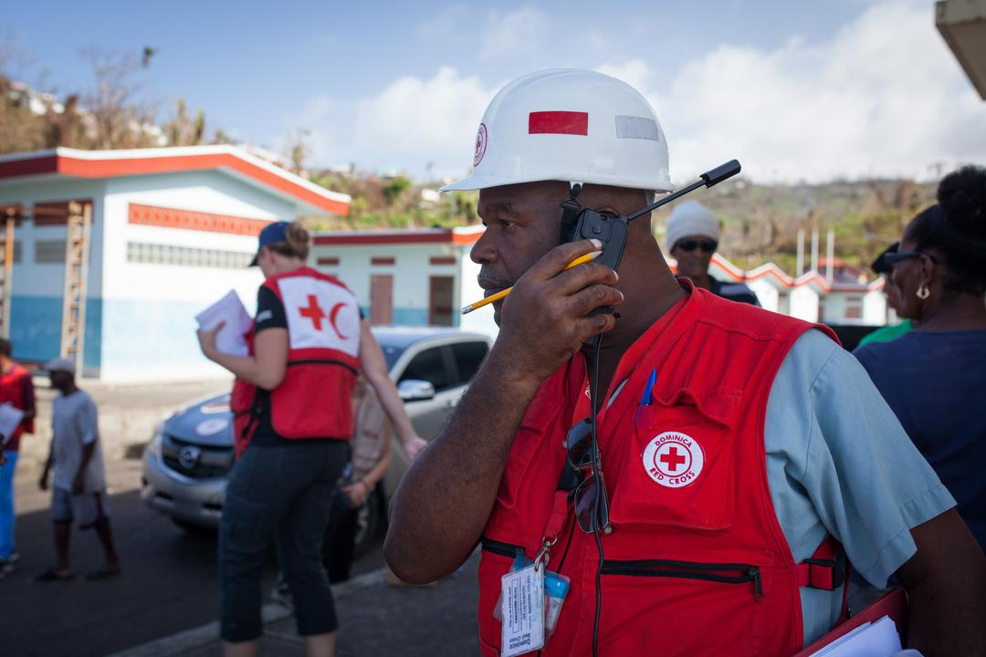
CDRTs & Communication
For Community Disaster Response Teams

Slide 2
Acknowledgements
We thank the Belize Red Cross, Grenada Red Cross, Guyana Red Cross, Jamaica Red Cross, St
Vincent and the Grenadines Red Cross, Trinidad and Tobago Red Cross and the Caribbean
Disaster Emergency Management Agency (CDEMA) for their commitment to collaborating with
the Caribbean Disaster Risk Management (CADRIM) Reference Centre. Together, we reviewed
and revised the CDRT Training Material, enhancing its relevance and effectiveness in disaster
response training. Your dedication exemplifies the spirit of cooperation within the humanitarian
community, and we deeply appreciate your invaluable contributions.

Slide 3
Objectives
Understand what is a two-way radio
Understand the basics of using a two-way radio

Slide 4
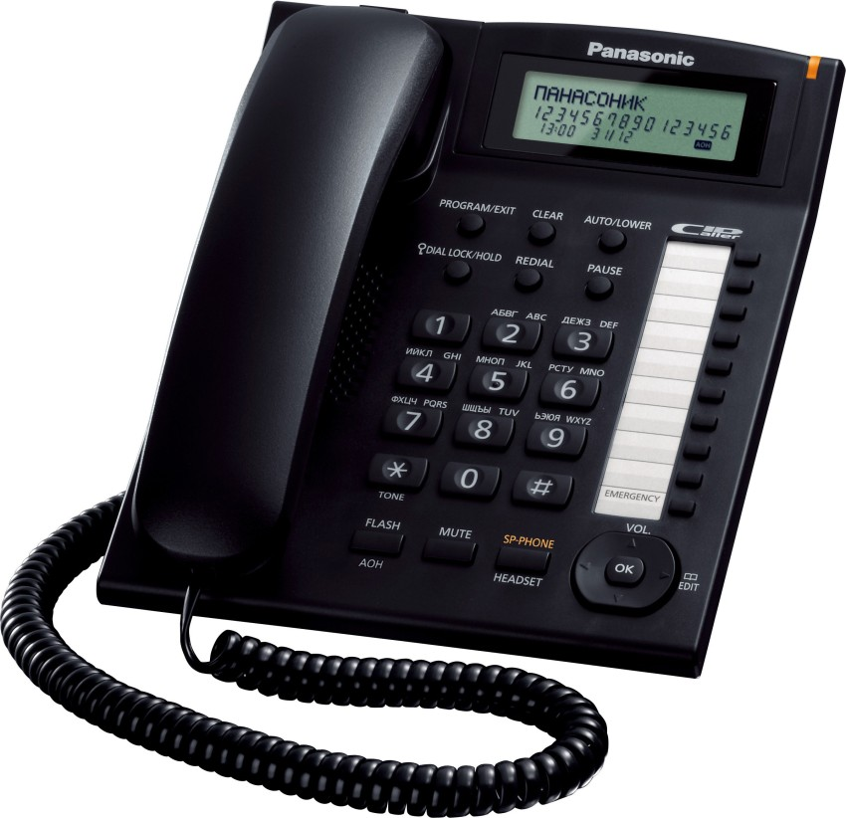
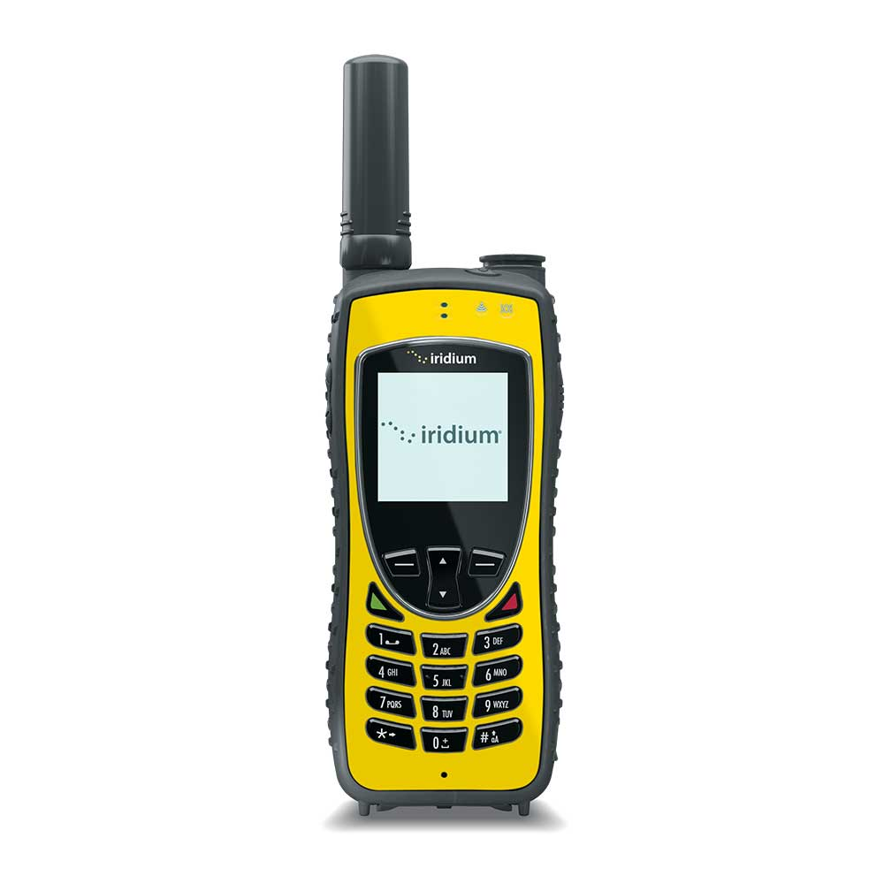
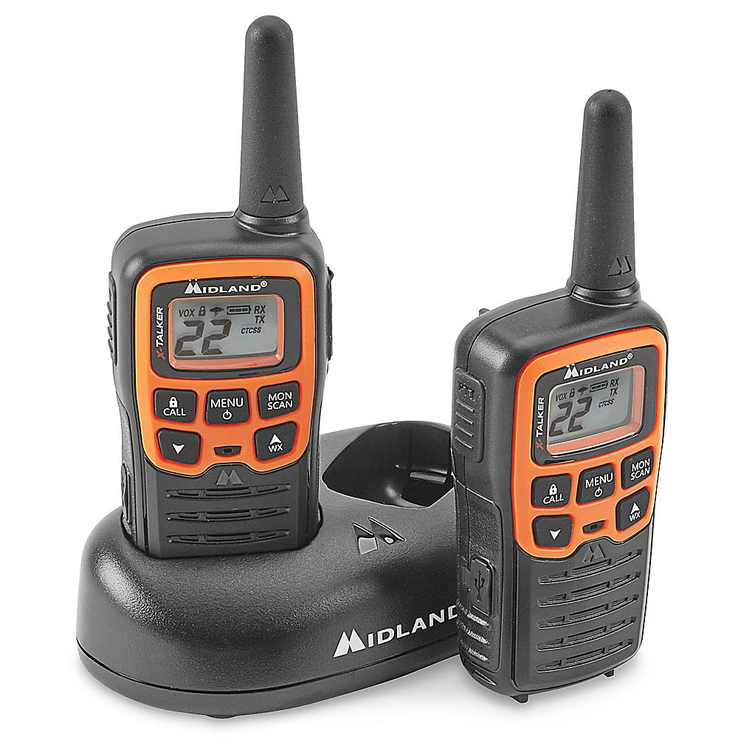
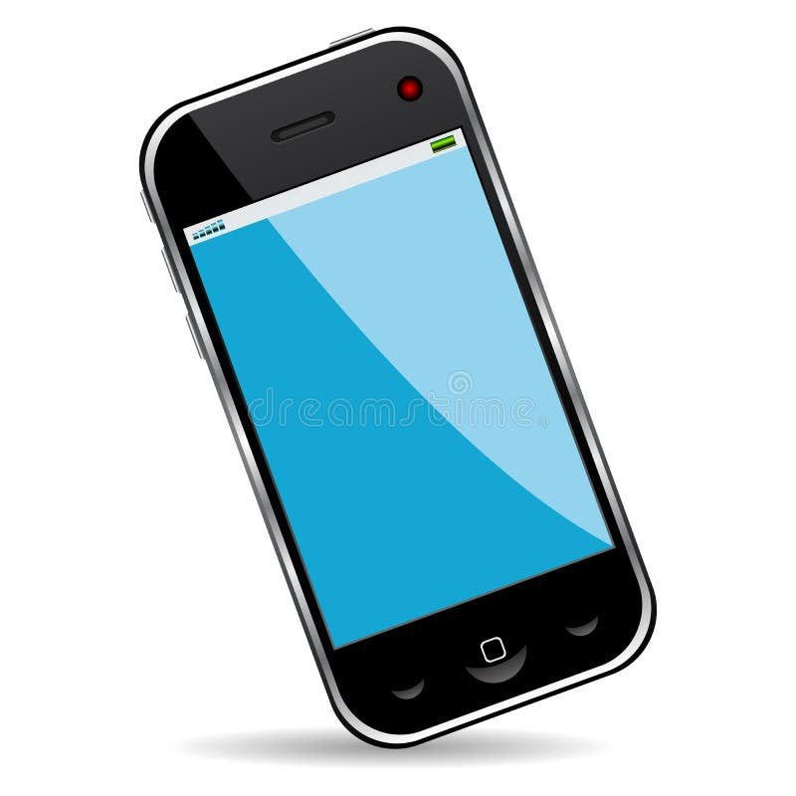
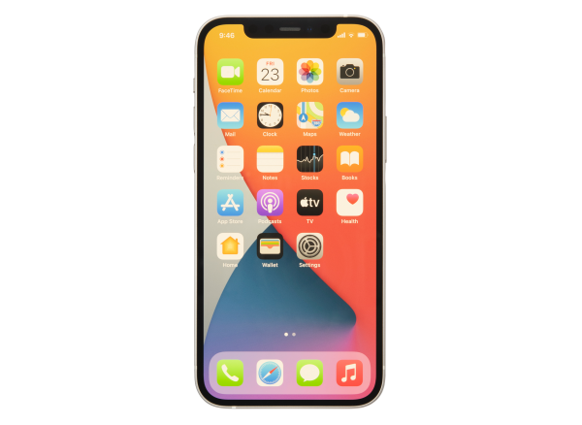
Modes Of
Communication
Runner
Landline Telephones
Cell Phones
Two-way Radios
Electronic
WhatsApp
Sat Phones

Slide 5
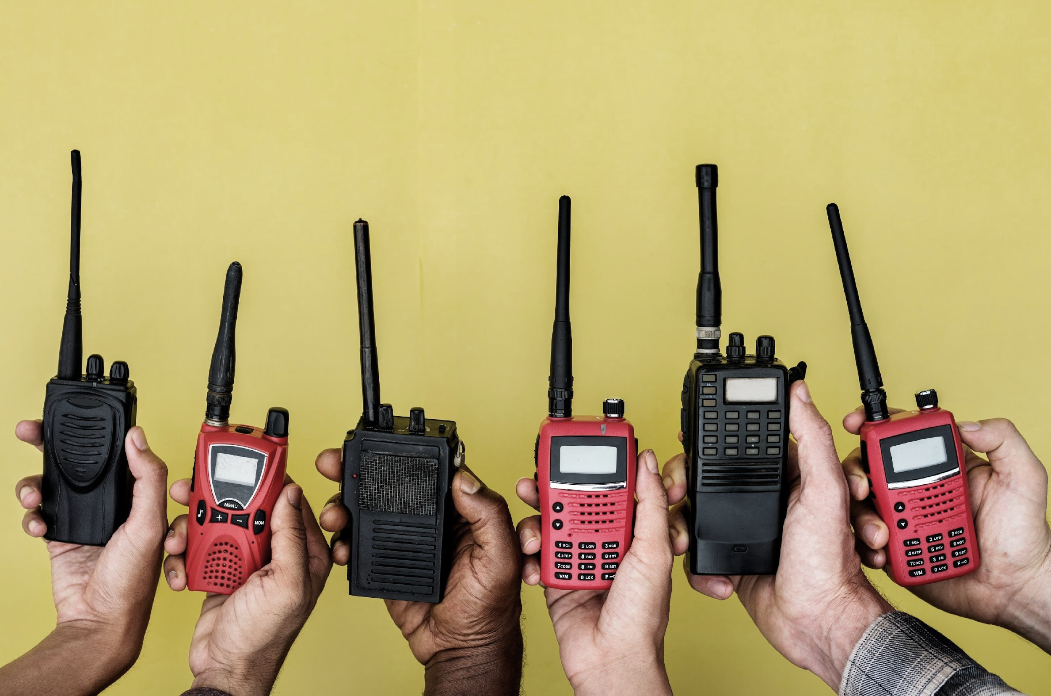
Two Way Radios
What Are Two
Way Radios?
Two-way radios include a variety of devices and are often defined by the frequencies (or channels) they are designed to operate on. Radios capable of more powerful transmissions typically require a license from your local Telecommunications Authority.

Slide 6
Two Way Radios
How Do They Work?
Two-way radios operate by transmitting and receiving on certain frequencies.
On radios, frequencies are typically divided into several discrete channels.
Only one person can speak on a channel at a time, more channel availability means more conversations can happen in the area.
Each team is typically assigned a channel to use as part of the communications plan.

Slide 7
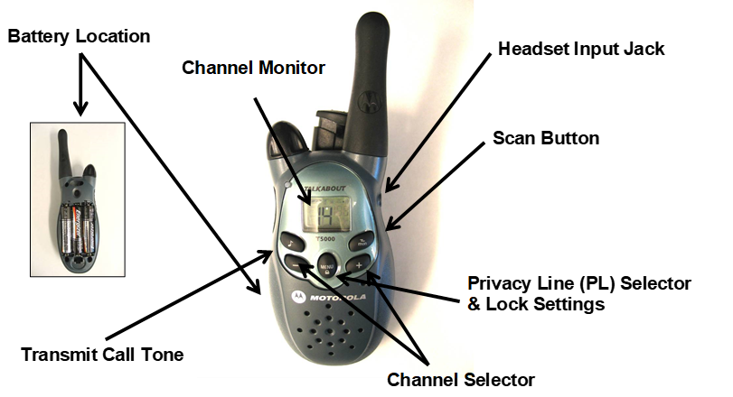
Two Way Radios
How Do They Work?

Slide 8
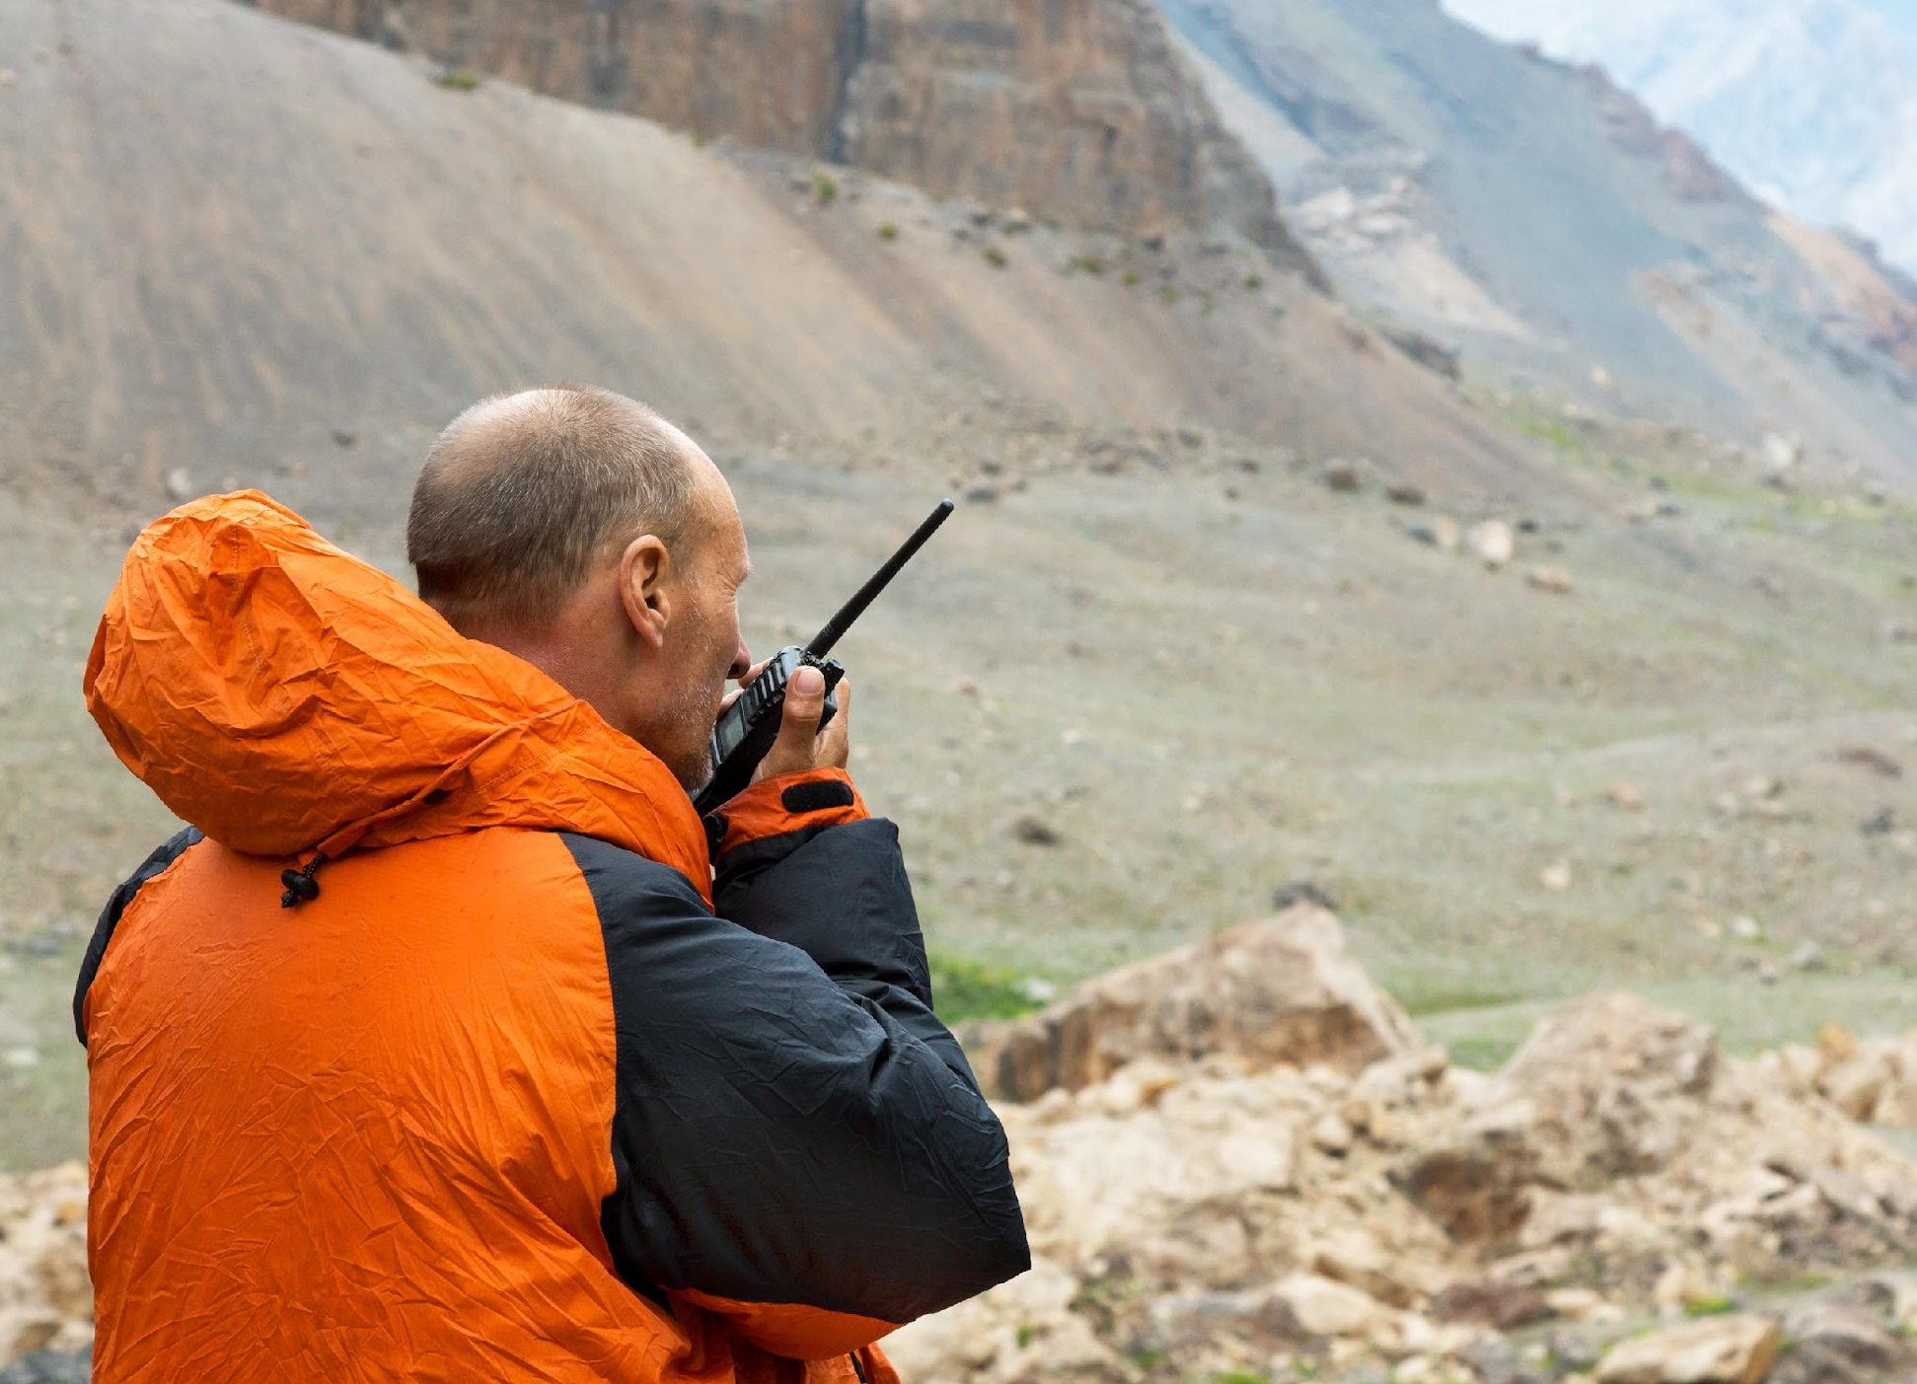
Tips On Using Two-Way Radios
Select a channel.
Listen for “traffic” first to see if the channel is clear.
If the chanel is clear press the Push-to-talk button to speak.
Speak across the radio microphone rather than directly into it.
Keep the antenna in a vertical position when talking.
Release the push-to-talk button when done speaking.

Slide 9
Phonetic Alphabet
A | Alfa | J | Juliet | S | Sierra
B | Bravo | K | Kilo | T | Tango
C | Charlie | L | Lima | U | Uniform
D | Delta | M | Mike | V | Victor
E | Echo | N | November | W | Whiskey
F | Foxtrot | O | Oscar | X | X ray
G | Golf | P | Papa | Y | Yankee
H | Hotel | Q | Quebec | Z | Zulu
I | India | R | Romeo

Slide 10
Activity:
Practice using the two-way radios
BEFORE:
Participants will be broken into groups.
Each group will be given two hand-held radios.
Each group will be given 15 minutes to practice using the radios.

Slide 11
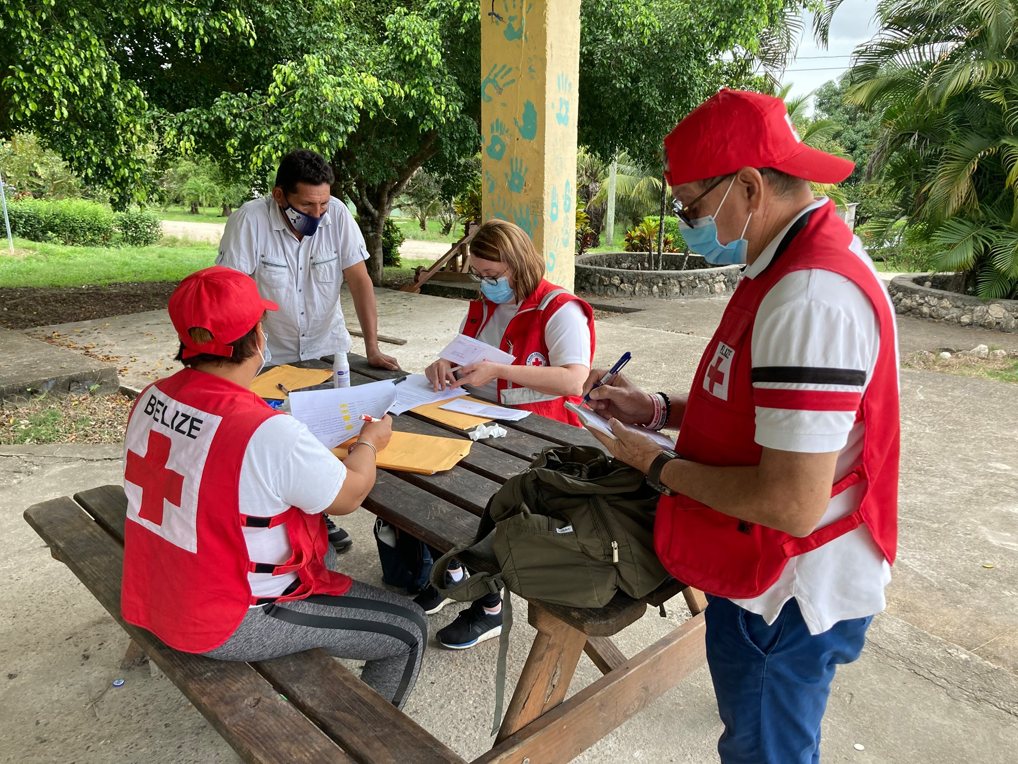
Working
With Others
Be aware of information being circulated it can become contradictory and disruptive causing isolation and fear among the affected communities.
Find out if there is an existing CEA group and join. This allows for sharing of information and improved planning on needs and state of local media and communications.
Coordinate with other departments in your NS and be aware of the information shared as this will provide for better CEA involvement

Slide 12
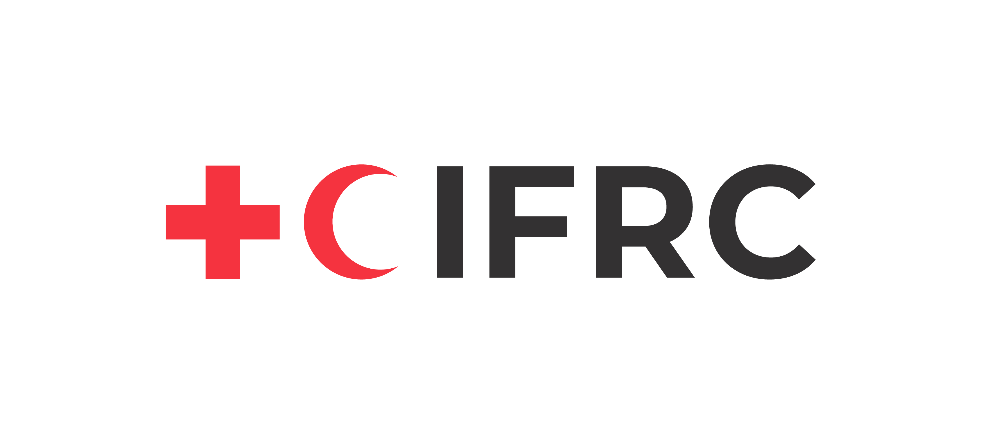
Volunteer, Donate, Join Us In Partnership, or share our appeals and stories on social media. Find out more about IFRC and learn how to contact your National Red Cross or Red Crescent Society, at www.ifrc.org.
Get Involved
There are many ways of becoming a part of the world’s largest humanitarian network
To stay informed about Caribbean disaster response activities or to access additional information on available trainings, training materials, research and information management tools, visit: www.cadrim.org.
: CADRIM.IFRC
: @cadrim_ifrc
: @CADRIM_IFRC

