Slide 1



CDRTs & Shelter Management
For Community Response Teams

Slide 2
Objectives
Understand What is a Shelter
Learn the Types of Shelters
Learn about the Basic Considerations that Should be Provided By a Shelter.
Learn about Opening an Alternative Shelter or Pre-activation Activities.
Learn the Standards for Shelter Capacity.
Learn the Rules of a Shelter.
Learn about the Challenges Faced by in Shelters.
Learn how to Close a Shelter or De-activate a Shelter.

Slide 3
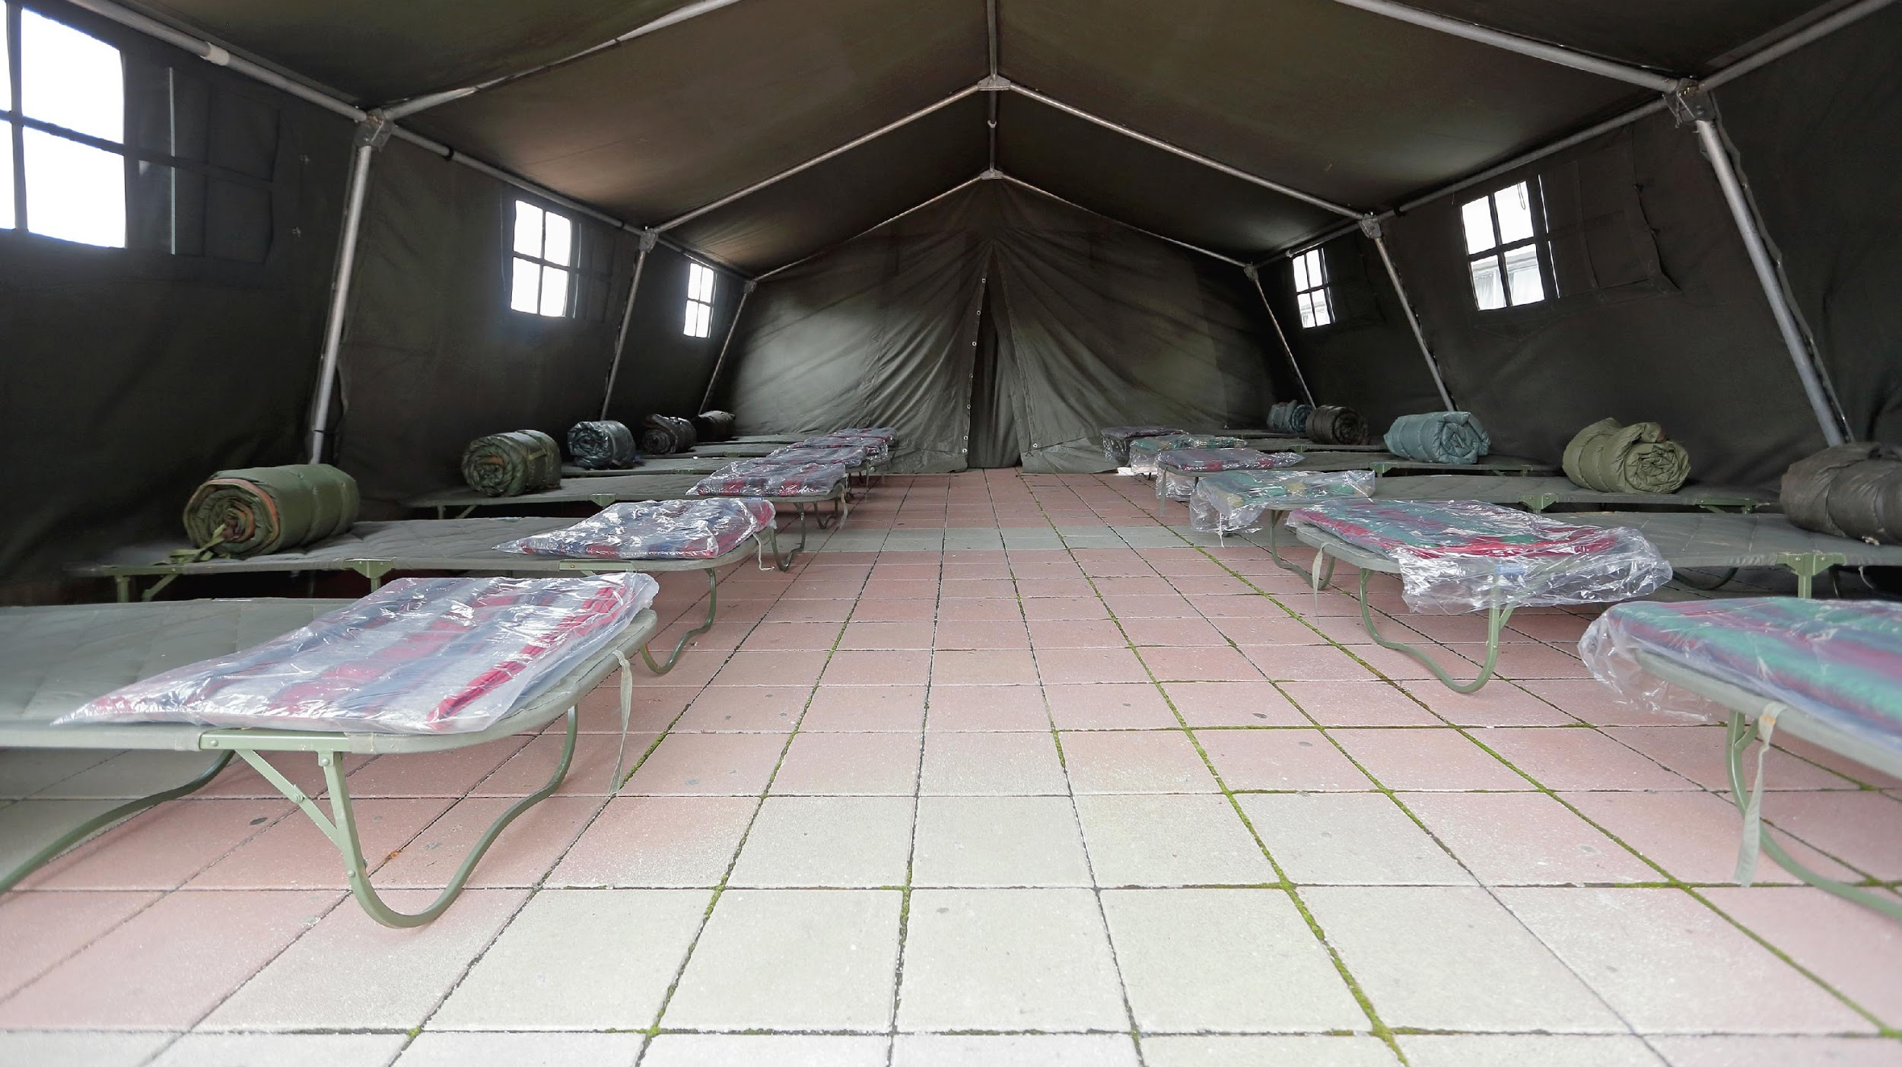
What Is A
Shelter?
A shelter is a secure habitable covered living space providing privacy and dignity for those within it.
Shelter Management:
This looks at the management of such spaces identified above.

Slide 4
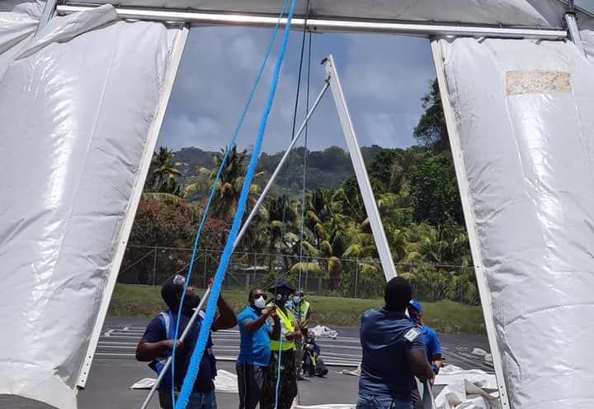
Types Of
Shelters
Single host shelters (provided by family and friends).
Community or collective shelters (community centers, schools, religious buildings stadium, public or private buildings.

Slide 5
Advantages & Disadvantages of Single Host Shelters.
Advantages
Disadvantages
Living needs are available
Fewer health considerations
Less logistical and organisational problems
Can be done quickly
They are usually overlooked in damage assessments and overlooked when social assistance is given
It does not create as much social pressure
It alters the lifestyle of the host family
Notes:
Persons should identify possible host family shelters in their Family Emergency Plan.

Slide 6
Advantages & Disadvantages of Collective
Shelters.
Advantages
Disadvantages
Centrally located within the community.
In some cases it does not require much re-organization.
It is a focal point for aid delivery aid delivery.
May not always be ideal as an emergency shelter.
The building and its surroundings may be dangerous.
Can result in major overcrowding and exert social pressure.
If the number of persons in the facility is large, there is usually limited privacy.
Occupation of the building as a shelter can result in damage to the facility and its resources and delay the restoration of this service.

Slide 7
All Shelters Should:
Provide Relief:
Focus is on saving lives, include rapid shelters such as tents and shelter kits.
Provide More Than Relief:
Provide protection from climate
Ensure privacy and dignity
Provide personal safety and security
Shelters Should Also:
Enhance resistance to ill health and spread of disease
Support family and community life during an emergency
Communal coping strategies

Slide 8
Shelters Should:
Encourage self sufficiency
& discourage dependency.

Slide 9
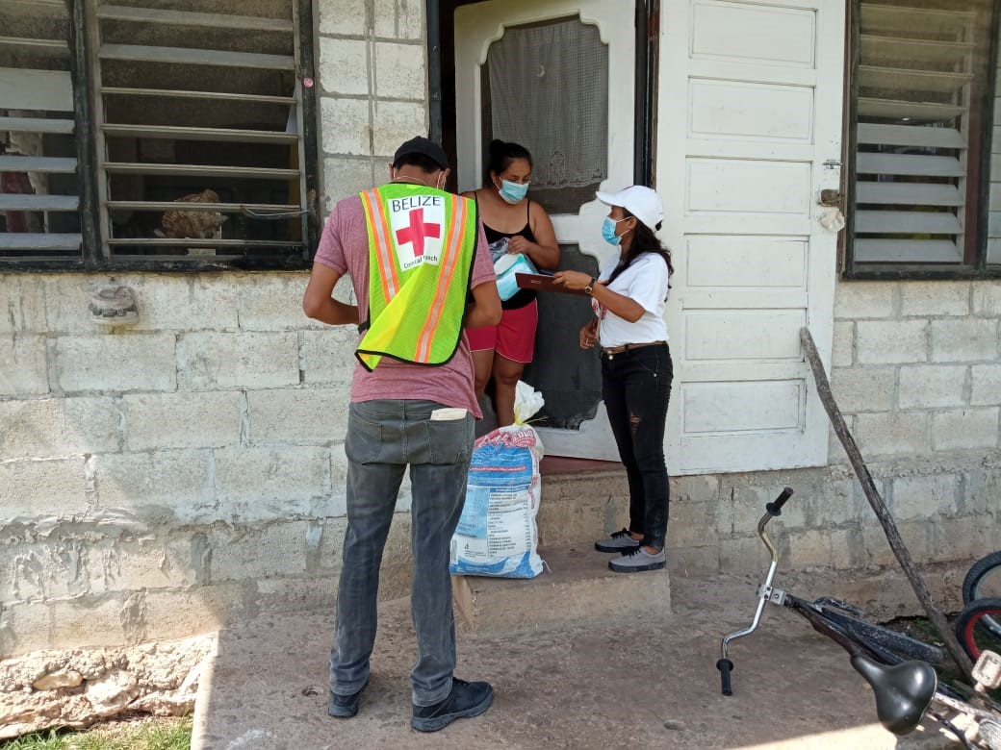
Role Of Your CDRT
What is the Role of the CDRT where Shelter Management is concern?
Notes:
As a CDRT member the aim is to pre-disaster reduce the shelter risk in your community through on going improvements in construction and infrastructure that will reduce your community’s susceptibility to such risk. Shelter management post disaster should always seek to empower those affected to rebuild not just their homes (building) but their livelihoods and their community as well. Partnering with the affected populations as well as other key partners is the best way to achieve this.

Slide 10
CDRT Role:
Identifying A Community Shelter
Identify community shelters and know the location of your designated community shelter.
Know the type of disasters these shelters are appropriate for.
Determine their capacity to host pets and if there are special needs considerations.
Identify alternative shelters and find out who provides permission for use of these buildings. Work with authorities to obtain permission to use building.
Find out which agency is responsible for Shelter Management in your area and work with or through these agencies.

Slide 11
CDRT Role:
Education/Awareness
Encourage community members to learn the location of the shelters.
Educate the community about putting together a “grab and go” bag that can be taken with them to a shelter.
Educate community members about the rules and regulations that should be followed at a shelter.
Identify high risk families/individuals and review this information with them.
Maintain periodic contact with other CDRT members to review roles and responsibilities.

Slide 12
Pre-Activation:
Opening A Shelter
Inspect The Building/Shelter.
Determine and allocate spaces for shelterees.
Plan for obtaining, transporting, receiving and storing supplies at the shelter.
Support team mobilization.
Establish & maintain contact with relevant response agencies and interest groups.
Set up meetings to coordinate tasks with other CDRT members/volunteers.
Obtain all necessary forms.
Meet with shelterees.
Develop a list of shelterees needs and priorities.
Notes:
In impromptu circumstances CDRTs may be responsible for opening a shelter to a community. Once permission is granted to open an alternative shelter the following should be done:
Inspect the building/shelter- check that essential facilities and equipment are in place and functioning (running water, toilets, communication system, electricity). Make note of any equipment that might be needed and share this with response agencies.
Determine and allocate spaces for shelterees- how many persons could be accommodated at the shelter. Sphere guidelines outlining space requirements will be discussed later in the presentation.
Plan for obtaining, transport etc- This should include having a proper inventory and careful checking of expiration dates and defects in canned food.
Set up meetings to coordinate tasks- Draft rules and regulations for shelterees; prepare activities and equipment for the shelter and enlist the support of the shelterees in managing the shelter.
Meet with shelterees to abreast them of the rules of the shelter so they will know what to expect.

Slide 13
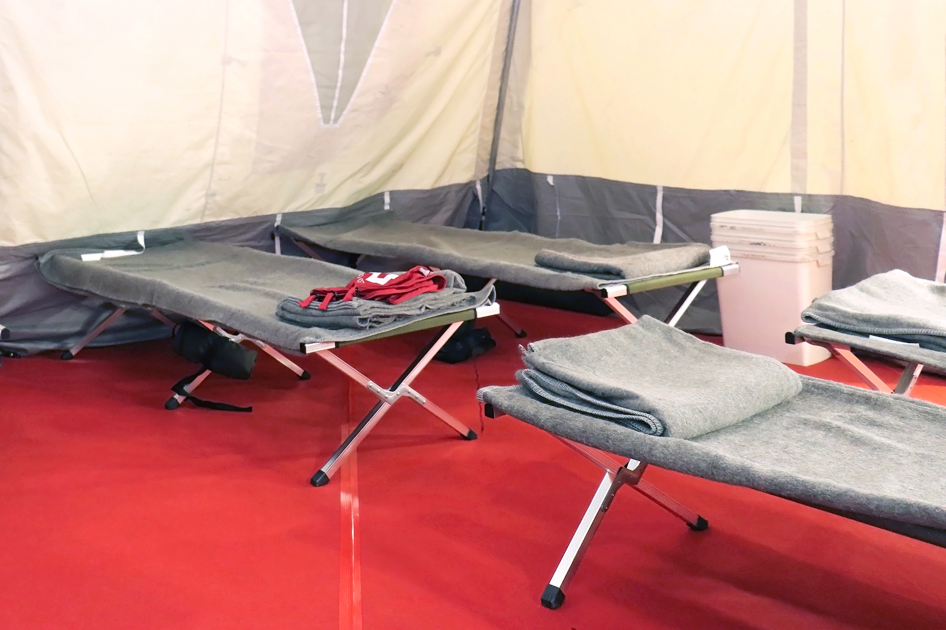
Activity: Key Considerations
What are some of the basic needs that a shelter should provide?
Notes:
Use Guide or handouts to discuss the sphere core standards
Also go through the steps for opening and closing a shelter

Slide 14
Food & Nutrition
Health
Water & Sanitation
Livelihoods
Creating A Safe Environment For Children & Other Vulnerable Groups
Security
Physical Space
Accessibility By Persons With Disabilities
Key Considerations
See Section 10.4.3 of Field Guide for more information.

Slide 15
Standards
For Shelter Capacity
Sleeping Accommodations
Minimum floor space of 3.5 sq. metres (40 sq. ft.) per person.
Minimum distance of 75 cm (2.5 ft.) between beds.
Minimum one blanket and bedding (floor mat, mattress, sheeting) per person.
Ensure COVID-19 social distancing protocols.

Slide 16
Standards
For Shelter Capacity
Water Requirements
For drinking: 2.5-3 litres per person per day.
For hygiene practices: 2-6 Litres per person per day.
Minimum of 15 litres per person per day.

Slide 17
Standards
For Shelter Capacity
Washing Facilities
Bathrooms for male and female must be separate.
1 toilet per 25 females.
1 toilet and 1 urinal per 35 males.
One (1) hand wash basin per 10 persons.
One (1) shower per 30 persons.

Slide 18
Standards
For Shelter Capacity
Health & Sanitation
Access to hygiene products including menstrual and incontinence products.
Access to mosquito nets where needed.
Establish a private area where shelterees can access psychosocial and mental health support and medical services.
Access to hand sanitizer and face masks.
Ensure all COVID-19 health protocols are followed.

Slide 19
Shelter Rules And Needs
Fire & Safety
No dangerous weapons, liquids, or other safety hazards shall be kept by shelterees.
Smoking will be permitted only in designated areas.
No alcoholic beverages will be consumed within the shelter area.
No drugs are allowed.

Slide 20
Shelter Rules And Needs
Health and Sanitation
Shelter floors and yard area shall be kept clean and swept free of waste materials.
Sleeping areas shall be kept clean and tidy at all times.
Dispose of solid waste containers in designated areas and ensure proper disposal of these often.
Ensure water is available to maintain hygiene (bathing, laundering and toilet duties, etc.).
Maintain a distance of 6 feet between you and persons who are not in your immediate family.
Bathroom and washing facilities should be kept clean.

Slide 21
Shelter Rules And Needs
Other Rules
No livestock (some shelters may allow pets to be kept outside).
No loud music.
No boisterous or discourteous behaviour.
Shelterees leaving the shelter for any period of time must sign out and in at the registration area.
Do not leave children unattended and keep track of children.
Remember the existing laws of the land remain enforced at shelters.

Slide 22
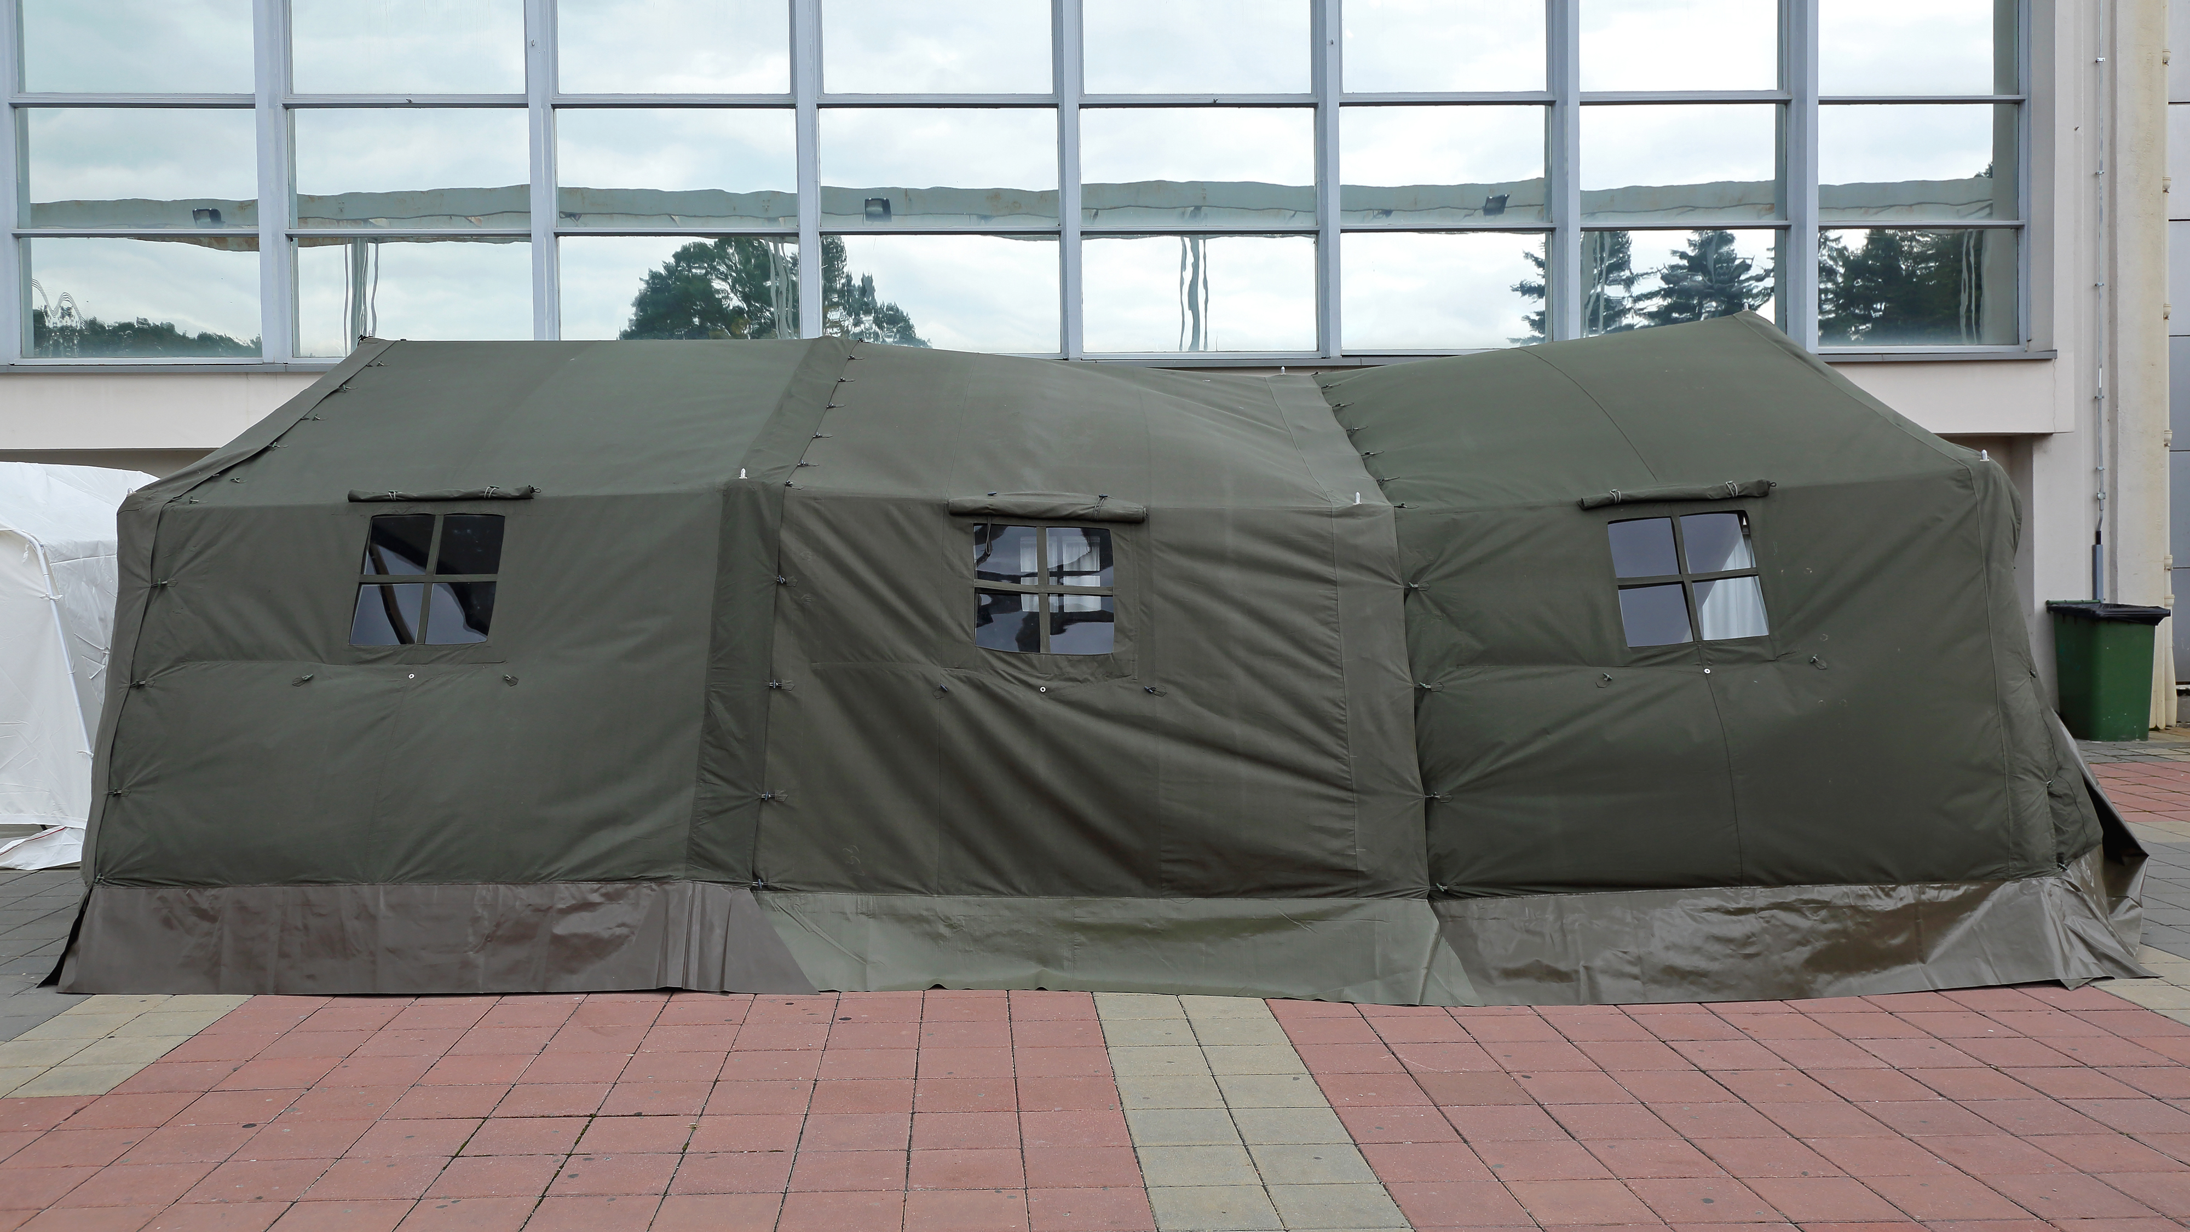
Challenges Faced In Shelters
Privacy
Fear Of Discrimination By Illegal Immigrants And Migrants
No Shelter Recovery Policy For The Landless
Reluctance To Leave
Compensation For Damage
Notes:
hese would also be linked to shelteree needs identified:
Privacy – families, women and girls need privacy. Arrangements should be made to offer privacy and protection to these persons. Some uninhibited shelterees have engaged in sexual acts in the presence of other shelterees. Codes of conduct and enforcement arrangements are necessary in shelters
Illegal immigrants and migrants often live in marginal areas prone to hazard impact and will need collective shelters. Unfortunately they may be reluctant to use these facilities due to discrimination, abuse or fear of deportation. In an emergency the most vulnerable must be protected.
National policies on shelter and recovery often omit the landless and socially outcast. Arrangements for these shelterees are slow in coming.
Reluctant to leave – Shelters are often a magnet for assistance and aid. Shelterees who benefit from public and private goodwill are reluctant to leave and arrangements/encouragement for closing the shelters are necessary.
Where permission is granted there should also be arrangements to compensate for the damage incurred

Slide 23
Challenges Faced In Shelters
Indigent & Poor Have Few Resources
Security
Water & Sanitation
Food
Livestock & Animals
Socially Displaced
Notes:
National shelter policy often requires the shelteres to bring resources to the location. The indigent & poor have few resources to bring to the shelter. Some prefer to avoid the safety of shelter rather than face the humilitation arriving without resources
Security – The grouping of people present risk to children, women and men. Special arrangements are needed to protect those vulnerable to discrimination, abuse and harassment. Security should also be provided against the presence of illegal drugs and weapons.
Water & sanitation – May buildings used as shelters are not usually equipped for occupation for more than a day. Special arrangements for water and sanitation are required for the operation of shelters
Food -Shelterees may often not have food for the duration and this need arranged. Long term sheltering e.g. volcanic eruption require special arrangements to give privacy to families and encourage self sufficiency
Livestock & animals – Shelters often prohibit these. But livestock represent wealth and persons at risk are reluctant to move away from their animals. Families have attachments to pets which if abandoned can result in psychological damage. Special arrangements should be made for animals when shelters are in operation
Socialy displaced – unfortunately shelters can be a dumping ground for relatives wanting to have someone else care for older or infirm relatives. Homeless persons and persons with mental illnesses often end up in shelters. These persons require special medical care

Slide 24
Reporting Shelter Activities
Use the shelter log to document problems, solutions and other important information throughout the shelter operation. Be sure all volunteer workers are aware of the log so they can contribute to it.
Prepare and provide statistics on the number of shelter residents, as required by the government and aid agencies.
Requirements for reporting population could change over the course of a relief operation.

Slide 25
Shelter
Re-Inspection Checklist
Check Section 10.9.1 for the checklist under page 225

Slide 26
Closing A Shelter: Deactivation
Evacuation of Shelter Completed
Rehabilitation arrangements completed for shelterees.
Necessary transportation arranged
Shelterees signed out
Administrative details completed
Volunteer staff debriefed.
All forms completed (Registrations, requisitions, inventories).
Activity log completed.
Final reports written.

Slide 27
Closing A Shelter: Deactivation
Shelter Building Cleaned & Restored
Remaining supplies and equipment returned
Shelter inspected
Damage to structure repaired/reported
Shelter cleaned

Slide 28
Volunteer, Donate, Join Us In Partnership, or share
our appeals and stories on social media. Find out more about IFRC, and learn how to contact your National Red Cross or Red Crescent Society, at www.ifrc.org
Get Involved
There are many ways of becoming a part of the world’s largest humanitarian network
P.O. Box 303
CH-1211 Geneva 19
Switzerland
Telephone: +41 22 730 4222
Fax: +41 22 730 4200
Email: secretariat@ifrc.org
Website: www.ifrc.org

