Slide 1
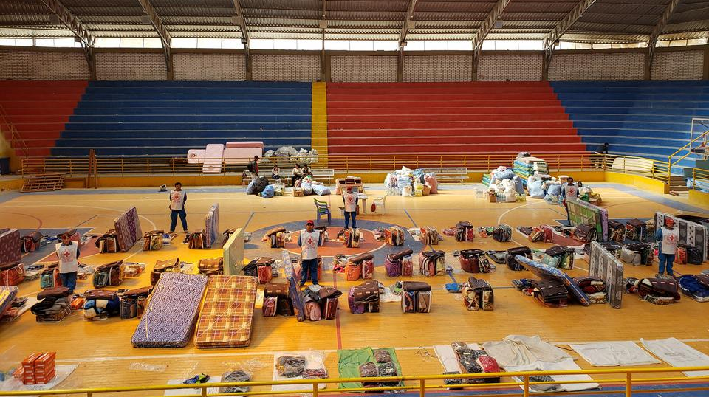

CDRTs & Shelter Management
For Community Disaster Response Teams

Slide 2







Acknowledgements
We thank the Belize Red Cross, Grenada Red Cross, Guyana Red Cross, Jamaica Red Cross, St
Vincent and the Grenadines Red Cross, Trinidad and Tobago Red Cross and the Caribbean
Disaster Emergency Management Agency (CDEMA) for their commitment to collaborating with
the Caribbean Disaster Risk Management (CADRIM) Reference Centre. Together, we reviewed
and revised the CDRT Training Material, enhancing its relevance and effectiveness in disaster
response training. Your dedication exemplifies the spirit of cooperation within the humanitarian
community, and we deeply appreciate your invaluable contributions.

Slide 3

Objectives
Understand What is a Shelter.
Learn the Types of Shelters.
Learn about the Basic Considerations that Should be Provided By a Shelter.
Learn about Opening an Alternative Shelter or Pre-activation Activities.
Learn the Standards for Shelter Capacity.
Learn the Rules of a Shelter.
Learn about the Challenges Faced by in Shelters.
Learn how to Close a Shelter or De-activate a Shelter.

Slide 4
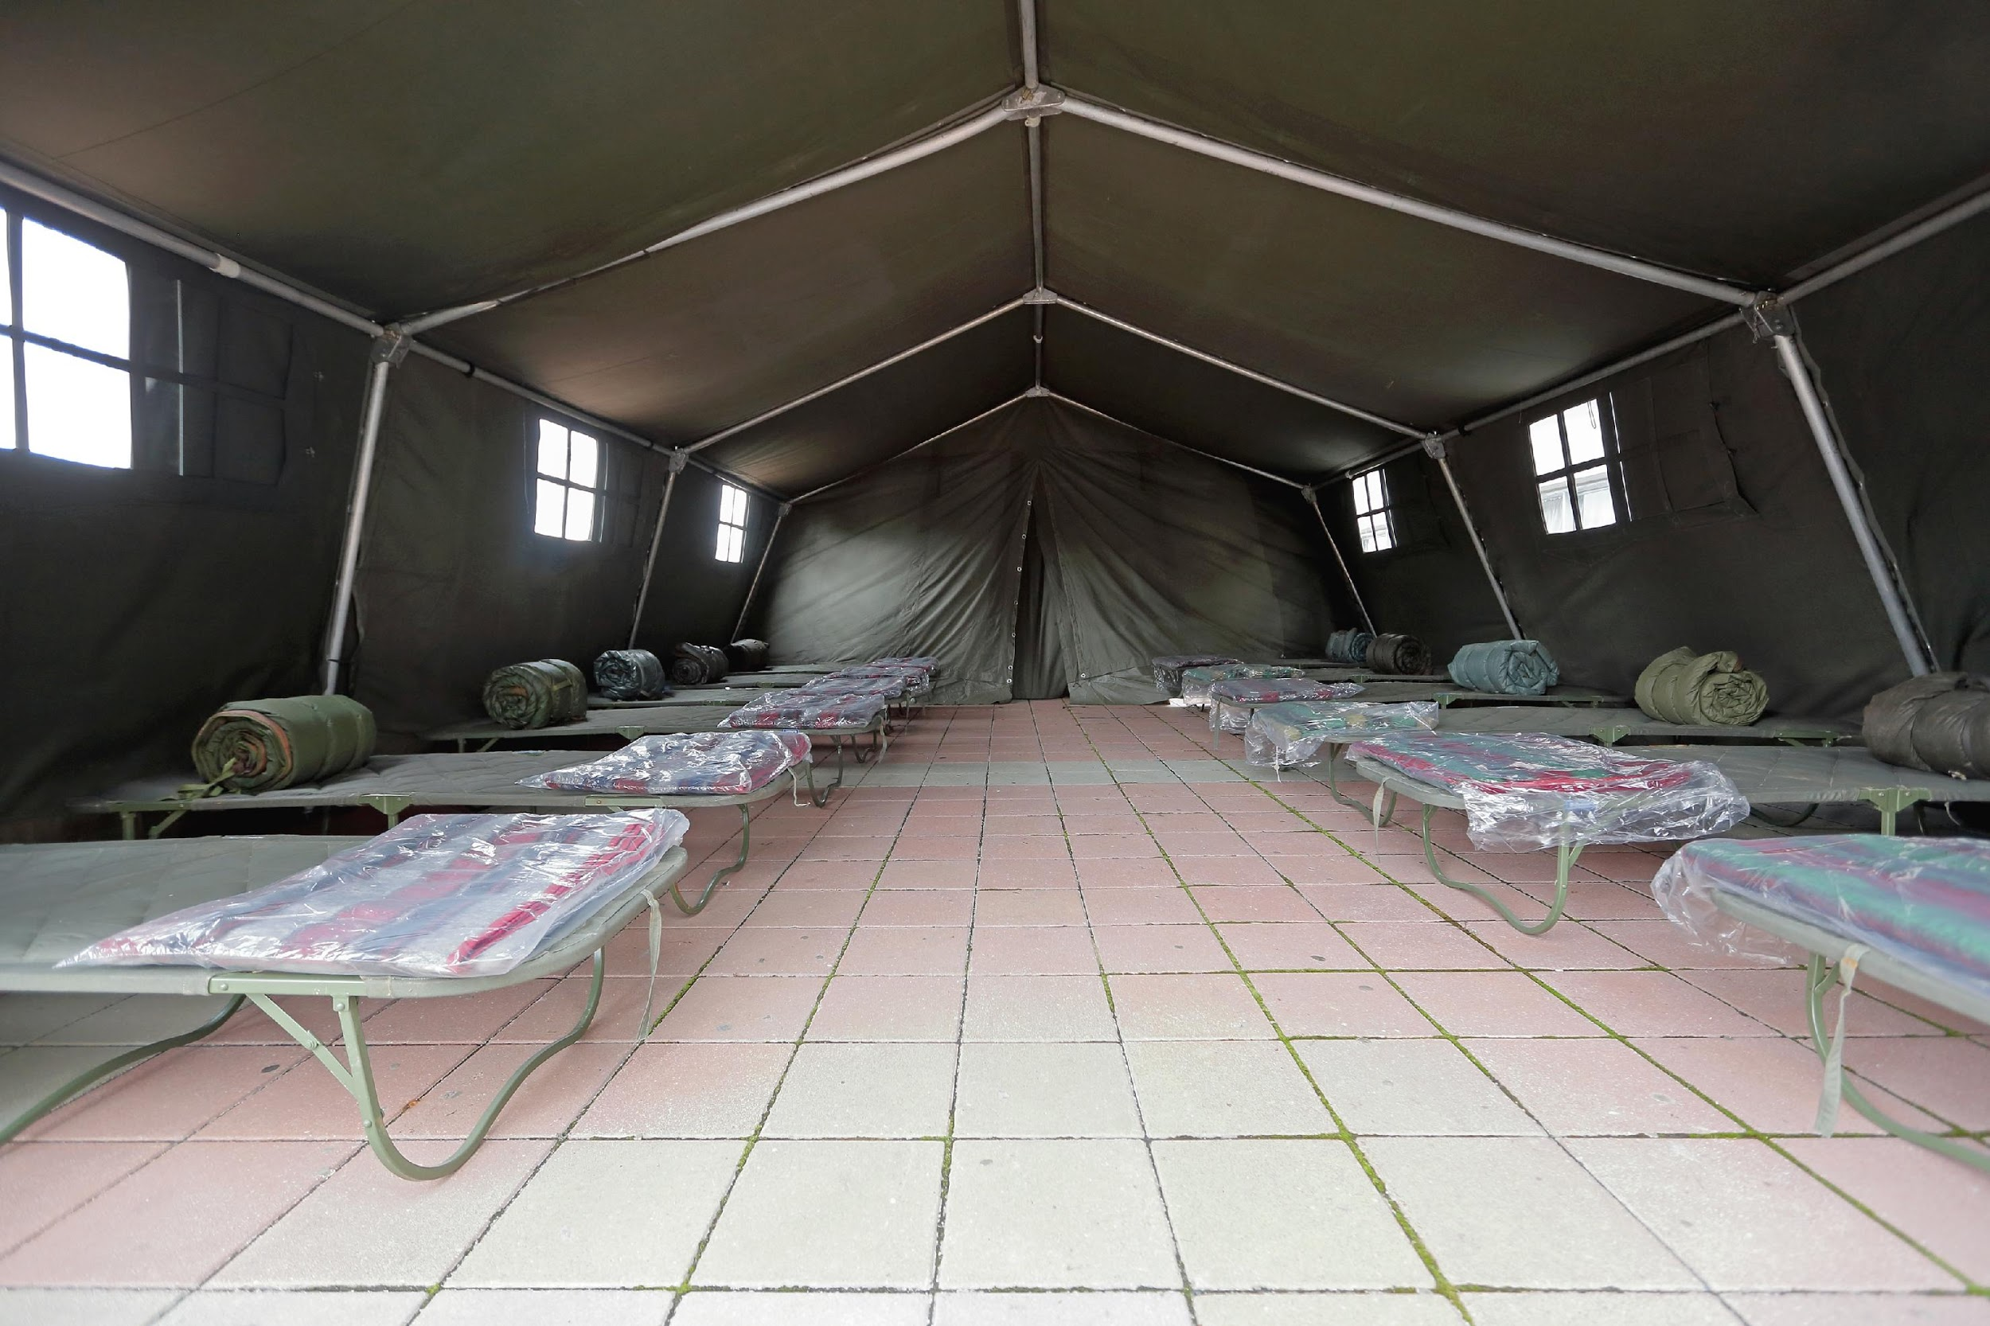
What Is A
Shelter?
A shelter is a secure habitable covered living space providing privacy and dignity for those within it.
Shelter Management:
This looks at the management of such spaces identified above.

Slide 5
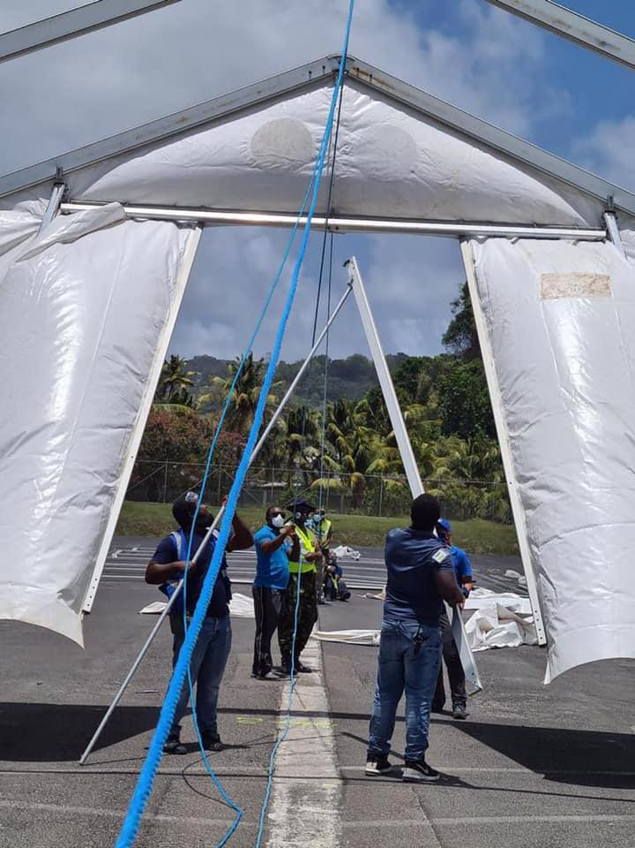
Types Of Shelters:
Single host shelters (hosted by family or friends).
Community or collective shelters (community centers, schools, religious buildings stadium, public or private buildings.

Slide 6
Advantages & Disadvantages of Single Host Shelters
Advantages
Disadvantages
Living needs are available
Fewer health considerations
Less logistical and organisational problems
Can be done quickly
X
They are usually overlooked in damage assessments and overlooked when social assistance is given
It does not create as much social pressure
It alters the lifestyle of the host family
X
X
Notes:
Persons should identify possible host family shelters in their Family Emergency Plan.

Slide 7
Advantages & Disadvantages of Collective
Shelters
Advantages
Disadvantages
Centrally located within the community.
In some cases, it does not require much re-organization.
It is a focal point for aid delivery.
X
The building and its surroundings may be dangerous.
Can result in major overcrowding and exert social pressure.
If the number of persons in the facility is large, there is usually limited privacy.
Occupation of the building as a shelter can result in damage to the facility and its resources and delay the restoration of this service.
X
X
X

Slide 8
All Shelters Should:
Provide Relief:
Focus is on saving lives, include rapid shelters such as tents and shelter kits.
Provide More Than Relief:
Provide protection from climate
Preserve dignity
Provide safety and security
Shelters Should Also:
Enhance resistance to ill health and spread of disease
Support family and community life during an emergency
Communal coping strategies

Slide 9
Shelters Should:
Encourage self sufficiency
& discourage dependency.

Slide 10
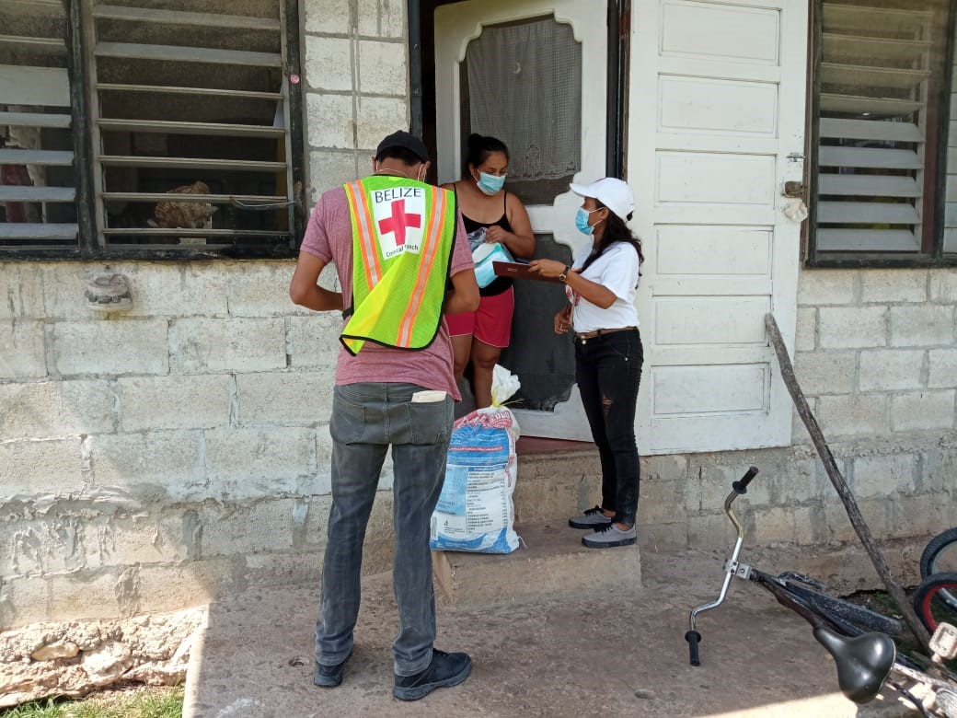
Role Of Your CDRT
What is the Role of the CDRT where Shelter Management is concern?
Notes:
As a CDRT member the aim is to pre-disaster reduce the shelter risk in your community through on going improvements in construction and infrastructure that will reduce your community’s susceptibility to such risk. Shelter management post disaster should always seek to empower those affected to rebuild not just their homes (building) but their livelihoods and their community as well. Partnering with the affected populations as well as other key partners is the best way to achieve this.

Slide 11
CDRT Role:
Education/ Awareness
Encourage community members to learn the location of the shelters.
Educate the community about putting together a “grab and go” bag that can be taken with them to a shelter.
Educate community members about the rules and regulations that should be followed at a shelter.
Identify high risk families/individuals and review this information with them.
Maintain periodic contact with other CDRT members to review roles and responsibilities.
Notes:
What are the items that you should include in the “grab and go” bag?

Slide 12
Pre-Activation:
Opening A Shelter
Inspect The Building/Shelter.
Determine and allocate spaces for shelterees.
Coordinate with state agencies for obtaining, transporting, receiving and storing supplies at the shelter.
Support team mobilization.
Establish & maintain contact with relevant response agencies and interest groups.
Set up meetings to coordinate tasks with other CDRT members/volunteers.
Obtain all necessary forms.
Meet with shelterees.
Develop a list of shelterees needs and priorities.
Notes:
In impromptu circumstances CDRTs may be responsible for opening a shelter to a community. Once permission is granted to open an alternative shelter the following should be done:
Inspect the building/shelter- check that essential facilities and equipment are in place and functioning (running water, toilets, communication system, electricity). Make note of any equipment that might be needed and share this with response agencies.
Determine and allocate spaces for shelterees- how many persons could be accommodated at the shelter. Sphere guidelines outlining space requirements will be discussed later in the presentation.
Plan for obtaining, transport etc- This should include having a proper inventory and careful checking of expiration dates and defects in canned food.
Set up meetings to coordinate tasks- Draft rules and regulations for shelterees; prepare activities and equipment for the shelter and enlist the support of the shelterees in managing the shelter.
Meet with shelterees to abreast them of the rules of the shelter so they will know what to expect.

Slide 13
Activity –Perform A Inspection
Participants will be given a shelter inspection form and split into teams.
Each team will have 15 minutes to walk around the designated “shelter” and complete the inspection form (don’t worry if you cannot complete the form in its entirety).
Participants will be asked to talk about their experience.

Slide 14
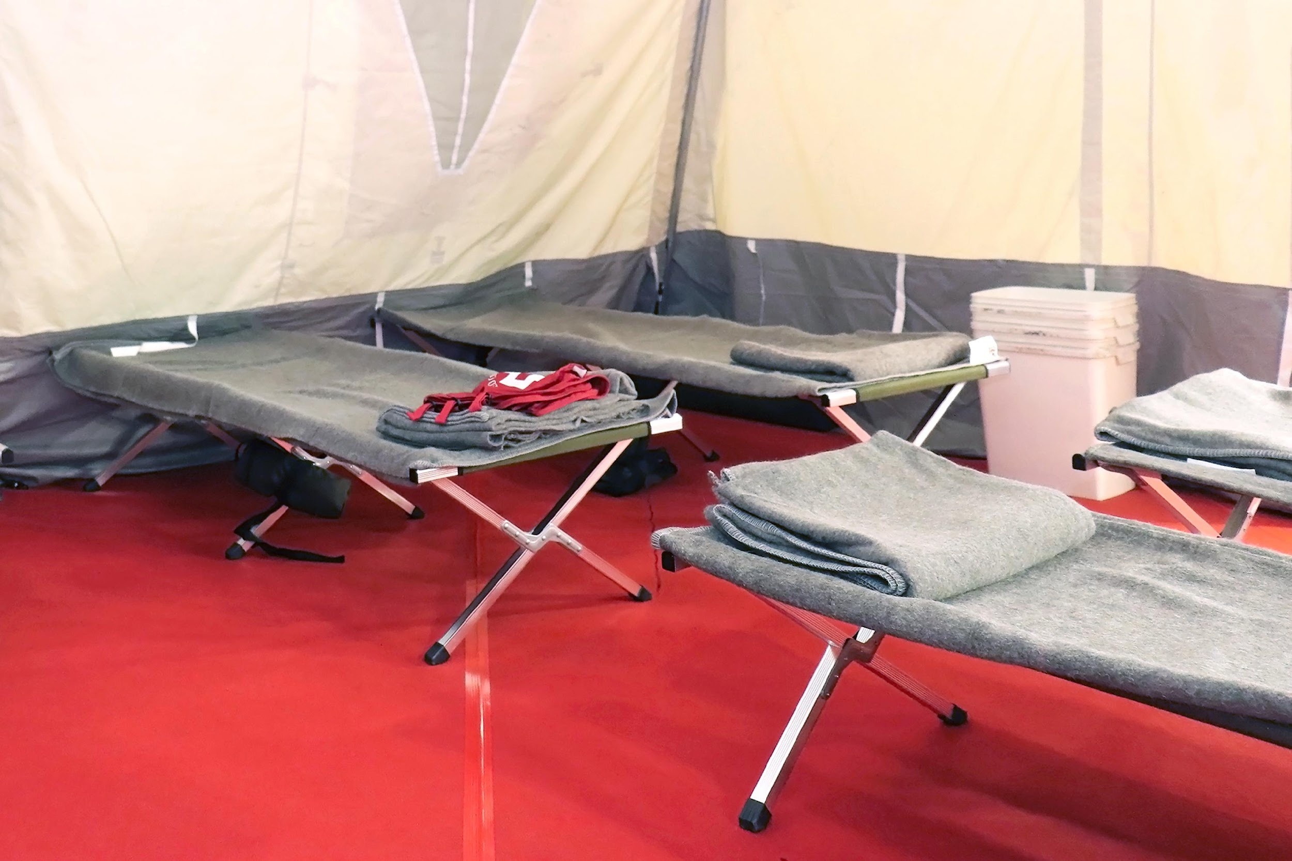
What are some of the basic needs that a shelter should provide?
Notes:
Use Guide or handouts to discuss the sphere core standards
Also go through the steps for opening and closing a shelter

Slide 15
Key Considerations
Food & Nutrition
Health
Water & Sanitation
Creating A Safe Environment For Children & Other Vulnerable Groups
Security
Physical Space
Accessibility By Persons With Disabilities
Access to Psychosocial Support
See Section 10.4.3 of Field Guide for more information.

Slide 16

Standards
For Shelter Capacity
Sleeping Accommodations
Minimum floor space of 3.5 sq. metres (40 sq. ft.) per person.
Minimum distance of 75 cm (2.5 ft.) between beds.
Minimum one blanket and bedding (floor mat, mattress, cots, sheeting) per person.

Slide 17

Standards
For Shelter Capacity
Water Requirements
For drinking: 2.5-3 litres per person per day.
For hygiene practices: 2-6 Litres per person per day.
Minimum of 15 litres per person per day.

Slide 18

Standards
For Shelter Capacity
Washing Facilities
Bathrooms for male and female must be separate.
1 toilet per 25 females.
1 toilet and 1 urinal per 35 males.
One (1) hand wash basin per 10 persons.
One (1) shower per 30 persons.

Slide 19

Standards
For Shelter Capacity
Health & Sanitation
Access to hygiene products including menstrual and incontinence products.
Access to mosquito nets where needed.
Establish a private area where shelterees can access psychosocial and mental health support and medical services.

Slide 20

Shelter Rules And Needs
Fire & Safety
No dangerous weapons, liquids, or other safety hazards shall be kept by shelterees.
No smoking will be permitted
No alcoholic beverages will be consumed within the shelter area.
No drugs are allowed.

Slide 21

Shelter Rules And Needs
Health and Sanitation
Shelter floors and yard area shall be kept clean and swept free of waste materials.
Sleeping areas shall be kept clean and tidy at all times.
Dispose of solid waste containers in designated areas and ensure proper disposal of these often.
Ensure water is available to maintain hygiene (bathing, laundering and toilet duties, etc.).
Bathroom and washing facilities should be kept clean.
Note: Shelterees will be required to implement these activities.

Slide 22

Shelter Rules And Needs
Other Rules
No livestock and pets (some shelters may allow pets to be kept outside).
No loud music.
No boisterous or discourteous behaviour.
Shelterees leaving the shelter for any period of time must sign out and in at the registration area.
Do not leave children unattended and keep track of children.
Remember the existing laws of the land remain enforced at shelters.

Slide 23
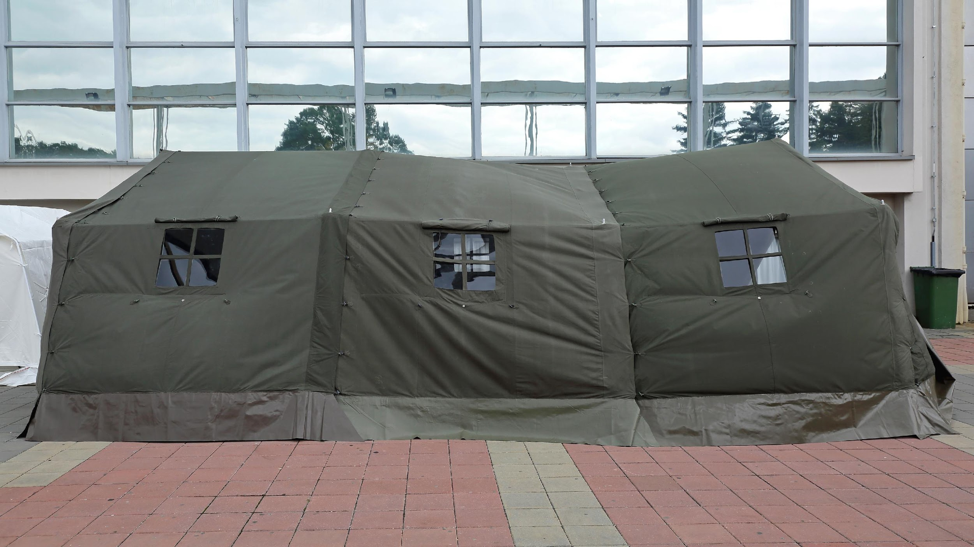
Challenges Faced In Shelters
Privacy
Fear Of Discrimination By Migrants
No Shelter Recovery Policy For The Landless
Reluctance To Leave
Compensation For Damage
Notes:
hese would also be linked to shelteree needs identified:
Privacy – families, women and girls need privacy. Arrangements should be made to offer privacy and protection to these persons. Some uninhibited shelterees have engaged in sexual acts in the presence of other shelterees. Codes of conduct and enforcement arrangements are necessary in shelters
Illegal immigrants and migrants often live in marginal areas prone to hazard impact and will need collective shelters. Unfortunately they may be reluctant to use these facilities due to discrimination, abuse or fear of deportation. In an emergency the most vulnerable must be protected.
National policies on shelter and recovery often omit the landless and socially outcast. Arrangements for these shelterees are slow in coming.
Reluctant to leave – Shelters are often a magnet for assistance and aid. Shelterees who benefit from public and private goodwill are reluctant to leave and arrangements/encouragement for closing the shelters are necessary.
Where permission is granted there should also be arrangements to compensate for the damage incurred

Slide 24
Challenges Faced In Shelters
Security
Water & Sanitation
Meals
Livestock & Animals
Socially Displaced
Notes:
Security – The grouping of people present risk to children, women and men. Special arrangements are needed to protect those vulnerable to discrimination, abuse and harassment. Security should also be provided against the presence of illegal drugs and weapons.
Water & sanitation – May buildings used as shelters are not usually equipped for occupation for more than a day. Special arrangements for water and sanitation are required for the operation of shelters
Food -Shelterees may often not have food for the duration and this need arranged. Long term sheltering e.g. volcanic eruption require special arrangements to give privacy to families and encourage self sufficiency
Livestock & animals – Shelters often prohibit these. But livestock represent wealth and persons at risk are reluctant to move away from their animals. Families have attachments to pets which if abandoned can result in psychological damage. Special arrangements should be made for animals when shelters are in operation
Socialy displaced – unfortunately shelters can be a dumping ground for relatives wanting to have someone else care for older or infirm relatives. Homeless persons and persons with mental illnesses often end up in shelters. These persons require special medical care

Slide 25
Reporting Shelter Activities
A shelter log is maintained by the shelter manager to document problems, solutions and other important information throughout the shelter operation. CDRTs can discuss issues with the shelter manager and contribute to the shelter log.
Support the shelter manager with preparing and providing statistics on the number of shelter residents, as required by the government and aid agencies.
Requirements for reporting population could change over the course of a relief operation.

Slide 26


Closing A Shelter: Deactivation
Evacuation of Shelter Completed
Rehabilitation arrangements completed for shelterees.
Necessary transportation arranged
Shelterees signed out
Administrative details completed
Volunteer staff debriefed.
All forms completed (Registrations, requisitions, inventories).
Activity log completed.
Final reports written.
.

Slide 27

Closing A Shelter: Deactivation
Shelter Building Cleaned & Restored
Remaining supplies and equipment returned
Shelter inspected by the facility manager.
Damage to structure repaired/reported
Shelter cleaned

Slide 28
Consider your community and identify persons who can assist with shelter management.
Identify the vulnerable persons in the community who may need shelter.
Identify the shelters in your community or buildings that can be used as temporary shelters (include any limitations such as if the building cannot be used as a shelter when flooding occurs because it is in a flood prone area).
Activity
(Can be done after the training)
Note: You can also reference Unit 10 on page 21 of the CDRT Workbook

Slide 29
Activity: Setting up a mock shelter
Participants will be split into 6 teams (registration, dormitory, feeding, health and PSS and shelterees).
Each team has 10 minutes set up their designated areas.
Participants will talk about their experience.

Slide 30





Volunteer, Donate, Join Us In Partnership, or share our appeals and stories on social media. Find out more about IFRC and learn how to contact your National Red Cross or Red Crescent Society, at www.ifrc.org.
Get Involved
There are many ways of becoming a part of the world’s largest humanitarian network
To stay informed about Caribbean disaster response activities or to access additional information on available trainings, training materials, research and information management tools, visit: www.cadrim.org.
: CADRIM.IFRC
: @cadrim_ifrc
: @CADRIM_IFRC

