Slide 1
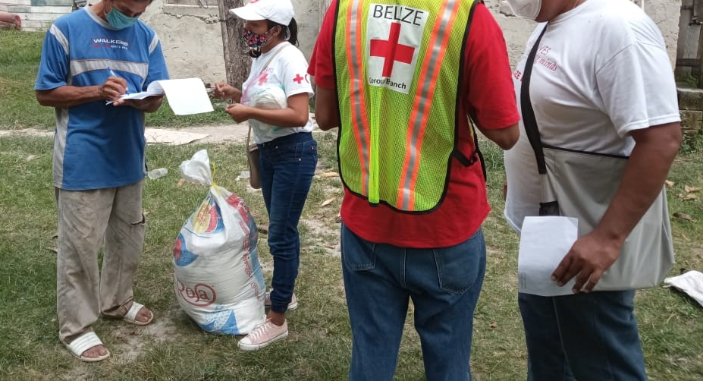

CDRTs & Community Assessment Extra- using the Kobo Collect App.
For Community Disaster Response Teams

Slide 2







Acknowledgements
We thank the Belize Red Cross, Grenada Red Cross, Guyana Red Cross, Jamaica Red Cross, St
Vincent and the Grenadines Red Cross, Trinidad and Tobago Red Cross and the Caribbean
Disaster Emergency Management Agency (CDEMA) for their commitment to collaborating with
the Caribbean Disaster Risk Management (CADRIM) Reference Centre. Together, we reviewed
and revised the CDRT Training Material, enhancing its relevance and effectiveness in disaster
response training. Your dedication exemplifies the spirit of cooperation within the humanitarian
community, and we deeply appreciate your invaluable contributions.

Slide 3
Objectives
How to use the Kobo Collect App

Slide 4
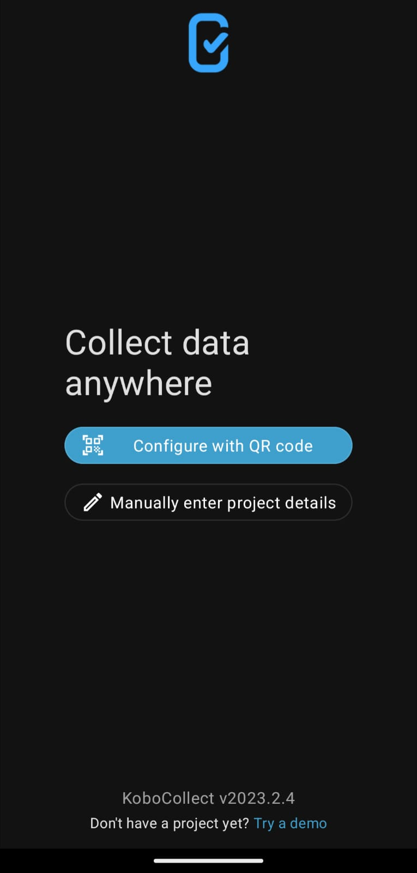
Kobo Collect Demo
After installing KoBoCollect, you need to configure it so that it can be used together with your KoBo account for data collection.
Install KoboCollect on your android device.
2. On your android device, open KoboCollect and open “Manually enter project details”.
3. Under URL, enter the server URL: https://kc.ifrc.org/
Please note that you must include https:// when entering the URL.
4. Under Username, enter: cadrimtraining
5. Under Password, enter: kobotraining

Slide 5
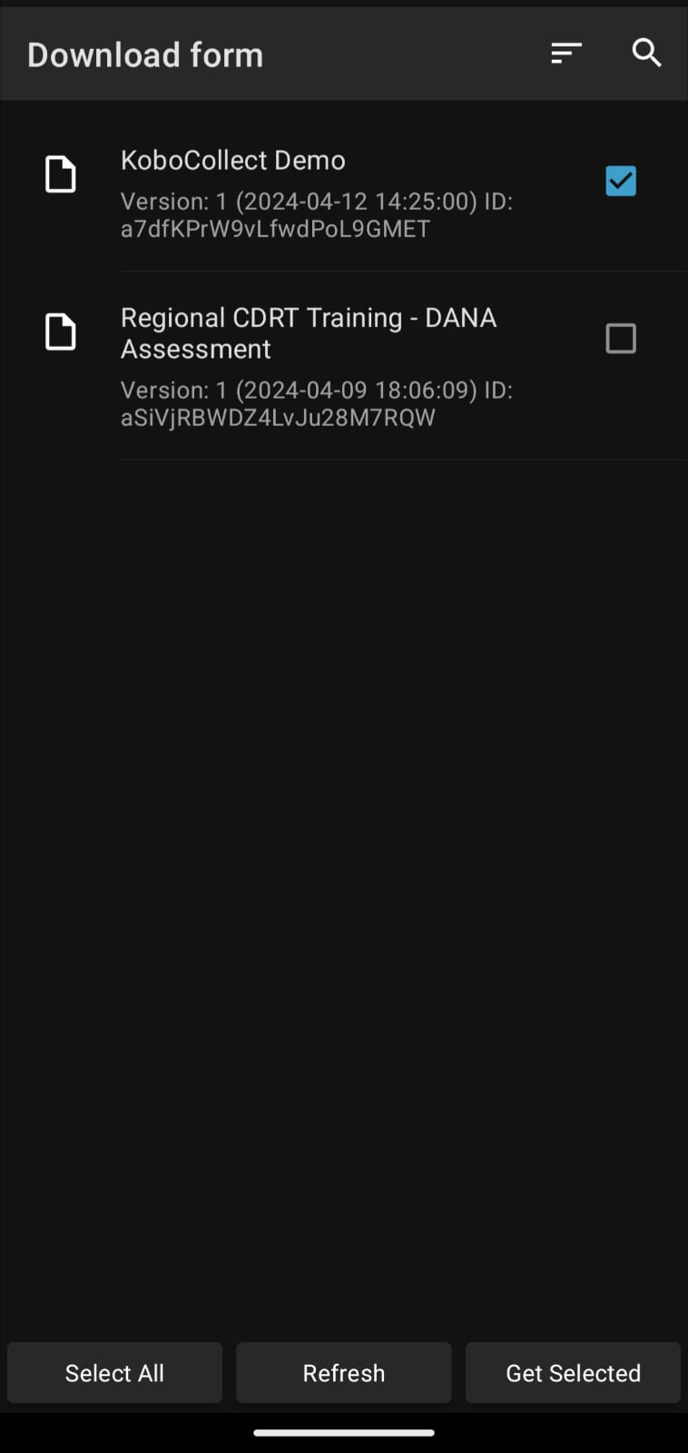

Kobo Collect Demo
To download the forms from your account and start the data collection, follow these steps:
Make sure you are connected to the internet on your device.
2. Go on “Download form”
3. A list of all your forms will appear. Select the one you wish to download. Then choose “Get Selected”.

Slide 6
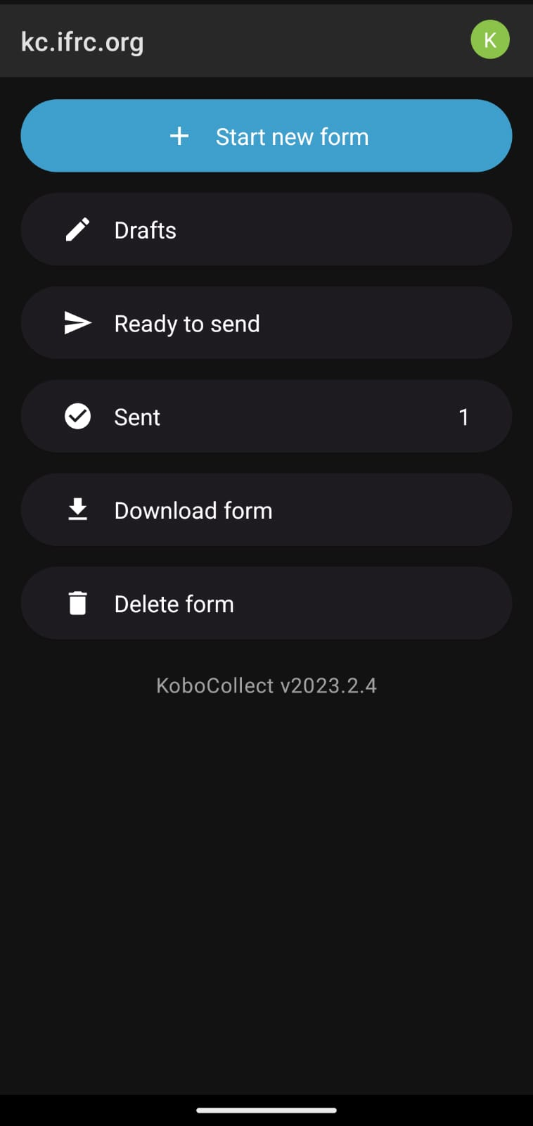
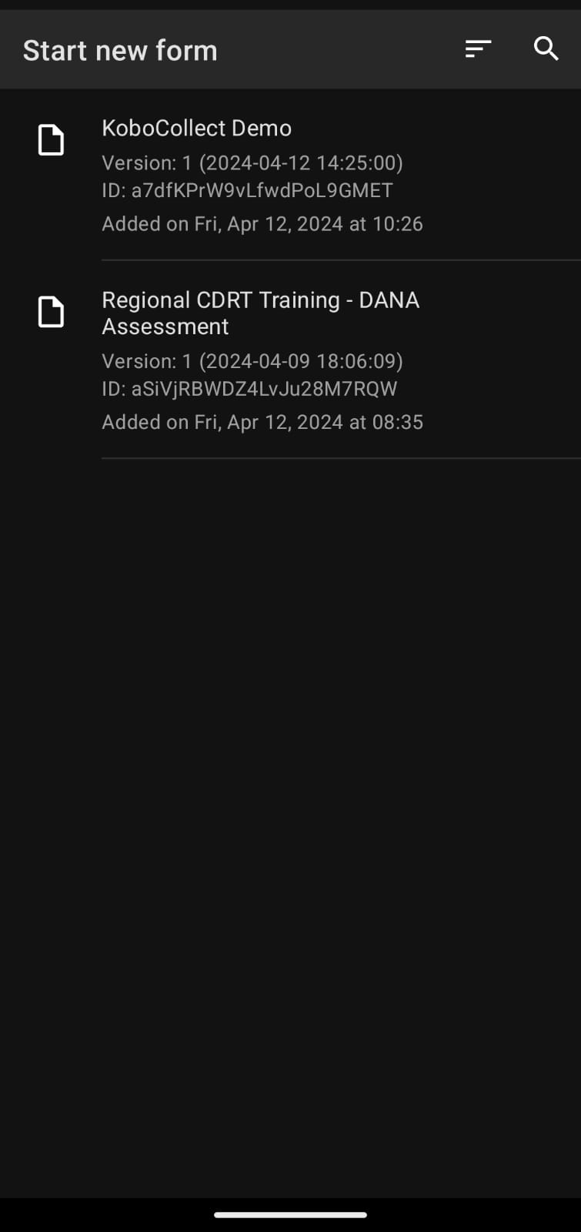
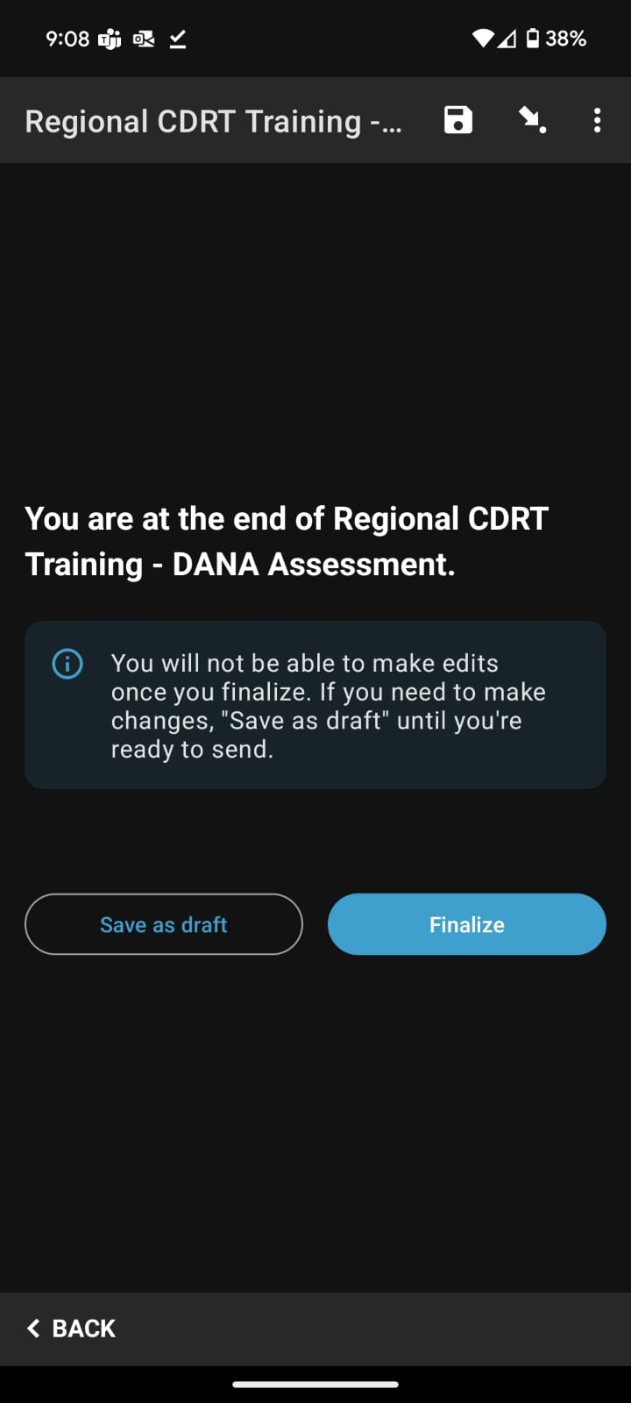
Kobo Collect Demo:
Collecting Data
To collect data:
Go to “Start a new form”.
Select the form to which you would like to enter data.
Go through the questions.
At the end select “Finalize”.

Slide 7

Kobo Collect Demo:
Submitting Data
Uploading finalized data.
From the home screen, select “Read to send”.
A list of your most recent collected forms will appear.
2. Select the form you wish to submit.
3. Select “Go to end”
4. Select “Send selected”

Slide 8
After the Kobo Demonstration, you should now have the Kobo Collect App on your phone.
On the Kobo Collect App enter the following:
URL: https://kc.ifrc.org
Username: Password:
NOTE: (You can liaise with CADRIM to develop a test form: https://www.cadrim.org/helpdesk)
In your groups, walk around the room and look at the pictures posted on the walls showing the different types of damages sustained in the community after a flooding.
Use the information from the pictures to complete and submit the DANA form on the Kobo Collect App.
You have 20 minutes for this activity.
Activity:
Complete A Rapid Assessment
Notes:
You can liaise with CADRIM to develop a test form: https://www.cadrim.org/helpdesk

Slide 9





Volunteer, Donate, Join Us In Partnership, or share our appeals and stories on social media. Find out more about IFRC and learn how to contact your National Red Cross or Red Crescent Society, at www.ifrc.org.
Get Involved
There are many ways of becoming a part of the world’s largest humanitarian network
To stay informed about Caribbean disaster response activities or to access additional information on available trainings, training materials, research and information management tools, visit: www.cadrim.org.
: CADRIM.IFRC
: @cadrim_ifrc
: @CADRIM_IFRC

