Slide 1
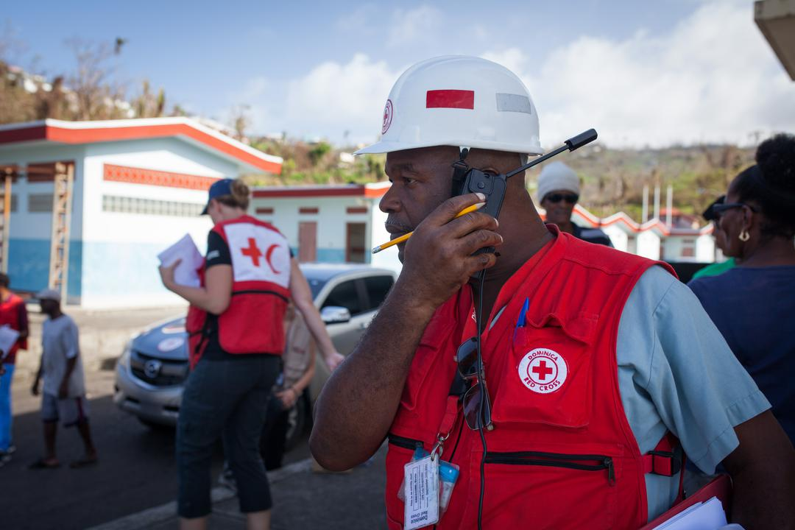

CDRTs & Communication
For Community Disaster Response Teams

Slide 2







Acknowledgements
We thank the Belize Red Cross, Grenada Red Cross, Guyana Red Cross, Jamaica Red Cross, St
Vincent and the Grenadines Red Cross, Trinidad and Tobago Red Cross and the Caribbean
Disaster Emergency Management Agency (CDEMA) for their commitment to collaborating with
the Caribbean Disaster Risk Management (CADRIM) Reference Centre. Together, we reviewed
and revised the CDRT Training Material, enhancing its relevance and effectiveness in disaster
response training. Your dedication exemplifies the spirit of cooperation within the humanitarian
community, and we deeply appreciate your invaluable contributions.

Slide 3

Objectives
Understand communication
How to communicate effectively
Understand Community Engagement and Accountability (CEA)
Assess barriers to effective communication
Learn to communicate in times of disaster

Slide 4
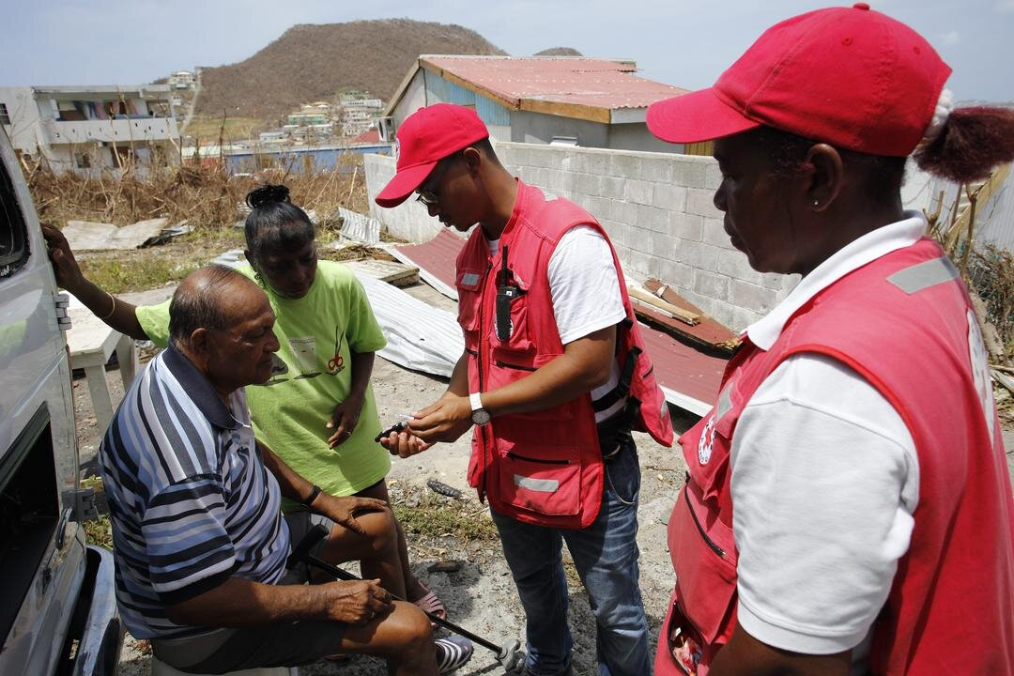
What Is Communication
A process by which information is exchanged between individuals through a common system of symbols, signs, or behaviour.
In its simplest form, it can be defined as an exchange of information.

Slide 5
Activity:
Pass the message
Participants will be split into groups
One person in each group will be given a message
The message will be passed on verbally from one group member to the next
The last person in the group will reveal what the message received.

Slide 6
Communicating
Appropriately
Communication skills are needed for transferring information for different phases of an emergency.
CDRTs MUST CONSIDER:
Preferred method of communicating in the community
Timeliness of communicating
Vulnerable Groups
Appropriate communication tools

Slide 7
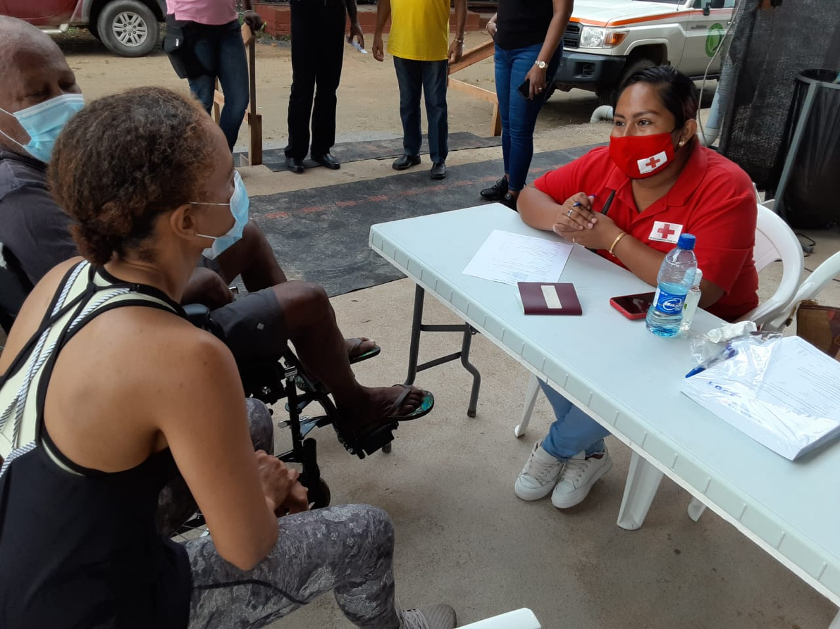
What is Community Engagement & Accountability (CEA)?
It is an approach used by the Red Cross to ensure that communities are at the centre of the work being done by integrating communication and participation throughout programme cycles and operations.

Slide 8
Why is CEA Important?
Leads to better, more effective programming
Improves acceptance and trust
Feedback and complaints are good.
Help to saves lives.
Empower people and builds community resilience.
Supports positive behavior and social change.
Recognises the community as experts and partners.
Supports NS to fulfil their auxiliary role.
Contributes to “do no harm” programming.
Helps to manage community expectations.

Slide 9
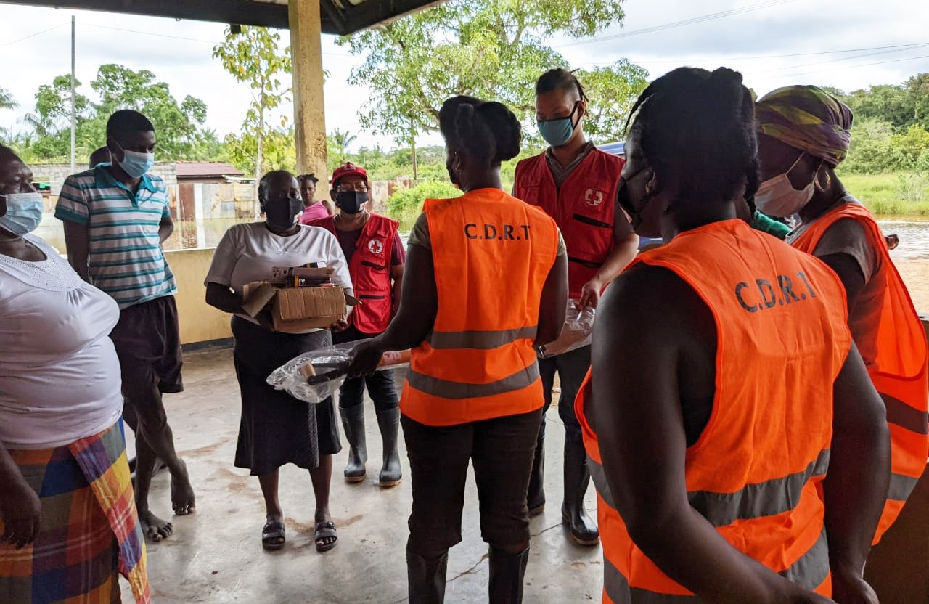
CEA Contributes To
Stronger Accountability To Communities
Safer Access And Acceptance
Sustainable & Community Driven Programmes
More Resilient Communities

Slide 10



Let’s Talk
Communicating Before A Disaster
Ensure Community Participation & Feedback
Share information that meet their needs and are relevant.
Include all groups in discussions
Establish a feedback system
Encourage Behaviour & Social Change Communication
Encourage open discussions that allow insight into perceptions and behaviours.
Help communities adopt safer and healthier practices.
Use Community-based Information To Help With Advocacy
Help communities understand how to use their knowledge and information to speak out about issues that affect them and make their voices heard.

Slide 11




Communicating
During Disasters
Providing timely, accurate, life saving information to the affected population using local media.
Provide information intended to save lives and prevent further crisis
Provide guidance on where to get assistance
Provide information regarding their legal rights and who is in charge

Slide 12




Let’s Talk
Communication
Barriers
Linguistic And Cultural Diversity.
Exposure To A Range Of Hazards.
Variable Access To, And Use Of Technology
Age Differences

Slide 13
Activity:
CDRT Communications Plan
Discuss the type of information that should be included in a CDRT Communications Plan.
Note: You can also reference Unit 8 on page 19 of the CDRT Workbook

Slide 14
Develop A CDRT Communications Plan
Your plan should outline:
How CDRTs are activated
How CDRTs communicate with each other
Who and how CDRTs can communicate with the National Society
Who and how CDRTs can communicate with the National Disaster Office
Identify other relevant stakeholders and identify who, how and when these stakeholders should be contacted.

Slide 15
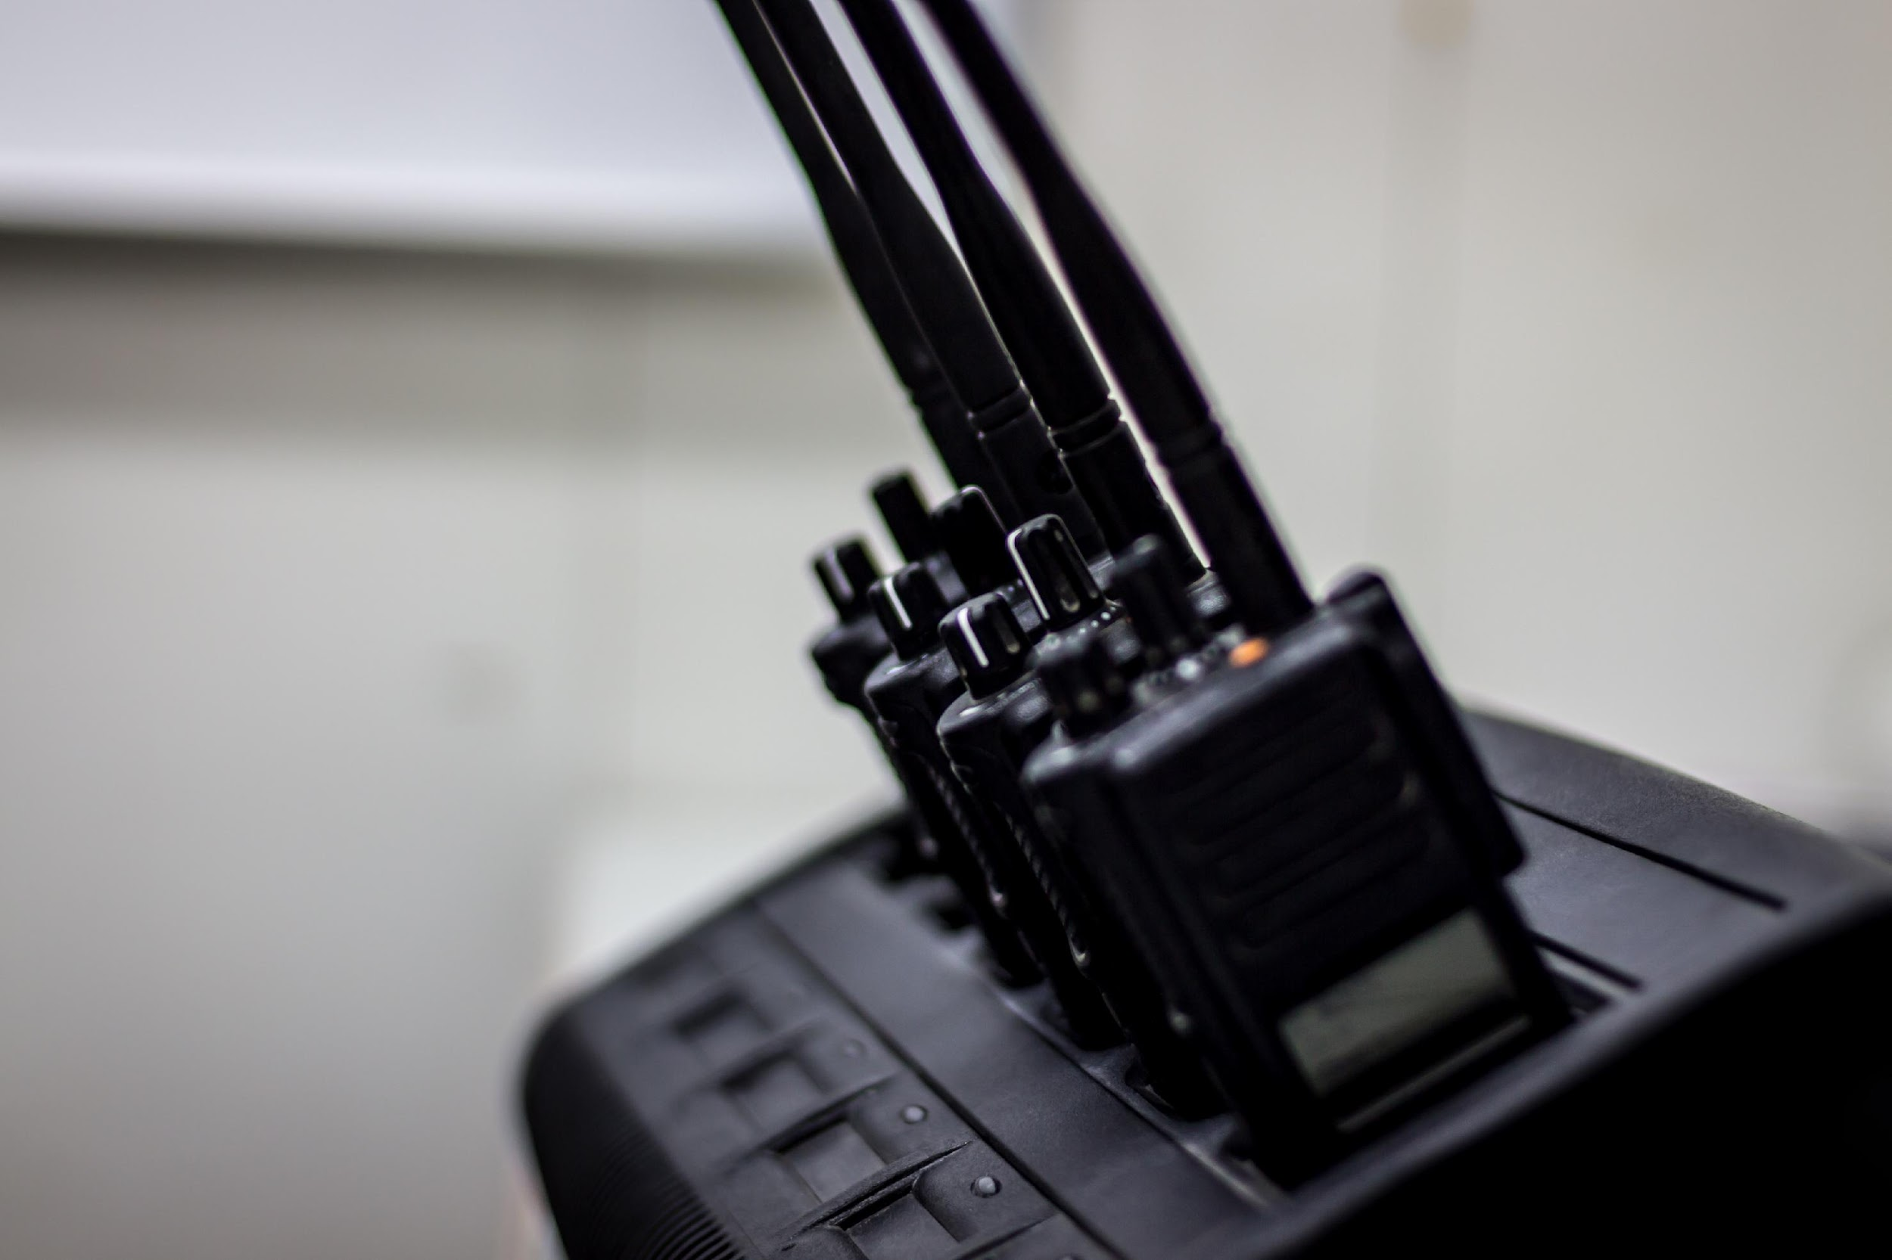
Communicating In A Disaster :
Effective Messaging
Be Simple
Communicate The Threat
Provide A Call To Action
Be Accessible
Reach Out To As Many People As Possible
Never Cause Harm Or Create A Panic
Coordinate With Others

Slide 16


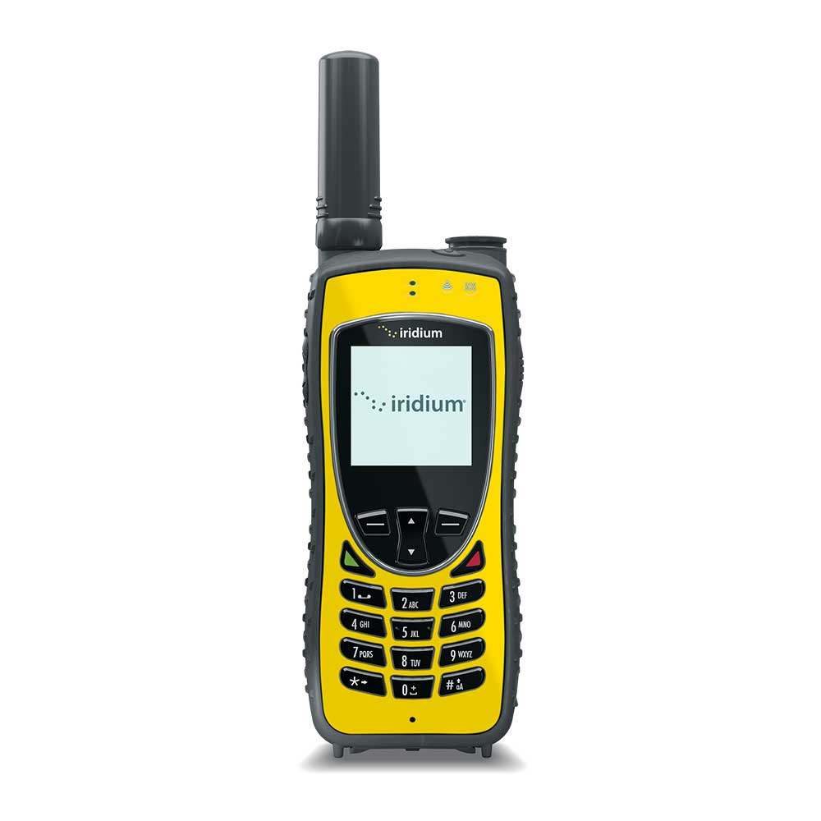

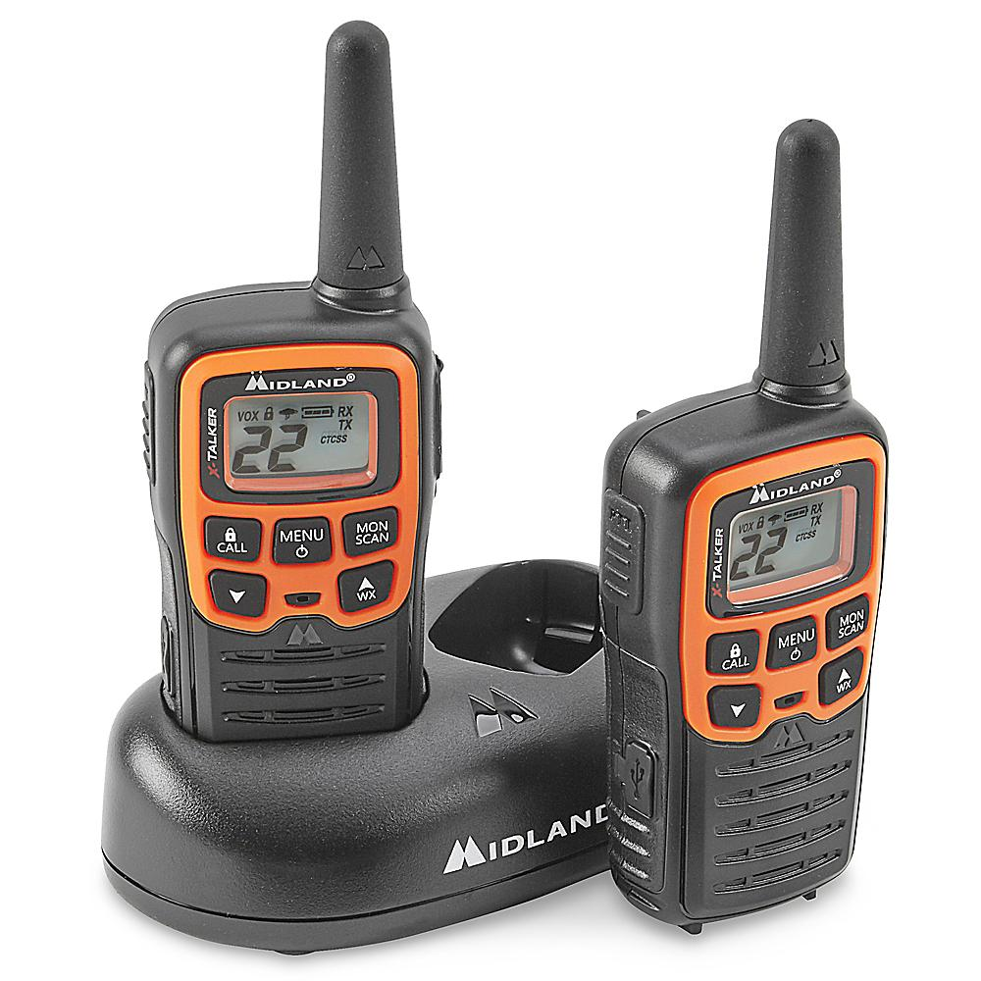
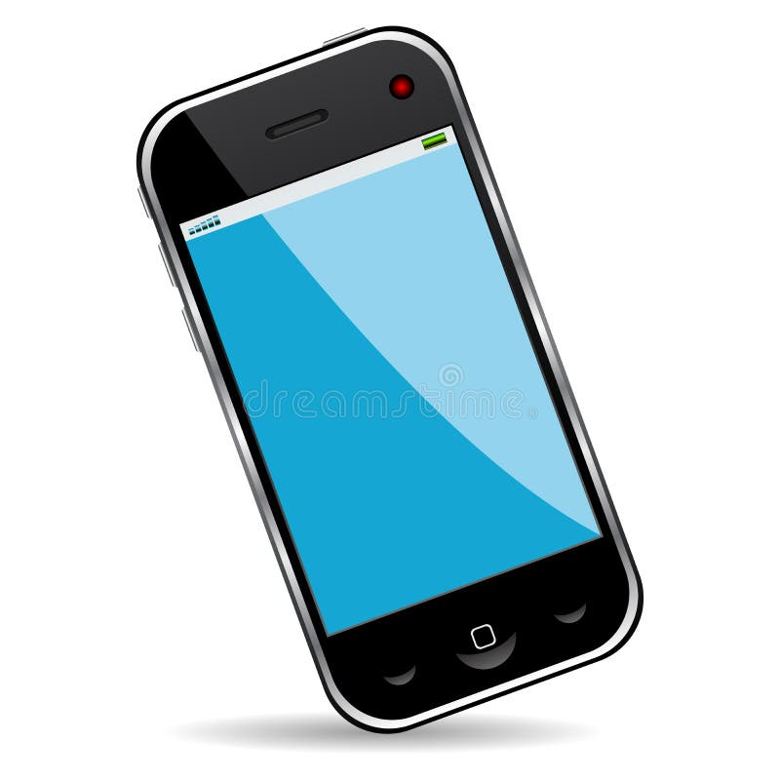

Modes Of
Communication
Runner
Landline Telephones
Cell Phones
Two-way Radios
Electronic
WhatsApp
Sat Phones

Slide 17
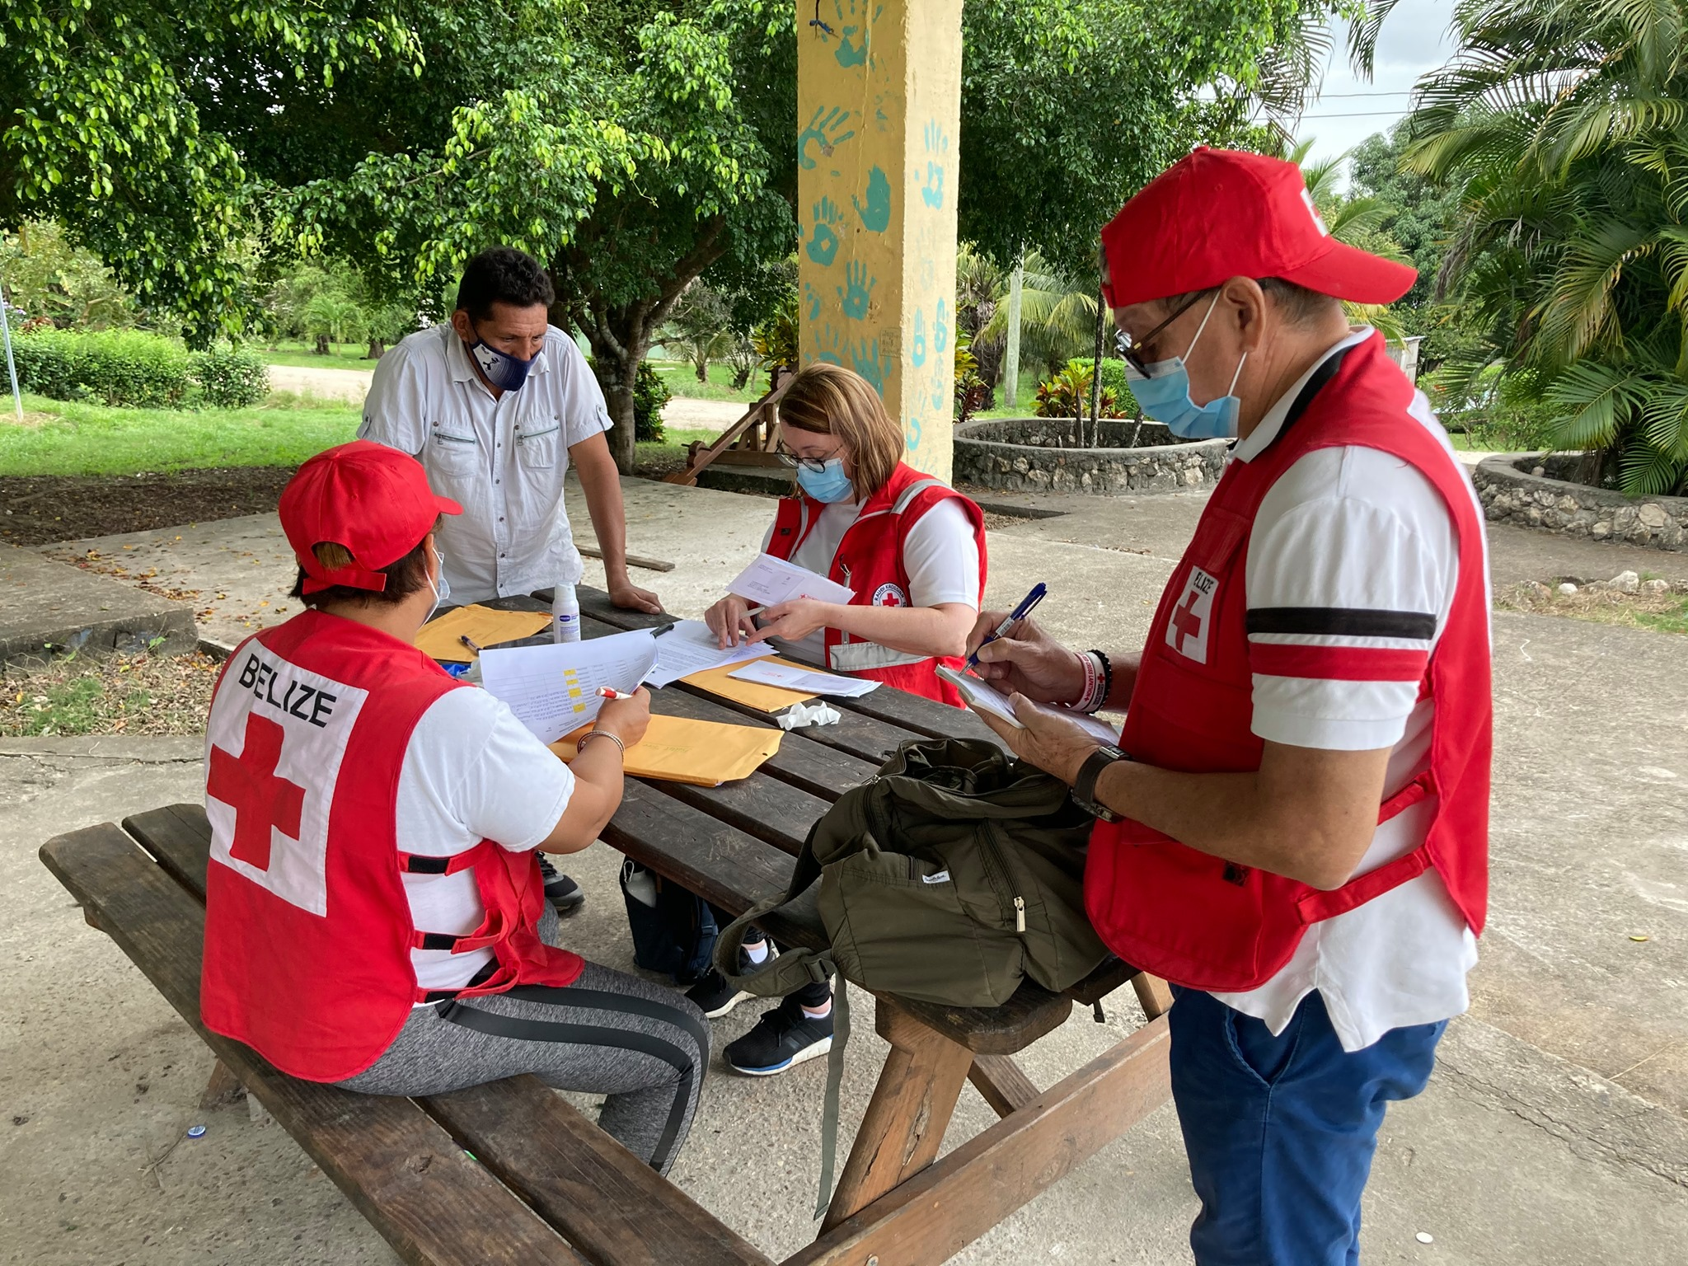
Working
With Others
Be aware of information being circulated it can become contradictory and disruptive causing isolation and fear among the affected communities.
Find out if there is an existing CEA group and join. This allows for sharing of information and improved planning on needs and state of local media and communications.
Coordinate with other departments in your NS and be aware of the information shared as this will provide for better CEA involvement

Slide 18
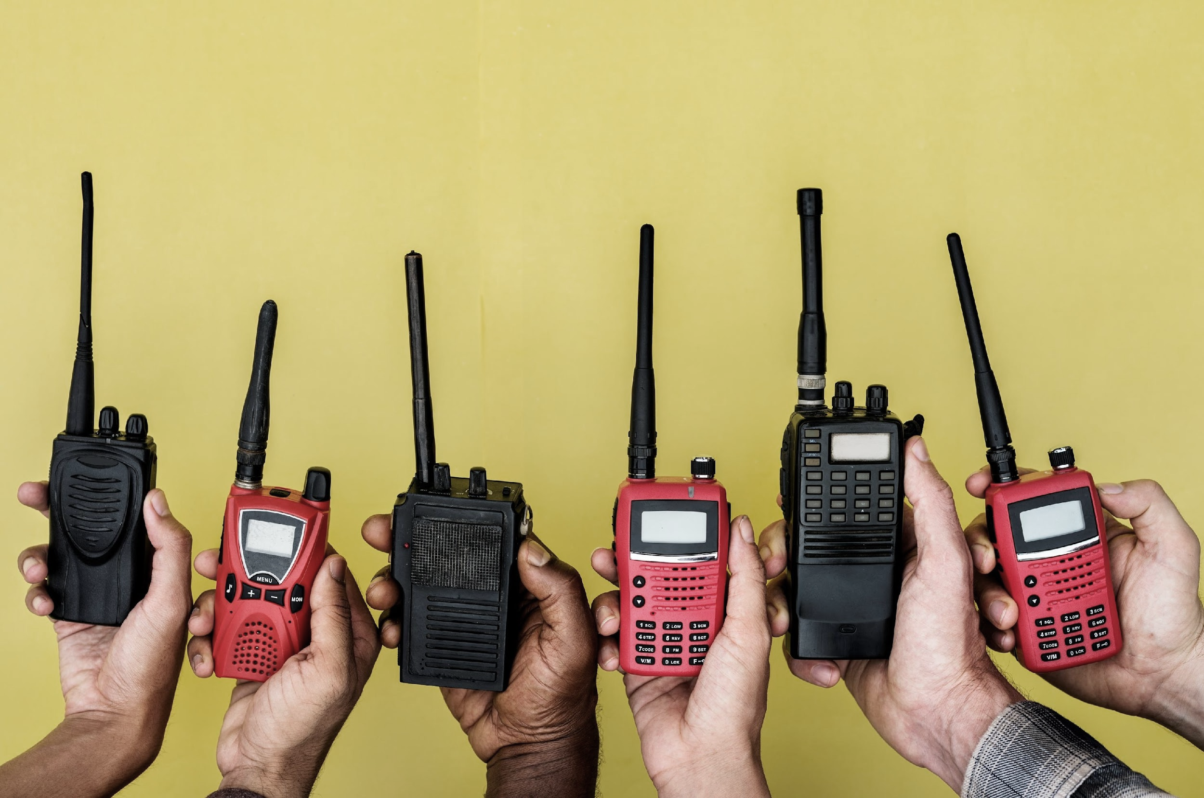
Activity:
Exercise On Communication In Disasters
BEFORE:
How would you approach community members to support you as a CDRT to respond in emergencies within the community?
DURING:
Then, identify a risk such as Flooding, Fires or landslides, whereby you will need to list 3 appropriate channels of communicating to community members about the hazard and danger
AFTER:
Discuss a proper method to collect feedback and complaints in their community.

Slide 19





Volunteer, Donate, Join Us In Partnership, or share our appeals and stories on social media. Find out more about IFRC and learn how to contact your National Red Cross or Red Crescent Society, at www.ifrc.org.
Get Involved
There are many ways of becoming a part of the world’s largest humanitarian network
To stay informed about Caribbean disaster response activities or to access additional information on available trainings, training materials, research and information management tools, visit: www.cadrim.org.
: CADRIM.IFRC
: @cadrim_ifrc
: @CADRIM_IFRC

