Slide 1
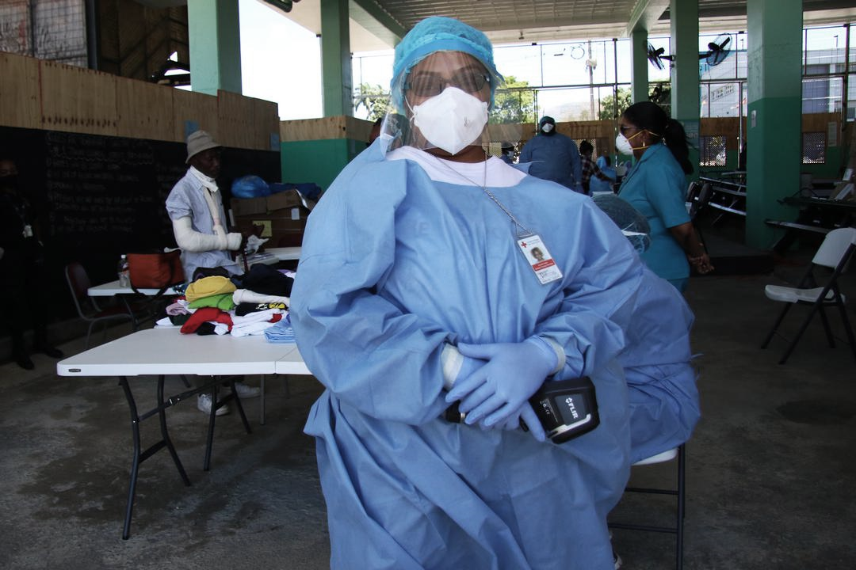

CDRTs & Health in Emergencies
For Community Disaster Response Teams

Slide 2
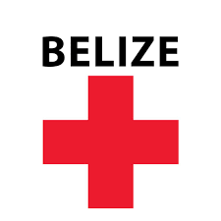






Acknowledgements
We thank the Belize Red Cross, Grenada Red Cross, Guyana Red Cross, Jamaica Red Cross, St
Vincent and the Grenadines Red Cross, Trinidad and Tobago Red Cross and the Caribbean
Disaster Emergency Management Agency (CDEMA) for their commitment to collaborating with
the Caribbean Disaster Risk Management (CADRIM) Reference Centre. Together, we reviewed
and revised the CDRT Training Material, enhancing its relevance and effectiveness in disaster
response training. Your dedication exemplifies the spirit of cooperation within the humanitarian
community, and we deeply appreciate your invaluable contributions.

Slide 3

Objectives
Understand The Basics Of Triage

Slide 4
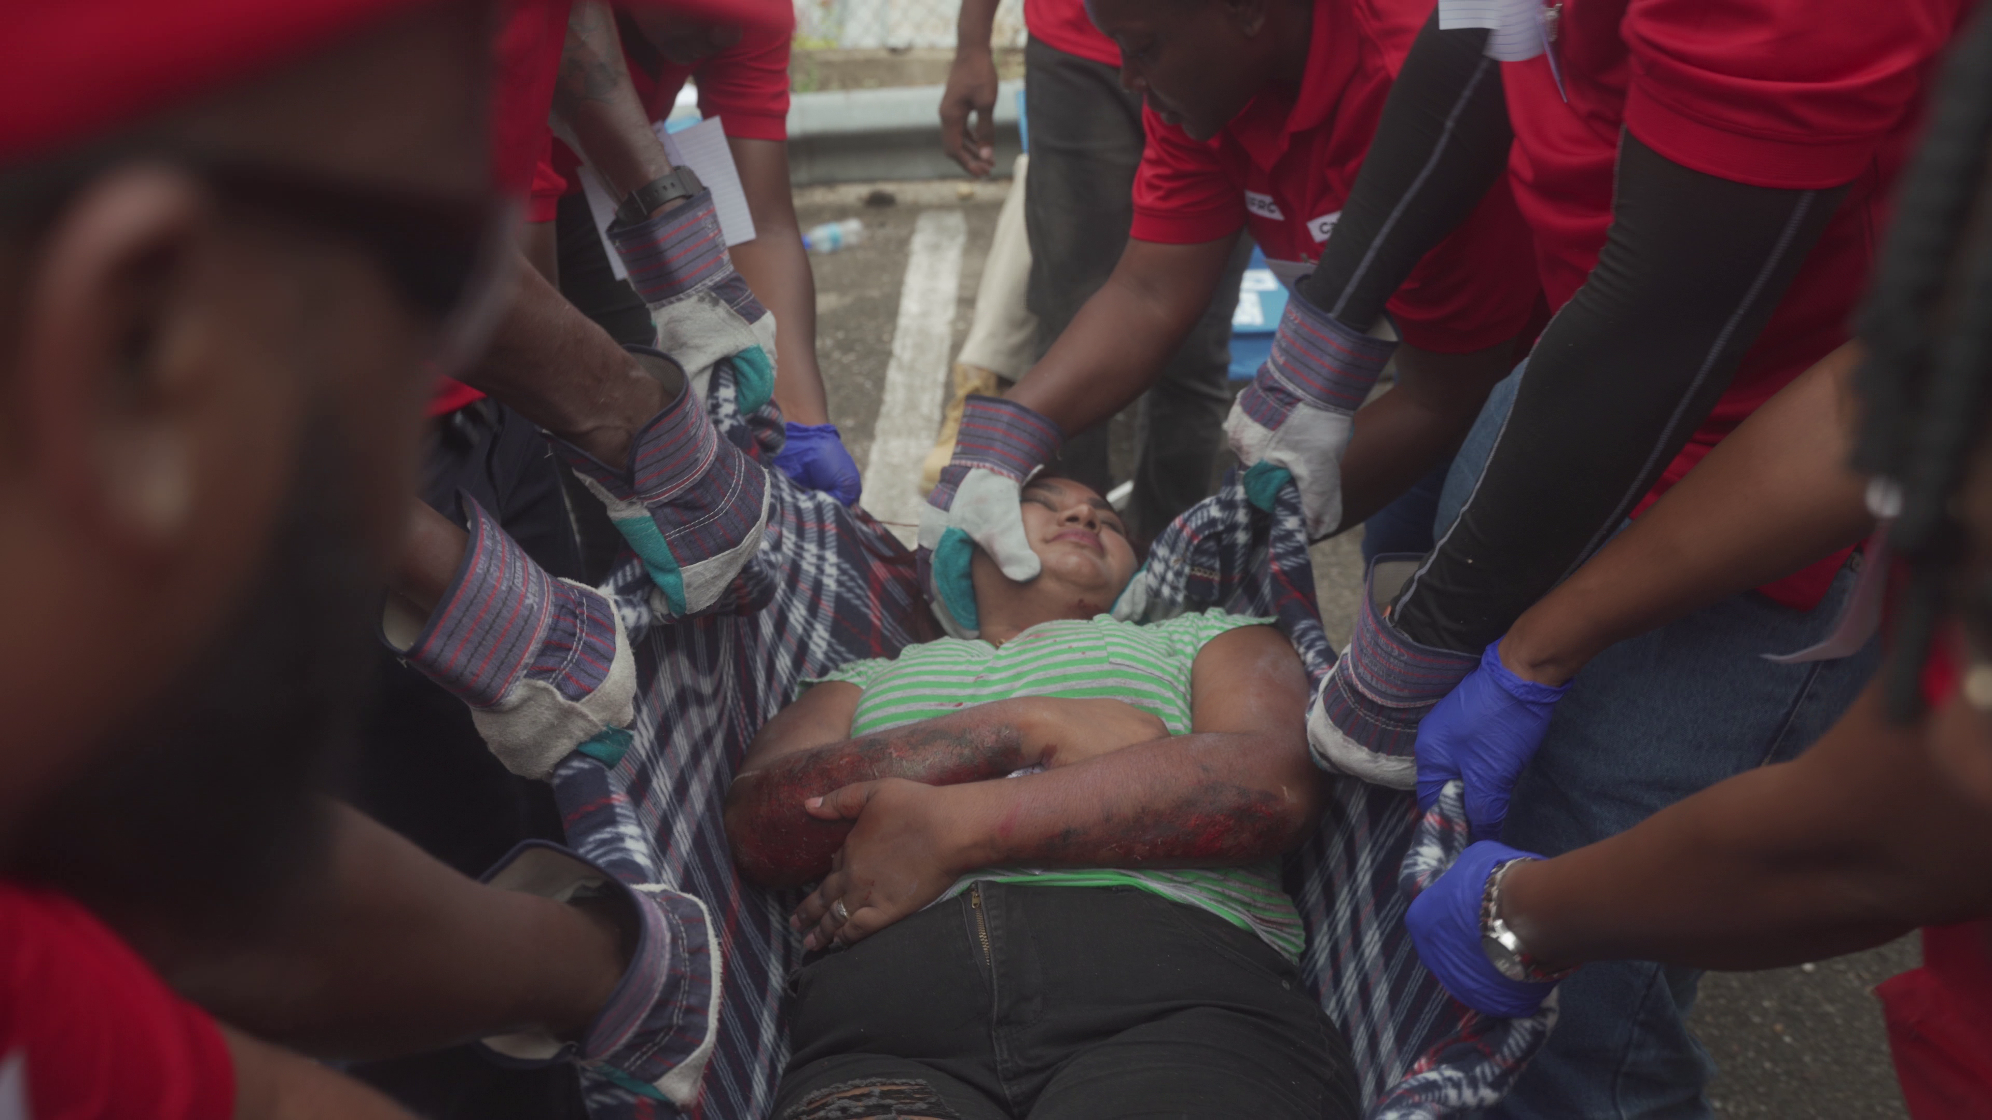
What Is Triage?
Victims are evaluated, sorted by immediacy of treatment needed, and set up for immediate or delayed treatment.
Notes:
When working in a disaster with multiple casualties, the first goal is Simple Triage And Rapid Treatment (START).
Experience has shown that triage is an effective strategy in situations where:
rescuers are overwhelmed,
there are limited resources,
and time is a critical factor.

Slide 5
S.T.A.R.T Treatment of Triage
Treatment for life-threatening conditions such as Airway obstruction, Bleeding and shock
Treatment for other, less urgent conditions
Provide greatest good for greatest number
by conducting
Simple Triage And Rapid Treatment
S.T.A.R.T. SYSTEM OF TRIAGE
Notes:
When working in a disaster with multiple casualties, the first goal is Simple Triage And Rapid Treatment (START).
Experience has shown that triage is an effective strategy in situations where:
rescuers are overwhelmed,
there are limited resources,
and time is a critical factor.

Slide 6
Establish A Medical Treatment Area
Select site and set up treatment area as soon as injured victims are confirmed.
When determining best location(s) for treatment area, consider:
  Safety of rescuers and victims
  Most effective use of resources

Slide 7
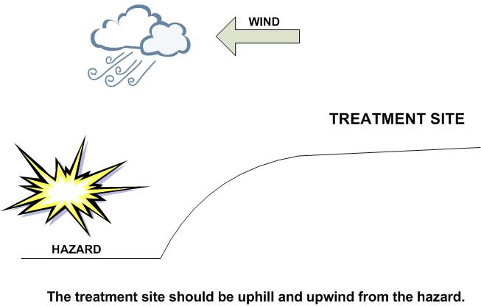
The site selected should be:
Treatment Area Selection
  In a safe area, free of hazards and debris
  Upwind, uphill, and upstream (if possible) from hazard zone(s)
  Accessible by transportation vehicles
  Expandable

Slide 8
Treatment Area Layout
Four treatment areas:
“I” for Immediate care
“D” for Delayed care
“M” for Minor injuries/ walking wounded
“DEAD” for the morgue

Slide 9
Victim Treatment Area Record
VICTIM TREATMENT AREA RECORD |  | CERT |  | DATE
Treatment Area/Location
Time In | Name or Description | Condition/ Treatment | Moved To | Time Out

Slide 10
What is Triage?
Process for managing mass casualty event
Victims are evaluated
Victims are sorted by urgency of treatment needed
Victims are set up for immediate or delayed treatment

Slide 11
Where and When?
Light Damage: assess in place
Moderate Damage: rescue victims and move to collection point first, triage here and then move to treatment area
Heavy Damage: Do not go in, conduct voice triage only

Slide 12
Immediate (I): Victim has life-threatening injuries (airway, bleeding, or shock)
Delayed (D): Injuries do not jeopardize victim’s life; treatment can be delayed
Minor (M): Walking wounded and generally ambulatory. When you call out, they can come towards you
Dead (DEAD): No respiration after two attempts to open airway
Triage:
Remember IDMD

Slide 13
What’s Good/
What’s Bad
GOOD | BAD
BREATHING < 30 12 – 30 Breaths per minute (BPM) | BREATHING > 30
1 Breath every 3 seconds (20 BPM) 1 Breath every 4 seconds (15 BPM) 1 Breath every 5 seconds (12 BPM) | 1 Breath every 2 seconds (30 BPM) 1 Breath every 1 second (60 BPM)
Capillary Refill <2 | Capillary Refill >2
Follows commands
Impaired mental status

Slide 14
Triage Process
Step 1: Stop, Look, Listen, and Think
Step 2: Conduct voice triage
Step 3: Start where you stand; follow systematic route
Step 4: Evaluate each victim and tag
Step 5: Treat “I” victims immediately
Step 6: Document triage results

Slide 15
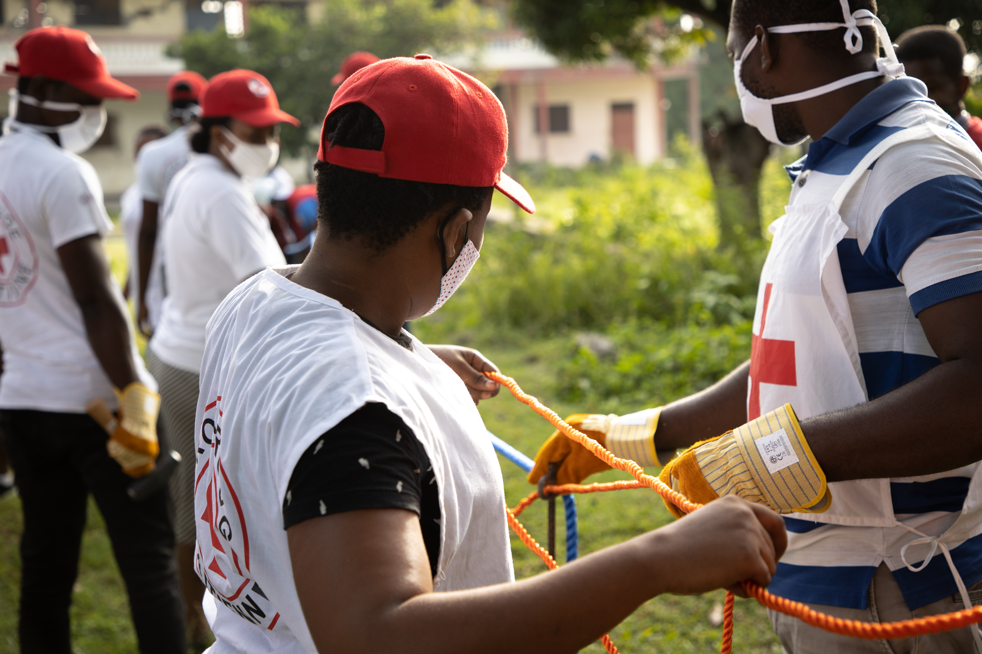
Triage Pitfalls
No team plan, organization, or goal
Indecisive leadership
Too much focus on one injury
Treatment (rather than triage) performed

Slide 16

Performing A Triage Evaluation
Check Section 6.6.2 page 22-24 of the Field Guide
To learn basic First Aid please contact your National Society for information.

Slide 17





Volunteer, Donate, Join Us In Partnership, or share our appeals and stories on social media. Find out more about IFRC and learn how to contact your National Red Cross or Red Crescent Society, at www.ifrc.org.
Get Involved
There are many ways of becoming a part of the world’s largest humanitarian network
To stay informed about Caribbean disaster response activities or to access additional information on available trainings, training materials, research and information management tools, visit: www.cadrim.org.
: CADRIM.IFRC
: @cadrim_ifrc
: @CADRIM_IFRC

