Slide 1
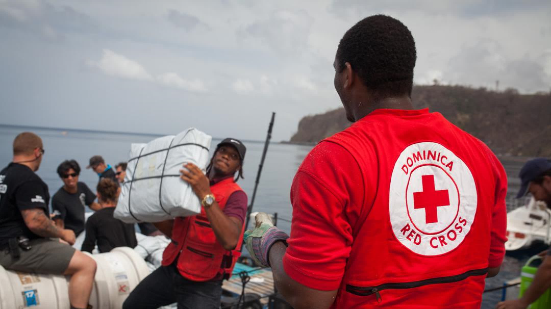
CDRTs & Disaster Risk Management
For Community Disaster Response Teams

Slide 2
Acknowledgements
We thank the Belize Red Cross, Grenada Red Cross, Guyana Red Cross, Jamaica Red Cross, St
Vincent and the Grenadines Red Cross, Trinidad and Tobago Red Cross and the Caribbean
Disaster Emergency Management Agency (CDEMA) for their commitment to collaborating with
the Caribbean Disaster Risk Management (CADRIM) Reference Centre. Together, we reviewed
and revised the CDRT Training Material, enhancing its relevance and effectiveness in disaster
response training. Your dedication exemplifies the spirit of cooperation within the humanitarian
community, and we deeply appreciate your invaluable contributions.

Slide 3
Objectives
Be more knowledgeable about the Disaster Management Cysle
Disaster vs Hazard?
Have an awareness & understanding of common hazards & understand how they affect households, communities & countries.
Learn about climate change, adaptation & Nature-Based Solutions.

Slide 4
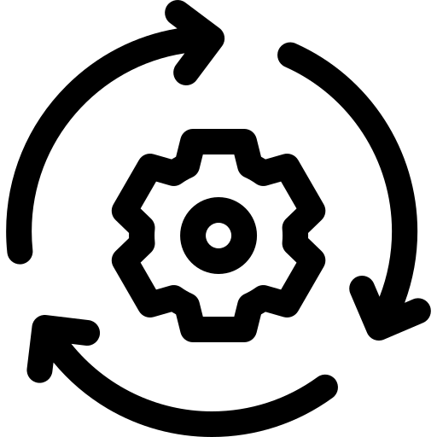
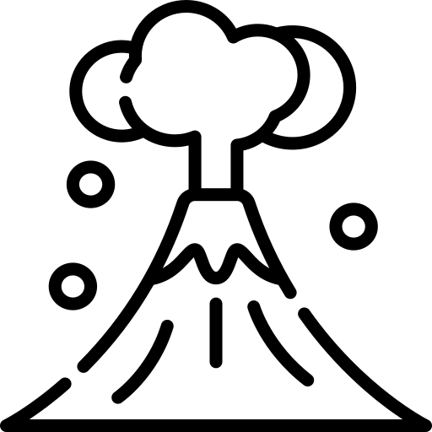
Mitigation
Prevention
Preparedness
The Disaster Management Cycle
DISASTER MANAGEMENT CYCLE
Recovery
Event
Response
Notes:
The Disaster Management Cycle (DMC)- the process that helps communities prepare for, respond to, & recover from disasters. It includes planning ahead, getting prepared, reacting when disasters happen, and rebuilding afterward.
Mitigation
preparedness and prevention are continuous processes
Preparedness
The knowledge and capacities developed by governments, response and recovery organizations, communities and individuals to effectively anticipate, respond to and recover from the impacts of likely, imminent or current disasters. Annotation: Preparedness action is carried out within the context of disaster risk management and aims to build the capacities needed to efficiently manage all types of emergencies and achieve orderly transitions from response to sustained recovery. Preparedness is based on a sound analysis of disaster risks and good linkages with early warning systems, and includes such activities as contingency planning, the stockpiling of equipment and supplies, the development of arrangements for coordination, evacuation and public information, and associated training and field exercises. These must be supported by formal institutional, legal and budgetary capacities. The related term “readiness” describes the ability to quickly and appropriately respond when required. A preparedness plan establishes arrangements in advance to enable timely, effective and appropriate responses to specific potential hazardous events or emerging disaster situations that might threaten society or the environment. 02 Feb 2017
Prevention
Activities and measures to avoid existing and new disaster risks. Annotations: Prevention (i.e., disaster prevention) expresses the concept and intention to completely avoid potential adverse impacts of hazardous events. While certain disaster risks cannot be eliminated, prevention aims at reducing vulnerability and exposure in such contexts where, as a result, the risk of disaster is removed. Examples include dams or embankments that eliminate flood risks, land-use regulations that do not permit any settlement in high-risk zones, seismic engineering designs that ensure the survival and function of a critical building in any likely earthquake and immunization against vaccine-preventable diseases. Prevention measures can also be taken during or after a hazardous event or disaster to prevent secondary hazards or their consequences, such as measures to prevent the contamination of water. 16 Feb 2017
Reconstruction
The medium- and long-term rebuilding and sustainable restoration of resilient critical infrastructures, services, housing, facilities and livelihoods required for the full functioning of a community, or a society affected by a disaster, aligning with the principles of sustainable development and “build back better”, to avoid or reduce future disaster risk. 02 Feb 2017
Recovery
The restoring or improving of livelihoods and health, as well as economic, physical, social, cultural and environmental assets, systems and activities, of a disaster-affected community or society, aligning with the principles of sustainable development and “build back better”, to avoid or reduce future disaster risk. 02 Feb 2017
Rehabilitation
The restoration of basic services and facilities for the functioning of a community or a society affected by a disaster. -02 Feb 2017 UNISDR.org

Slide 5
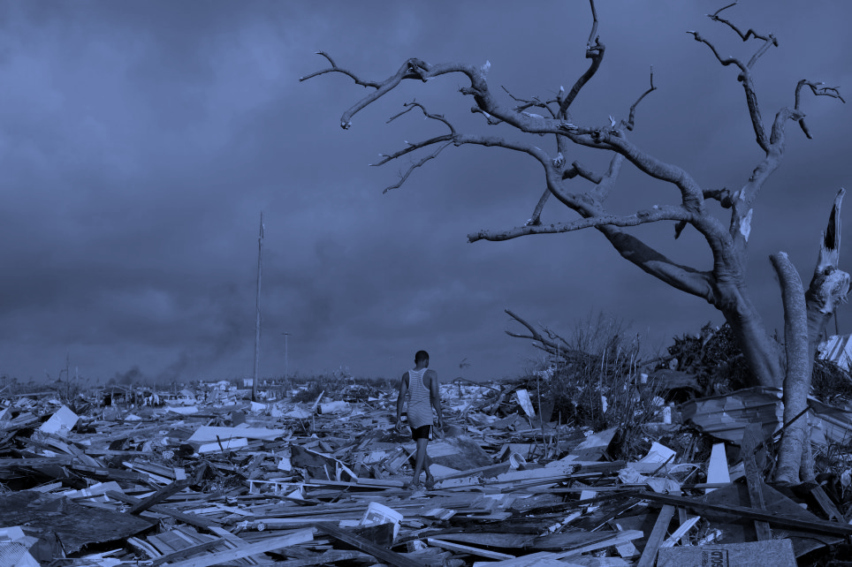
What Is
A Disaster?
A serious disruption of the functioning of a community or a society.
Widespread effect that could last for a long period of time.
Any effect that may exceed the capacity of a community or society to cope using its own resources.
Notes:
A serious disruption of the functioning of a community or a society at any scale, due to hazardous events interacting with conditions of exposure, vulnerability and capacity, leading to one or more of the following: human, material, economic and environmental losses and impacts.
In other words-
Pic source Read more: https://metro.co.uk/2019/09/09/will-devastating-hurricane-dorian-hit-uk-week-10708668/?ito=cbshare
Twitter: https://twitter.com/MetroUK | Facebook: https://www.facebook.com/MetroUK/
Annotations: The effect of the disaster can be immediate and localized, but is often widespread and could last for a long period of time.
The effect may test or exceed the capacity of a community or society to cope using its own resources, and therefore may require assistance from external sources, which could include neighbouring jurisdictions, or those at the national or international levels.

Slide 6
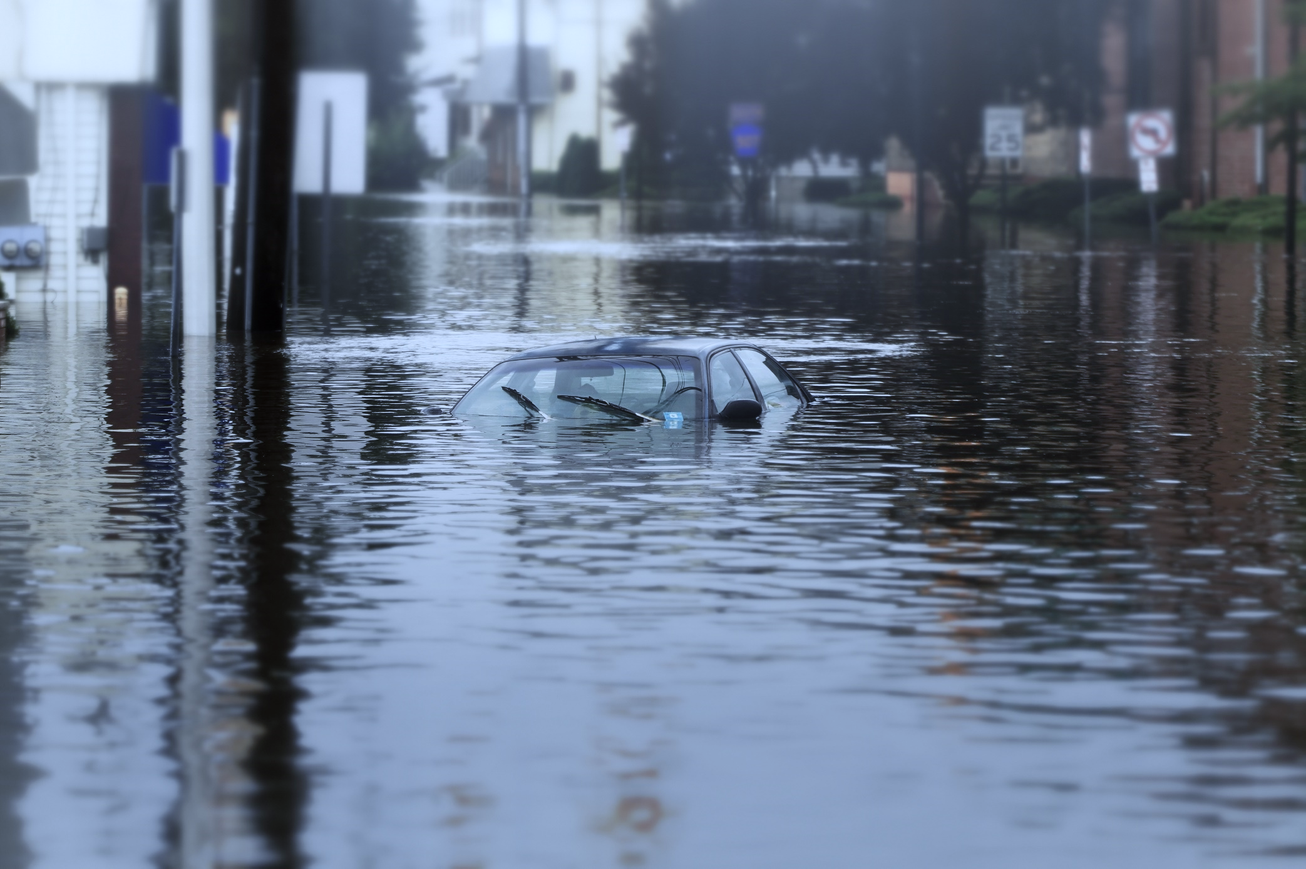
What Is
A Hazard?
A dangerous event,
substance, human activity or condition that causes loss.
Notes:
“A dangerous phenomenon, substance, human activity or condition that may cause loss of life, injury or other health impacts, property damage, loss of livelihoods and services, social and economic disruption, or environmental damage” Definition (UNDRR)
Pic. Mashable.Com IMAGE: @MACHEL MONTANO ON INSTAGRAM

Slide 7
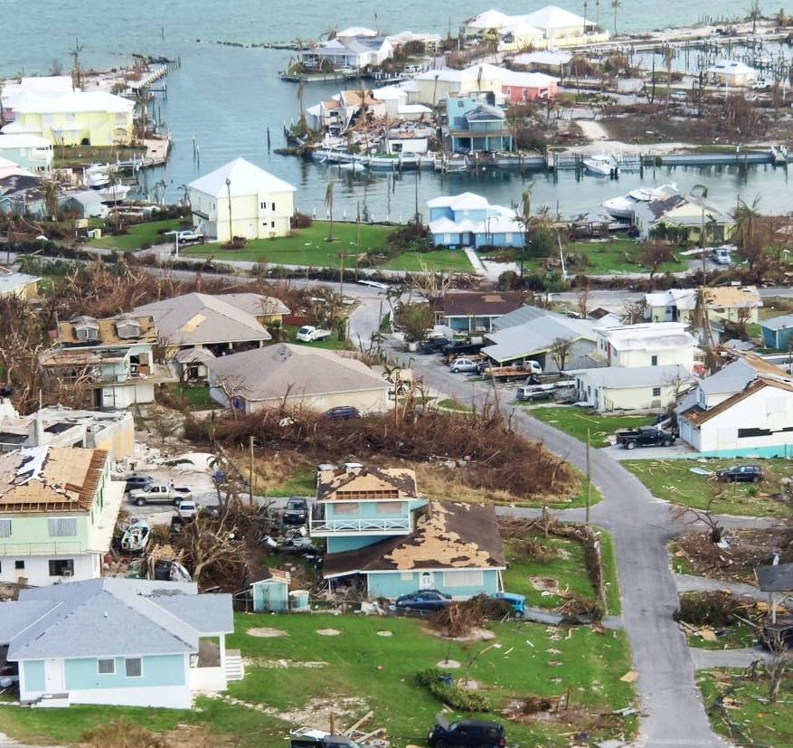
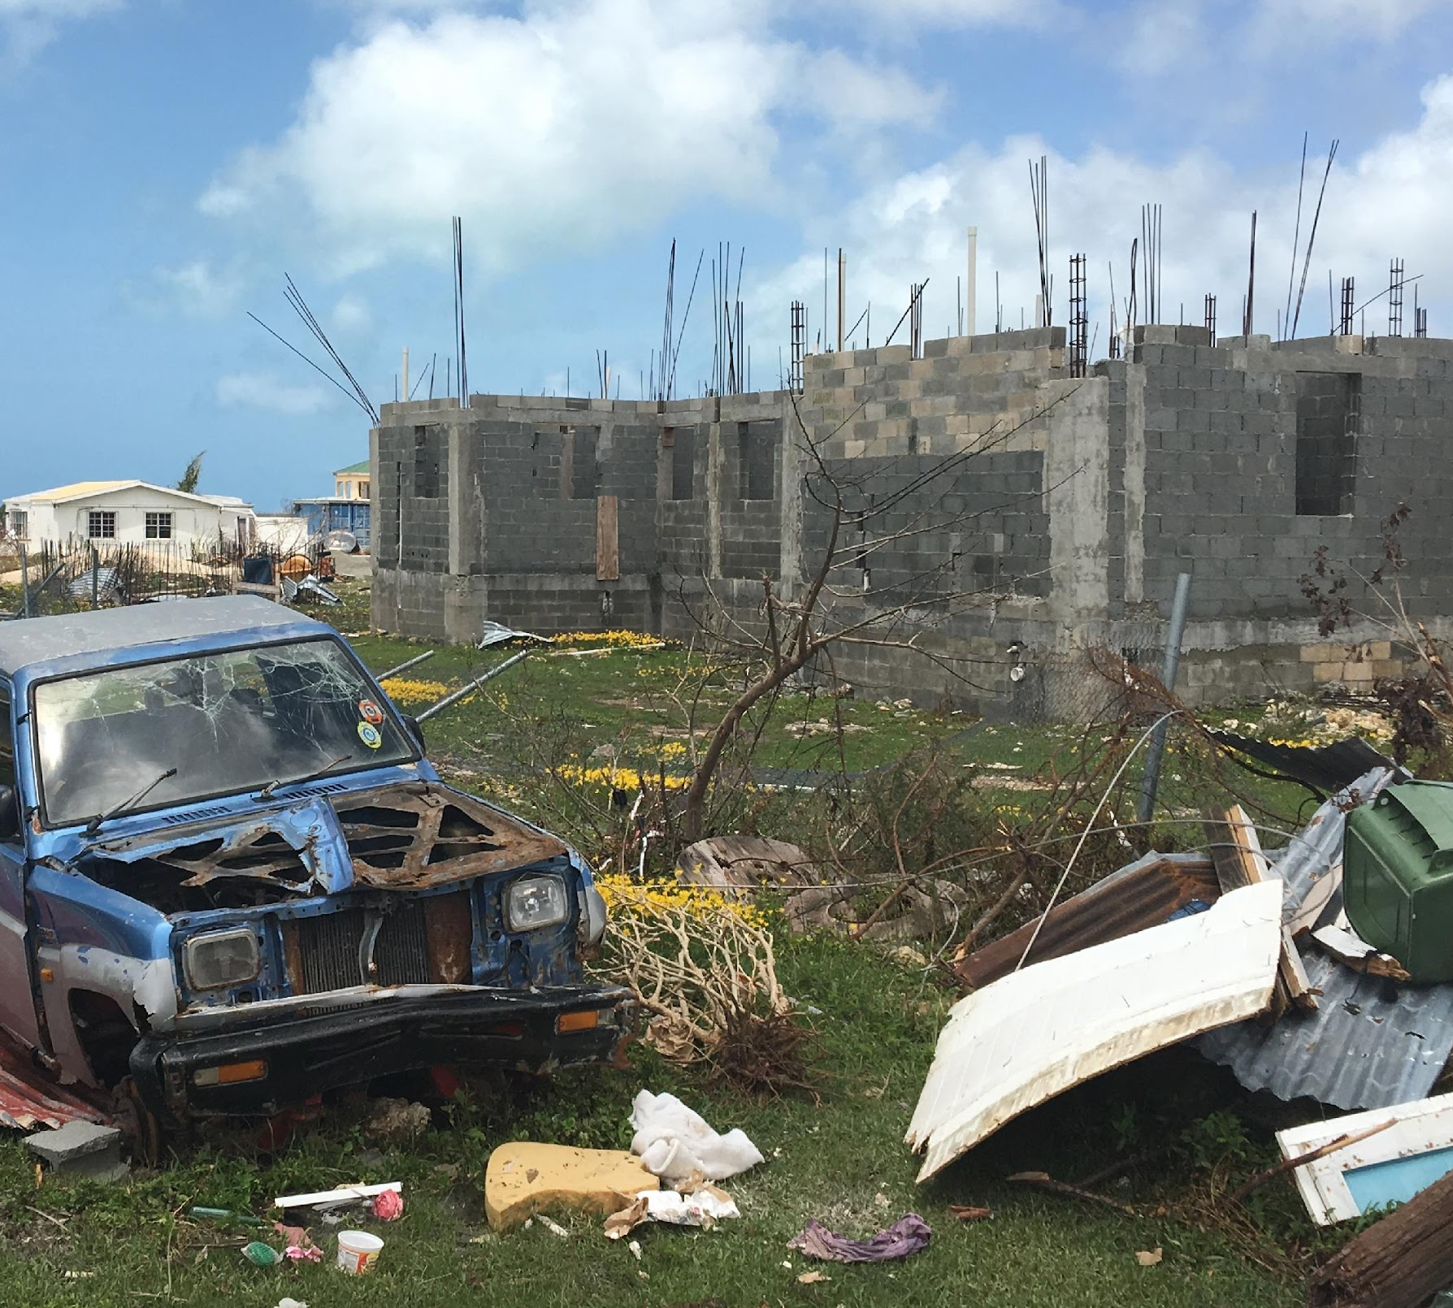
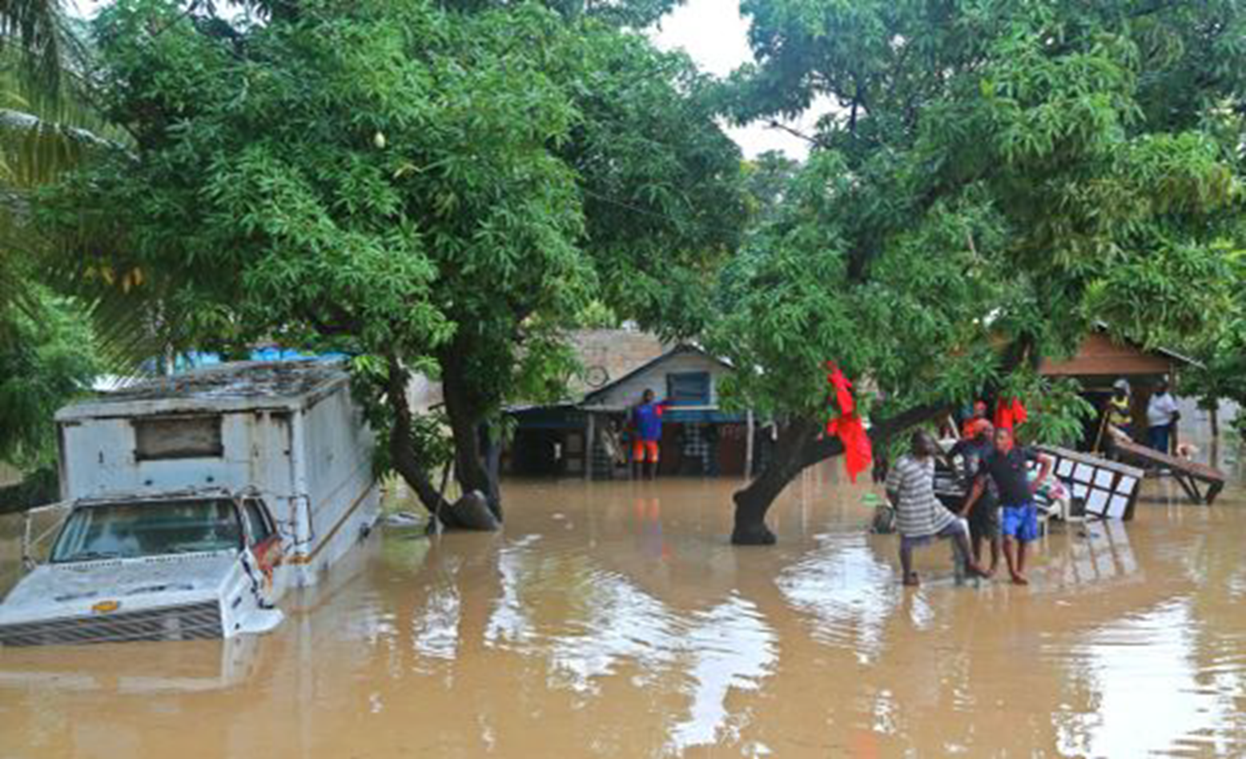
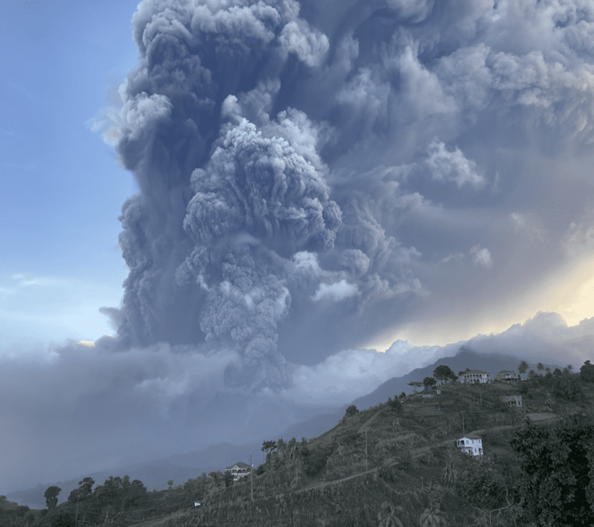
The Hazards
Notes:
Recall hazards are dangerous phenomenon/events
as compared to the disaster which is the impact of the hazard, widespread disruption of services, loss (people, property & services) and being negatively impacted beyond your local resources to cope.

Slide 8
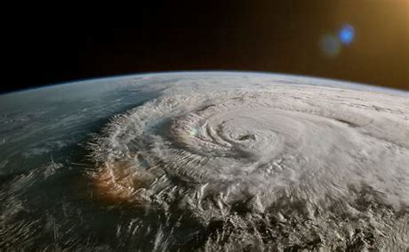
Hurricanes
Hurricanes usually form in the tropical Atlantic Ocean from June to November.
Hurricanes have sustained winds of at least 119 kilometers per hour and are accompanied by torrential rains and storm surges..
Notes:
Hurricanes are violent areas of low pressure forming in the tropical Atlantic Ocean from June to November. Hurricanes have sustained winds of at least 119 kilometers per hour and are accompanied by torrential rains and along coastal regions storm surge. Hurricanes cause millions of dollars in damage in the Caribbean every year
Pic http://www.aquaticsportsadventures.com/Articles/Nature/Hurricanes/Hurricanes.html
Can we predict hurricanes?
We do have ways to predict hurricanes but our ability to forecast and
track storm movements and landfall is still not up to scratch. Generally,
hurricanes travel across the Caribbean from the east to the north-west,
the windward coastlines of countries tend to feel the first effects.
The United States National Weather Service publishes regular updates
and forecasts on current weather systems in the Atlantic on their website:
www.nhc.noaa.gov.

Slide 9
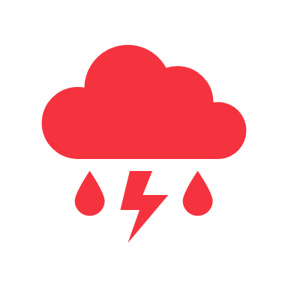
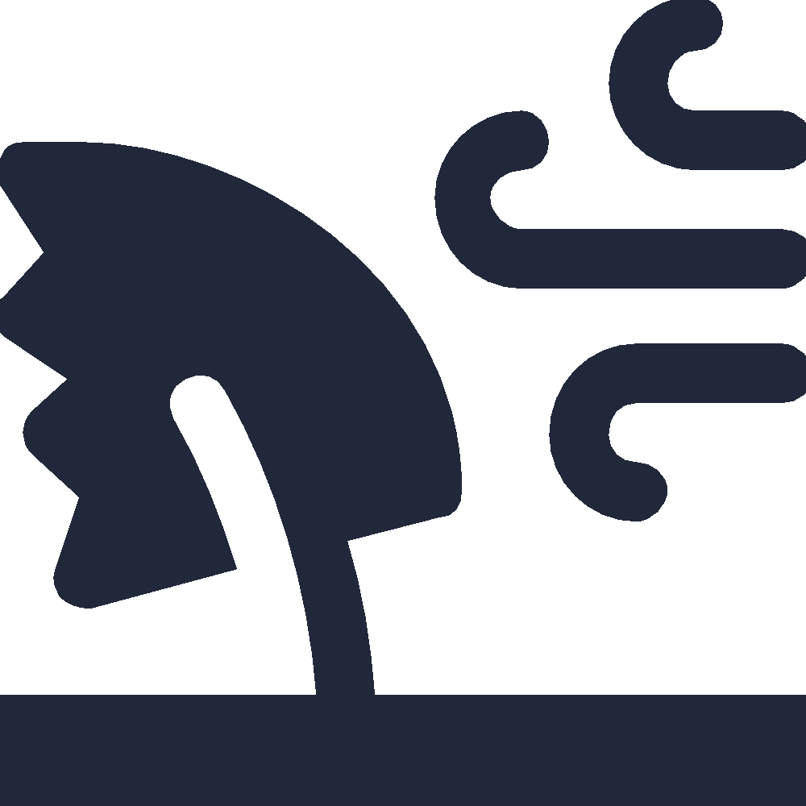
Stages of Development of A Hurricane
Tropical Disturbance
Tropical Depression
Tropical Storm
Hurricane
Notes:
A Tropical Disturbance is a discrete weather system of apparently organized convection, originating in the tropics or subtropics and existing for a period of over 24 hours. Disturbances are characteristically approximately 200-600 km in diameter.
A Tropical Depression is a tropical cyclone displaying a closed circulation pattern, in which the maximum sustained wind speed reaches up to but does not exceed 17m/s. freeicons.png
A Tropical Storm is also a tropical cyclone, but with faster winds speeds. Tropical cyclones are classified as tropical storms when the maximum sustained surface wind speed ranges between 17.5 m/s and 32.5 m/s.
A Hurricane occurs when a tropical cyclone reaches or exceeds maximum sustained wind speeds of 33 m/s.

Slide 10
Hurricanes:
Before
Know what are a hurricane watch (hurricane conditions within 48 hours) and a hurricane warning (hurricane conditions within 36 hours).
Have a disaster kit which includes a portable radio and flashlight.
Ensure you have enough nonperishable food and water stored to last you up to 2 weeks.
Floodproof your home.
Keep trees and shrubbery trimmed.

Slide 11
Hurricanes:
During The Watch &
Warning Phase
Board up all windows
Check batteries and stock up on canned food, medical supplies, and drinking water.
Bring in outside objects (e.g., garbage cans, lawn furniture, bicycles).
Listen to the advice of local officials and evacuate if told to do so.

Slide 12
Hurricanes:
During
If you are not advised to evacuate, stay indoors and away from windows.
Stay away from flood waters; never drive through them.
Be aware of the calm “eye”; the storm is not over.

Slide 13
Hurricanes:
After
Wait until an area is declared safe before entering.
Use a flashlight to inspect for damage including gas, water, and electrical lines and appliances
Stay away from downed power lines.
If you smell gas of if there is a fire, turn off the main gas valve. Switch off individual circuit breakers (or unscrew individual fuses), then switch off the main circuit breaker (or unscrew the main fuse)
Use a portable radio for information from officials.
Stay out of flood waters.

Slide 14
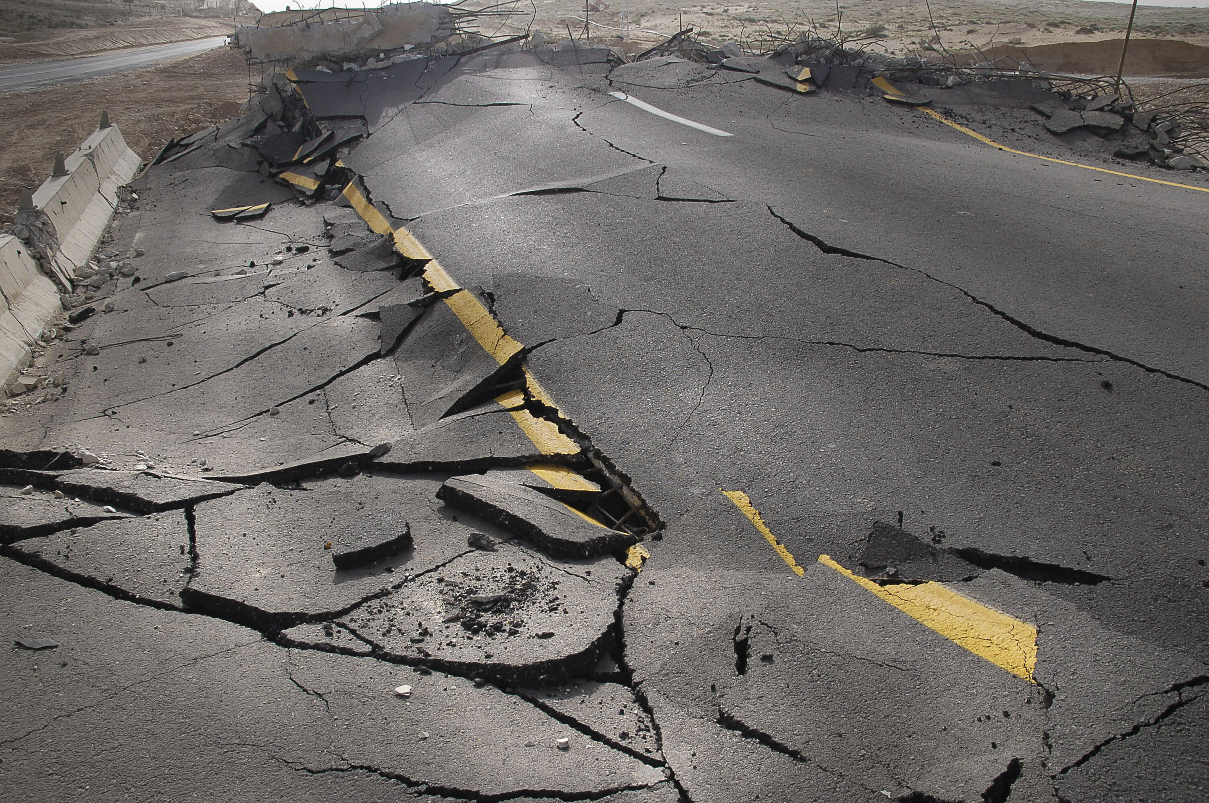
Earthquakes
Earthquakes are the vibration of the rocks of the earths surface/ These can be mild – tremors or violent.
Earthquakes are measured by magnitude M1-4 mild; M5 moderate; M6 and above severe.
Where in the earth’s crust the EQ occurs is called the epicenter. This can be shallow or deep.
its own resources.
Notes:
Earthquakes are the vibration of the rocks of the earths surface/ These can be mild – tremors or violent e.g. Haiti 2010. Earthquakes are measured by magnitude M1-4 mild; M5 moderate; M6 and above severe. Where in the earth’s crust the EQ occurs is called the epicenter. This can be shallow or deep.
Build 3 D subduction zone model or strike slip model using block of wood cut at 45 degrees. For liquefaction create a mud pie and place a stone on it then shake and watch the stone sink as the mud turns liquid.
These are plate tectonic earthquakes – large scale events
http://uwiseismic.com/General.aspx?id=85 Earthquakes are caused by the movement of plates (huge slabs of rock) making up the surface of the Earth. The region where two or more plates meet is called a plate boundary. The plates are constantly moving but this plate movement is neither smooth nor continuous, rather the plates often lock together at plate boundaries causing a build-up of energy. When the plates eventually move out of this locked position the energy that is released may be felt as an earthquake. Much of the world’s earthquake and volcanic activity takes place along plate boundaries, the area where plates meet. Countries located along plate boundaries, such as the Eastern Caribbean islands, Japan, Chile and the USA (California) are likely to experience earthquakes. At these plate boundaries the plates interact with each other in different ways; some of them slide past each other, others spread apart and others move toward each other with crumpling or with one dipping beneath the other. This last type of plate boundary is called a subduction zone which is the main type of plate interaction occurring in the Eastern Caribbean.

Slide 15
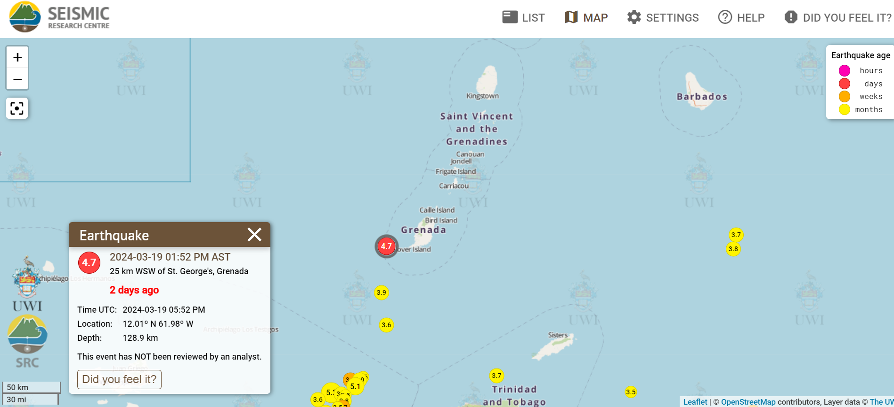
Example of An Earthquake Alert
Notes:
An example of what an earthquake alert from the UWI Seismic Research Center looks like after the occurrence of an earthquake. Mention that the alert include the magnitude and depth of the earthquake.
NB The UWI Seismic Research Centre is responsible for monitoring and conducting research on earthquakes, volcanoes and tsunamis in the English-speaking Eastern Caribbean.

Slide 16
Earthquake Facts
Earthquakes strike without warning
Earthquakes can happen at any time of the year, day or night.
Aftershocks may be as strong the original earthquake.

Slide 17
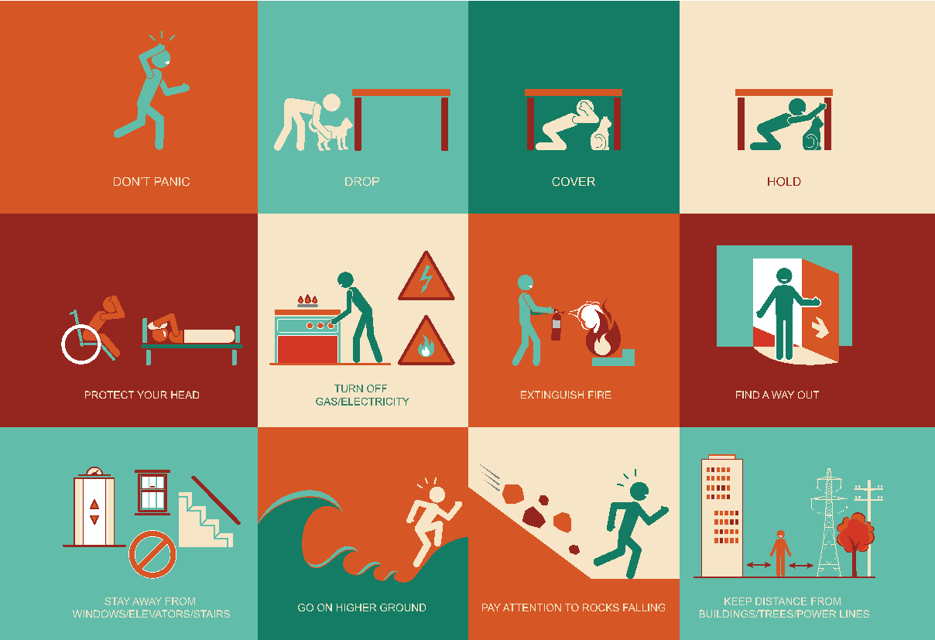
Earthquake
Safety Tips

Slide 18
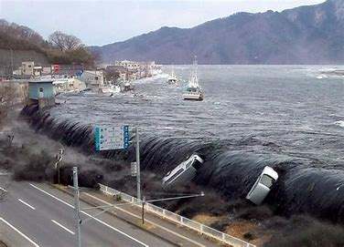
Tsunami
It is a series of travelling waves usually generated by disturbances associated with earthquakes and landslides occurring below or near the ocean floor.
Tsunamis increase in height on approaching shallow water.
Notes:
It is a series of travelling waves of extremely long length and period, usually generated by disturbances associated with earthquakes occurring below or near the ocean floor

Slide 19
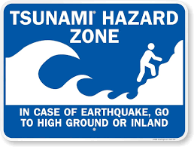
Tsunami – Warning Signs
See the water receding
Feel a strong earthquake while at the beach
Hear a loud crashing noise coming from the beach
Notes:
If you notice or experience any of these warning signs – leave the area and go to higher ground immediately

Slide 20
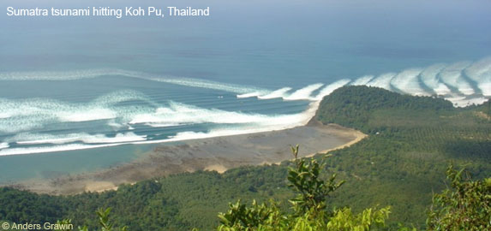
Tsunami Approaching
Multiple
Waves
Approaching Waves
Beach Water Recedes
Notes:
Note the series of waves

Slide 21
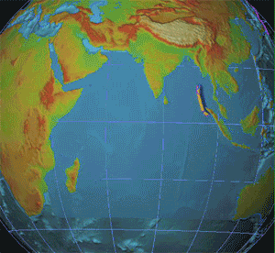
Fast Moving Waves
Notes:
Note how quickly the waves move. They can travel a large distance at a speed of 700 km/hr.

Slide 22
Tsunamis:
Before
Learn the three tsunami warning signs
Learn the difference between a tsunami warning and a tsunami watch and find out which local authority is responsible for sending out alerts.
Find out if there are any early warning systems in place.
Have a family emergency and evacuation plan in place.

Slide 23
Tsunamis:
During
If you are at the coast and you experience any of the warning signs, leave the area immediately.
Follow any evacuation orders issued by authorities and get to higher ground as soon as possible.
Take your animals with you if you can.
When at a safe place listen to the radio or TV for further updates and information.

Slide 24
Tsunamis:
After
Listen to a portable radio or TV for information.
Let friends and family know that you are safe.
If evacuated, do not return to your home unless authorities say it is safe to do so.
Be aware of any secondary effects such as contaminated water, mudflows, damaged buildings and roads etc.
Avoid any areas that may have been impacted.

Slide 25
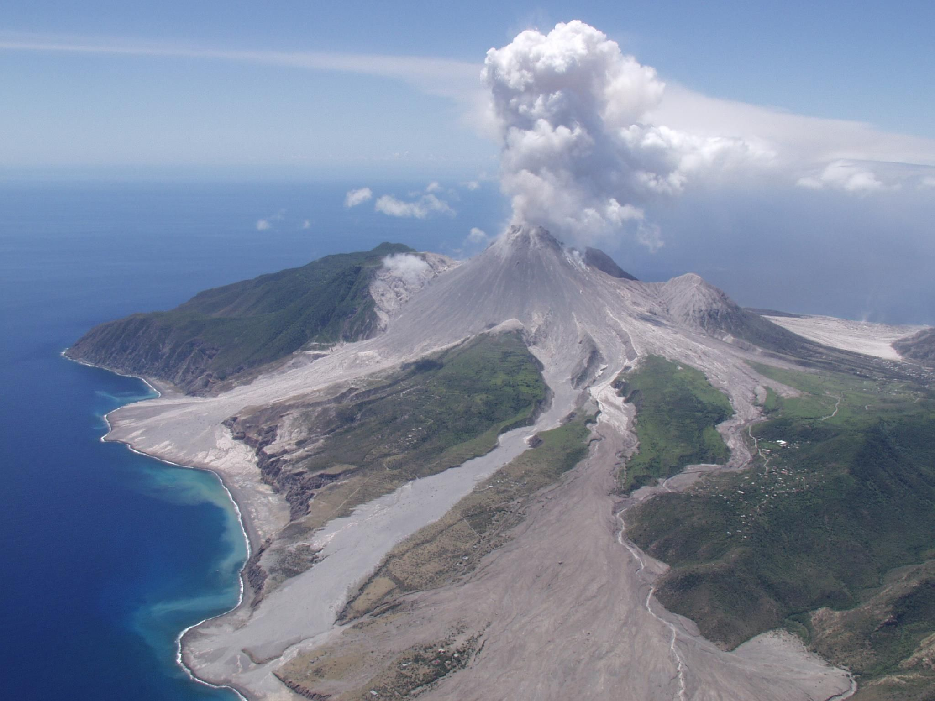
Volcanoes
Volcanoes are vents or openings in the Earth’s crust through which, gases and hot, molten rock (magma) from the interior of the Earth are released.
There are 21 known “live” (has the potential to erupt) volcanoes in the Eastern Caribbean.
Notes:
Volcanoes are vents or openings in the Earth’s crust through which, gases and hot, molten rock (magma) from the interior of the Earth are released.

Slide 26
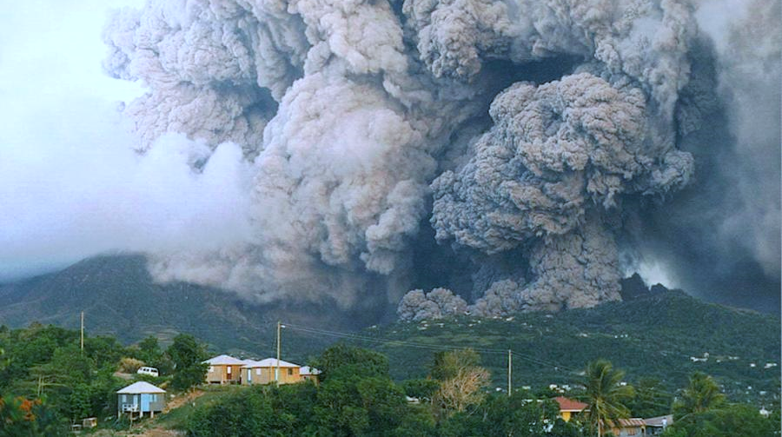
Volcanoes Effects
Vent
Pyroclastic flow
hot, fast-moving mix of ash, rocks and gas.

Slide 27
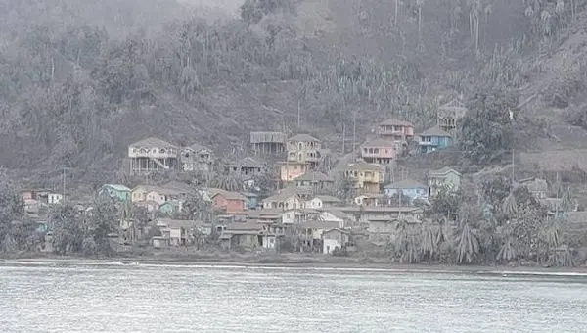
Heavy ashfall in St. Vincent 2021
Source: @Jacquiecharles

Slide 28
Volcanoes:
Before
Prepare a home evacuation or escape plan.
Keep insurance papers, important documents, and other valuables in a safe-deposit box or in a waterproof bag.
Have a family plan and choose a safe area in advance.
Have a portable radio, flashlight, and emergency supplies.
Listen to radio or TV for up-to-the-minute information from officials.

Slide 29
Keep listening to the radio or TV for information from officials.
Follow any evacuation orders issued by authorities.
Activate your family emergency plan.
If asked to stay indoors, ensure that all windows and doors are kept closed.
In the event of ashfall, seal your windows and door frames with wet rags.
Avoid low-lying areas
Bring all animals and livestock in closed shelters.
Put all machinery inside a garage or cover them with large tarps.
Cover water tanks and other deposits so they do not become contaminated by ash.
If you have to go out, use mouth guards, long sleeve clothes, protective glasses and a cap.
Volcanoes:
During

Slide 30
Volcanoes:
After
Listen to a portable radio or TV for information from officials.
Let friends and family know that you are safe.
If evacuated, do not return to your home unless authorities say it is safe to do so.
Stay out of the disaster area.
Do not use telephones except in emergencies.

Slide 31
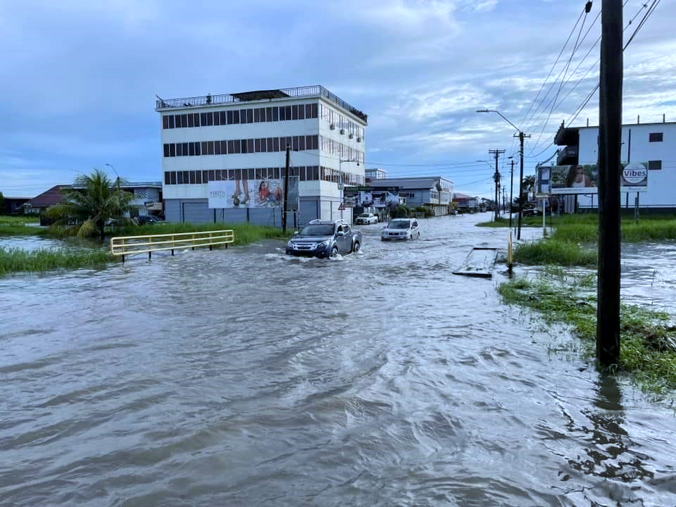
Floods
A flood is an overflow of water that submerges land that is usually dry.
It can result from various factors such as heavy rainfall or the overflow of rivers, lakes, or oceans.
Notes:
It is a series of travelling waves of extremely long length and period, usually generated by disturbances associated with earthquakes occurring below or near the ocean floor

Slide 32
Causes of Flooding
Intense (Heavy) Rainfall
Tropical Storms Erika / Tomas / Christmas Floods
Prolonged (Hours of) Rainfall
Example: Guy & Sur
Poor Drainage
Not enough for the amount water
Ponding
Low lying Anse La Raye, Green Bay Antigua, Barrackpore
Restriction / Blockage Barriers
High Tide, Clogged Drains

Slide 33
Floods:
Before
Know the flood risk and the elevation of the area.
Prepare a home flood evacuation or escape plan.
Keep insurance papers, important documents, and other valuables in a safe-deposit box or in a waterproof bag.
Have a family plan and choose a safe area in advance.
Have a portable radio, flashlight, and emergency supplies.
Stock up on sandbags.
Move furniture and other items to higher levels.
Listen to radio or TV for up-to-the-minute information from officials.

Slide 34
Floods:
During
Use telephones only for life-threatening emergencies.
Evacuate, if necessary, and follow instructions.
Do not walk or drive through flood waters.
Stay off bridges where water is covering them.
Heed barricades blocking roads.
Keep away from waterways during heavy rain. If you are in a valley area and hear a warning, get to high ground immediately.
Keep out of storm drains and gullies.

Slide 35
Floods:
After
Listen to a portable radio for information from officials.
Boil drinking water before using (rolling boil for 10 minutes).
Use a flashlight to check for damage including gas, water, and electrical lines and appliances.
If you smell gas or if there is a fire, turn off the main gas valve. Switch off individual circuit breakers (or unscrew individual fuses), then switch off the main circuit breaker (or unscrew the main fuse).
Stay out of the disaster area.

Slide 36
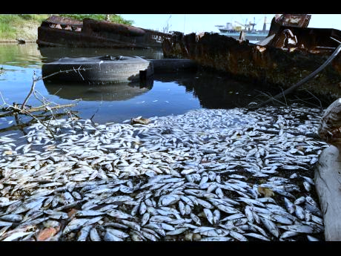
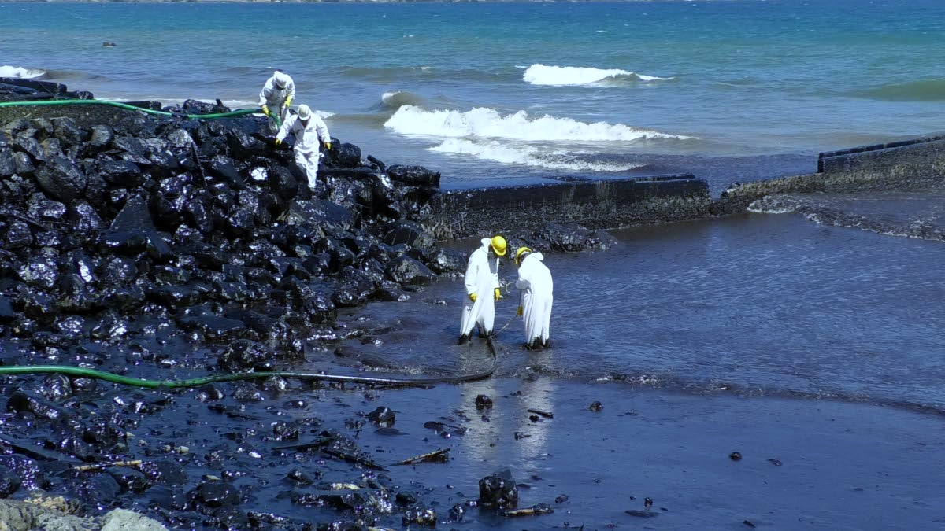
Man-made Hazards
Fish kill in Jamaica due to pollutants
Oil spill in Tobago

Slide 37
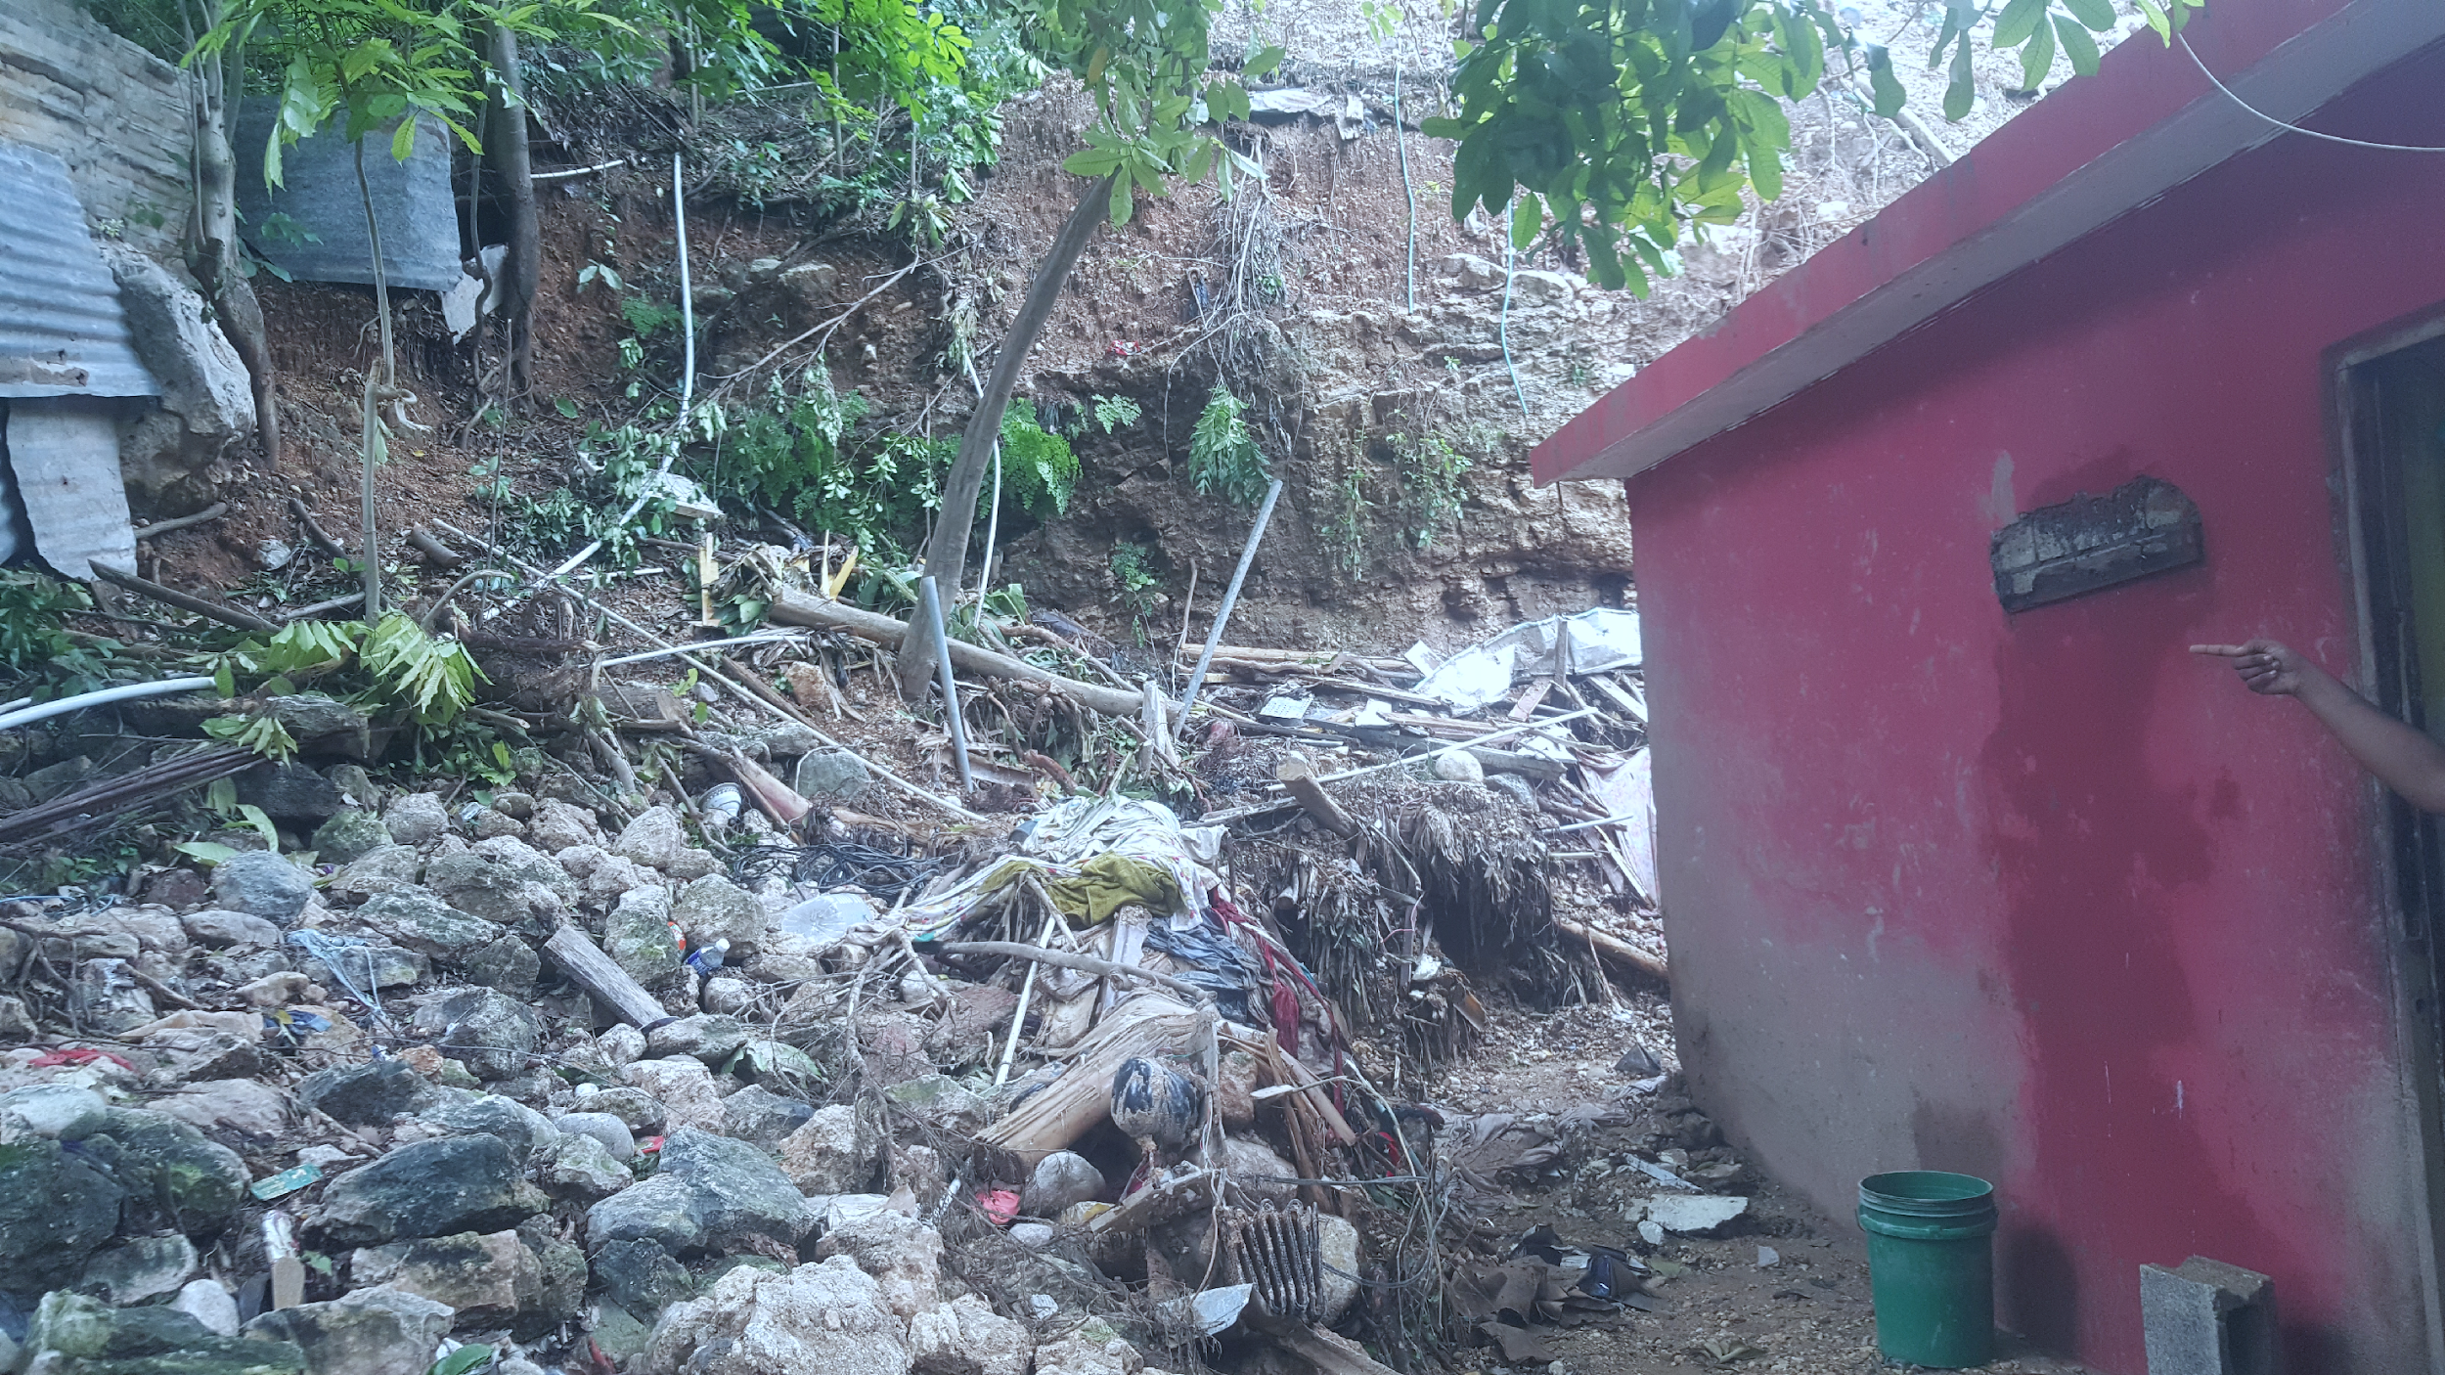
What Is
Vulnerability?
Conditions that increase risk to hazard impacts.
Notes:
The conditions determined by physical, social, economic and environmental factors or processes which increase the susceptibility of an individual, a community, assets or systems to the impacts of hazards. Annotation: For positive factors which increase the ability of people to cope with hazards, see also the definitions of “Capacity” and “Coping capacity”. UNISDR
Photo http://www.sofreshandsogreen.com/wp-content/uploads/2010/10/st-lucia-flood-thumb-2.jpg

Slide 38
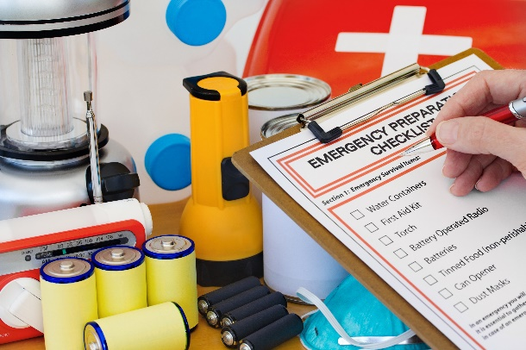
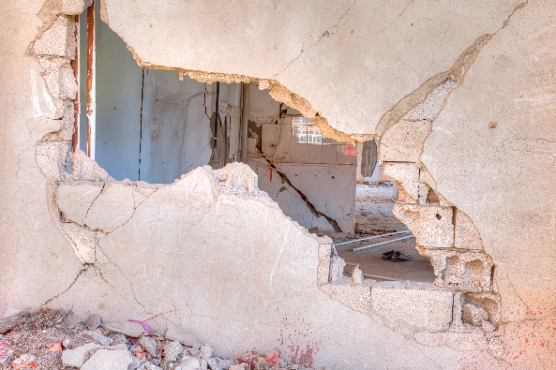
Types of Vulnerability
Social Vulnerability
Environmental Vulnerability
Economic Vulnerability
Physical Vulnerability
Notes:
The conditions determined by physical, social, economic and environmental factors or processes which increase the susceptibility of an individual, a community, assets or systems to the impacts of hazards. Annotation: For positive factors which increase the ability of people to cope with hazards, see also the definitions of “Capacity” and “Coping capacity”.
What makes us vulnerable?
Physical Vulnerability:
1) Location of our homes slopes – volcanoes/landslides, flood plains or coastal –storm surge; homes can generally built to reduce the risk of these (except perhaps volcanoes)
2) Construction standard – against earthquakes and hurricanes reinforce walls and roof – detailing. Against floods – raise house
Social Vulnerability:
Poor Health and disabilities - mobility, ability to earn
Customs and beliefs
Economic Vulnerability: economic opportunity and state – poverty, many dependents.
Environmental Vulnerability: poor farming practices, deforestation activities.

Slide 39
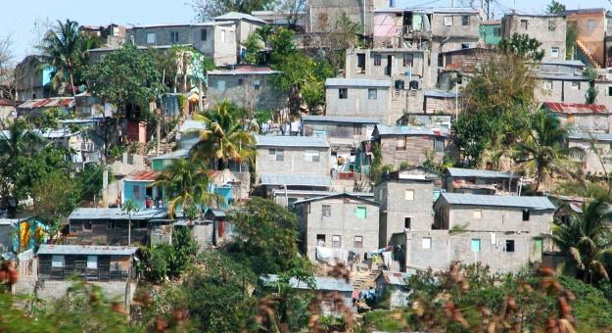
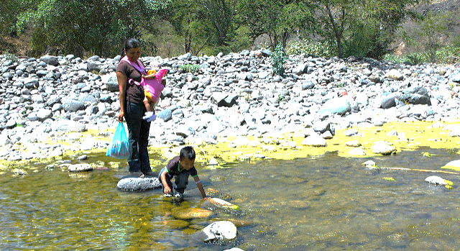
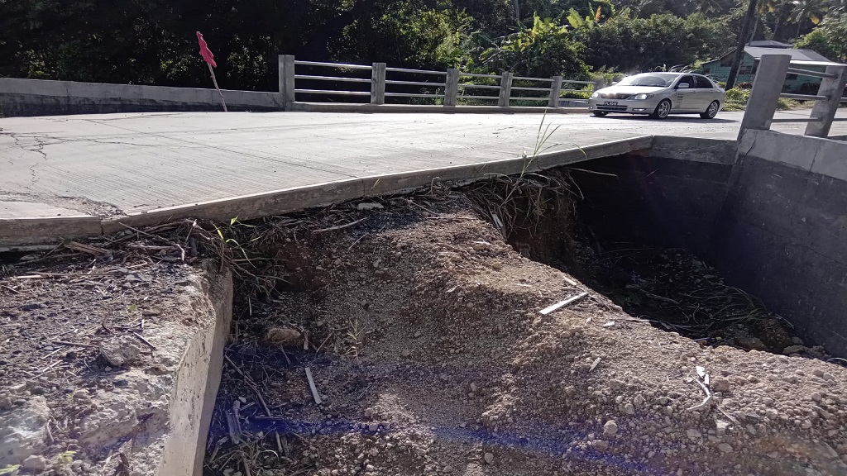
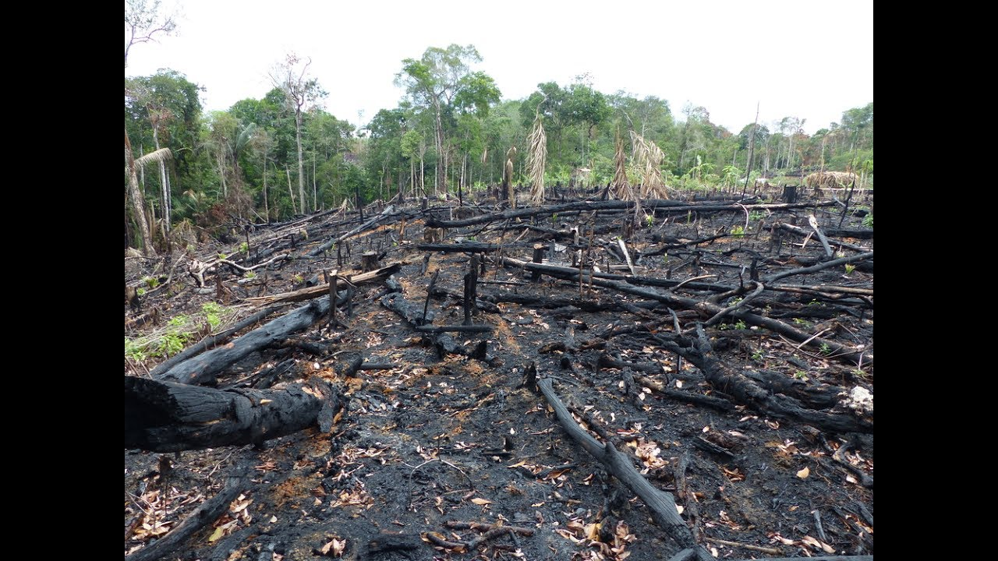

Slide 40
Think about your community and identify the different types of vulnerabilities and the hazards that can affect your community.
Make a list of these.
Activity
Note: You can also reference Unit 1 on page 3 of the CDRT Workbook

Slide 41
Disaster Impacts On Community Resources
 | Effects
Transportation | ■ Inability to get emergency service personnel into the affected area.  Inability to transport victims away from the area.
Electrical | ■ Increased risk of fire and electrical shock.  Possible disruption to transportation system if downed lines are across roads.
Telephone | ■ Lost contact between victims, service providers, and family members.  System overload due to calls from or to friends or relatives.
Water | ■ Disruption of service to homes, businesses, and medical providers.  Inadequate water supply for firefighting.  Increased risk to public health if there is damage to the water supply or if it becomes contaminated.
Livelihoods | ■ Loss of capital  Reduced ability to make an income.  Disruption of services from businesses.  Inability to reach markets.

Slide 42
Disaster Impacts On Community Resources
Type Of Damage | Effect On Disaster Services
Road | ■ Inability to assess damage accurately.  Ambulances prevented from reaching victims and/or victims prevented from reaching emergency medical services.  Police prevented from reaching areas of civil unrest.  Fire departments prevented from getting to fires.  Flow of needed supplies is interrupted.
Structural | ■ Damaged hospitals unable to receive patients.  Increased risk of injury from falling debris.
Disrupted Communication | ■ Victims unable to call for help.  Coordination of services is hampered.
Fuel Line Damage | ■ Fire and paramedic services overburdened.
Disrupted Water Service | ■ Firefighting capabilities restricted.  Medical facilities hampered.

Slide 43
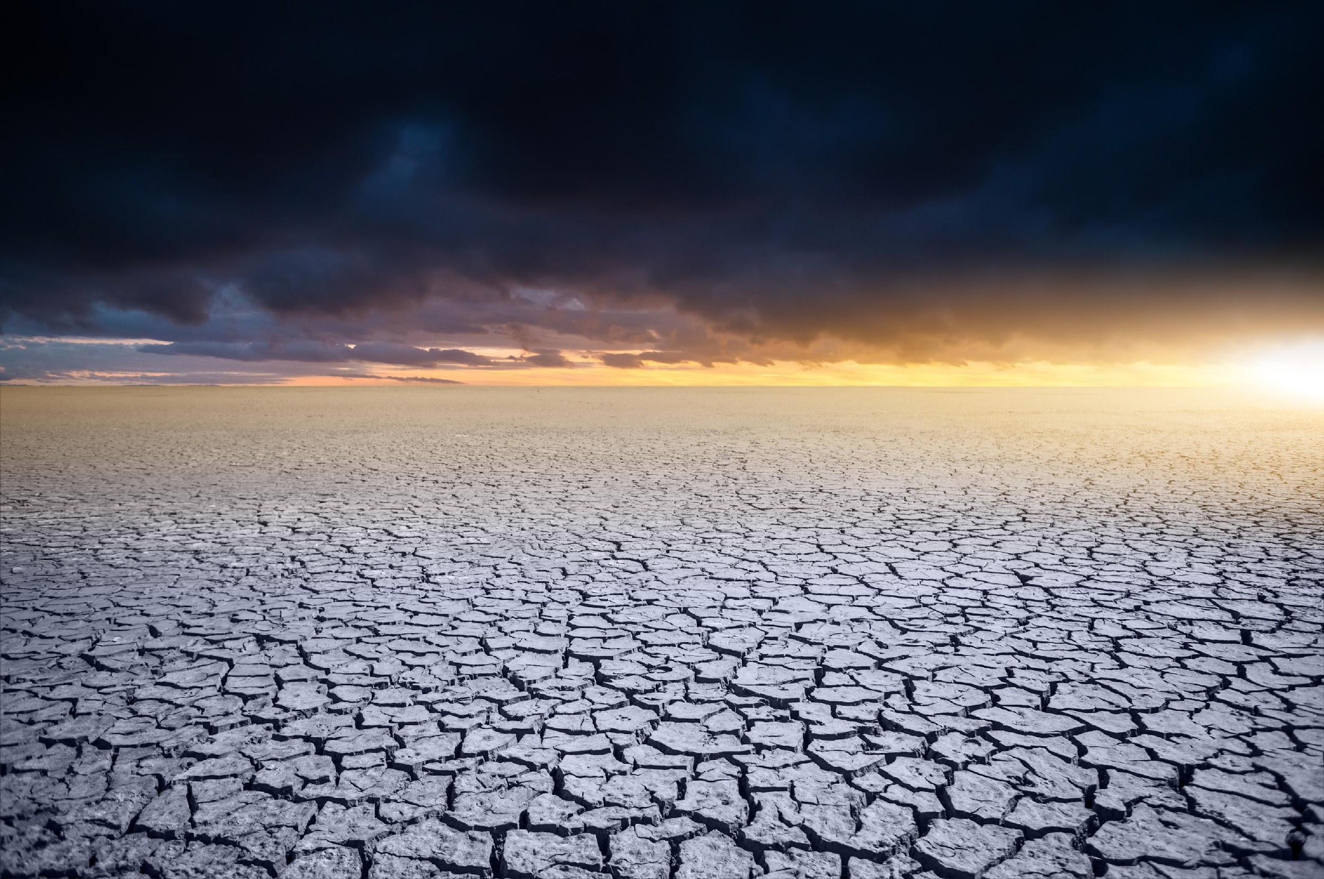
What Is
Climate Change?
Climate change is a long-term change in the average weather patterns that have come to define local, regional and global climates.
Notes:
These changes come as a result of the burning of fossil fuels, deforestation and other harmful practices that increase the concentration of greenhouse gases (carbon dioxide, methane and nitrous oxide etc.) in the atmosphere.

Slide 44
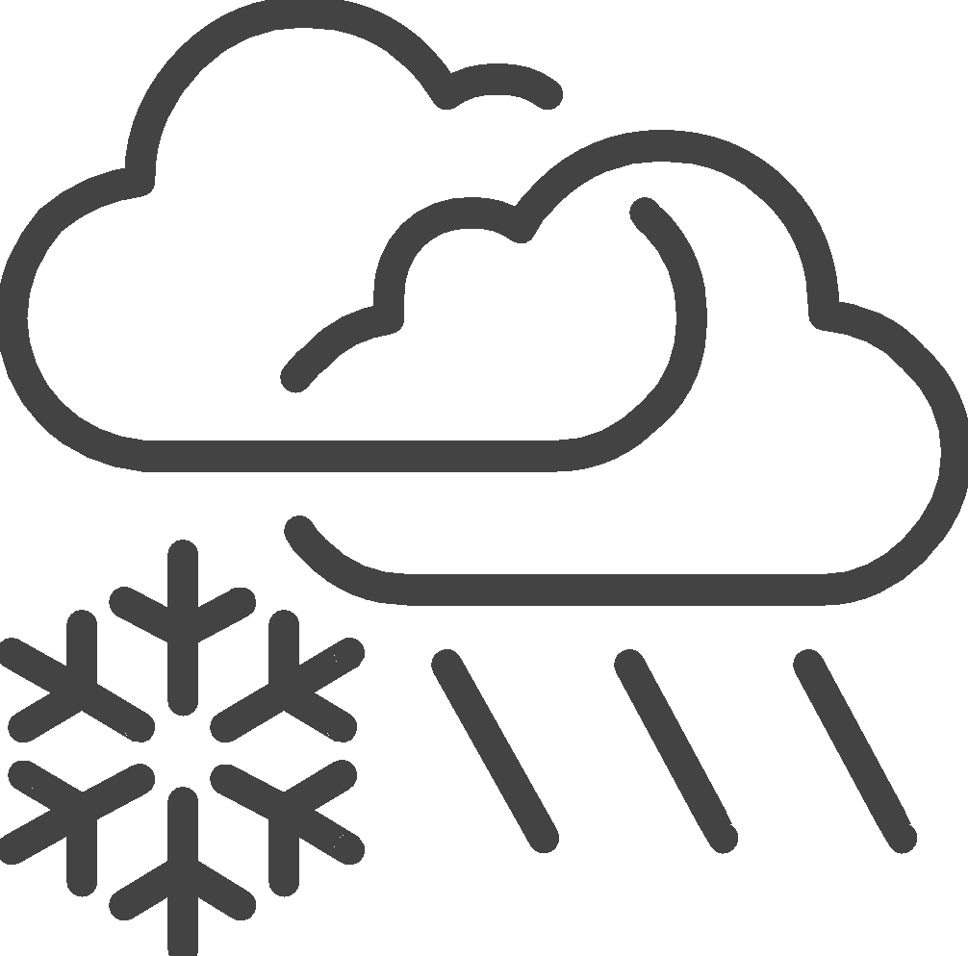
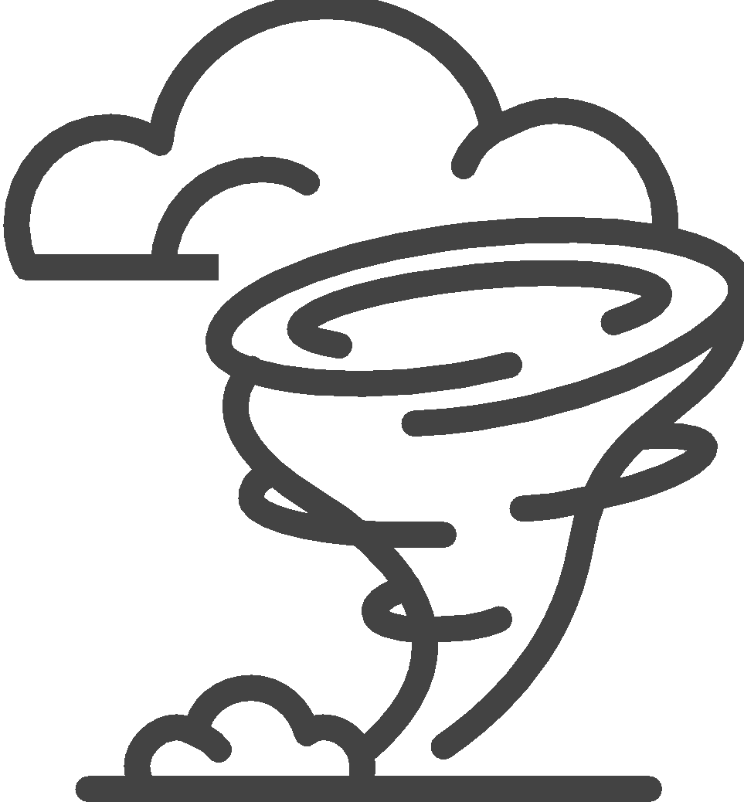
Effects of
Climate Change
Increase In Temperature
Changes In Precipitation Patterns
More Droughts
& Heat Waves
Stronger And More Intense Hurricanes
Sea Level Rise
Increase Ocean Acidification

Slide 45
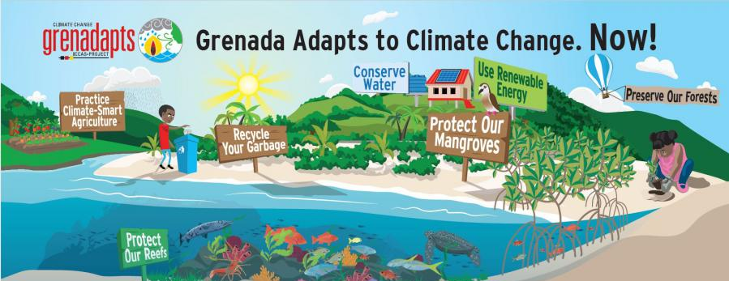
Climate change adaptation involves reducing the risk and vulnerabilities by putting measures in place or by building the capacity of cities, communities and individuals to cope with adverse climate impacts.
Climate Change
Adaptation

Slide 46
Nature-Based Solutions (NBS) is used to tackle climate change impacts and make communities stronger.
Nature-Based Solutions
Nature-Based Solutions uses nature, like plants and trees, to shield communities from disasters. For example, growing mangroves helps protect against storms.
‘Green infrastructure'—making strong things (like buildings) that work with nature. For instance, using special pavements and green roofs to stop floods in cities.
‘Agroecology’ is supported, which means food is grown by working with nature. It's like making friends with the environment. For example, planting trees with crops to make farming better.
IFRC believes communities can lead the way. We help people take care of nature around them. For example, communities planting more trees together to keep their area healthy.

Slide 47
?
?
?
Let’s Hear From You!
Do you think the implementation of Nature-Based Solution Activities can enhance Livelihoods in your country?
Notes:
These changes come as a result of the burning of fossil fuels, deforestation and other harmful practices that increase the concentration of greenhouse gases (carbon dioxide, methane and nitrous oxide etc.) in the atmosphere.

Slide 48
Volunteer, Donate, Join Us In Partnership, or share our appeals and stories on social media. Find out more about IFRC and learn how to contact your National Red Cross or Red Crescent Society, at www.ifrc.org.
Get Involved
There are many ways of becoming a part of the world’s largest humanitarian network
To stay informed about Caribbean disaster response activities or to access additional information on available trainings, training materials, research and information management tools, visit: www.cadrim.org.
: CADRIM.IFRC
: @cadrim_ifrc
: @CADRIM_IFRC

