Slide 1
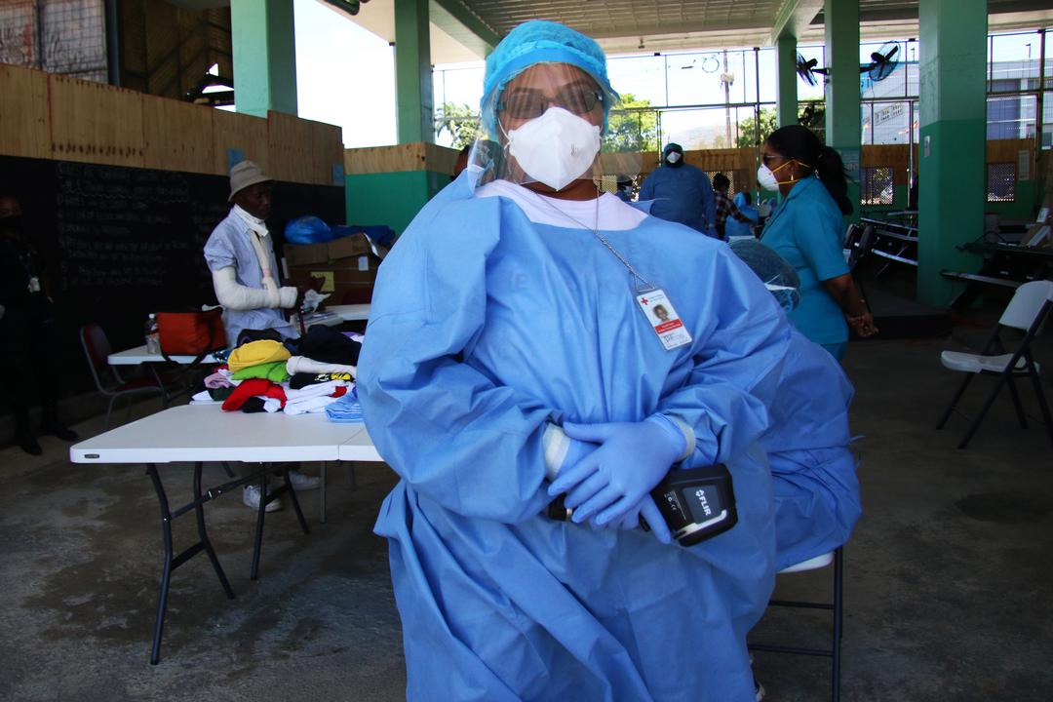


CDRTs & Health in Emergencies
For Community Response Teams

Slide 2
Objectives
Learn The Effects of Disasters on Health & Vulnerable Groups
Identify Common Diseases In Emergencies
Understand CDRT’s Role In Risk Assessment Activities
Obtain Information on Preventive measures For Communicable Diseases
Life-threatening Conditions- Airway Obstruction, Controlling Bleeding and Treating Shock
Triage

Slide 3
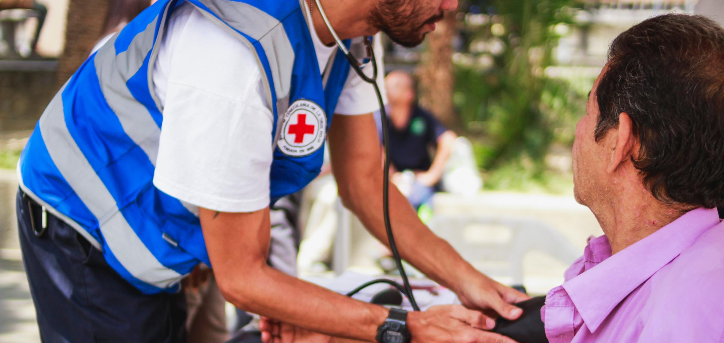
What Is Health?
“Health is a state of complete physical, psychological, and social well-being and not simply the absence of disease or infirmity.”
(World Health Organization, 1948)

Slide 4
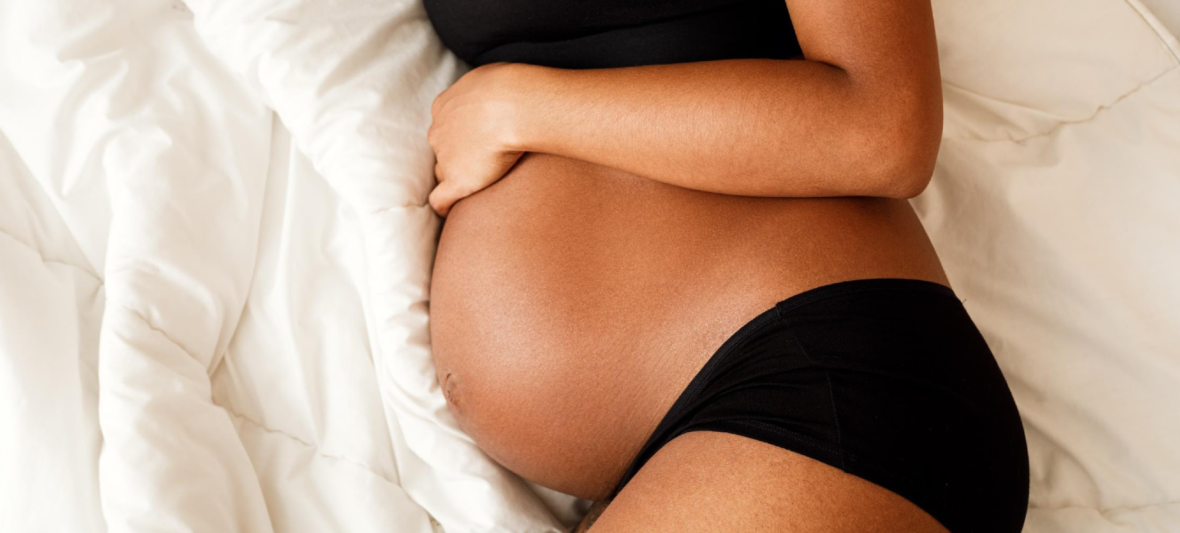


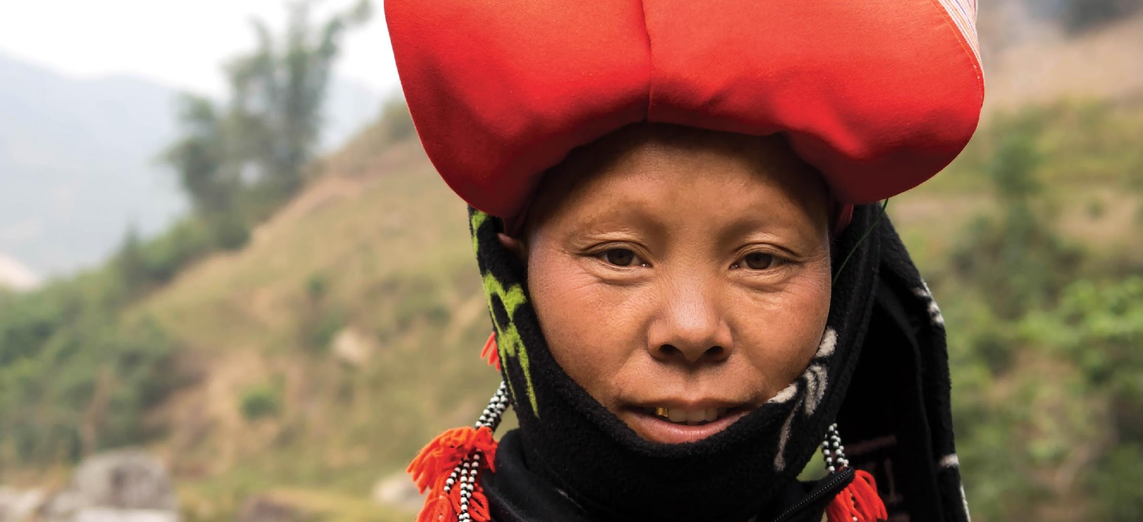
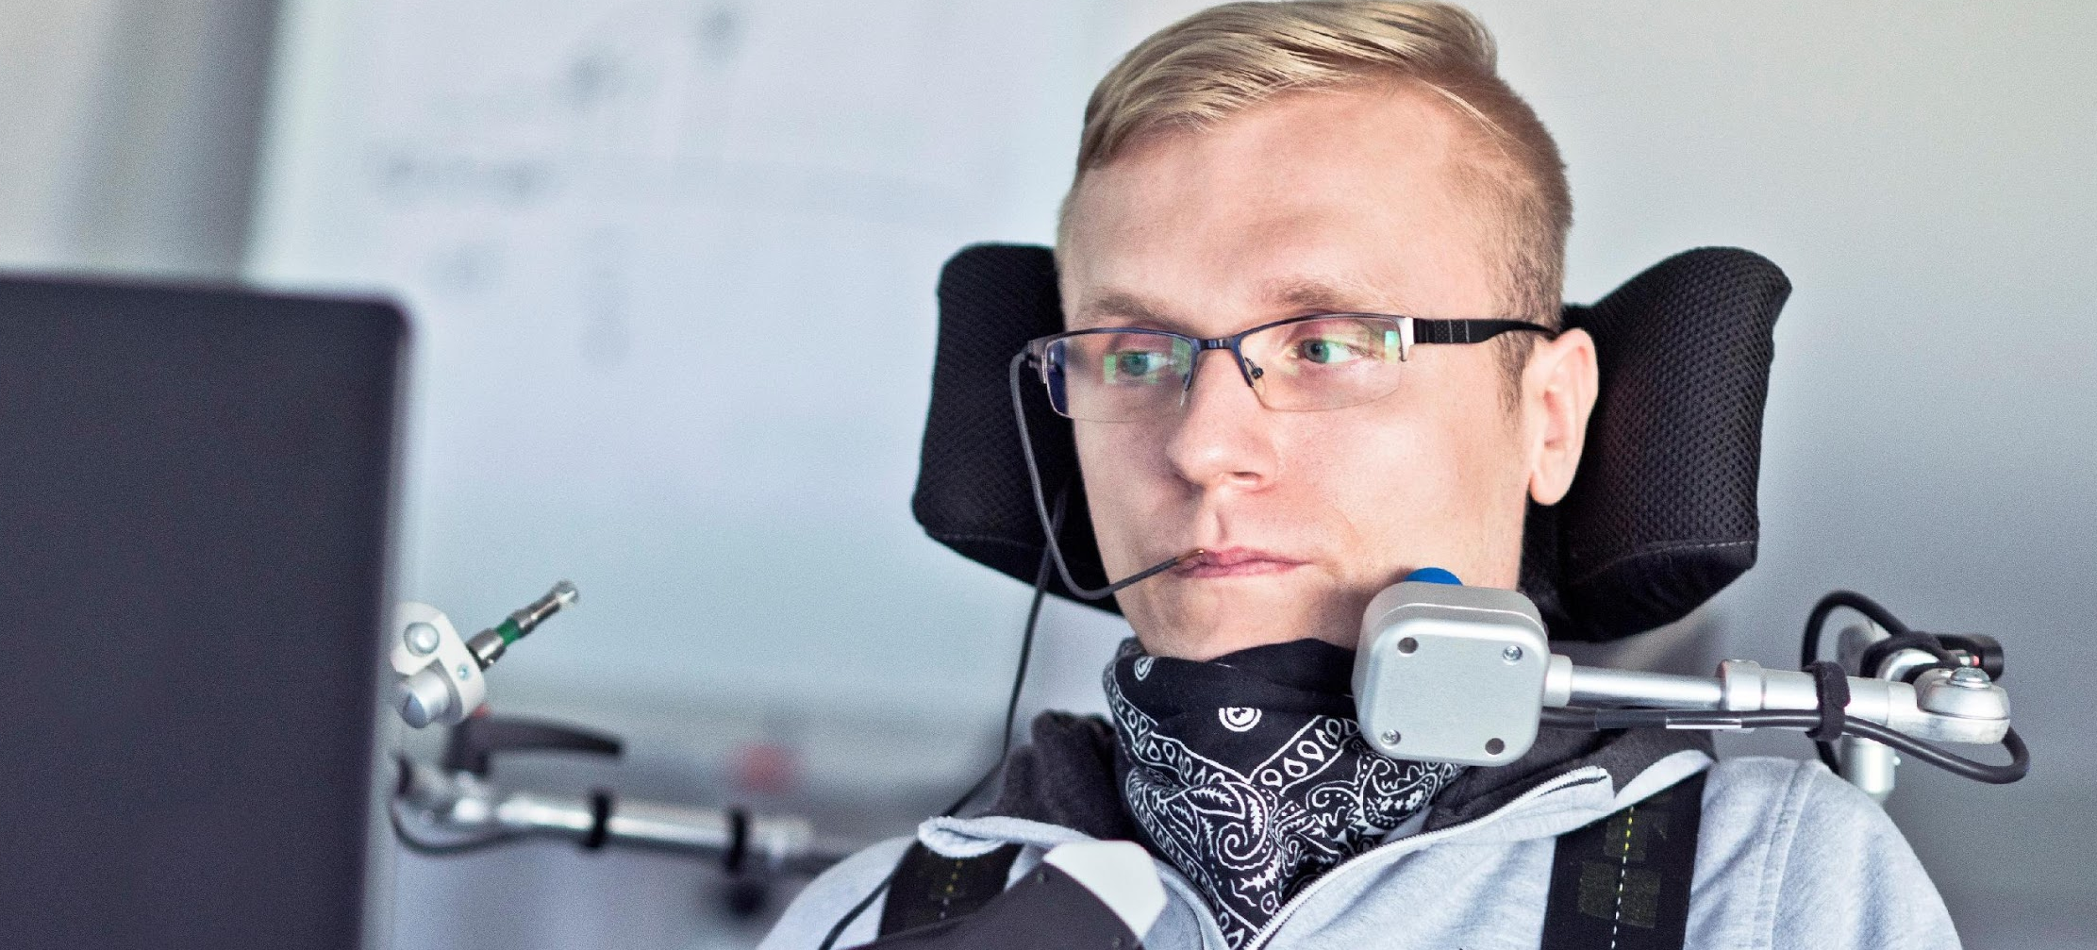
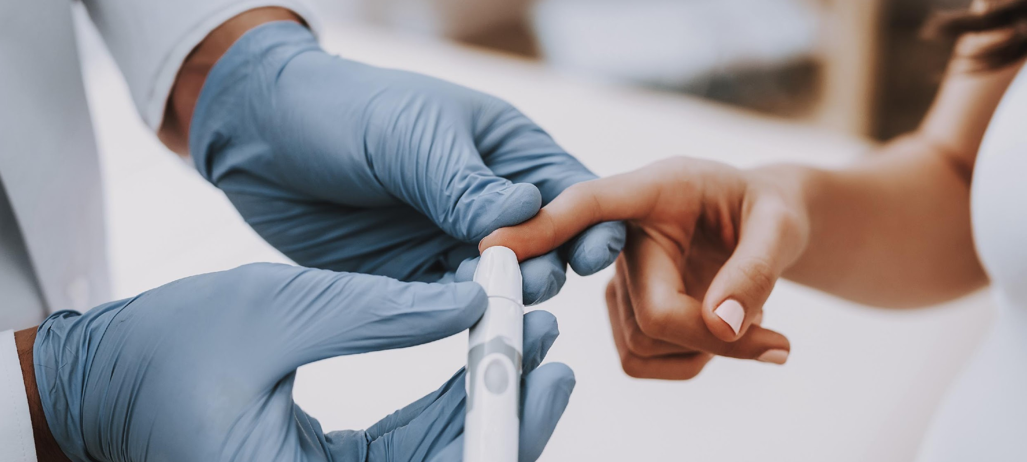
Vulnerable Groups
To Consider
Pregnant & Lactating Women (PLW’s)
Children Under
5 Years
Older Persons
Minority Ethnic Groups (Information Dissemination
& Language Barriers)
Persons With
Disabilities
People Living With A Chronic Disease Diabetes, HIV/AIDS

Slide 5
Effects Of
Disasters On Health
Communicable Diseases
& Disease Epidemics
Shelter & Protection
Poor Nutrition
Poor Access
To Health Care
Mental Health

Slide 6
What Are We
Looking For?
Who
What
Who is most affected?
What are some of the health concerns?
Where
How
Where are most affected persons located?
Who is most affected?
Notes:
Decision makers need adequate, sufficiently accurate and reliable information at the appropriate time to enable them to make informed decisions – both at strategic and operational levels

Slide 7




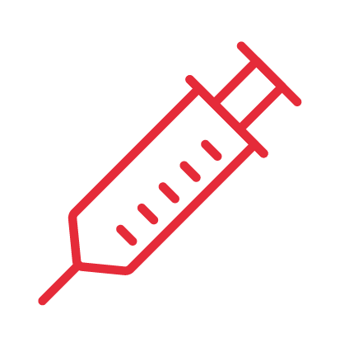


Risk Factors
Poor Access To Safe Water & Adequate Food
Poor Sanitation
& Hygiene Practices
Overcrowding
Seasonal Changes
Displaced Populations
Lack Of Access To Treatment
Underlying Conditions
Low Levels Of Immunity
(Have these diseases been in the
community before or are they new?)

Slide 8




CDRT’s Role In Helping
Manage An Epidemic
Assisting with
Community Preparedness
Being aware of outbreaks &
contacting relevant health officials
Responding appropriately and assisting with the mobilization of volunteers & education of the community
Evaluation
Notes:
It is important that volunteers and community members prepare for certain epidemic outbreaks in their community. In doing so CDRT members need to include in the community disaster plans ways to deal with epidemic outbreaks within the community and household levels.

Slide 9


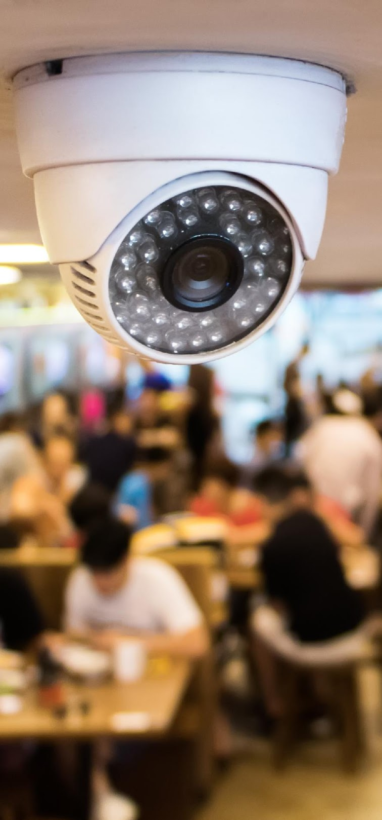
Assessing Risk For
Potential Health Threats
Assisting with
Community Preparedness
Community Risk
Assessment
Rapid
Assessment
Surveillance

Slide 10
Surveillance
Of Diseases After Disasters
After some disasters, the ability of the health sector to respond to diseases is overwhelmed.
In select cases Red Cross volunteers may be called upon to assist local health authorities in collecting data about a specific disease and its spread.
Even where Red Cross volunteers do not have a formal surveillance role it is important to report symptoms that you see to relevant field officers. (e.g. many cases of diarrhea in one shelter.)
All people who report illness should be referred to the nearest health clinic.

Slide 11
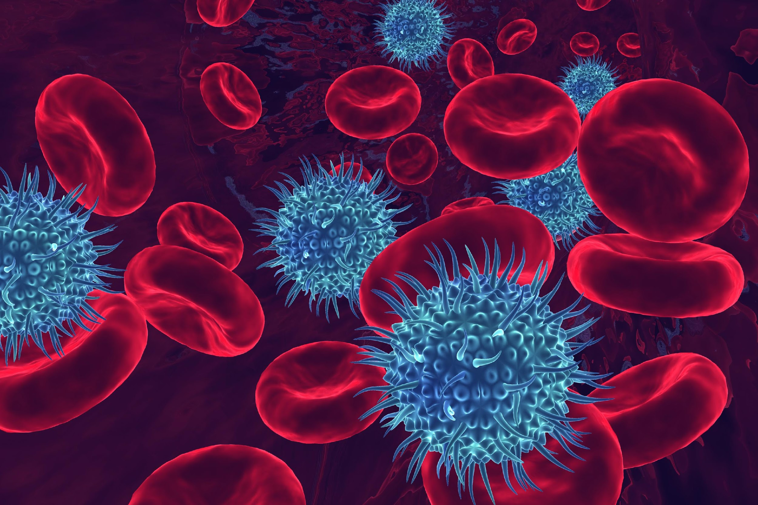
Diseases In
Emergencies

Slide 12
Noncommunicable Diseases
Health conditions which cannot be spread from person to person.
They require ongoing treatment.
Types of Noncommunicable Diseases
Cardiovascular diseases
Diabetes
Cancer
Chronic lung diseases.
Noncommunicable Diseases Statistics
1500 – 3000 people with hypertension.
500 – 2000 people with diabetes.
3 - 8 acute heart attacks over a normal 90-day period.
4 – 16 acute strokes over a normal 90-day period.

Slide 13
Impacts of Disasters on Persons with NCDs
The health of persons with NCDs can deteriorate as a result of the following:
Direct physical injury.
Loss of access to prescribed medication
Lack of water and food can add to physical and psychological stress
Lack of access to health services

Slide 14
How to Prepare?
Include a backup supply of prescribed medication in your disaster kit.
Store appropriate non-perishable foods in your disaster kit.
Include instructions for emergency care in your family emergency plan.

Slide 15
Communicable Diseases
Communicable diseases spread from one person to another or from an animal to a person.
The spread often happens via airborne viruses or bacteria, but also through blood or other bodily fluid.
The terms infectious and contagious are also used to describe communicable disease
Types of Communicable Diseases
Air-Bourne
Water-Bourne
Direct Contact
Vector Bourne

Slide 16

Human
To Human
Direct
Sneezing
Coughing
Touching
Mother to Unborn Baby
Indirect
Touching something that’s Infected
Drinking after someone with an infectious disease

Slide 17

Animal
To Human
Direct
Sneezing
Coughing
Touching
Mother to Unborn Baby
Indirect
Touching something that’s Infected
Drinking after someone with an infectious disease
Direct
Eating Animals
Bugs Biting You
Getting Scratched
Getting Stung
Indirect
Petting Animals then touching your eyes, nose or mouth
Drinking water after an infected Animal

Slide 18

Plant
To Human
Direct
Eating Unwashed Fruits & Vegetables
Touching Fruits then putting your fingers in your eyes or mouth

Slide 19
Air Bourne
Germs spread through the air.
(E.g. When someone sneezes or coughs.)
Examples of Common Air Borne Diseases
Influenza like illnesses (H1N1 & Swine Flu)
Measles
Whooping Cough
Chicken Pox
Tuberculosis
Pneumonia & Other Respiratory Diseases

Slide 20
Water Bourne
Water contaminated with germs can cause illness on ingestion or skin contact.
Examples of Common Water Borne Diseases
Gastroenteritis
Cholera
Infection with Water Borne diseases most often result
in Diarrhea

Slide 21
Diarrhea
Diarrhea is defined as the passage of three or more loose or liquid stools per day (or more frequent passage than is normal for the individual).
Frequent passing of formed stools is not diarrhea, nor is the passing of loose, "pasty" stools by breastfed babies.
The most severe threat posed by diarrhea is dehydration. During a diarrheal episode, water and electrolytes are lost through liquid stools, vomit, sweat, urine and breathing. Dehydration occurs when these losses are not replaced.

Slide 22
Other Modes Of Diarrhoeal Disease Transmission
Water Borne
Food Borne
Easy to spread in overcrowded conditions with poor access to sanitation and safe water, poor hygiene

Slide 23
Vector Bourne
A vector is a disease-carrying agent, normally an insect or animal and vector-borne diseases are a major cause of sickness and death in many disaster situations.
Main Vectors For Diseases: Mosquitos
DAYTIME BITING
Aedes
Chikungunya
Dengue Fever
Yellow Fever
Zika
NIGHT-TIME BITING
Anopheles
Malaria
Culex
West Nile Fever

Slide 24

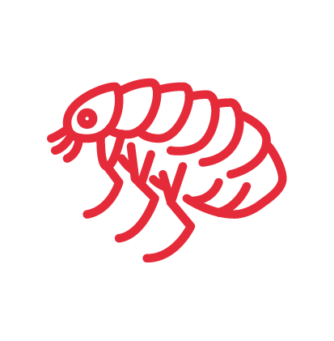


Main Vectors
For Disease Transmission
Ticks
Lyme Disease
Rickettsia
Bedbugs & Fleas
West Nile Fever
Rats & Mice (Urine Contact)
Leptospirosis
Rickettsia
Flies
West Nile Fever

Slide 25

Risk Assessment
Activity
Notes:
You will need: pens or markers, sticky notes and a large space
Participants walk around the room in different directions interacting with each other, placing stickers on colleagues backs or different symptoms and persons try to diagnose and guess the disease.
Stop after 90 seconds.

Slide 26

Preventative
Measures

Slide 27






Proper Sanitation Measures
Ensure safe excreta disposal
(latrine construction when necessary)
Proper solid waste collection and disposal
Burial of corpses and destruction of animal carcasses
Community education and mobilization to reduce standing water where mosquitoes are likely to breed
Wash fruits and vegetables before eating
Do not eat raw or undercooked meat or eggs

Slide 28
Aedes Mosquito: Evidence Is Important
Activity
Evidence
Reduces Mosquitos
& Diseases
Reduces
Mosquitos
Limited or
No Effect
Covering Water Containers
Larvicide As Part Of Government- Led Strategy
Screening In Homes(window & Door Screens)
Clean-up Campaigns To Reduce Breeding Sites
Repellents With DEET Picardin Or Lemon & Eucalyptus Oil
Bed Nets
Mosquito Coils
Bug Sprays(knockdown Sprays Like BOP)

Slide 29

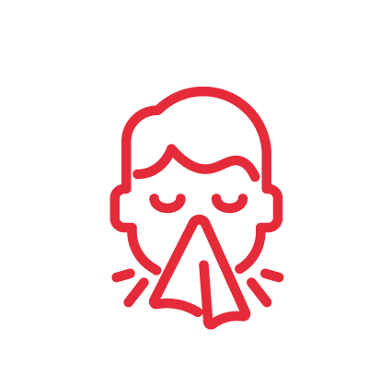

Personal Hygiene Measures
Wash your hands thoroughly and regularly using soap and water or an alcohol base sanitizer
Cover your mouth with a tissue when you sneeze or cough
Proper daily dental hygiene

Slide 30
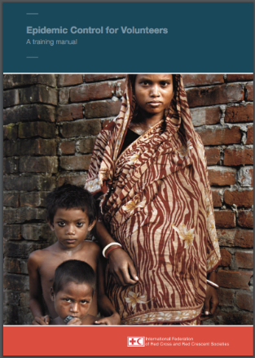
ECV: Epidemic Control For Volunteers
Training manual
Disease tools
Action tools
Community Message Tools
Access the revised toolkit online at: http://ifrcgo.org/ecv-toolkit/

Slide 31
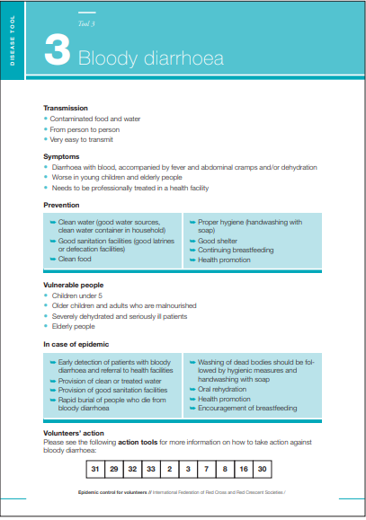
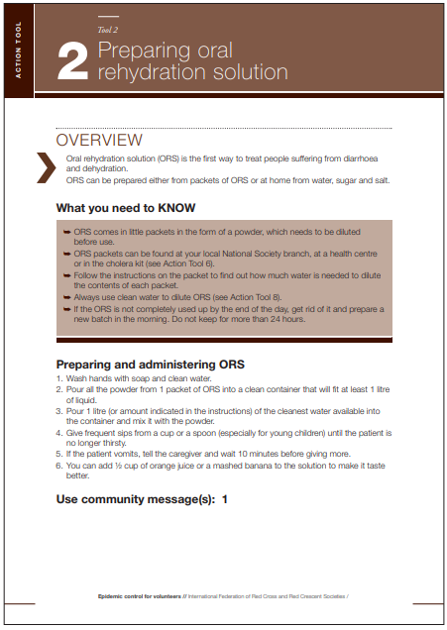
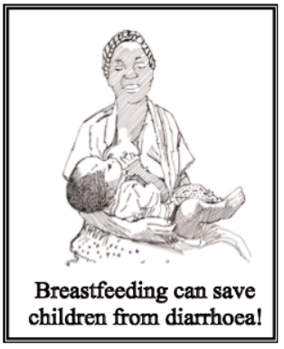
Disease, Actions &
Community Message Tools

Slide 32
Community Based Health And First Aid (eCBHFA)
RCRC approach used to empower communities to identify and address their health issues
Volunteers are trained in 5 core modules and develop community action plans with the community
Prevention modules are implemented based on community needs and action plans
Related eCBHFA prevention modules:
http://ifrc-ecbhfa.org/guides-and-tools/
Health in Emergencies
Communicable Disease Prevention

Slide 33



Life-Threating Conditions
The three main “Killers” in a medical emergency are:
Airway Obstruction
Bleeding
Shock

Slide 34
Head-Tilt/Chin-Lift Method For Opening An Airway
STEP | ACTION
1 | At an arm’s distance, shake the victim by touching the shoulder and shout, “Can you hear me?”
2 | If the victim does not or cannot respond, place one hand on the forehead.
3 | Place two fingers of the other hand under the chin and tilt the jaw upward while tilting the head back slightly.
4 | Look for chest rise.
5 | Listen for air exchange.
6 | Feel for abdominal movement.
Opening the Airways
Notes:
A victim with a suspected airway obstruction must be checked immediately for breathing and, if necessary, the airway must be opened.
When the victim is not breathing, use the Head-Tilt/Chin-Lift method of opening the airway.

Slide 35
Controlling Bleeding
The Are Three Main Types Of Bleeding:
Arterial Bleeding:
Arteries transport blood under high pressure - spurting bleeding.
Venous Bleeding:
Veins transport blood under low pressure - flowing bleeding.
Capillary Bleeding:
Capillaries also carry blood under low pressure - oozing bleeding.

Slide 36
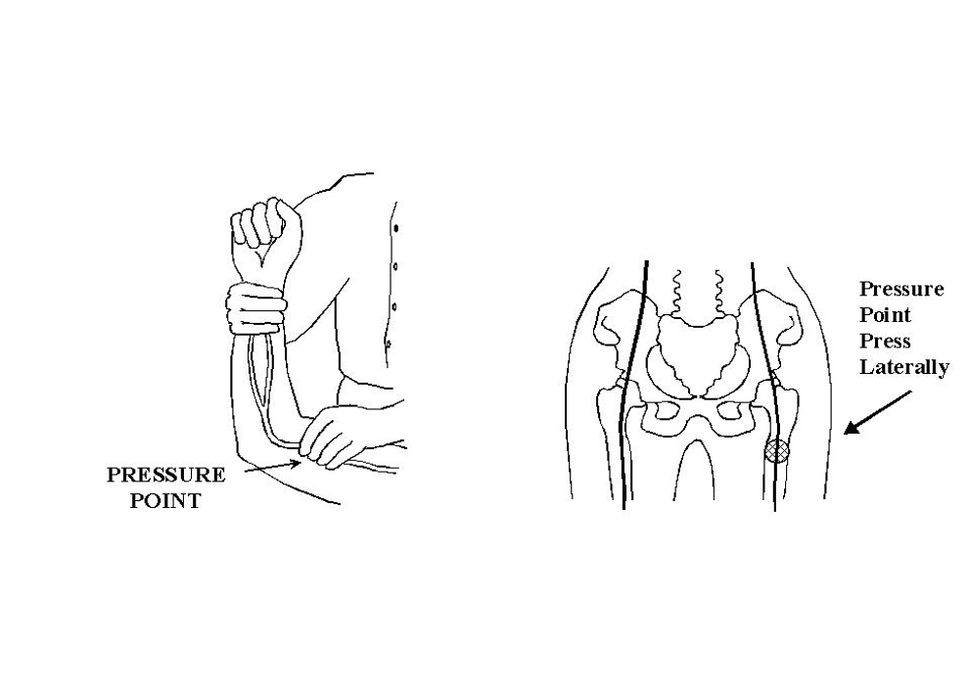
Controlling Bleeding
Brachial Pressure Point
Femoral Pressure Point

Slide 37
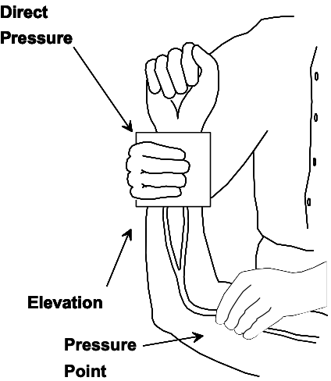
Controlling Bleeding
Methods for Controlling Bleeding by using direct pressure on wound, elevation, and pressure points.

Slide 38
Treating
For Shock
The Main Signs Of Shock To Look For Are:
Rapid and shallow breathing.
Failure to follow simple commands, such as, “Squeeze my hand.”
Changes in skin color.
Capillary refill (how long it takes for the color to return) is greater than 2 seconds

Slide 39
Treating
For Shock
Procedures For
Controlling Shock
Step | Action
1 | Lay the victim on his or her back. Elevate the feet 6-10 inches above the level of the heart. Maintain an open airway.
2 | Control obvious bleeding.
3 | Maintain body temperature (e.g., cover the ground and the victim with a blanket if necessary).
4 | Avoid rough or excessive handling unless the rescuer and victim are in immediate danger.

Slide 40
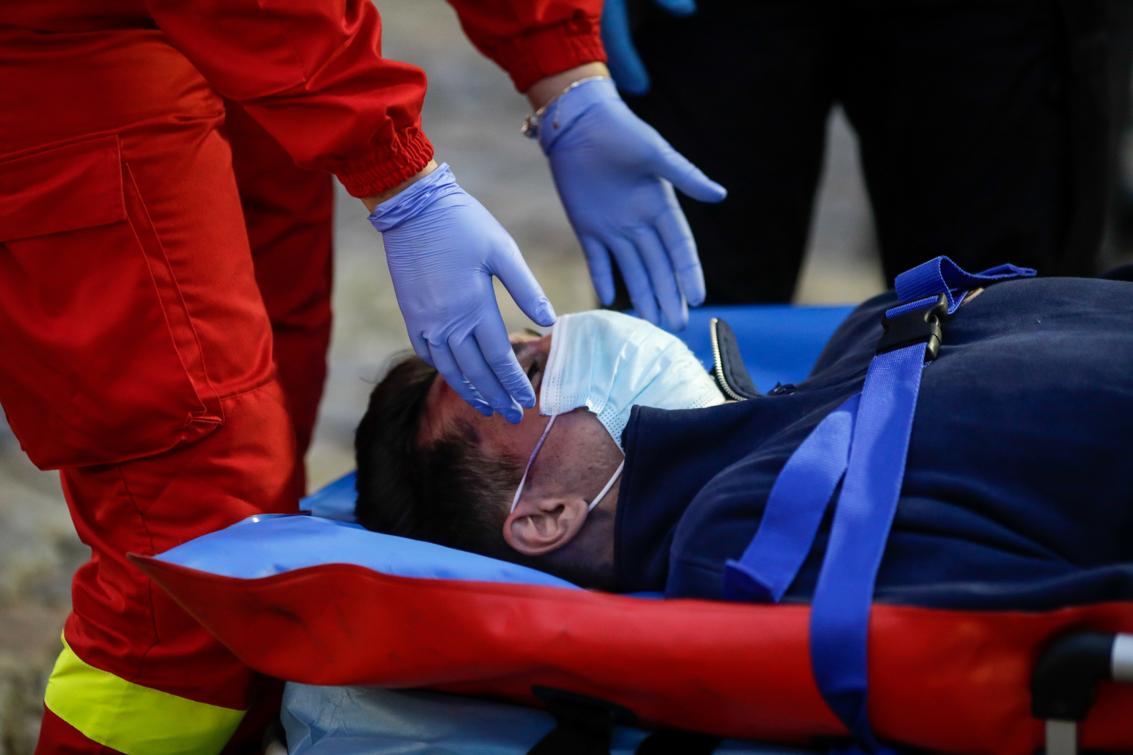
What Is Triage?
Victims are evaluated, sorted by immediacy of treatment needed, and set up for immediate or delayed treatment.
Notes:
When working in a disaster with multiple casualties, the first goal is Simple Triage And Rapid Treatment (START).
Experience has shown that triage is an effective strategy in situations where:
rescuers are overwhelmed,
there are limited resources,
and time is a critical factor.

Slide 41
Types Of Triage?
ACUTE:
Individuals who need help right away. These victims are the priority group for assistance;
NON-ACUTE:
Though the victim may be severely wounded, his /her situation is stable and does not require immediate assistance.
More urgent cases will receive assistance first

Slide 42
Performing A Triage Evaluation
Check Section 6.6.2 page 22-24 of the Field Guide
To learn basic First Aid please contact your National Society for information.

Slide 43
Volunteer, Donate, Join Us In Partnership, or share
our appeals and stories on social media. Find out more about IFRC, and learn how to contact your National Red Cross or Red Crescent Society, at www.ifrc.org
Get Involved
There are many ways of becoming a part of the world’s largest humanitarian network
P.O. Box 303
CH-1211 Geneva 19
Switzerland
Telephone: +41 22 730 4222
Fax: +41 22 730 4200
Email: secretariat@ifrc.org
Website: www.ifrc.org

