Slide 1
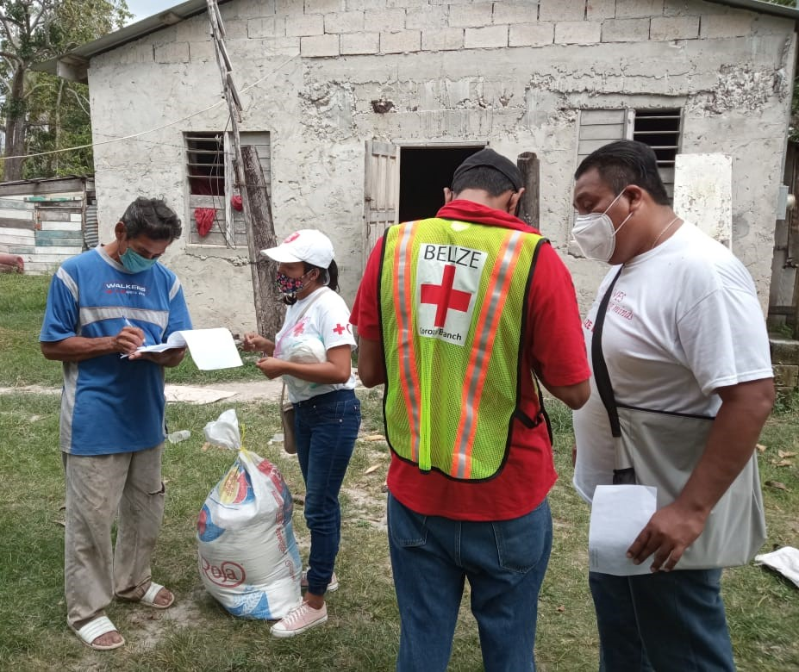


CDRTs & Community Assessment
For Community Response Teams

Slide 2
Objectives
To define an assessment
The purpose of Assessments
Assessments: Before, During and After
To explain how to do an assessment
To define the key principles and things to avoid

Slide 3
What Is An
Assessment
Assessment speaks to the collection and analysis of data and the reporting of information collected. Assessment can be done before and after a disaster.
Type of Information Collected Before A Disaster
What are the risks?
Who are the vulnerable persons within the communities?
What resources are available? (equipment, people and plans).
Where do people get information?
What channels of communication is popular in the community?
Notes:
assessments need to take into account CEA and protection considerations, some examples of questions:
1. What are the risks in the community people might need warned about? [info needs]
2. Where do people get information about the weather? What channels of communication are popular in the community?
3. How does the community agree on joint actions? When do people work?
4. Are vulnerable groups listened to? Can they participate? What is their location in the community?

Slide 4
What Type Of Information Is
Collected After
A Disaster?
What Happened?
  Gather the details of the emergency
Who/What was affected and how?
  (Demographics of the affected, number and conditions?)
Who’s On The Scene?
  (What are they doing, where are the gaps?)
What Is Needed?
  Identify stakeholders or partners that can assist.

Slide 5
Purpose Of
Assessments
As a CDRT your first reason for carrying out an assessment may be to determine how your team will respond or assist the community.
Secondly your assessment will help provide information to the emergency organisations. Damage assessment and needs analysis ultimately assist emergency agencies in decision making and provide fast relief to affected persons.
Assists agencies in determining the extent of an event or a disaster.

Slide 6
Types Of
Assessments
Community Mapping
(DANA) Damage and needs analysis
Early Rapid Assessments 24 hrs Detailed assessments
Ongoing Community Monitoring and Surveillance
Key Areas To Cover When Doing Assessments
Health and PSP
Water and Sanitation
Shelter
Livelihood, economic and infrastructural damage, including damage to the physical environment
Notes:
Be sure to mention the DANA is also used by the Government in most countries and used by secondary response agencies such as Ministries of Social Welfare, Ministries of Health and Ministries of Housing for example.
Persons with special needs should also be considered while assessments are conducted.the assessments need to have a brief, concrete but NEEDED protection, gender and inclusion section. Two things to assess: protection issues present in the community ( sexual gender based violence, violence against children...) and who are the vulnerable groups present. This is an ethical commitment and a humanitarian requirement.

Slide 7
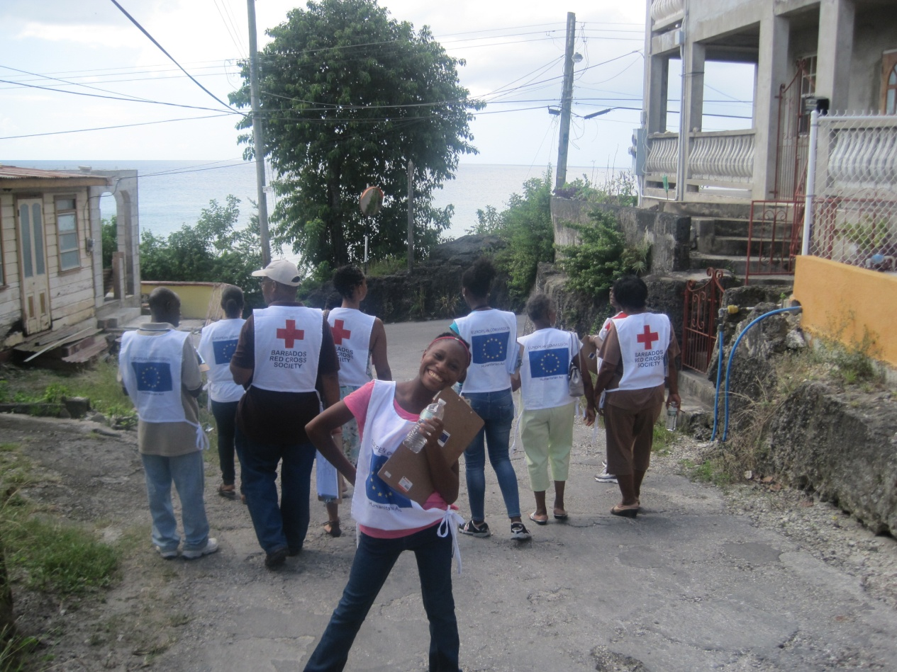
If There Is No
Disaster Why Do
Assessments?

Slide 8

Assessments Done Before A Disaster Allows You To:
Determine how familiar you are with information to be collected.
Identify gaps and capacities.
Plan according to resources available in the community.
Notes:
Mention examples from a recent event of the community, if there is none a flooding event scenario can be used and describe knowing who is vulnerable such as older persons and disabled. Knowing their location what their needs are before flooding occurs and what there needs may be before the event happens.
Consider how useful this information can be to other agencies in terms of providing assistance.
Relating this to eVCA is also a good practice if the community has one or needs to conduct one.
Highlight when in the DRM Process are the various types or assessments used. eg. VCA is used in pre and DANA in post
VCA could be used post impact as well
Consider vulnerable groups ( gender i.e. women, men, boys and girls, LBGTW, environmental impacts, ecological, infrastructural and human needs) and how they may be impacted differently.

Slide 9
Assessment Done Before A Disaster
Planning
Practice
Better Response & Faster Recovery
There is much that can be done where assessments are concerned prior to impact. Now is the best time to do your community mapping. (Disaster Plans, Evacuation, Early Warning Systems)
Learn all you can about your community and anticipate the needs that you might have to response to in an emergency.
Notes:
Being prepared is best. As you would have learned before the best time to prepare is before disaster strike.

Slide 10
Get to know the other players, agencies and disaster personnel, get an understanding of what their information needs will be in an emergency
Develop your assessment strategy for your community. Work out different sampling methods, different methods of data collection etc
Get familiar with the forms you will use and develop forms where needed
Train your team and practice, make sure you know what you will do and who will be responsible for what areas and task.
Role of
CDRT Before

Slide 11
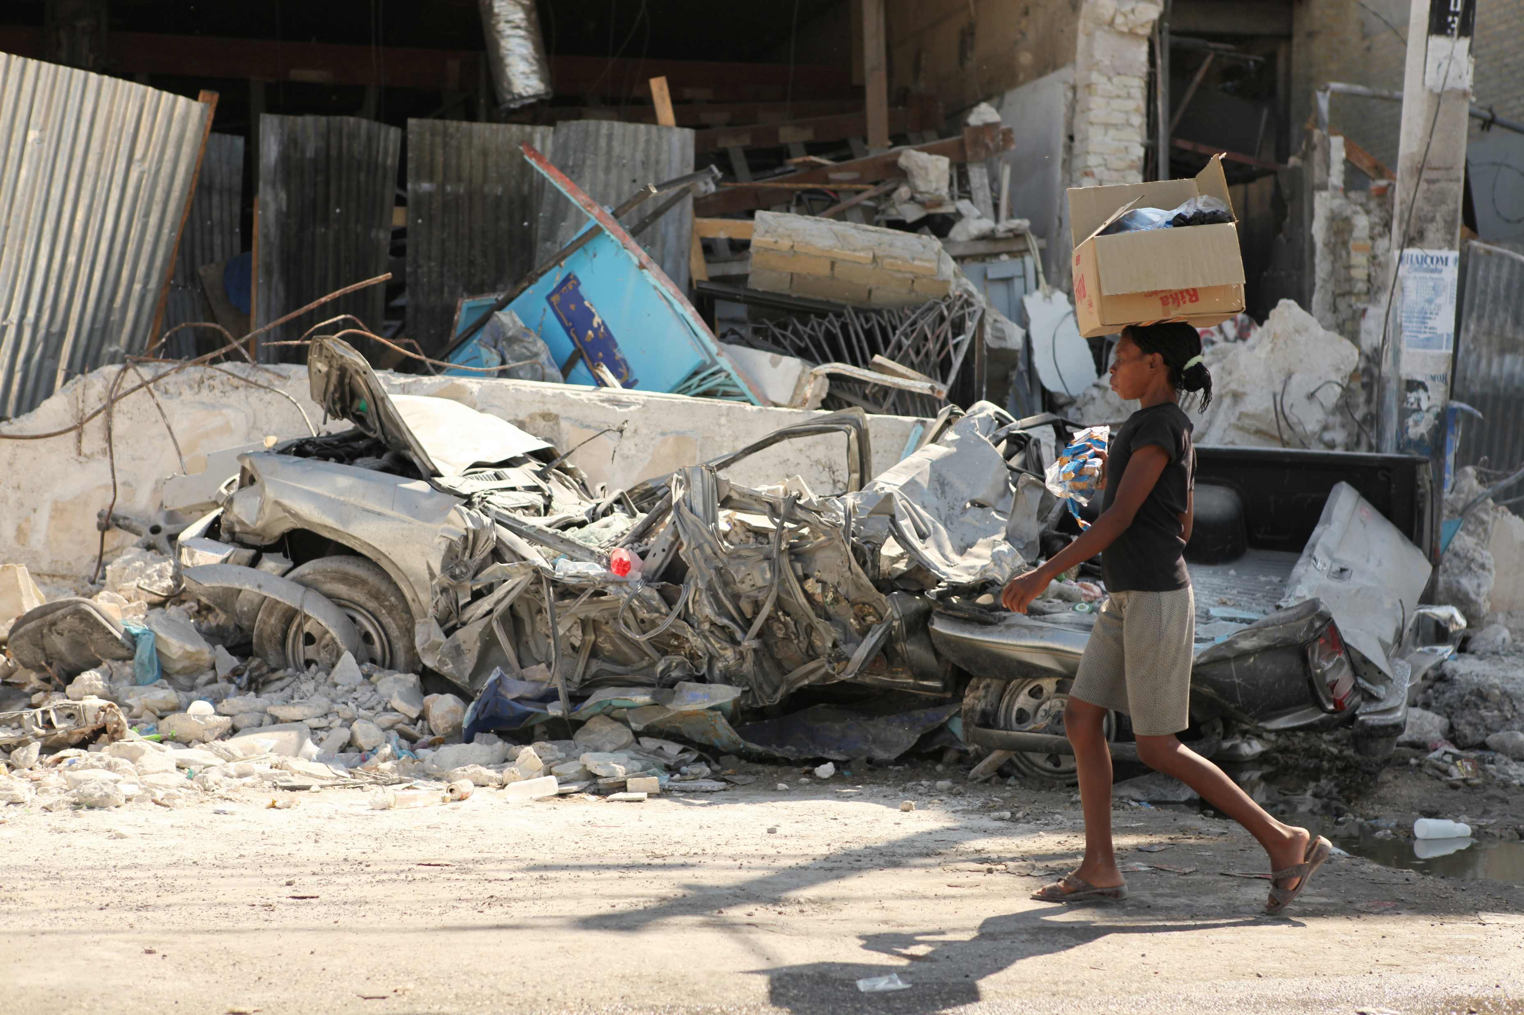
A Disaster
Has Happened, Now What?

Slide 12

What Is
A Damage Assessment & Needs Analysis DANA?
The process of determining the impact of a disaster or events on a society, the needs for immediate, emergency measures to save and sustain the lives of survivors, and the possibilities for expediting recovery and development.
Notes:
Needs being assessed: The gaps in access to goods and services created by the risks on life, health, basic subsistence and security. Identifying which stakeholders and partners can assist with providing goods and services such as water and food and shelter.

Slide 13
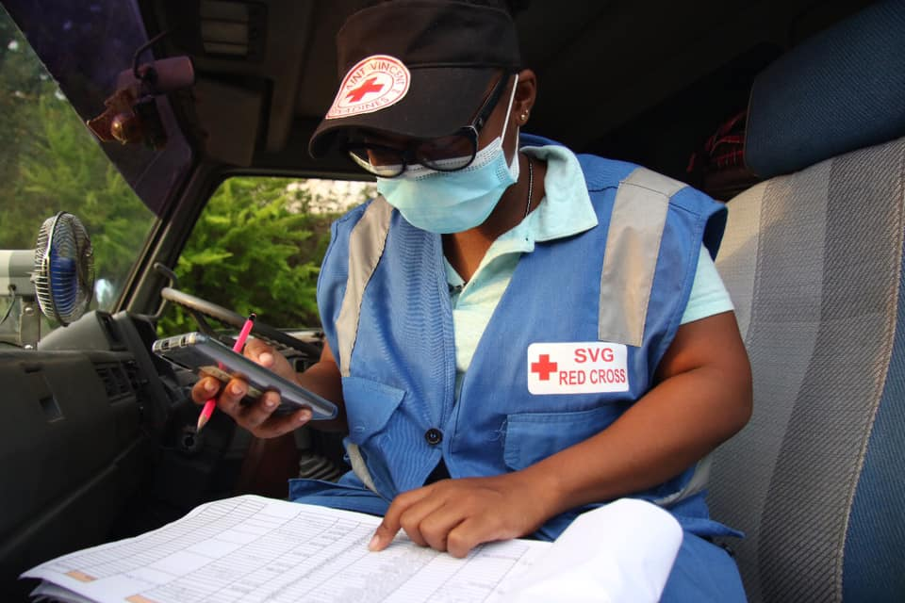
What is an Early Rapid Assessment?
It is a DANA that is conducted immediately after a disaster. It provides information on needs, possible courses of action and resource requirements. A more detailed assessment will be carried out as the situation changes.

Slide 14
Benefits Of Conducting An Assessment?
The information collected is needed for the development
of an action and monitoring plan. The information helps decision-makers to:
Choose priorities, objectives and identify intervention alternatives
Determine if outside help is needed.
Implement response based on these objectives and alternatives.
The aim is to help those who have been impacted, meet their immediate needs and save lives

Slide 15
More realistically describe the needs of the most vulnerable
Forecast sector needs for the next 7-28 days and a projection for 1-3 months
Define alternatives for reducing immediate risks
Preparation of the longer-term Plan of Action
Revision of the Emergency Needs and Priority
Detail programming
Gauge local response capacity
Decide how best to use existing resources for immediate relief
Seek alternatives to response objectives and intervention
Purpose Of
A Detailed Assessment

Slide 16
How To Do
An Assessment
Strategy/Plan
Develop an outline of how you will go about doing your assessments, what methods and tools you will use.
Sampling
How will you select the areas, households or individuals you include in your assessment
Methods : interviews, observations – checklist, focus groups, secondary sources, conducting an Initial Damage Assessment (IDA).
Notes:
Sampling techniques: Simple Random, Alternate
Interviews: What is it? Structured, non structured interviews
Observations
Using checklists

Slide 17
Know who you are reporting to and what information they need.
Coordinate with agencies on the field and ensure there is teamwork and communication of roles and expectations
Describe the situation, what has happened?
Record Affected population, # of persons,# of families/households
Note Impact: Injuries, death, damage to livelihoods, infrastructure
Who is responding presently, what are they doing? What resources are available?
Where are the gaps. What is needed now?
What are the future needs of those affected?
Reporting
Notes:
For point 2 – explain that this conversation is crucial to Red Cross’s role as an auxiliary to government, stress RC support role. More importantly, as CDRTs emphasise the support role to other agencies and doing no harm to agencies at work, avoiding duplication of efforts and doing no harm, while ensuring affected persons are getting assistance.
This is good opportunity to mention and discuss affected populations, also consider sex, age and disability disaggregated data.
damage to the natural environment/ecosystem. Reference to the Eco-based Approach EbA checklist or can be shared with interested persons.
Private Public Partnerships are also good to mention here, community members who can encourage small to medium business owners to support response actions or projects within the community before the event occurs. Examples are networking before the event with building and construction workers (for rebuilding), landscapers (equipment for debris removal), doctors, pharmacies (medication), shops (food supplies) etc.

Slide 18
Key Principles And Tips
Pit falls to avoid: Biases
Introduce yourself properly, don’t make promises.
Always get consent.
Be respectful.
Try to identify the gaps.
Information collected must be accurate and reliable.
Include vulnerable persons
Assistance should be given based on needs.

Slide 19
Ongoing Community Monitoring And Surveillance: Recovery Process
The restoration, and improvement where appropriate, of facilities, livelihoods and living conditions of disaster-affected communities, including efforts to reduce disaster risk factors. (ISDR)
Why Assess Here?
To see how people are coping
How quickly is life is returning to normal?
Rebuilding resilience
Monitoring of ongoing programmes and needs

Slide 20
Working With Other Partners
Is a must and very crucial during Emergencies.
Discuss Partners’ Roles &
The Reporting Hierarchy
Respect Differences
Maintain Open Communication
And Transparency
Remember: You are working with others united by common motivation and vision with the purpose of planning executing cooperative activities according to clearly defined and accepted objectives.

Slide 21
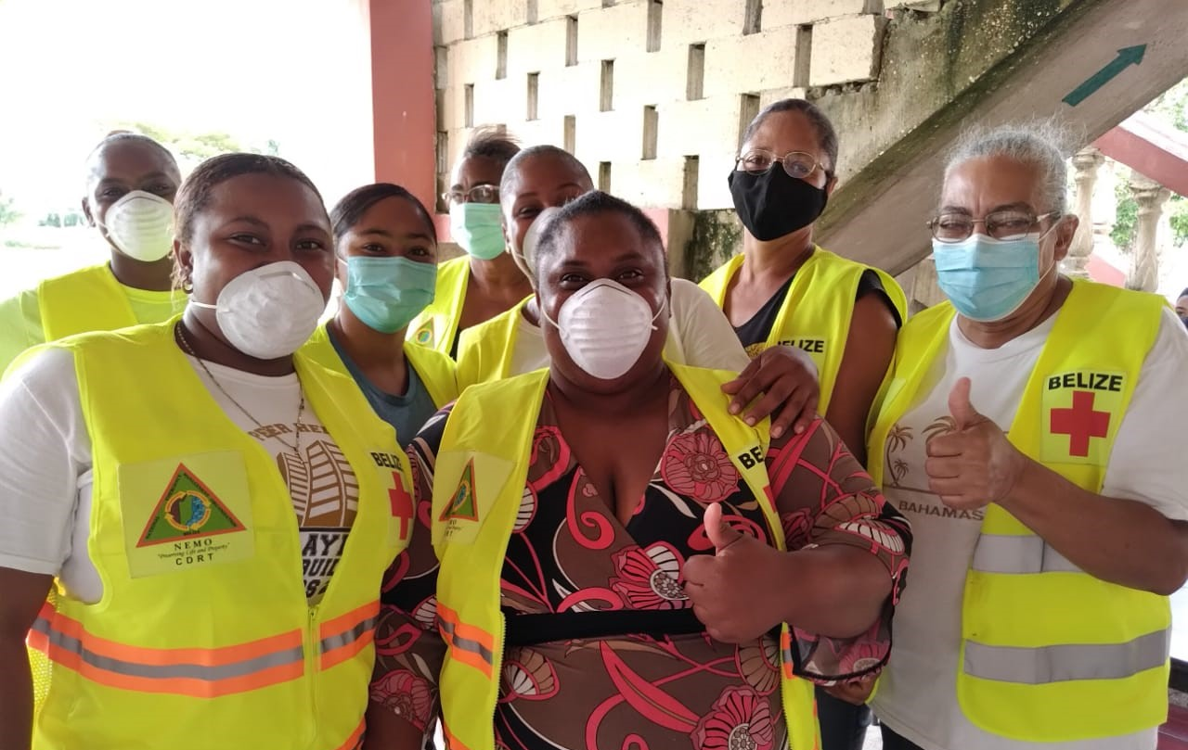
Group Activity
Strategy
Response Plan
Rapid Assessment
Notes:
Use Forms and Scenarios (can develop scenarios from NS context also) in CDRT Field Guide to practice filling in developing steps or a strategy to conduct the assessment, follow a response plan or discuss one for the community and conduct a Rapid Assessment. Then ask groups to present on the form they filled, whether it be IDA or DANA.

Slide 22
Volunteer, Donate, Join Us In Partnership, or share
our appeals and stories on social media. Find out more about IFRC, and learn how to contact your National Red Cross or Red Crescent Society, at www.ifrc.org
Get Involved
There are many ways of becoming a part of the world’s largest humanitarian network
P.O. Box 303
CH-1211 Geneva 19
Switzerland
Telephone: +41 22 730 4222
Fax: +41 22 730 4200
Email: secretariat@ifrc.org
Website: www.ifrc.org

