Slide 1
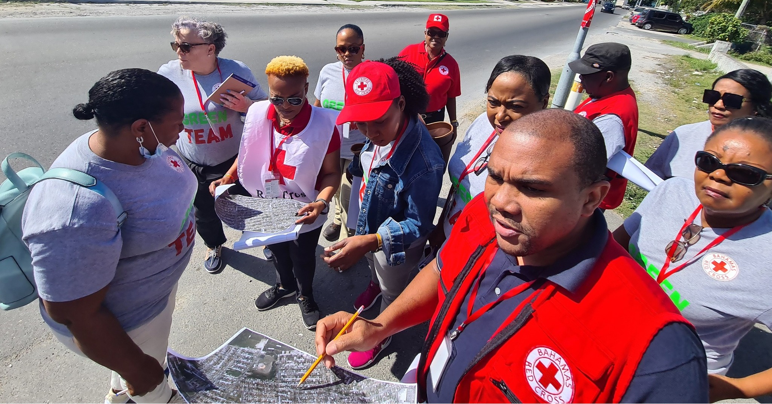
CDRTs & Disaster Preparedness
For Community Disaster Response Teams

Slide 2
Acknowledgements
We thank the Belize Red Cross, Grenada Red Cross, Guyana Red Cross, Jamaica Red Cross, St
Vincent and the Grenadines Red Cross, Trinidad and Tobago Red Cross and the Caribbean
Disaster Emergency Management Agency (CDEMA) for their commitment to collaborating with
the Caribbean Disaster Risk Management (CADRIM) Reference Centre. Together, we reviewed
and revised the CDRT Training Material, enhancing its relevance and effectiveness in disaster
response training. Your dedication exemplifies the spirit of cooperation within the humanitarian
community, and we deeply appreciate your invaluable contributions.

Slide 3
Objectives
Understand What Is Preparedness
Learn about Home & Community Preparedness
Learn about the CDRTs Role

Slide 4
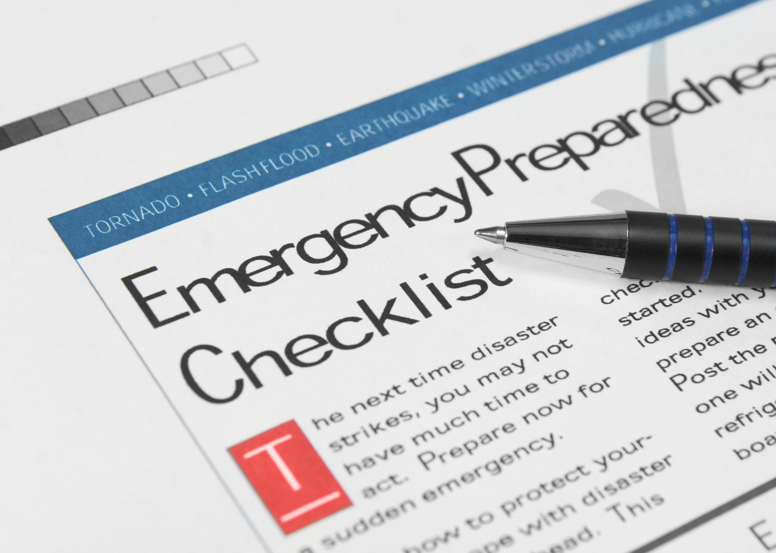
What Is
Preparedness?
Activities and measures taken in advance to ensure effective response to the impact of hazards.
It includes the delivery of timely & effective early warnings and the temporary evacuation of people and property from threatened locations.
Source: UNISDR

Slide 5
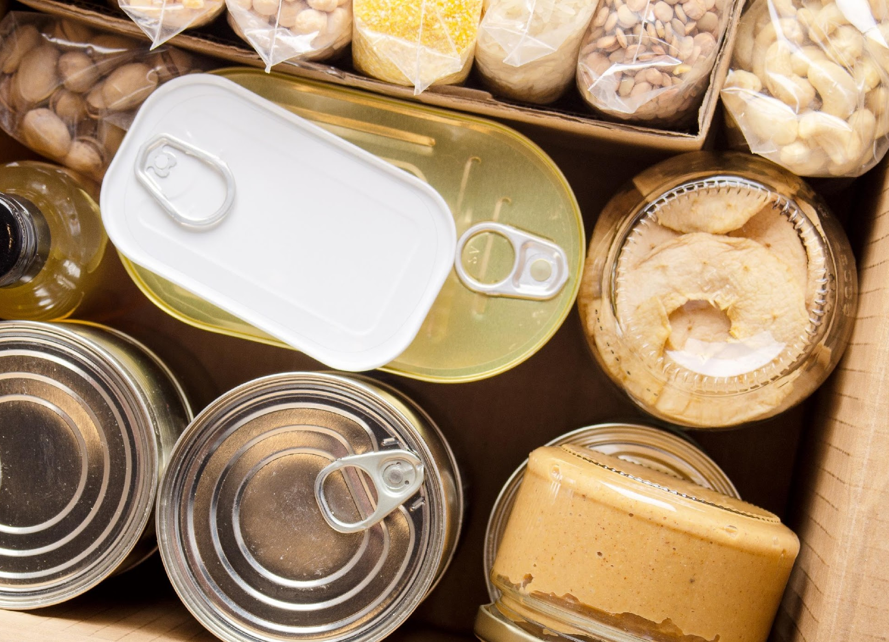
Why Prepare?

Slide 6
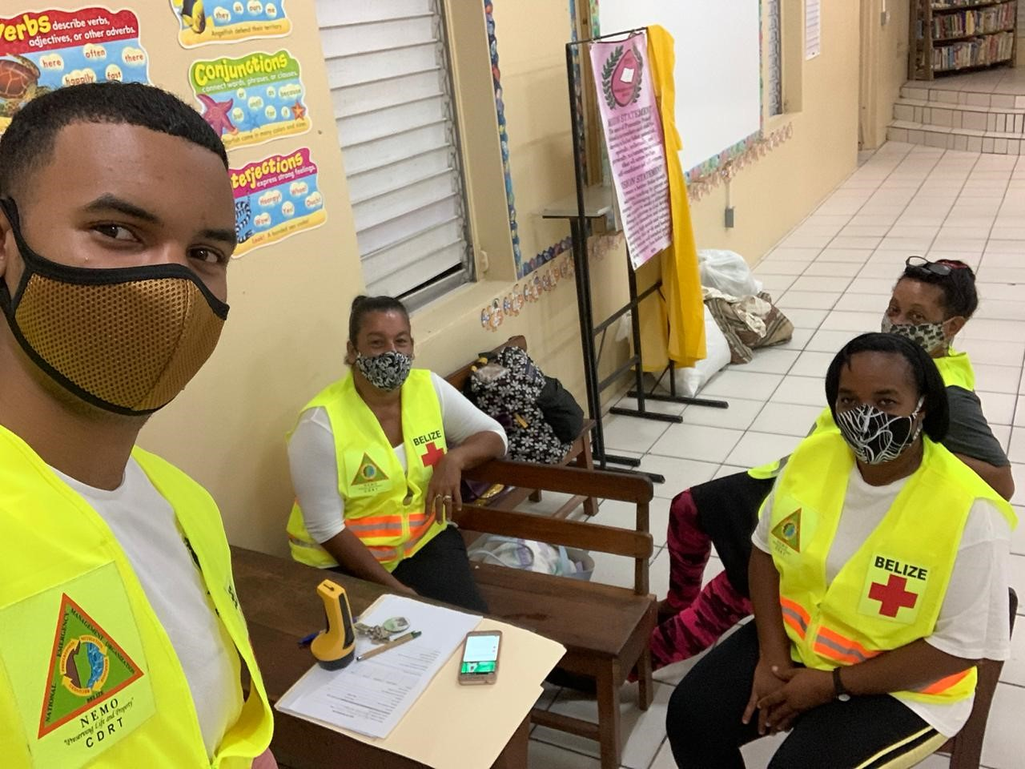
CRDTs Roles In Preparedness
Education and training
Development of Disaster Plans
Evacuation
Early Warning
Practice and Testing

Slide 7
What Is Community
Preparedness?
Community preparedness is sharing the information with your community and making sure people understand what could happen and what they can do.
Your community is made up of different types of people, from different backgrounds, with different attitudes and beliefs but everyone needs to be prepared. And you need the cooperation and participation of everyone
Notes:
When talking about past events, it is important to identify previous situations of violence, internal crisis, or any other social disruption

Slide 8
Engaging The
Community
In engaging the community, it is important to know the facts, have evidence to support the need for community preparedness.
Talk about past events and impact.
Highlight the climate related changes that are visible.
Your creativity and innovate to get people’s interest. It’s important to reach all the groups in your area.

Slide 9
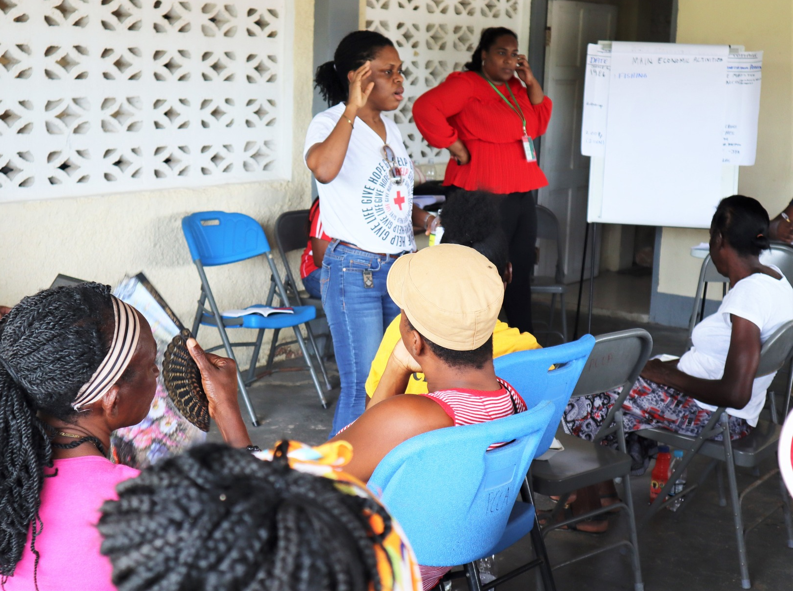
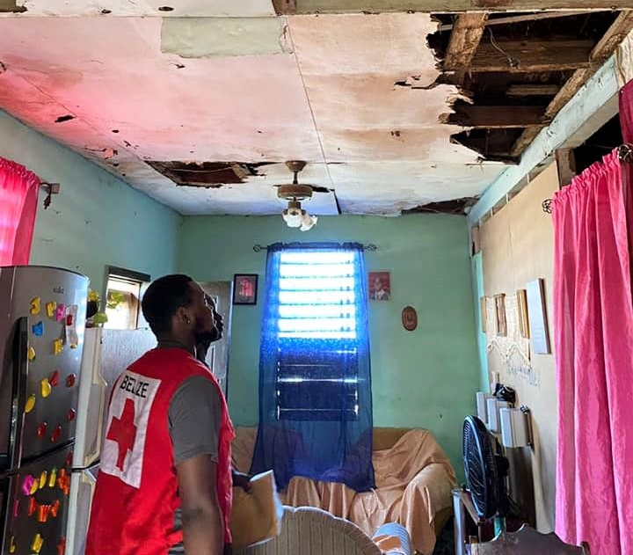
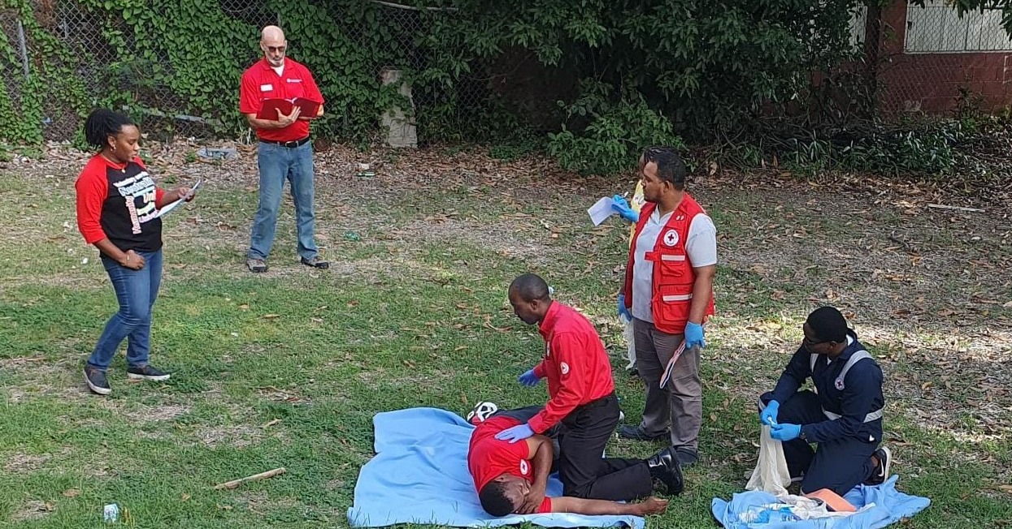
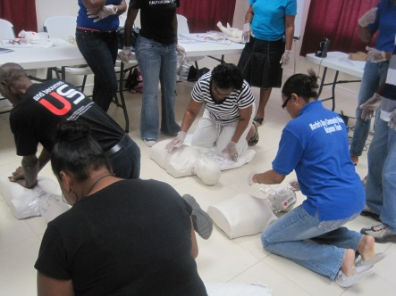
Preparedness
Activities
Notes:
What type of plans would CDRTs need to create?

Slide 10
Disaster Plans
A disaster plan is a systematic way of capturing the hazards and vulnerabilities in your community, it presents strategies for mitigating and reducing their impact, it also outlines the what steps are to be taken before, during and after, the responsibilities and roles of all involved as well as the mechanism for testing and evaluation.

Slide 11
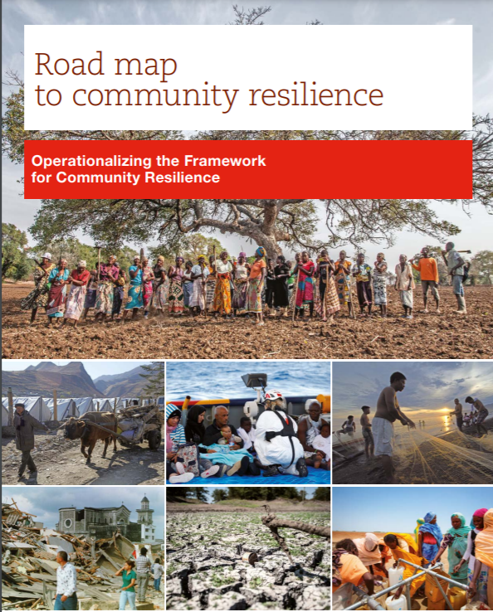
Community Mapping
Use the Roadmap to Resilience Approach.
This is a community driven process that allows the community to identify their hazards, vulnerabilities, threats and capacities which are then measured against 6 resilience characteristics.

Slide 12
Six
Resilience
Characteristics
1
Knowledgeable and healthy and can meet their basic needs.
2
Is socially cohesive
3
4
Well maintained and accessible infrastructure and services
Economic opportunities
5
Can manage its natural resources
6
Is connected
Notes:
1- Knowledgeable and healthy and can meet their basic needs: Persons are aware of the various risks and vulnerabilities and their capacity to take actions to increase their resilience. Persons can meet their food, water and shelter needs.
2- Socially cohesive: The existence of social groups within the community and the lack of major conflicts within the community.
3- Economic opportunities: Persons have access to livelihood opportunities and can cover their health, education and nutrition needs daily.
4- Well maintained and accessible infrastructure and services: Access to healthcare and education facilities and emergency services.
5- Can manage its natural assets: Natural forests, vegetation and wetlands are maintained.
6- Is connected: persons are aware of relevant policies and laws and how those can affect the community.

Slide 13
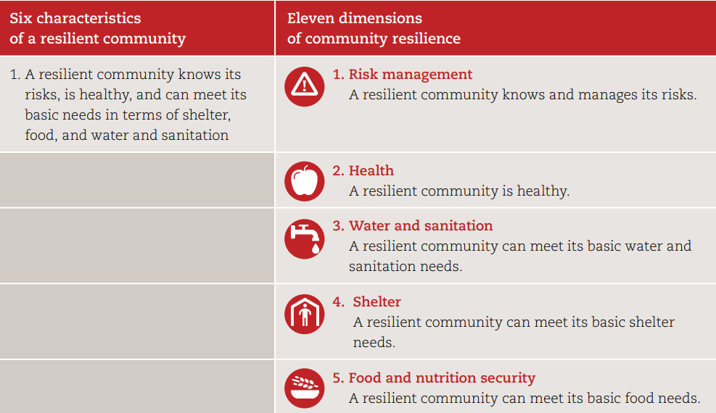
11 Dimensions
of Resilience
Characteristics
Notes:
1- Knowledgeable and healthy and can meet their basic needs: Persons are aware of the various risks and vulnerabilities and their capacity to take actions to increase their resilience. Persons can meet their food, water and shelter needs.
2- Socially cohesive: The existence of social groups within the community and the lack of major conflicts within the community.
3- Economic opportunities: Persons have access to livelihood opportunities and can cover their health, education and nutrition needs daily.
4- Well maintained and accessible infrastructure and services: Access to healthcare and education facilities and emergency services.
5- Can manage its natural assets: Natural forests, vegetation and wetlands are maintained.
6- Is connected: persons are aware of relevant policies and laws and how those can affect the community.

Slide 14
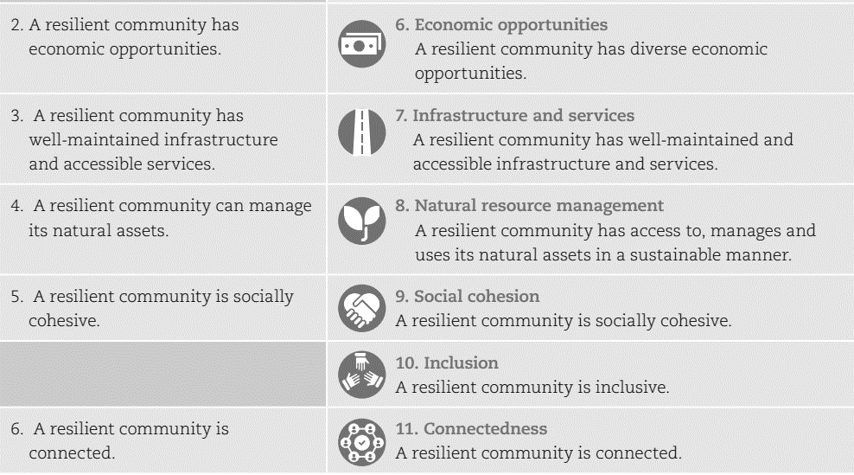
11 Dimensions
of Resilience
Characteristics
Notes:
1- Knowledgeable and healthy and can meet their basic needs: Persons are aware of the various risks and vulnerabilities and their capacity to take actions to increase their resilience. Persons can meet their food, water and shelter needs.
2- Socially cohesive: The existence of social groups within the community and the lack of major conflicts within the community.
3- Economic opportunities: Persons have access to livelihood opportunities and can cover their health, education and nutrition needs daily.
4- Well maintained and accessible infrastructure and services: Access to healthcare and education facilities and emergency services.
5- Can manage its natural assets: Natural forests, vegetation and wetlands are maintained.
6- Is connected: persons are aware of relevant policies and laws and how those can affect the community.

Slide 15
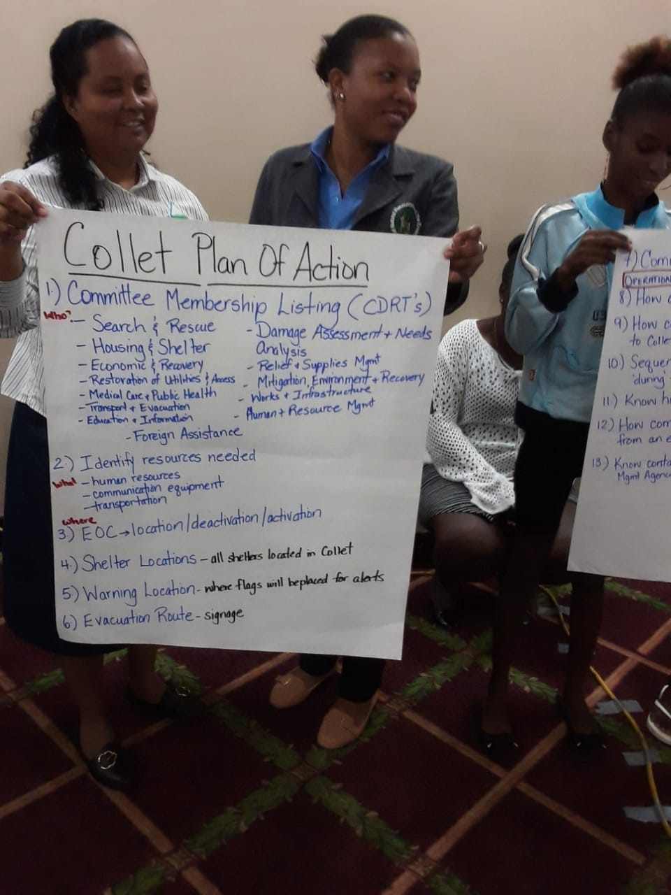
Community Disaster Plan
A document that outlines how the community will deal with a disaster.
Main hazards.
Outline the actions that the community will take before, during and after.
Notes:
Communities that plan before a disaster what they will do are more likely to be able to respond effectively to a disaster. So how can a CDRT help its community in doing this? First of all it is important to know what a disaster plan is. Put simply a disaster plan is a document that outlines how the community will deal with a disaster. It might look at the main hazards that are likely to affect that community and outline the actions that the community will take before, during and after
this threat. Plans must be tested and evaluated to know if they work and how well they work.
As with the Family Plan, it would be important to mention into the different actions that the community will take in terms of: 1) protecting children, single women, and other people with vulnerabilities, 2) Determine responsibilities of evacuation for people with disabilities and elderly.

Slide 16
Activity:
What should be included in a Community Map?
A community map enables you to connect issues or problems with particular places and makes information easy to see.
Identify the type of information that should be included in a community map and where you can get the information.

Slide 17
Community Mapping
Risk, Threats and Vulnerability
A CDRT should engage the community to determine:
What are the major threats and hazards that could affect the community?
Identify Who and What would be affected.
What are the areas in the community most like to be impacted?
Who are the vulnerable persons (pay close attention to children, elderly especially those who live alone, pregnant women, persons with disabilities).

Slide 18
Community Mapping
Resources and Capabilities
What are the things that your community has that can help it to be prepared or to response to a disaster? Make a list of them. These could be persons with skills, a shelter, equipment and so on.
Identify Who and What would be affected.
What are the areas in the community most like to be impacted?
Who are the vulnerable persons (pay close attention to children, elderly especially those who live alone, pregnant women, persons with disabilities).
Notes:
Explain that CDRTs must be impartial and have the capacity to identify the most vulnerable populations considering: who takes the decisions, who are the ones that have access to the resources, who are the ones that have the control over resources in the community, who works outside, who is responsible for the duties at home, who are the ones that receive most violence, who are the ones that are always left out of decisions or community meetings.
Resources and Capacities
What are the things that your community has that can help it to be prepared or to response to a disaster. Make a list of them. These could be persons with skills, a shelter, equipment and so on.
What are they?
Where are they located?
Who has access to them?
Where the protection organizations (responsible for defending human right, including the most vulnerable people in the community
are located?

Slide 19
Use the information provided in the previous slides and identify:
The areas in your community most likely to be impacted by a disaster.
Vulnerable persons living in those areas.
List of things that your community has that can help it to be prepared or to response to a disaster? These could be persons with skills, a shelter, equipment and the location of fire station, police etc.
Activity:
Work together to create a Community Map

Slide 20
Family Disaster Plans
Each CDRT member should ensure that his or her family has a plan in place. You will want to make sure that your family is taken care of before you can respond to the needs of others.
Be sure to discuss the role and responsibility of each family member, children can also assist with preparation activities.
Meet with the family.
Discuss the types of disasters that could occur.
Explain how to prepare and respond.
Notes:
In terms of a positive approach, it is important to give to all the family members a responsibility even if they have special needs or special considerations. This enhance their coping mechanisms and create a sense of trust between the family members

Slide 21
Family Disaster Plans
Discuss what to do if advised to evacuate.
What will you do if you cannot leave home?
Practice what you have discussed.
Help the family plan how it will stay in contact if separated by disaster.
Pick two meeting places

Slide 22
Family Disaster Plans
A location a safe distance from your home in case of fire.
A place outside your neighbourhood in case you can’t return home.
Choose an out-of-area family member or friend as a “check-in contact” for everyone to call.
Remember to plan for family members with special needs and pets.
Note: A Family Disaster Plan can be found on CADRIM’s website: https://www.cadrim.org/resources
Notes:
Help families to think about those members with special needs, for example persons living with chronic lifestyle diseases such as asthma, diabetics, children, differently abled persons etc.
Family will also have to make plans for their pets. The family disaster plan template can be printed and distributed to community members

Slide 23
What to do After Developing a Family Disaster Plan?
All family members should know & practice family disaster plan
Know safe areas based on the hazard
Know the nearest shelters
Know the best escape route from the home
Know the meeting places
Know the numbers for response agencies (fire, police and ambulance)

Slide 24
Key
Considerations When Developing Plans
Hazards & Vulnerability
Preparedness, Mitigation & Prevention Activities
Equipment Listing
Evacuation Plan
Early Warning Systems
Roles & Responsibilities

Slide 25
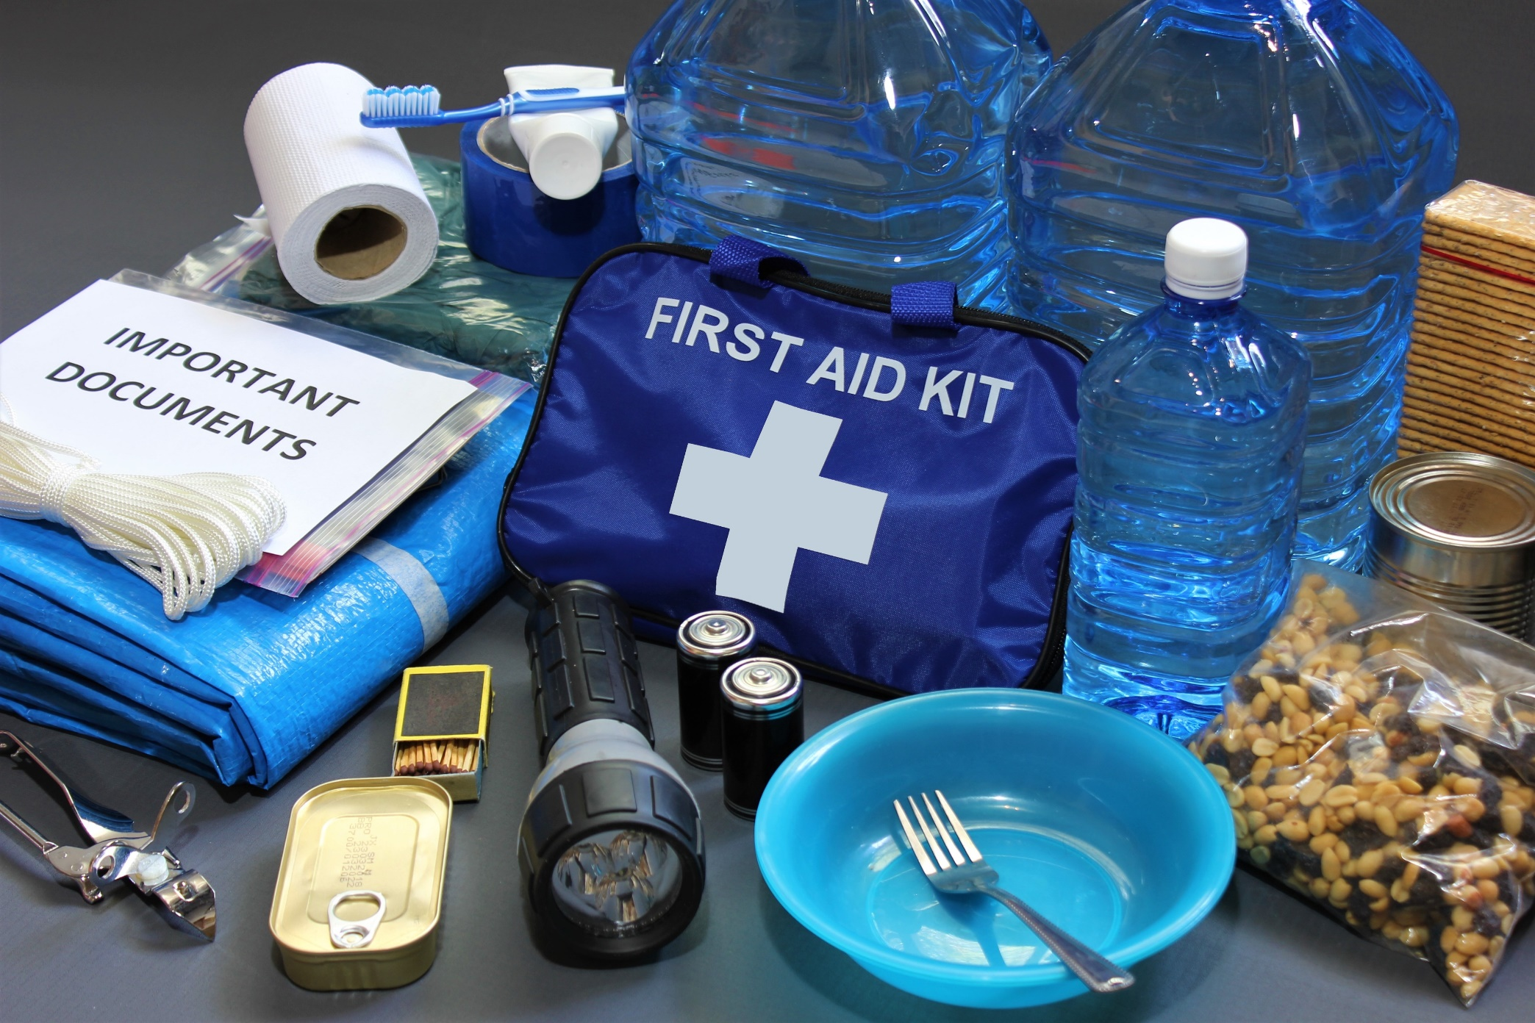
Disaster Supplies Kit
Notes:
Emergency preparedness manual*Battery-operated radio and extra batteries*Flashlight and extra batteries*Cash, Can opener, utility knife, Pliers, hammer, saw, cutlass/machete, nails (lg) Tape, rope Raincoat, boots, gloves, Matches in a waterproof container Plastic storage containers Paper, pencil Toilet paper, Soap Feminine supplies* Sanitation Personal hygiene items* toiletries Plastic garbage bags, ties Plastic bucket with tight lid Disinfectant Household chlorine bleach Sturdy shoes or work boots*Rain gear*Blankets Hat and working gloves Sheet or blanket
For Baby* Formula Diapers Bottles Powdered milk Medications For Adults* Heart and high blood pressure medication Insulin Prescription drugs Denture needs Extra eye glasses Important Family Documents Keep these records in a waterproof, portable container. Will, insurance policies, contracts, deeds Passports, immunization records Bank cards and account numbers important telephone numbers Family records (birth, marriage, death)

Slide 26
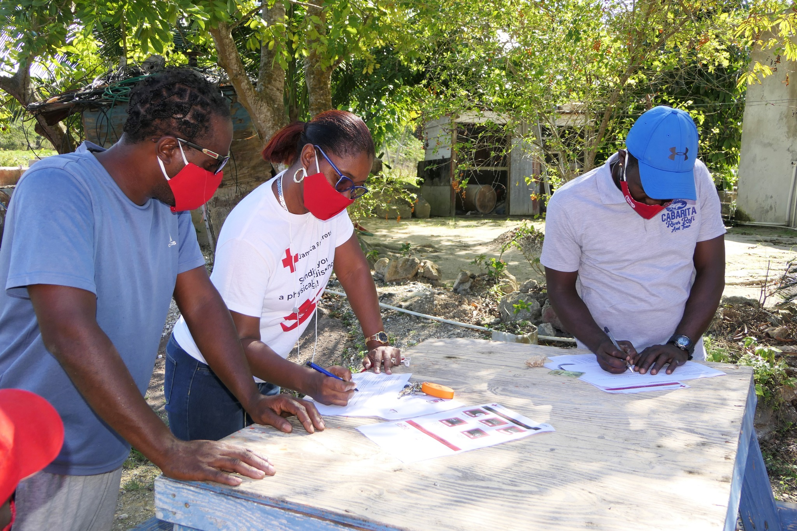
Evacuation Plans
An evacuation involves moving persons who are threatened by a hazard to a safer location. It also include moving persons back to their respective homes once the threat has passed.
Notes:
considerations of access and security: where to evacuate people with physical impairments and other disabilities, where to locate signs in multiple locations, where to put safety considerations so anyone is at risk of any situation of violence

Slide 27
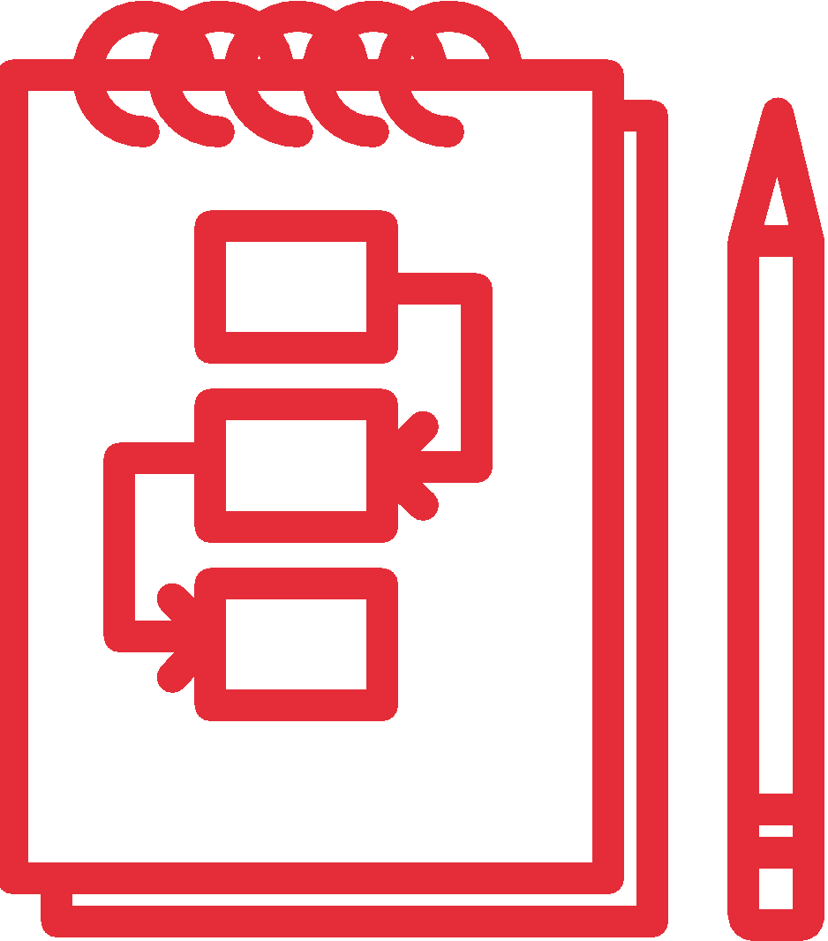
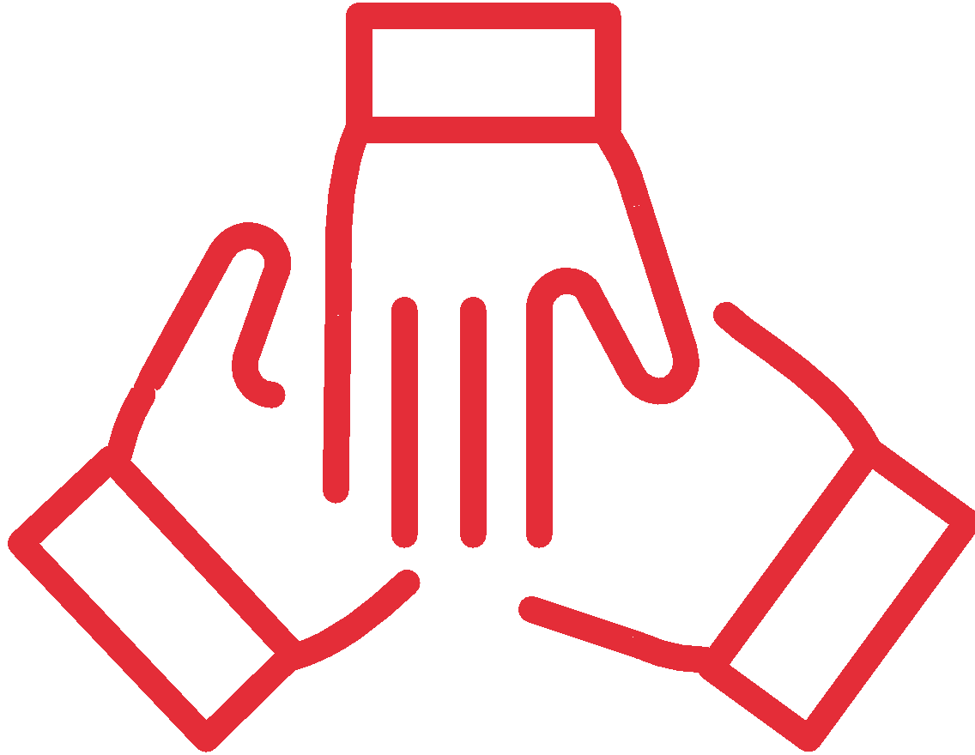
Early Warning Systems
Risk Knowledge
Strong knowledge of hazard and community.
Monitoring
A reliable, consistent, systematic way of predicting the event
Warning Communication
The warning or message that informs the community
Response Action
Response capacity
Practiced actions to protect lives and property

Slide 28
Community Early Warning System
An early warning should lead to actions that save lives and reduce damage.
Your community must be empowered to act once it is warned.
Warning messages should be clear and logical and should be from a source that people respect and will respond to.
It is about reaching the vulnerable in a timely manner and putting systems in place before so that people know what to do.
Notes:
The most important thing is that early warning should lead to actions that save lives and reduce damage. Your community must be empowered to act once it is warned. Warning messages should be clear and logical and should be from a source that people respect and will respond to. It is about reaching the vulnerable in a timely manner and putting systems in place before so that people know what to do
Early Warning System
Activity: Using all the information you have collected so far work with your community to develop an early warning system for your area keeping in mind the key risk that exist. Be sure to think about the following:
How will you monitor the event (think about, local agencies, regional and international bodies, as well as your personal monitoring) What information is available?
What warnings or messages will you use (consider the limitations of a disaster situation and the resources you have)
How will you get the message to the persons who need to know
Who will be responsible for the different areas
Make sure you consider fast and slow unset disasters and multiply hazards.

Slide 29
If your community has a community early warning system, discuss
how it works,
who is responsible for sending out alerts,
the type of information that should be included in the alerts
The actions to be taken based on the types of alerts received.
If your community does not have a community early warning system, discuss
The national agencies that send out alerts (meteorological office, national disaster office, Red Cross National Society)
The meanings of the different types of alerts
The actions to be taken based on the type of alerts received.
Activity:

Slide 30
Activity:
Note: You can also reference Unit 2 on page 7 of the CDRT Workbook

Slide 31
Ensuring Inclusivity In All Disaster Plans
Identify who these persons are within the community and get their contact information.
Include them when conducting assessments.
Determine what type of assistance they might need in an emergency, which include assistance needed during an evacuation.
Determine their preferred mode of communication to receive information so that information can be relayed to them before, during and after an emergency.
Discuss ways to prepare and respond.
Notes:
When developing any plans always engage with and take into consideration any requirements of persons within vulnerable groups. Vulnerable groups include women and girls, low-income households, minority/marginalized groups, people loving with disabilities, migrants and the elderly.

Slide 32
CDRT Role In Disaster Preparedness

Slide 33
Volunteer, Donate, Join Us In Partnership, or share our appeals and stories on social media. Find out more about IFRC and learn how to contact your National Red Cross or Red Crescent Society, at www.ifrc.org.
Get Involved
There are many ways of becoming a part of the world’s largest humanitarian network
To stay informed about Caribbean disaster response activities or to access additional information on available trainings, training materials, research and information management tools, visit: www.cadrim.org.
: CADRIM.IFRC
: @cadrim_ifrc
: @CADRIM_IFRC

