Slide 1
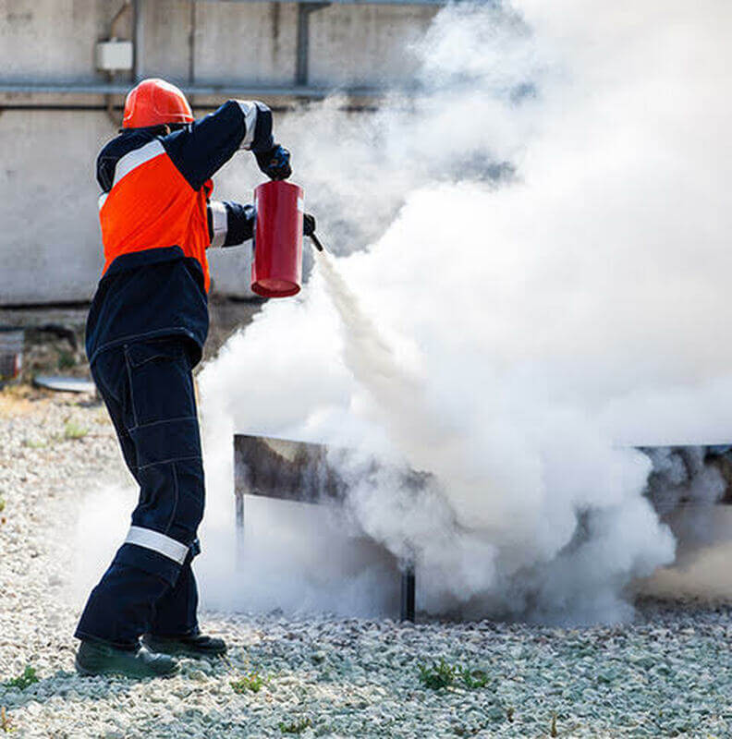

CDRTs &
Fire Safety
For Community Disaster Response Teams

Slide 2







Acknowledgements
We thank the Belize Red Cross, Grenada Red Cross, Guyana Red Cross, Jamaica Red Cross, St
Vincent and the Grenadines Red Cross, Trinidad and Tobago Red Cross and the Caribbean
Disaster Emergency Management Agency (CDEMA) for their commitment to collaborating with
the Caribbean Disaster Risk Management (CADRIM) Reference Centre. Together, we reviewed
and revised the CDRT Training Material, enhancing its relevance and effectiveness in disaster
response training. Your dedication exemplifies the spirit of cooperation within the humanitarian
community, and we deeply appreciate your invaluable contributions.

Slide 3

Objectives
Understand Fire Basics
Understand Fire Chemistry
Understand Fire Hazards in the Home and Workplace
Learn Fire Classifications and How to extinguish a fire.
Fire Prevention
Learn About Fire Fighting Agents and Portable Fire Extinguishers
Understand Fire Safety: Assess the Situation and Determine a Course of Action

Slide 4


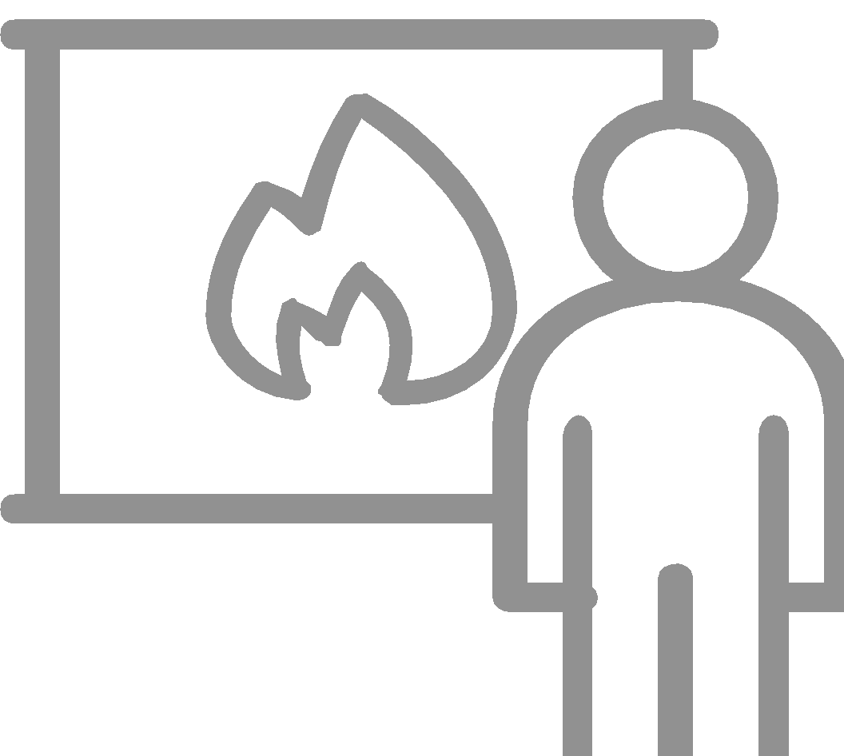



CDRT Role
Overall Responsibilities and What to do during a fire where possible
Before
During & After
Prevent additional fires by removing fuel sources.
Extinguish small fires before they become major fires.
Educate communities about fire safety.
Assist with evacuations where necessary.
Shut off utilities where necessary.
Call Fire Service

Slide 5
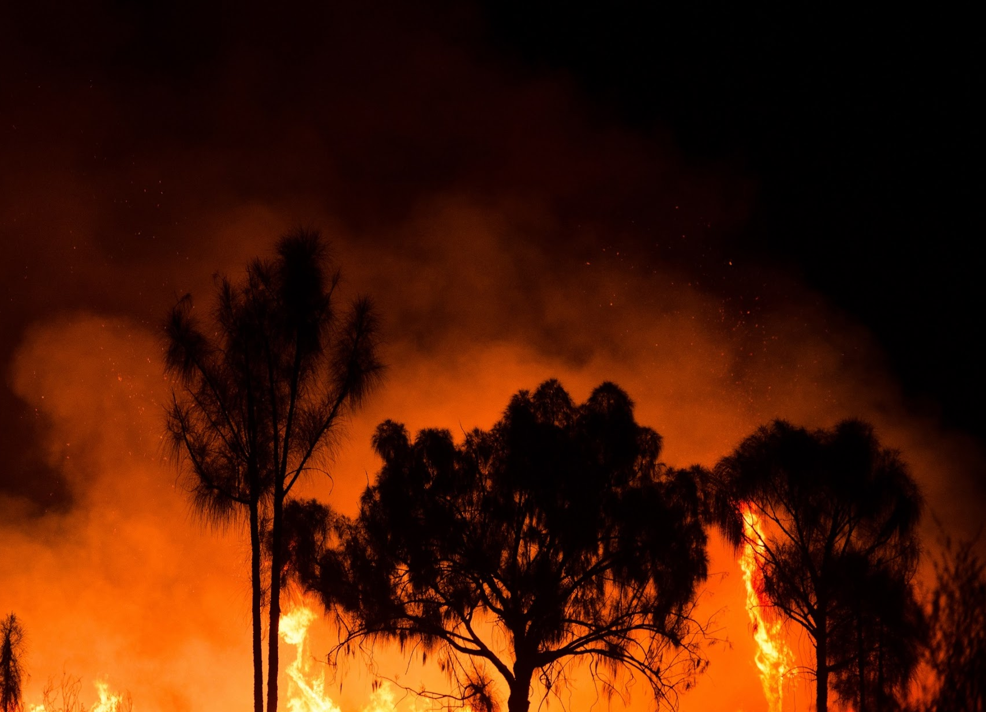
What Is
A Fire?
A chemical reaction that produces heat and light in the form of flames.

Slide 6
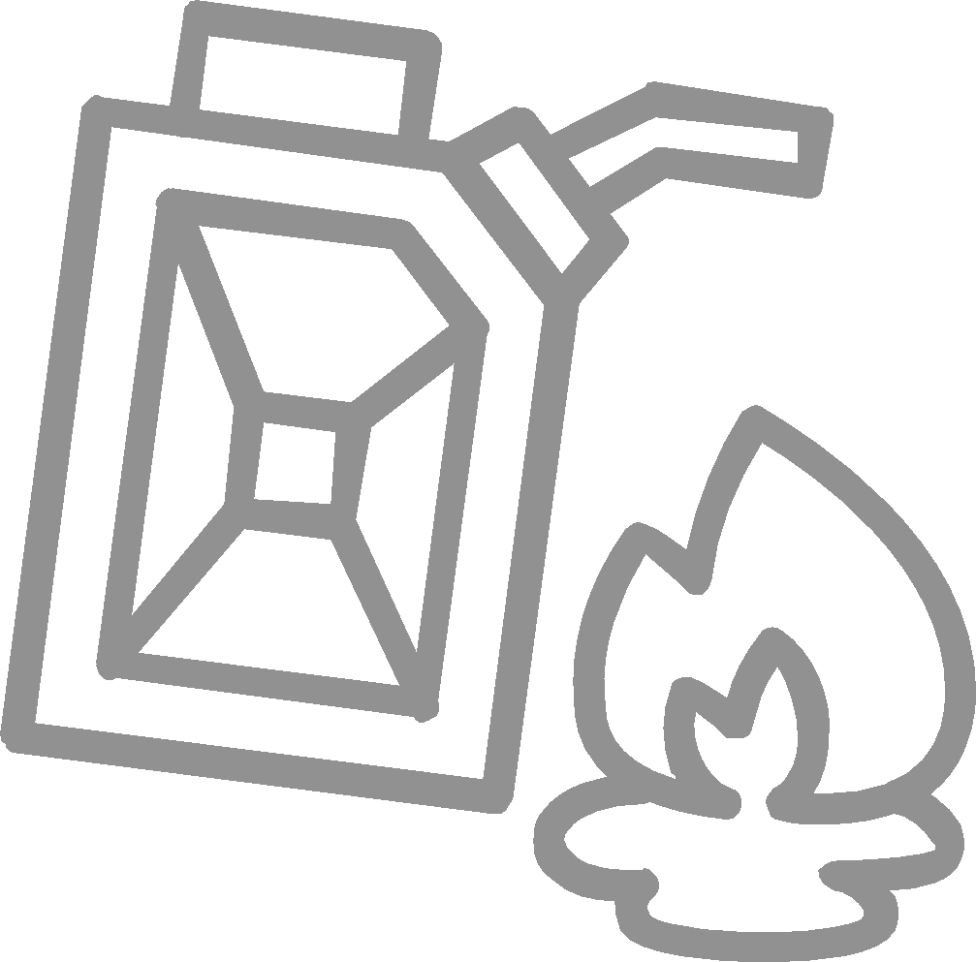


Fire Chemistry
Three elements required for a fire are:
Fuel
Any material that will burn (e.g. rags, paper, wood)
Heat
Anything which raises temperature of a fuel source
Mechanical Friction
Electrical high current
Static charge/discharge
Chemical reaction
Oxygen
The content of the surrounding air
Air normally contains about 21% oxygen
The minimum oxygen needed for combustion is 15%

Slide 7
Heat Transference
Methods By Which Heat
Is Transferred
Conduction
Transfer of heat through a solid (object) or liquid (water)
Convection
Transfer of heat through the motion of smoke and hot gases in the air
Radiation
Transfer of heat through space eg. sunlight

Slide 8
STEP
01
Incipient Stage
The incipient stage or is the beginning of a fire where the temperature is low, the fire is localized in the vicinity of its origin and smoke has not yet reduced visibility in the vicinity of the fire.
Fire Has
4 Distinct
Stages
Growth Stage
In the growth stage the fire size continues to increase in size by generating its own heat and plumes of smoke is visible.
STEP
02
Fully Developed
In this stage the fire is at its hottest point and all flammable materials in the space is burning. The rate of burning is also limited to the amount of oxygen present and during this stage, all persons should stay clear of the fire.
STEP
03
Decay Stage
The fire has consumed all available oxygen and fuel and can no longer sustain itself. The temperature starts to decrease, and the fire becomes less intense until the combustion fully stops.
STEP
04

Slide 9
Fact #1: Kitchen Fires are the Most Common
Safety Tips:
Stay in the kitchen while cooking on stovetops.
Make sure the area near the microwave is free of clutter.
Don’t use water to stop a grease fire, use a fire extinguisher or cover the pan or pot with a lid to suffocate the fire.
Fact #2: Faulty or Old Appliances Can Cause Fires
Safety Tips
Unplug appliances when not in use.
Don’t run extension cords under rugs.
Check cords of appliances for wear and tear periodically.
Ensure that electrical outlets are not overloaded.
Fires at Home

Slide 10


Prevent Fires at Home
Install Fire Alarms and Fire Extinguishers
Test them once a month
Ensure all household members including children, know what to do when they hear the alarm.
Develop an Evacuation Plan
Ensure all household members know of two ways to escape from every room.
Keep keys for burglar proof windows in a safe place that is easily accessible.

Slide 11

Additional Tips
Keep matches and lighters out of the reach of children.
Store all flammable liquids or hazardous chemicals in a safe place away from heat releasing objects or appliances.
Keep adequate space between appliances.
Ensure all household members know the number for the fire department.
Avoid clutter or pile up of old newspapers
Learn how to switch off circuit box/fuse box.
Take precaution when using fireworks.
Prevent Fires at Home

Slide 12
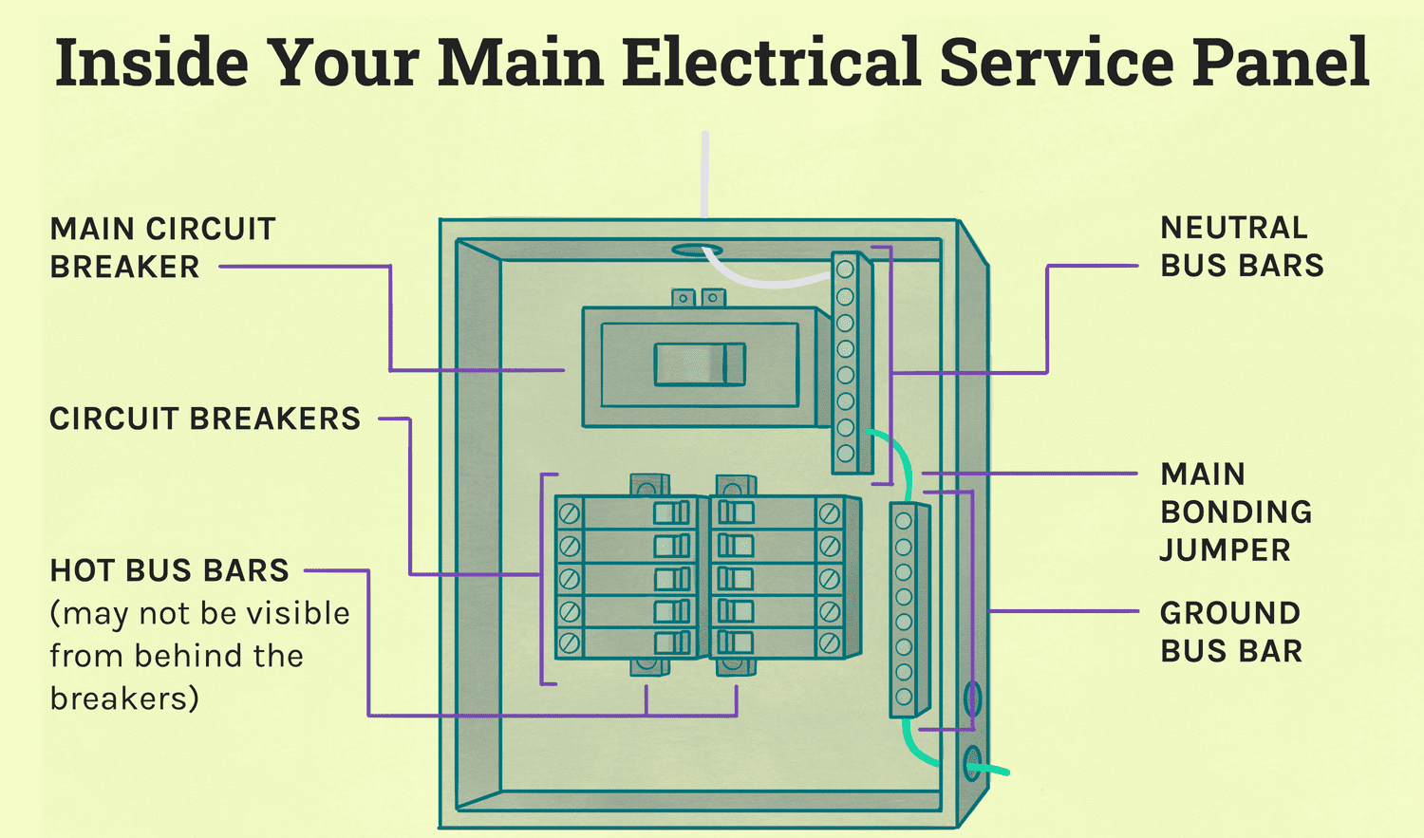
Turning Off
Circuit Breakers
CIRCUIT BREAKERS
Circuit box showing shutoff steps.
Step 1: Shut off main breakers in an emergency situation.
Step 2: When turning back on, shut off individual breakers then turn back on main followed by individual breakers.
Notes:
Avoid the “electrical octopus.” Eliminate tangles of electrical cords. Don’t overload electrical outlets. Don’t plug power strips into other power strips.
Don’t run electrical cords under carpets.
Replace broken or frayed cords immediately.
Maintain electrical appliances properly. Repair or replace malfunctioning appliance
Know where the power shutoffs for electrical appliances are.
Know where the power shutoff for circuit breakers or fuses is and how to shut off the power.

Slide 13

Main Causes of Workplace Fires
Neglect and overloading of electrical outlets.
Smoking and not discarding of cigarette butts or lit matches appropriately.
Improper storage of flammable liquids and hazardous chemicals.
Clutter and pile up of shredded paper or old newspapers.
Faulty wiring and repair work by uncertified persons.
Fires
At The Workplace

Slide 14


Install Fire Alarms and Fire Extinguishers
Test them once a month
Ensure all employees know what to do when they hear the alarm.
Conduct electrical inspections by Health and Safety Department.
Develop An Evacuation Plan
Post fire escape plans on every level of the building.
Assign and train safety wardens on every level of the building.
Teach employees about exit locations, escape routes and where the fire extinguishers and first aid kits are located.
Practice drills regularly and training on using a fire extinguisher.
Keep emergency exits free of clutter.
Prevent
Fires
At The Workplace

Slide 15




Class A Fires
Ordinary combustibles such as paper, cloth, wood, rubber, and many plastics.
Class B Fires
Flammable liquids (e.g., oils, gasoline) and combustible liquids (e.g., charcoal lighter fluid, kerosene). These fuels burn only at the surface because oxygen cannot penetrate the depth of the fluid. Only the vapor burns when ignited.
Class C Fires
Energized electrical equipment (e.g., wiring, motors). (When the electricity is turned off, the fire becomes a class A fire.)
Class D Fires
Combustible metals (e.g., aluminum, magnesium, titanium).
Class K Fires
Kitchen fires involving cooking oils.
Fire Classification
D
K

Slide 16
Three Methods
How
To Extinguish
A Fire
Cooling
Cooling occurs when heat is either eliminated or reduced below the temperature needed for ignition. A common method of cooling is by using water.
Starving
Starving is the removal of the fuel needed to sustain a fire as a fire will keep burning once there is combustible material present. Starving can be done by turning off the gas supply.
Smothering
Smothering is the removal of oxygen and is most applicable to solid fuel fires. Smothering can be achieved by using a fire blanket.

Slide 17
Fire Fighting Agents
Many elements (liquids, gases and solids) can be used as firefighting agents. The proper agents to use in a given situation will depend on:
The Class Of Fire
The Location Of Fire
The Extent Of The Fire
Availability Of Fire Fighting Equipment

Slide 18
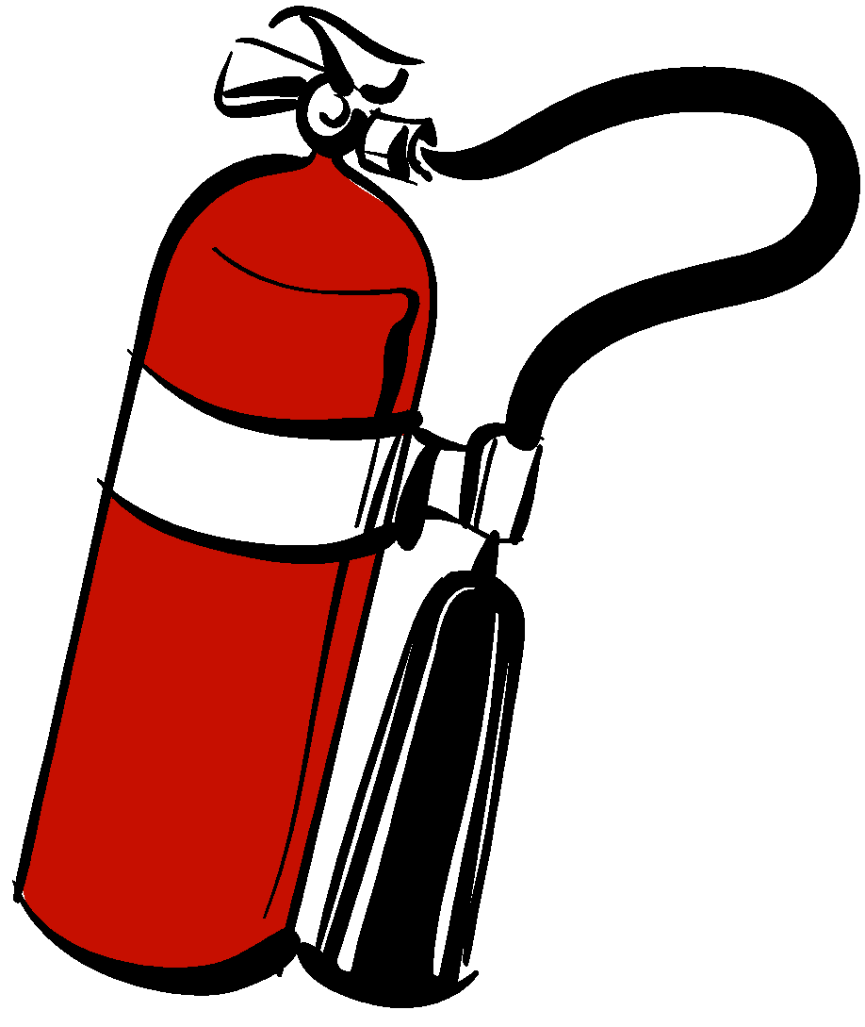
The Primary Agents Are:
Water
Dry Chemical
Carbon Dioxide
Foam

Slide 19
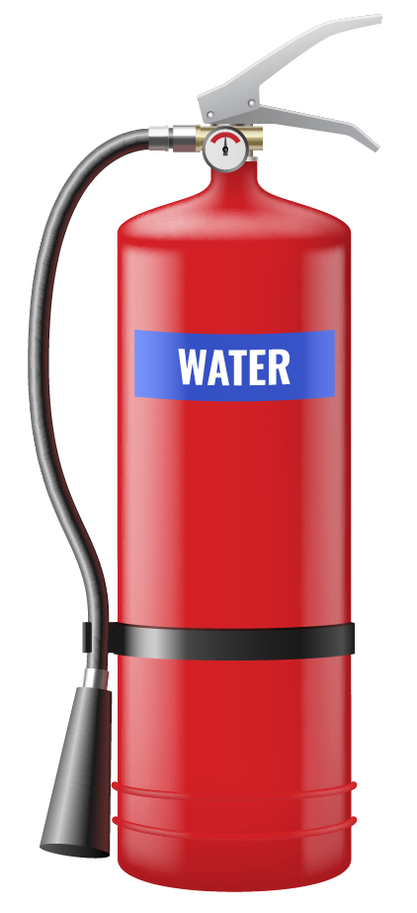
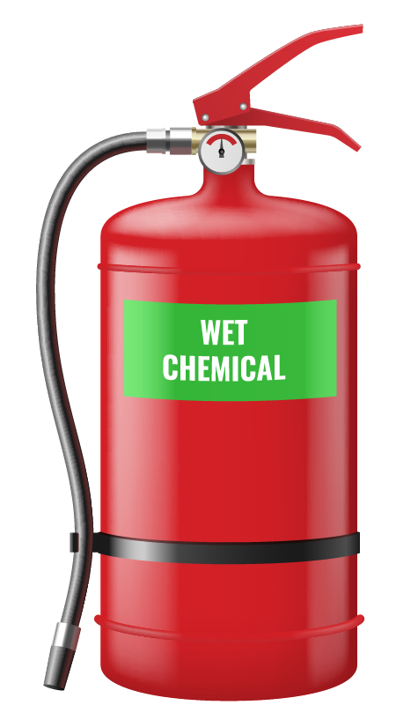
Primary
Fire Fighting Agents Are:
Water
This is the most common agent used with the removal of heat by cooling. It is the most effective method used to put out a class A fire.
Dry Chemical
This is used to smother the fire. It is the most effective method used to put out a classes A, B and C fires.

Slide 20
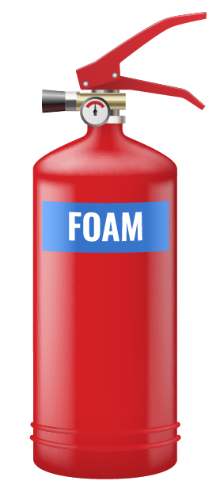
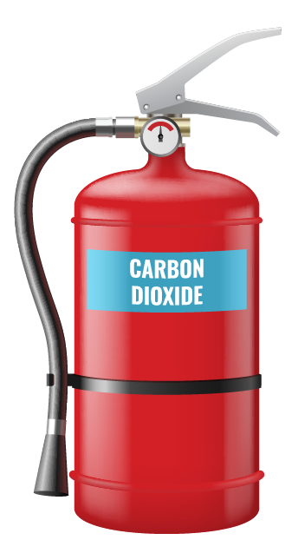
Primary
Fire Fighting Agents Are:
Foam
It is also used on a class B fire and produces a white foam blanket which floats on a flammable fluid.
As foam is applied, an aqueous (like water film) drains from the foam and floats out over the surface of the liquid to provide a seal taking away the oxygen from the fire
Carbon Dioxide
CO2 is used on a Class B and Class C fires.
It smothers a fire by reducing the amount of oxygen available for combustion.

Slide 21
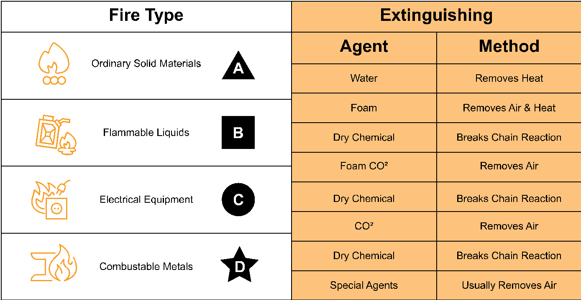
Extinguishing
Agents
Cooking Oils
Foam
Removes Air

Slide 22
You can create a short quiz using the questions in the following questions:
Fire Safety Activity 1
Questions:
For questions 1- 5 choose the class of fire for the following materials
Material: Circuit breaker. Answers: Class A, Class B, Class C, Class D or Class K
Material: Wood. Answers: Class A, Class B, Class C, Class D or Class K
Material Alcohol. Answers: Class A, Class B, Class C, Class D or Class K
Grease in a kitchen. Answers: Class A, Class B, Class C, Class D or Class K
The burning of metals such as metallic substances such as sodium, titanium, zirconium, or magnesium is considered which type of class fire? Answers: Class A, Class B, Class C, Class D or Class K
Activity
Notes:
Questions:
Fire Safety Activity 1
Questions:
For questions 1- 5 choose the class of fire for the following materials
Material: Circuit breaker. Answers: Class A, Class B, Class C, Class D or Class K
Material: Wood. Answers: Class A, Class B, Class C, Class D or Class K
Material Alcohol. Answers: Class A, Class B, Class C, Class D or Class K
Grease in a kitchen. Answers: Class A, Class B, Class C, Class D or Class K
The burning of metals such as metallic substances such as sodium, titanium, zirconium, or magnesium is considered which type of class fire? Answers: Class A, Class B, Class C, Class D or Class K

Slide 23
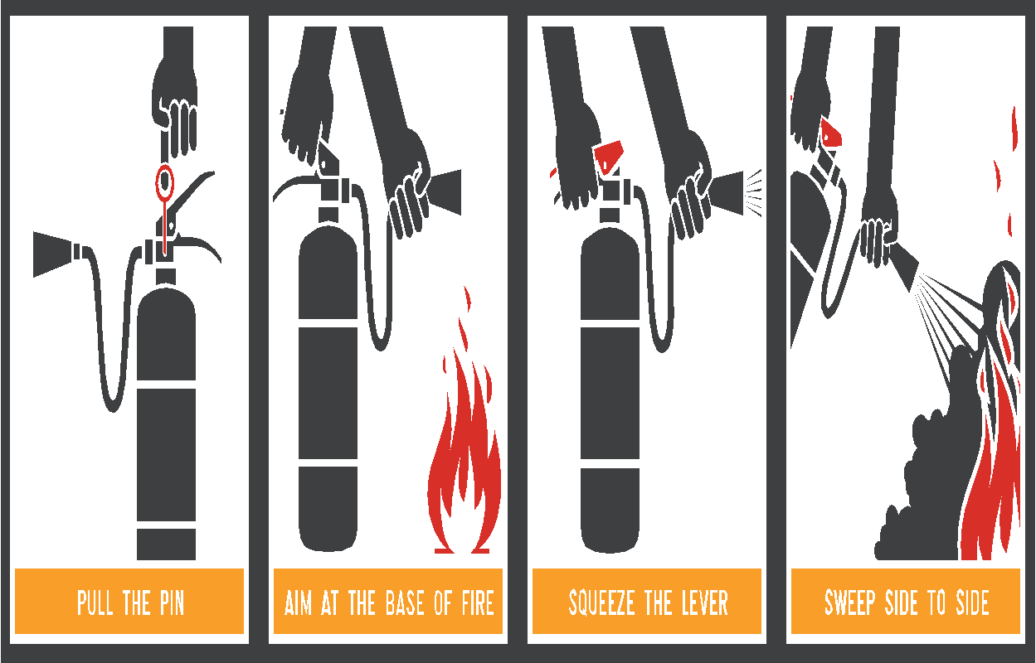

How To
Use A Fire Extinguisher
Extinguisher Instructions
How To Use A Fire Extinguisher: P.A.S.S
PULL THE PIN
AIM AT THE BASE OF FIRE
SQUEEZE THE LEVER
SWEEP SIDE TO SIDE

Slide 24
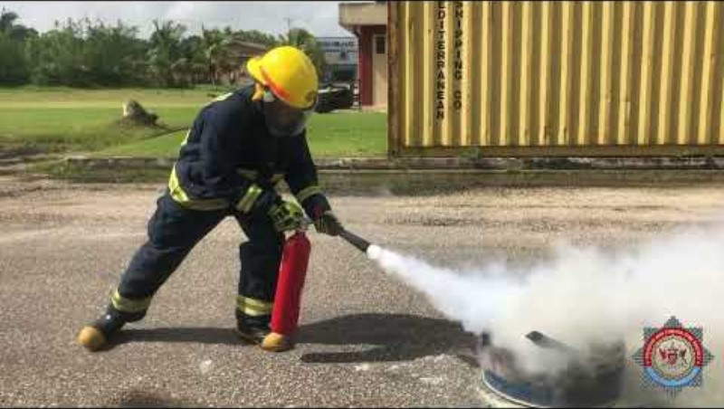
How To
Use A Fire Extinguisher
Extinguisher Instructions

Slide 25
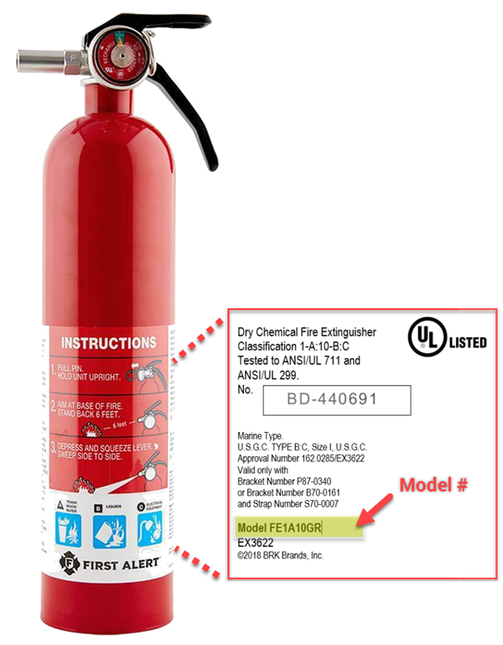
Safety Precautions
Reading the label

Slide 26
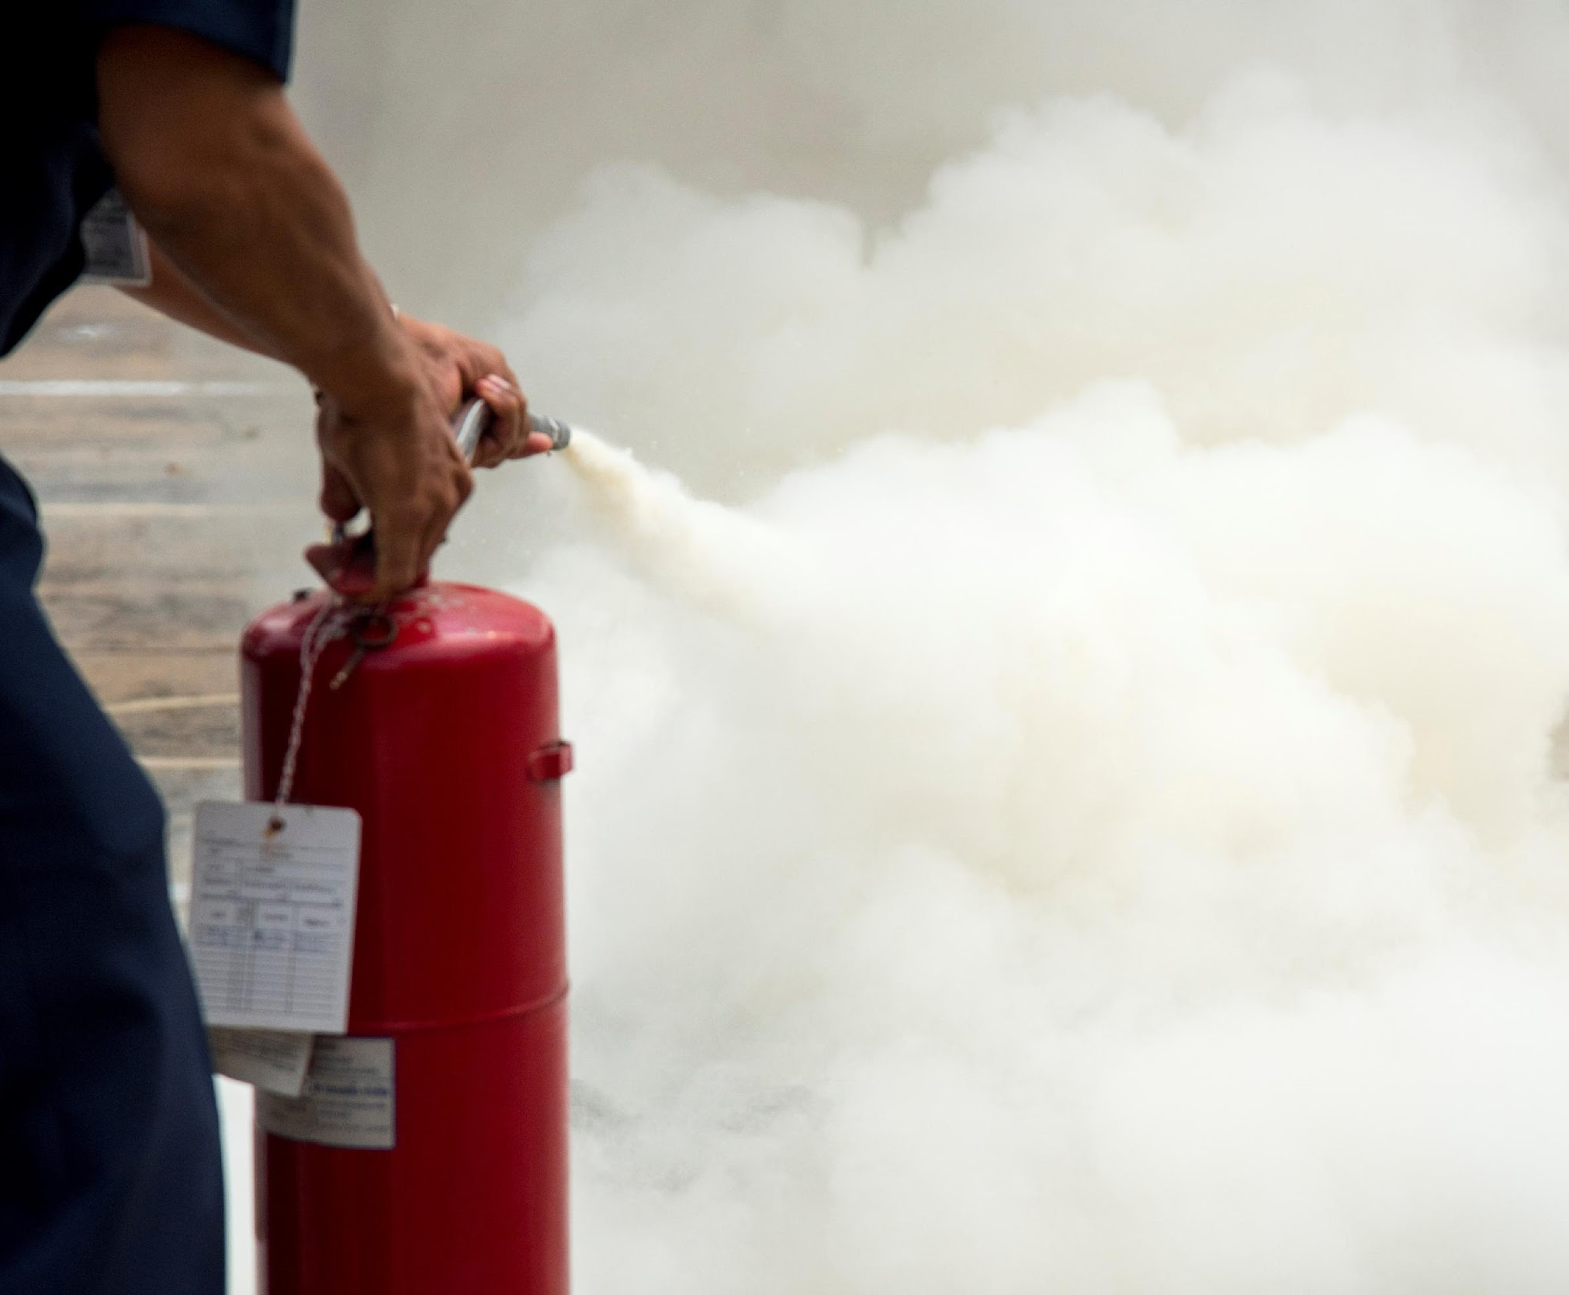
Safety Precautions
Extinguisher Instructions
Always ground the cylinder when using.
Never leave the cylinder standing upright unattended.
Never discharge on to the skin.
Remember CO2 is a smothering agent and is a potential hazard.
Always hold the horn handle to avoid frost burns.
Allow the room to ventilate after discharging a dry chemical fire extinguisher.

Slide 27



Initial Action
The initial action by the person who discovers a fire can MAKE a difference between a controllable fire and one which threatens the whole building
Even small fires can create untenable conditions within the space in as little as 2 minutes.
Initial action must be taken quickly and effectively by the person who discovers the fire.
Note: A fire can double in size every 30 seconds
Notes:
Fire can double in size every 30 seconds

Slide 28
Deciding To Address A Fire
Can I escape quickly and safely from the area if I attempt to extinguish the fire?
LEAVE
IMMEDIATELY, Raise the alarm and CALL THE FIRE DEPARTMENT!
NO
YES
LEAVE
IMMEDIATELY and CALL THE FIRE DEPARTMENT!
Do I have the right type of extinguisher?
NO
YES
LEAVE
IMMEDIATELY and CALL THE FIRE DEPARTMENT!
Is the extinguisher large enough for the fire?
NO
YES
Is the area free from other dangers such as hazardous materials and falling debris?
LEAVE
IMMEDIATELY and CALL THE FIRE DEPARTMENT!
NO
YES
EXTINGUISH THE FIRE!

Slide 29
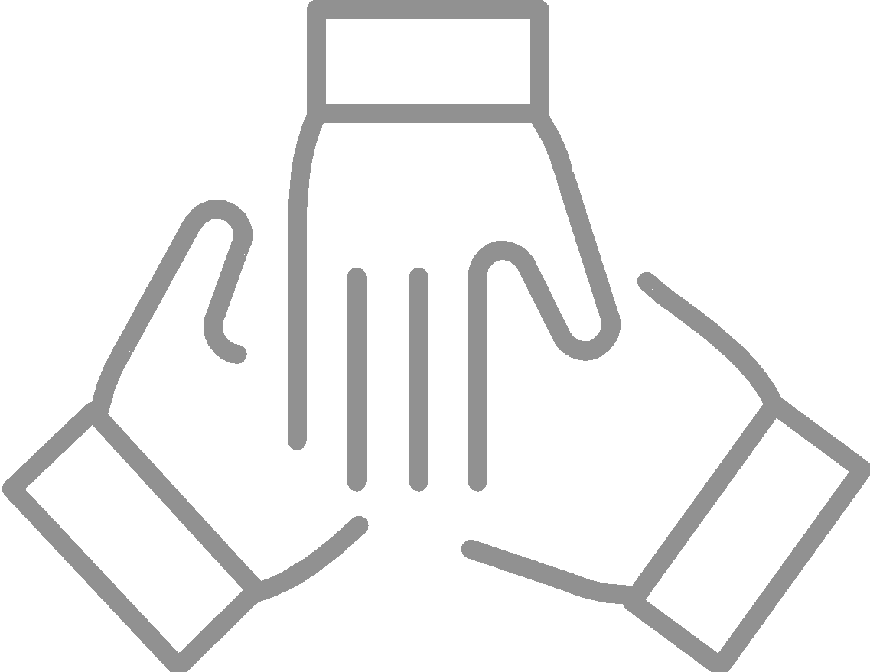

Activity
Each group will be given a paper with different fire scenarios.
Work as a group to decide if you can address each fire situation and if you can, how will you do so?
Scenario given:
Use slide 29 to decide on if you can take action.

Slide 30
Activity:
Fire Risks
Consider your community and
Identify any fire risks in your community.
Identify any actions you can take to reduce these fire risks.
Identify persons who can help with this.
Note: You can also reference Unit 7 on page 17 of the CDRT Workbook

Slide 31
Fire Safety Rules
Store a fire extinguisher at home or at the office.
Identify two ways to safely evacuate your home or office during a fire.
Feel closed doors with the back of your hand.
Confine the fire where possible.
Stay low to the ground and do not enter smoke filled areas.
Maintain a safe distance
Always work with a buddy
Never turn your back on a fire
Call Fire Service

Slide 32
Remember:
Prioritise your personal safety
Personal safety is important. Do not put yourself in unnecessary danger.
Follow the 5 second rule - if you notice no changes to the size of the fire after 5 seconds, evacuate the area.
Do Not make any further attempts at extinguishing the fire.

Slide 33
CDRT Role
Overall Responsibilities and What to do during a fire where possible
Before
During & After
Prevent additional fires by removing fuel sources.
Extinguish small fires before they become major fires.
Educate communities about fire safety.
Assist with evacuations where necessary.
Shut off utilities where necessary.
Call Fire Service

Slide 34
Activity
(If possible)
Practice using a fire extinguisher

Slide 35
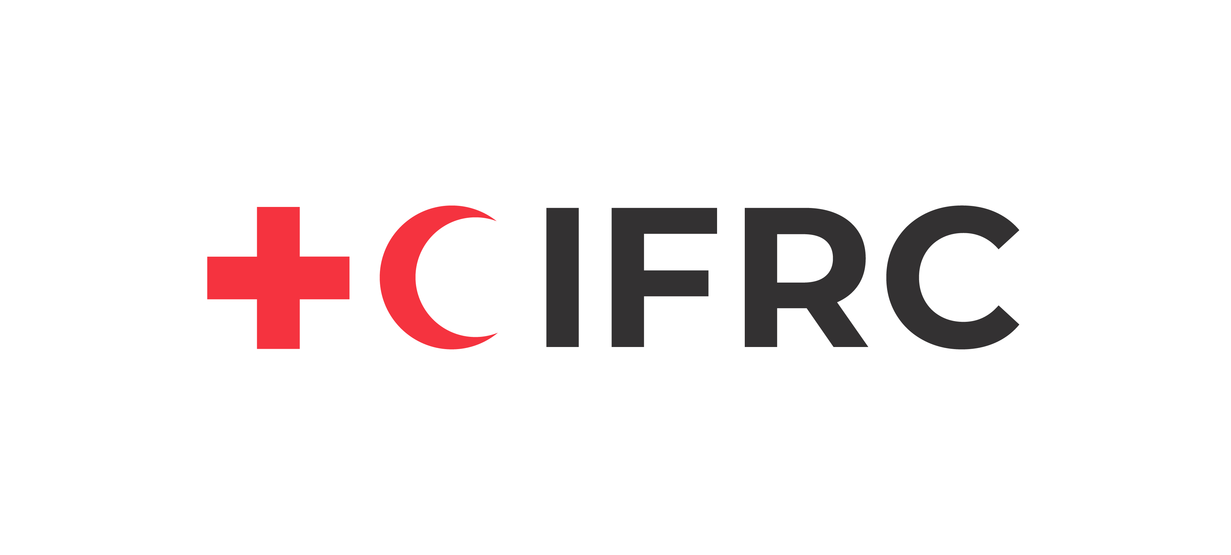




Volunteer, Donate, Join Us In Partnership, or share our appeals and stories on social media. Find out more about IFRC and learn how to contact your National Red Cross or Red Crescent Society, at www.ifrc.org.
Get Involved
There are many ways of becoming a part of the world’s largest humanitarian network
To stay informed about Caribbean disaster response activities or to access additional information on available trainings, training materials, research and information management tools, visit: www.cadrim.org.
: CADRIM.IFRC
: @cadrim_ifrc
: @CADRIM_IFRC

