Slide 1
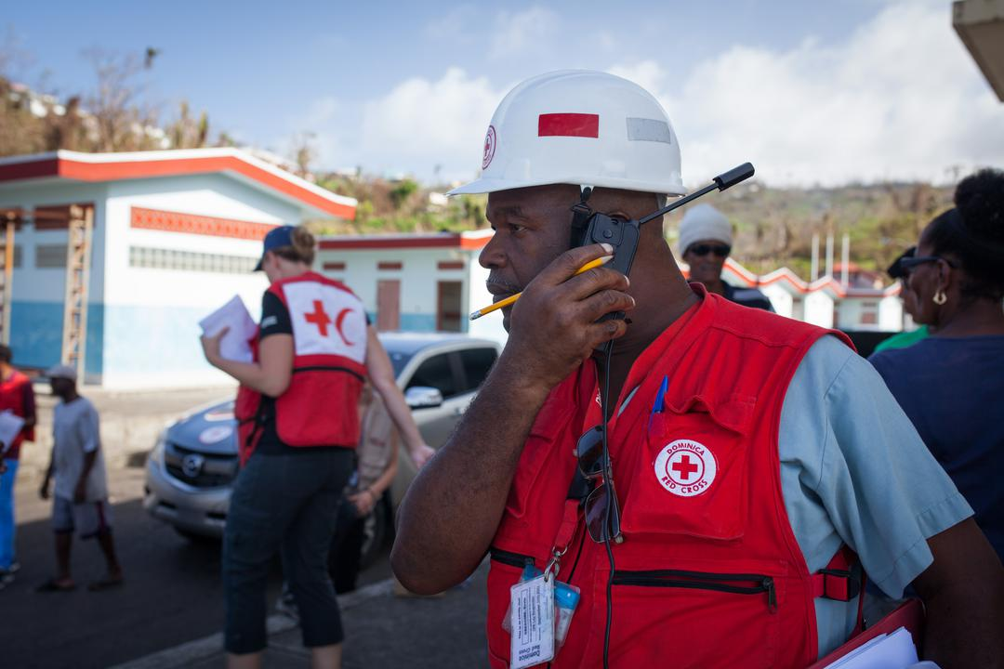


CDRTs & Communication
For Community Response Teams

Slide 2
Objectives
Understand communication
How to communicate effectively
Understand Community Engagement and Accountability (CEA)
Assess barriers to effective communication
Learn to communicate in times of disaster
Understand what is a two-way radio
Understand the basics of using a two-way radio

Slide 3
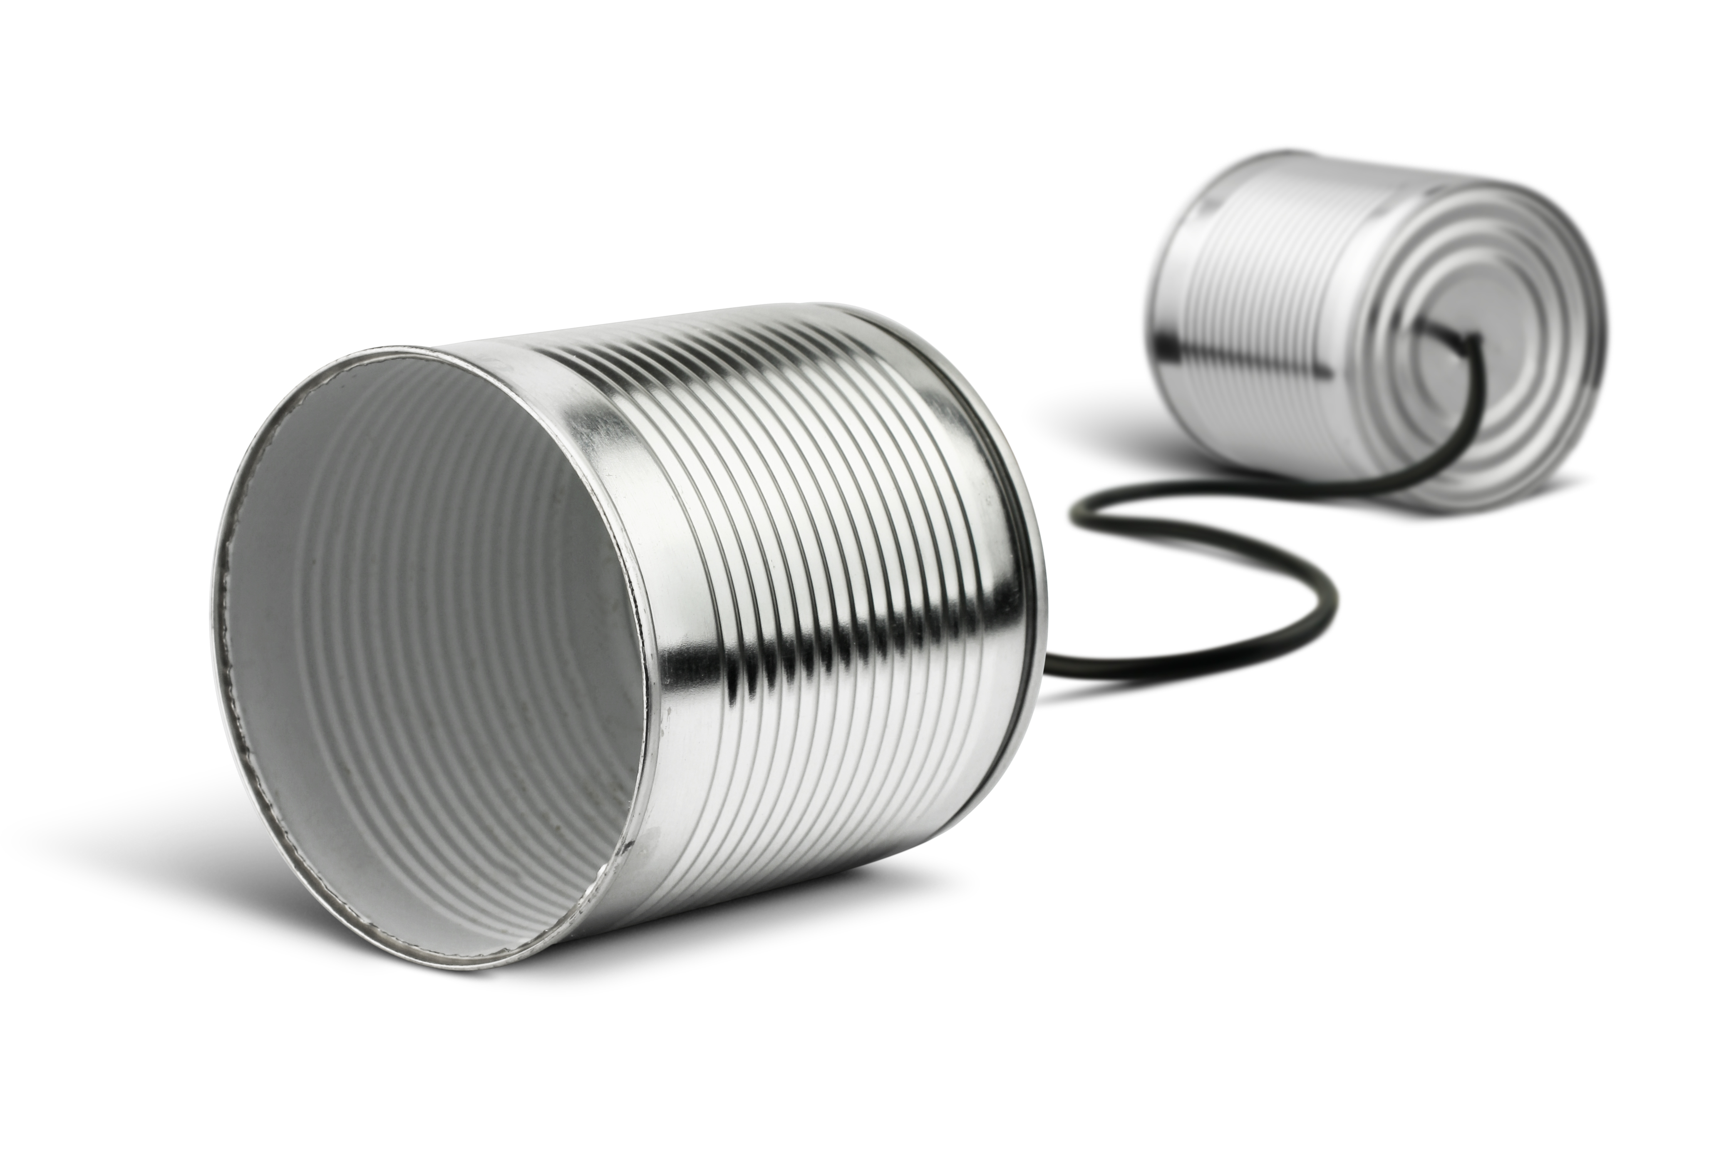
What Is Communication
A process by which information is exchanged between individuals through a common system of symbols, signs, or behaviour.
In its simplest form, it can be defined as an exchange of information.

Slide 4
Communicating
Appropriately
Communication skills are needed for transferring information for different phases of an emergency.
CDRTs MUST CONSIDER:
Preferred method of communicating in the community
Timeliness of communicating
Vulnerable Groups
Appropriate communication tools

Slide 5
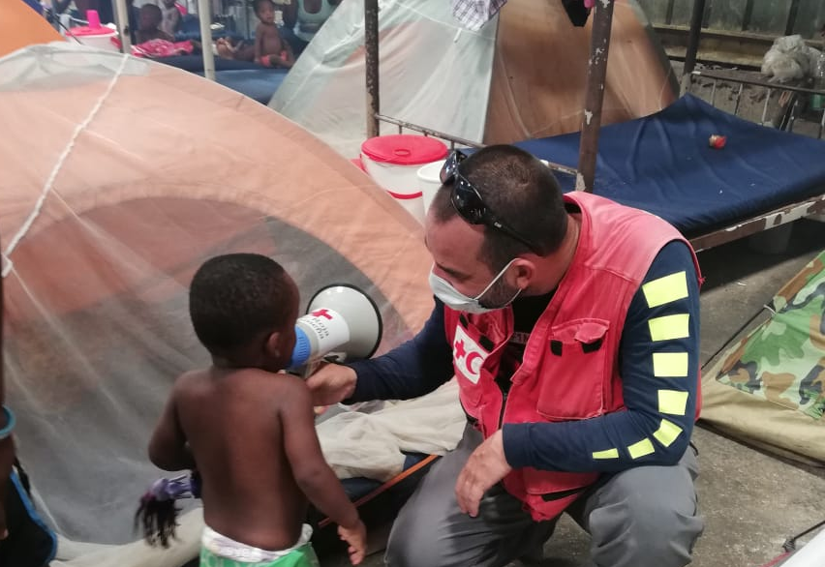
What is Community Engagement & Accountability (CEA)?
It is an approach used by the Red Cross to ensure that communities are at the centre of the work being done by integrating communication and participation throughout programme cycles and operations.

Slide 6
Why is CEA Important?
Leads to better, more effective programming
Improves acceptance and trust
Feedback and complaints are good.
Help to saves lives.
Empower people and builds community resilience.
Supports positive behavior and social change.
Recognises the community as experts and partners.
Supports NS to fulfil their auxiliary role.
Contributes to “do no harm” programming.
Helps to manage community expectations.

Slide 7

CEA Contributes To
Stronger Accountability To Communities
Safer Access And Acceptance
Sustainable & Community Driven Programmes
More Resilient Communities

Slide 8
CEA Contributes To

Slide 9
Let’s Talk
Communicating Before A Disaster
Ensure Community Participation & Feedback
Share information that meet their needs and are relevant.
Include all groups in discussions
Establish a feedback system
Encourage Behaviour & Social Change Communication
Encourage open discussions that allow insight into perceptions and behaviours.
Help communities adopt safer and healthier practices.
Use Community-based Information To Help With Advocacy
Help communities understand how to use their knowledge and information to speak out about issues that affect them and make their voices heard.

Slide 10
Communicating
During Disasters
Providing timely, accurate, life saving information to the affected population using local media.
Provide information intended to save lives and prevent further crisis
Provide guidance on where to get assistance
Provide information regarding their legal rights and who is in charge

Slide 11
Let’s Talk
Communication
Barriers
Linguistic And Cultural Diversity.
Exposure To A Range Of Hazards.
Variable Access To, And Use Of Technology
Age Differences

Slide 12
Develop A CDRT Communications Plan
Your plan should outline:
How CDRTs are activated
How CDRTs communicate with each other
Who and how CDRTs can communicate with the National Society
Who and how CDRTs can communicate with the National Disaster Office
Identify other relevant stakeholders and identify who, how and when these stakeholders should be contacted.

Slide 13

Modes Of
Communication
Runner
Landline Telephones
Cell Phones
Two-way Radios
Electronic

Slide 14
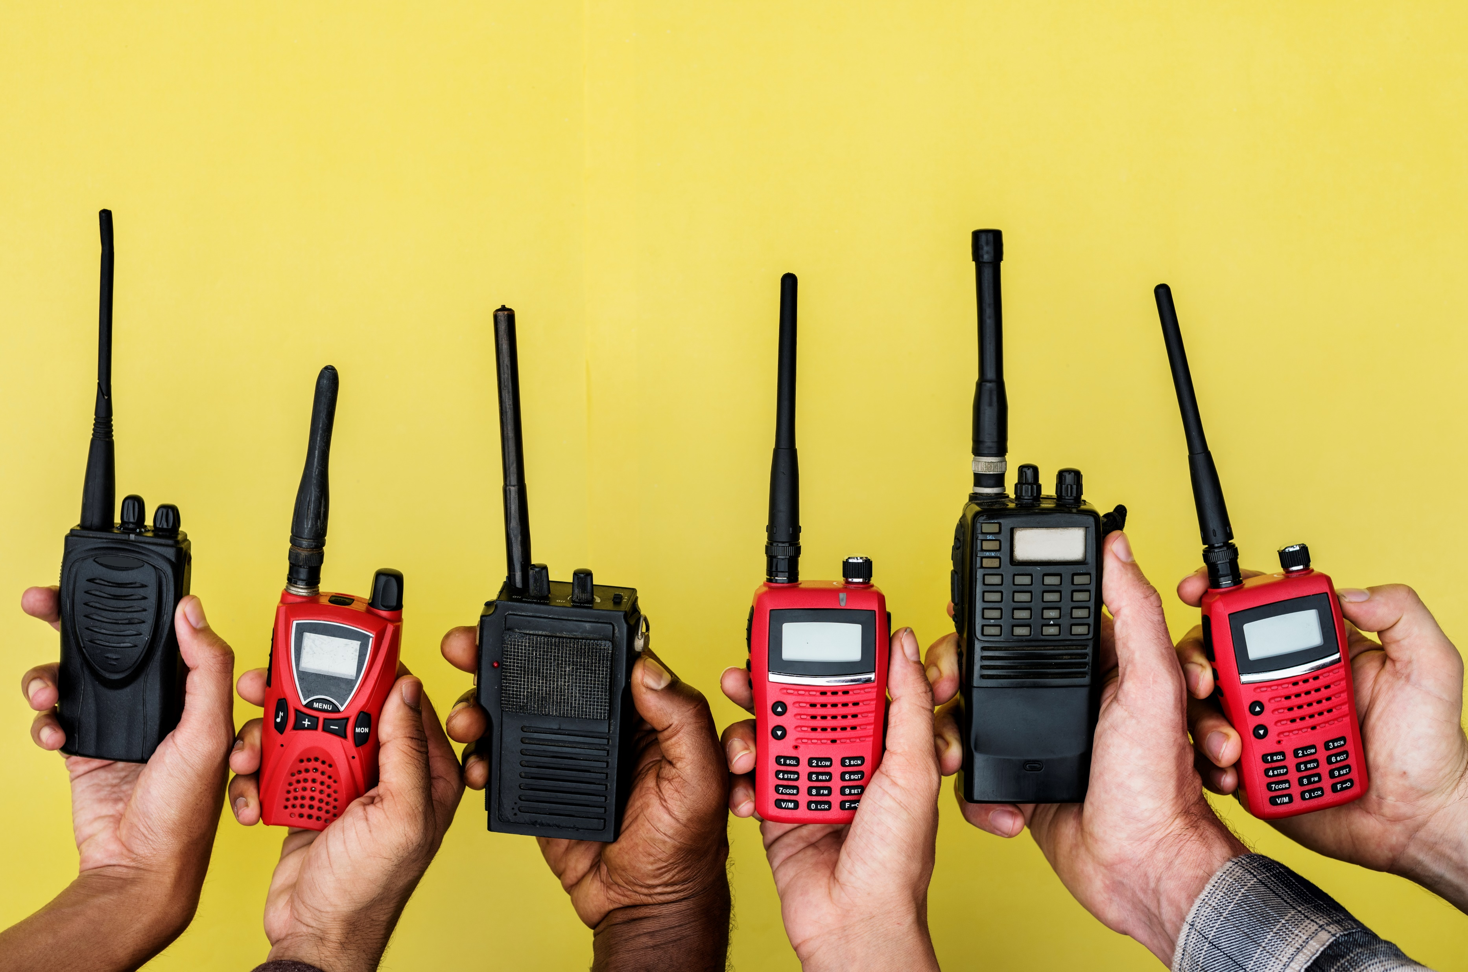
Two Way Radios
What Are Two
Way Radios?
Two-way radios include a variety of devices and are often defined by the frequencies (or channels) they are designed to operate on. Radios capable of more powerful transmissions typically require a license from the Federal Communications Commissions.

Slide 15
Two Way Radios
How Do They Work?
Two-way radios operate by transmitting and receiving on certain frequencies.
On radios, frequencies are typically divided into several discrete channels.
Only one person can speak on a channel at a time, more channel availability means more conversations can happen in the area.
Each team is typically assigned a channel to use as part of the communications plan.

Slide 16
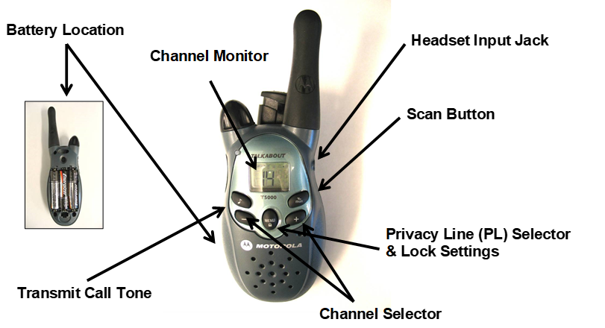
Two Way Radios
How Do They Work?

Slide 17
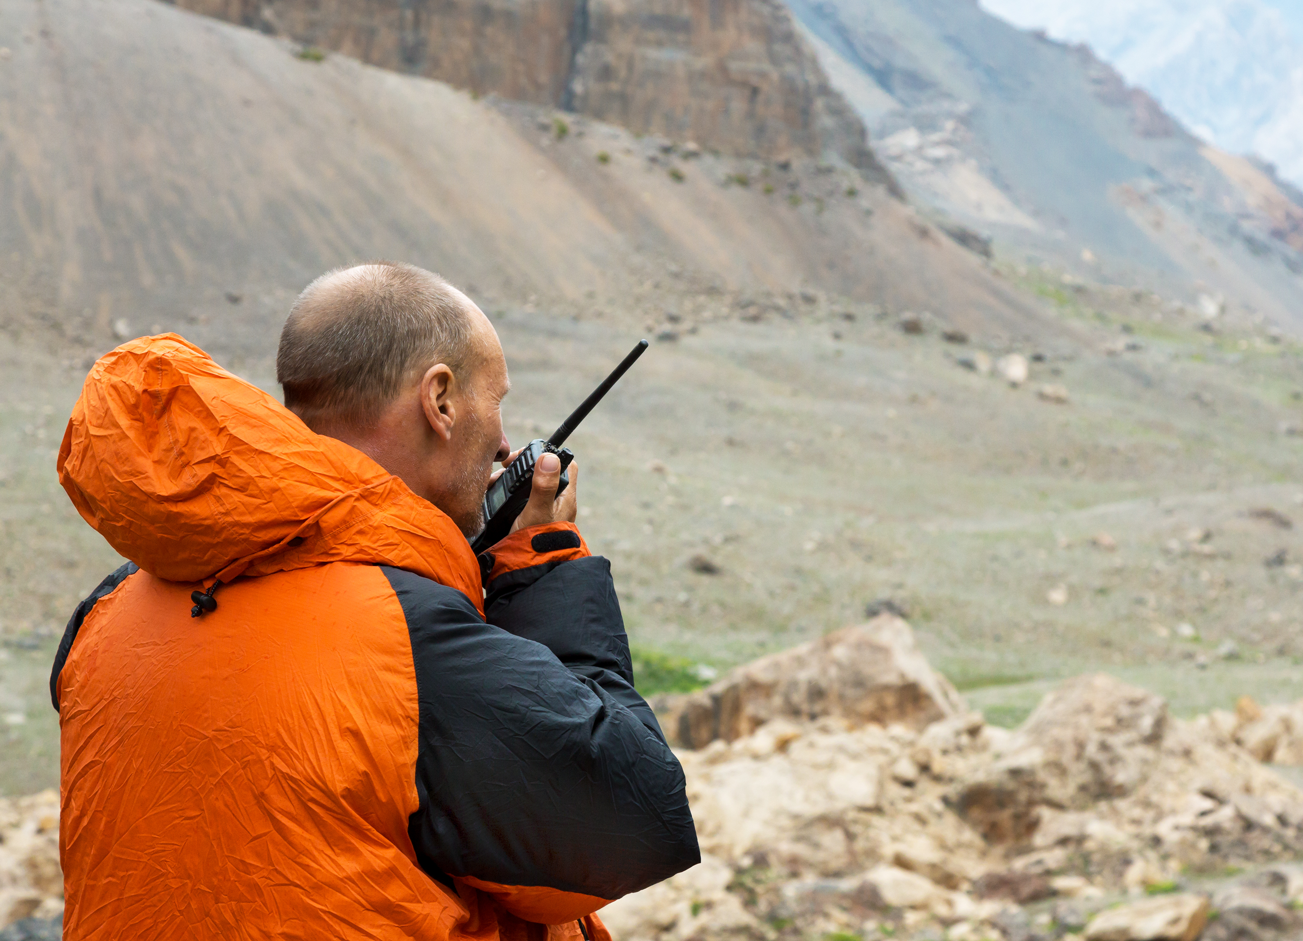
Tips On Using Two-Way Radios
Select a channel
Press the Push-to-talk button when speaking
Speak across the radio microphone rather than directly into it.
Keep the antenna in a vertical position when talking.
Release the push-to-talk button when done speaking.

Slide 18
Phonetic Alphabet
Phonetic Alphabet
A--Alfa B--Bravo C--Charlie D--Delta E--Echo F--Foxtrot G--Golf H--Hotel I--India | J--Juliet K--Kilo L--Lima M--Mike N--November O--Oscar P--Papa Q--Quebec R--Romeo | S--Sierra T--Tango U--Uniform V--Victor W--Whiskey X--X-ray Y--Yankee Z--Zulu

Slide 19
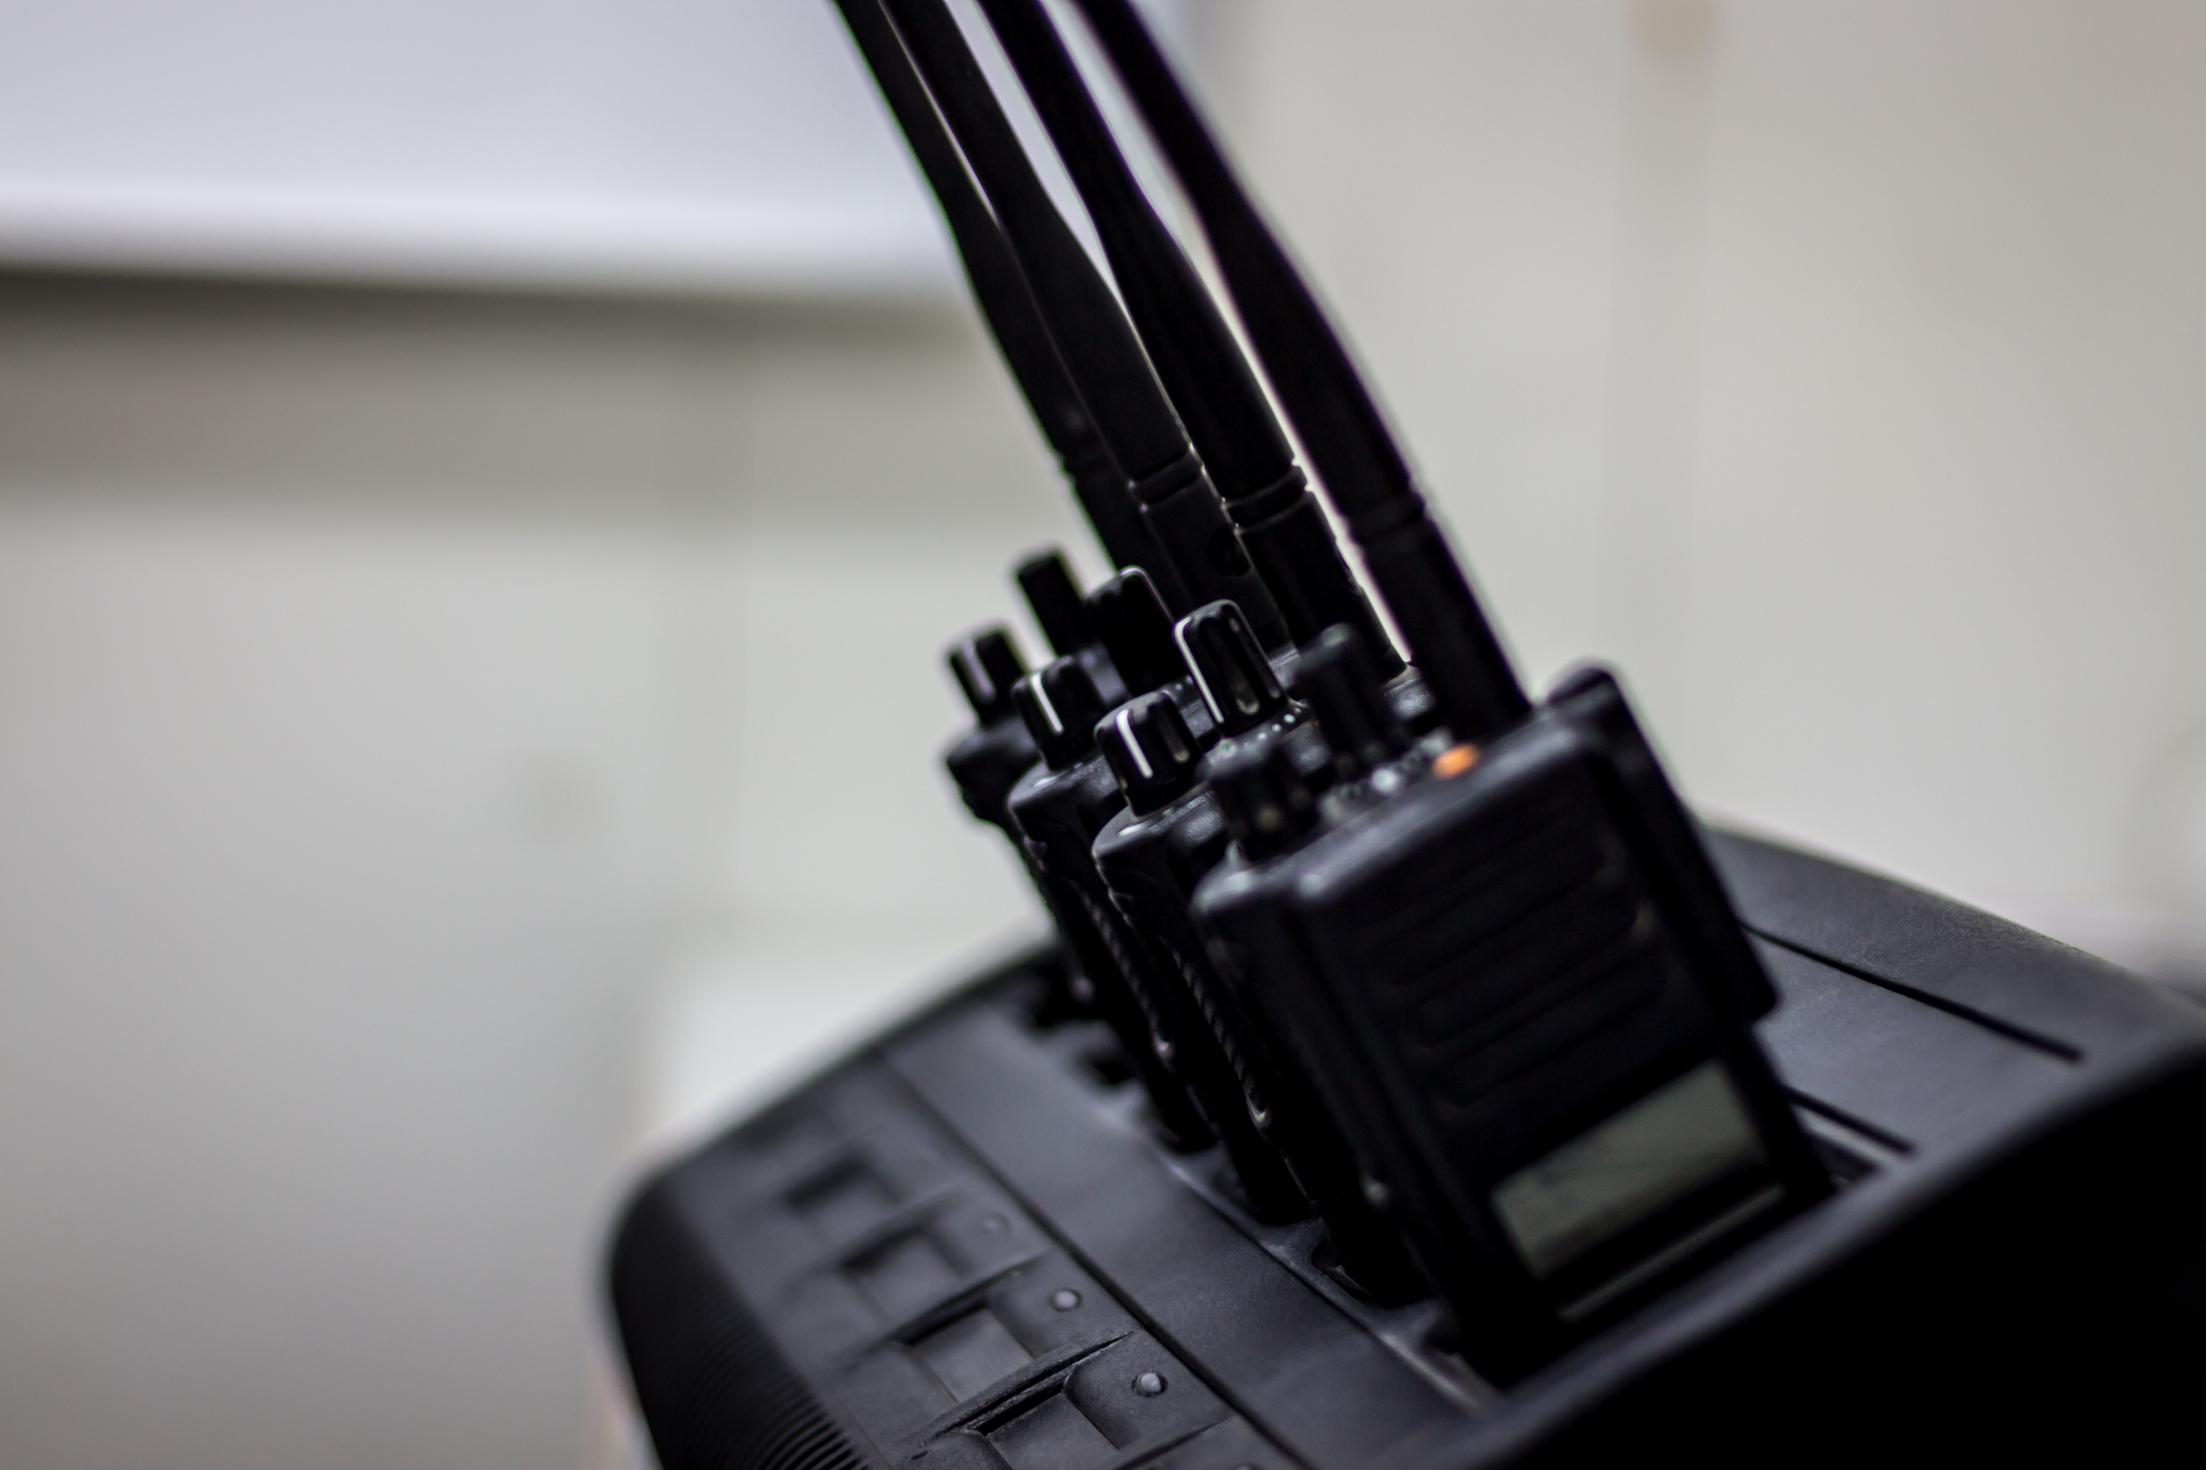
Communicating In A Disaster :
Effective Messaging
Be Simple
Communicate The Threat
Provide A Call To Action
Be Accessible
Reach Out To As Many People As Possible
Never Cause Harm Or Create A Panic
Coordinate With Others

Slide 20
Working
With Others
Be aware of information being circulated it can become contradictory and disruptive causing isolation and fear among the affected communities.
Find out if there is an existing CEA group and join. This allows for sharing of information and improved planning on needs and state of local media and communications.
Coordinate with other departments in your NS and be aware of the information shared as this will provide for better CEA involvement

Slide 21
Activity:
Exercise On Communication In Disasters
BEFORE:
How would you approach community members to support you as a CDRT to respond in emergencies within the community?
DURING:
Then, identify a risk such as Flooding, Fires or landslides, whereby you will need to list 3 appropriate channels of communicating to community members about the hazard and danger
AFTER:
Discuss a proper method to collect feedback and complaints in their community.

Slide 22
Volunteer, Donate, Join Us In Partnership, or share
our appeals and stories on social media. Find out more about IFRC, and learn how to contact your National Red Cross or Red Crescent Society, at www.ifrc.org
Get Involved
There are many ways of becoming a part of the world’s largest humanitarian network
P.O. Box 303
CH-1211 Geneva 19
Switzerland
Telephone: +41 22 730 4222
Fax: +41 22 730 4200
Email: secretariat@ifrc.org
Website: www.ifrc.org

