Slide 1
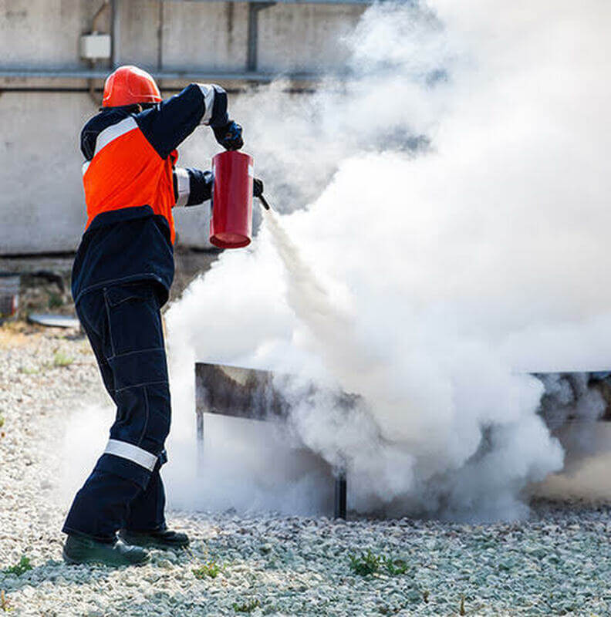


CDRTs &
Fire Safety
For Community Response Teams

Slide 2
Objectives
Understand Fire Basics
Understand Fire Chemistry
Understand Fire Hazards in the Home and Workplace- add content
Learn Fire Classifications and How to extinguish a fire.
Fire Prevention- add content
Learn About Fire Fighting Agents and Portable Fire Extinguishers
Understand Fire Safety: Assess the Situation and Determine a Course of Action

Slide 3
CDRT Role
Overall Responsibilities and What to do during a fire: two main themes
Extinguish small fires before they become major fires.
Assisting with evacuations where necessary.
Prevent additional fires by removing fuel sources.
Educating communities about fire safety.
Shutting off utilities where necessary.
Call Fire Service

Slide 4
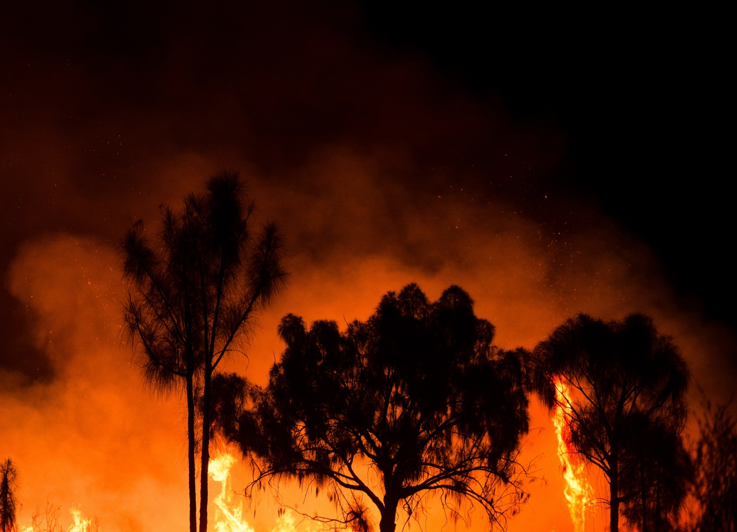
What Is
A Fire?
A chemical reaction known as a rapid oxidation that produces heat and light in the form of flames.

Slide 5
Fire Basics
Flash Point
The lowest temperature at which a flammable substance gives off vapours that will burn.
Fire Point
The lowest temperature at which a fuel will continue to burn after ignition.
Spontaneous Combustion
This is also called the auto-ignition/ when a substance or material ignites without the introduction of an outside source.

Slide 6

Fire Chemistry
Three elements required for a fire are:
OXYGEN
FUEL
Chemical
Reaction
IGNITION / HEAT

Slide 7
Fire Chemistry
Three elements required for a fire are:
Fuel
Any material that will burn (e.g. rags, paper, wood)
Heat
Anything which raises temperature of a fuel source
Mechanical Friction
Electrical high current
Static charge/discharge
Chemical reaction
Oxygen
The content of the surrounding air
Air normally contains about 21% oxygen
The minimum oxygen needed for combustion is 15%
Smoldering can take place with as little as 3% oxygen

Slide 8
Heat Transference
Methods By Which Heat
Is Transferred
Conduction
Transfer of heat through a solid (object) or liquid (water)
Convection
Transfer of heat through the motion of smoke and hot gases in the air
Radiation
Transfer of heat from a source across an intervening space eg. sunlight

Slide 9
Incipient Stage
The incipient stage or is the beginning of a fire where the temperature is low, the fire is localized in the vicinity of its origin and smoke has not yet reduced visibility in the vicinity of the fire.
Fire Has 4
Distinct Stages
Growth Stage
In the growth stage the fire size continues to increase in size by generating its own heat and plumes of smoke is visible.
Fully Developed
In this stage the fire is at its hottest point and all flammable materials in the space is burning. The rate of burning is also limited to the amount of oxygen present and during this stage, all persons should stay clear of the fire.
Decay Stage
The fire has consumed all available oxygen and fuel and can no longer sustain itself. The temperature starts to decrease, and the fire becomes less intense until the combustion fully stops.

Slide 10
Fires at Home
Kitchen Fires are the Most Common
Stay in the kitchen while cooking on stovetops.
Make sure the area near the microwave is free of clutter.
Don’t use water to stop a grease fire, use a fire extinguisher or cover the pan or pot with a lid to suffocate the fire.
Faulty or Old Appliances Can Cause Fires
Unplug appliances when not in use.
Don’t run extension cords under rugs.
Check cords of appliances for wear and tear periodically.
Ensure that electrical outlets are not overloaded.

Slide 11
Prevent Fires at Home
Install Fire Alarms
Test them once a month
Ensure all household members including children, know what to do when they hear the alarm.
Develop an Evacuation Plan
Ensure all household members know of two ways to escape from every room.
Keep keys for burglar proof windows in a safe place that is easily accessible.

Slide 12
Prevent Fires at Home
Other Tips
-Keep matches and lighters out of the reach of children.
-Store all flammable liquids or hazardous chemicals in a safe place away from heat releasing objects or appliances.
-Ensure all household members know the number for the fire department.
-Avoid clutter or pile up of old newspapers
-Learn how to switch off circuit box/fuse box.

Slide 13
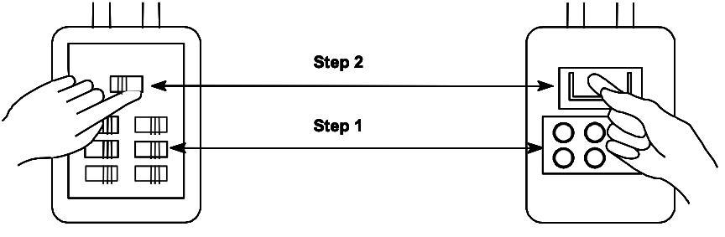
Turning Off Circuit Boxes and Fuse Boxes
CIRCUIT BOX WITH SHUTOFF
FUSE BOX WITH SHUTOFF
Circuit box showing shutoff steps.
Step 1: Shut off individual breakers. Step 2: Shut off main breaker.
Fuse box showing shutoff steps.
Step 1: Pull out individual fuses.
Step 2: Pull out main fuse.
Notes:
Avoid the “electrical octopus.” Eliminate tangles of electrical cords. Don’t overload electrical outlets. Don’t plug power strips into other power strips.
Don’t run electrical cords under carpets.
Replace broken or frayed cords immediately.
Maintain electrical appliances properly. Repair or replace malfunctioning appliance
Know where the power shutoffs for electrical appliances are.
Know where the power shutoff for circuit breakers or fuses is and how to shut off the power.

Slide 14
Main Causes of Workplace Fires
Neglect and overloading of electrical outlets.
Smoking and not discarding of cigarette butts or lit matches appropriately.
Improper storage of flammable liquids and hazardous chemicals.
Clutter and pile up of shredded paper or old newspapers.
Fires At The Workplace

Slide 15
Install Fire Alarms
Test them once a month
Ensure all employees know what to do when they hear the alarm.
Develop An Evacuation Plan
Post fire escape plans on every level of the building.
Assign and train safety wardens on every level of the building.
Teach employees about exit locations, escape routes and where the fire extinguishers are located.
Practice drills regularly.
Keep emergency exits free of clutter.
Prevent Fires At The Workplace

Slide 16
Fire Classification
Class A Fires
Ordinary combustibles such as paper, cloth, wood, rubber, and many plastics.
Class B Fires
Flammable liquids (e.g., oils, gasoline) and combustible liquids (e.g., charcoal lighter fluid, kerosene). These fuels burn only at the surface because oxygen cannot penetrate the depth of the fluid. Only the vapor burns when ignited.
Class C Fires
Energized electrical equipment (e.g., wiring, motors). (When the electricity is turned off, the fire becomes a class A fire.)
Class D Fires
Combustible metals (e.g., aluminum, magnesium, titanium).

Slide 17
How To Extinguish
A Fire
Cooling
Cooling occurs when heat is either eliminated or reduced below the temperature needed for ignition. A common method of cooling is by using water.
Starving
Starving is the removal of the fuel needed to sustain a fire as a fire will keep burning once there is combustible material present. Starving can be done by turning off the gas supply.
Smothering
Smothering is the removal of oxygen and is most applicable to solid fuel fires. Smothering can be achieved by using a fire blanket.

Slide 18
Fire Fighting Agents
Many elements (liquids, gases and solids) can be used as firefighting agents. The proper agents to use in a given situation will depend on:
The Class Of Fire
The Location Of Fire
The Extent Of The Fire
Availability Of Fire Fighting Equipment

Slide 19
The Primary Agents Are:
Water
Aqueous potassium carbonate (APC)
Aqueous Firm Forming Foam (AFFF)
Carbon Dioxide
Purple Potassium Powder (pkp)
Halon 1301

Slide 20
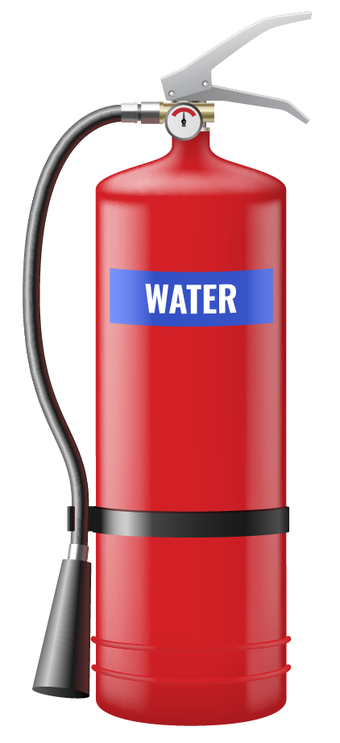
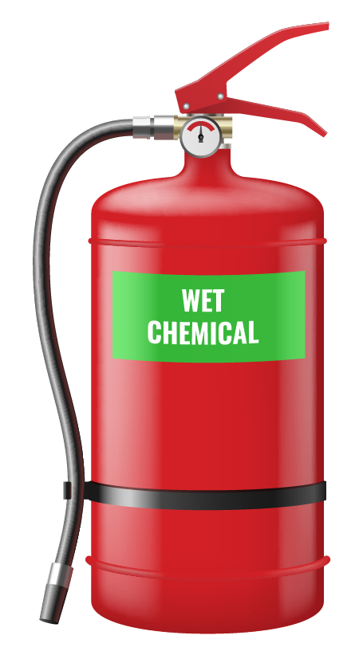
Primary
Fire Fighting Agents Are:
Water
This is the most common agent used with the removal of heat by cooling. It is the most effective method used to put out a class A fire.
Aqueous Potassium Carbonate
It is used for Class B fires. It extinguishes burning cooking oil and grease in deep fat fryers in kitchens. Upon contact with the burning surface the (APC) releases a soapy foam. This foam releases carbon dioxide glycerin bubbles that float on top of the grease, preventing air from reaching the fire.

Slide 21
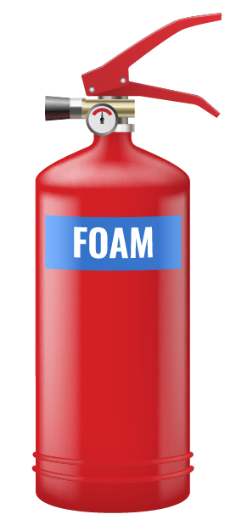
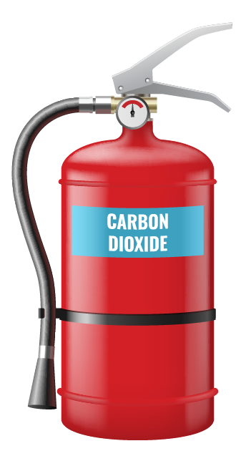
Primary
Fire Fighting Agents Are:
Aqueous Film Foaming Foam (AFFF)
It is also used on a class B fire and produces a white foam blanket which floats on a flammable fluid.
As foam is applied, an aqueous (like water film) drains from the foam and floats out over the surface of the liquid to provide a seal taking away the oxygen from the fire
Carbon Dioxide
CO2 is used on a Class B and Class C fires.
It smothers a fire by reducing the amount of oxygen available for combustion.

Slide 22
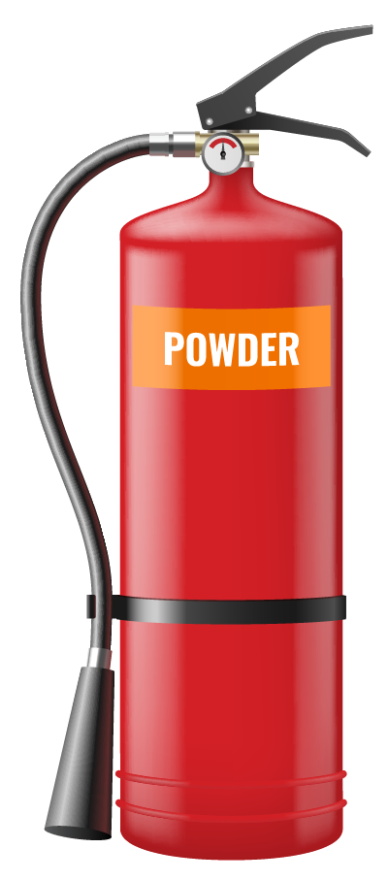
Primary
Fire Fighting Agents Are:
Purple Potassium Powder (PKP)
It is used on Class B and C fires. It is a dry chemical agent that extinguishes the fire by interrupting the chemical chain reaction.
This should not be used on electrical or electronic equipment as it can cause damage to them. This is found in portable extinguishers and can be effective up to 19 feet away from the fire.

Slide 23
Extinguishing
Agents

Slide 24
Activity
Split into groups.
Each group will be given pieces of paper with the name of a flammable material.
Take turns randomly choosing a piece of paper and state the corresponding class of fire and type of fire extinguisher to be used.
Notes:
Portable extinguishers use either Carbon Dioxide or PKP

Slide 25
How To
Use A Fire Extinguisher
Extinguisher Instructions
How To Use A Fire Extinguisher: P.A.S.S

Slide 26
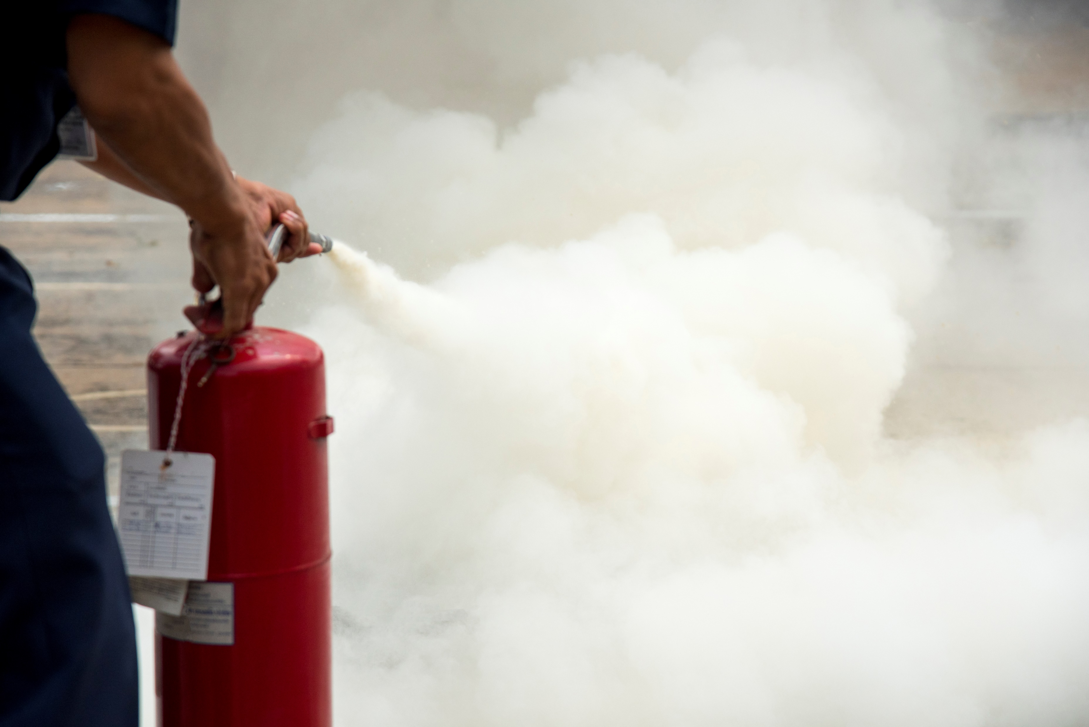
Safety Precautions
Extinguisher Instructions
Always ground the cylinder when using.
Never leave the cylinder standing upright unattended.
Never discharge on to the skin.
Remember CO2 is a smothering agent and is a potential hazard.
Always hold the horn handle to avoid frost burns.

Slide 27
Initial Action
The initial action by the person who discovers a fire can MAKE a difference between a controllable fire and one which threatens the whole building
Even small fires can create untenable conditions within the space in as little as 2 minutes.
Initial action must be taken quickly and effectively by the person who discovers the fire.

Slide 28
Deciding To Address A Fire
LEAVE
IMMEDIATELY and CALL THE FIRE DEPARTMENT!
Can I escape quickly and safely from the area if I attempt to extinguish the fire?
NO
YES
LEAVE
IMMEDIATELY and CALL THE FIRE DEPARTMENT!
Do I have the right type of extinguisher?
NO
YES
LEAVE
IMMEDIATELY and CALL THE FIRE DEPARTMENT!
Is the extinguisher large enough for the fire?
NO
YES
Is the are free from other dangers such as hazardous materials and falling debris?
LEAVE
IMMEDIATELY and CALL THE FIRE DEPARTMENT!
NO
YES
EXTINGUISH THE FIRE!

Slide 29
Activity
Work as a group to decide if you can address a fire situation and if you can, how will you do so?
Scenario given:
Use slide 25 to decide on if you can take action.

Slide 30
Fire Safety Rules
Store a fire extinguisher at home or at the office.
Identify two ways to safely evacuate your home or office during a fire.
Feel closed doors with the back of your hand.
Confine the fire where possible.
Stay low to the ground.
Maintain a safe distance
Call Fire Service

Slide 31
CDRT Role
Overall Responsibilities and What to do during a fire: two main themes
Extinguish small fires before they become major fires.
Assisting with evacuations where necessary.
Prevent additional fires by removing fuel sources.
Educating communities about fire safety.
Shutting off utilities where necessary.
Call Fire Service

Slide 32
Volunteer, Donate, Join Us In Partnership, or share
our appeals and stories on social media. Find out more about IFRC, and learn how to contact your National Red Cross or Red Crescent Society, at www.ifrc.org
Get Involved
There are many ways of becoming a part of the world’s largest humanitarian network
P.O. Box 303
CH-1211 Geneva 19
Switzerland
Telephone: +41 22 730 4222
Fax: +41 22 730 4200
Email: secretariat@ifrc.org
Website: www.ifrc.org

