Slide 1
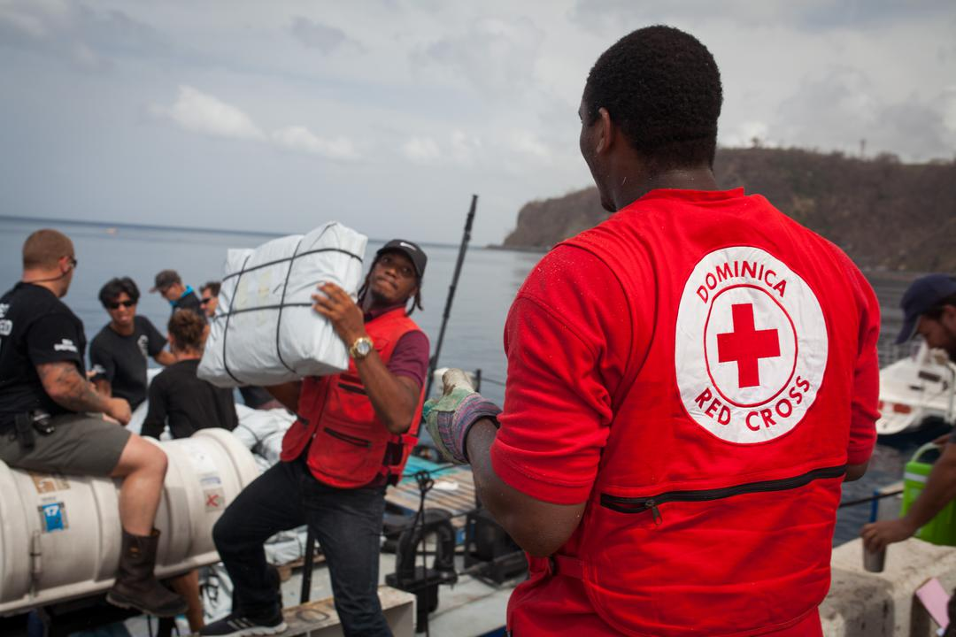


CDRTs & Disaster Risk Management
For Community Response Teams

Slide 2
Objectives
Be more knowledgeable about the common disaster management terms
Understand what is a disaster and a hazard
Have an awareness and understanding of the common hazards
Understand why these hazards affect households and countries
Learn about climate change and its effects
Learn about climate change adaptation

Slide 3
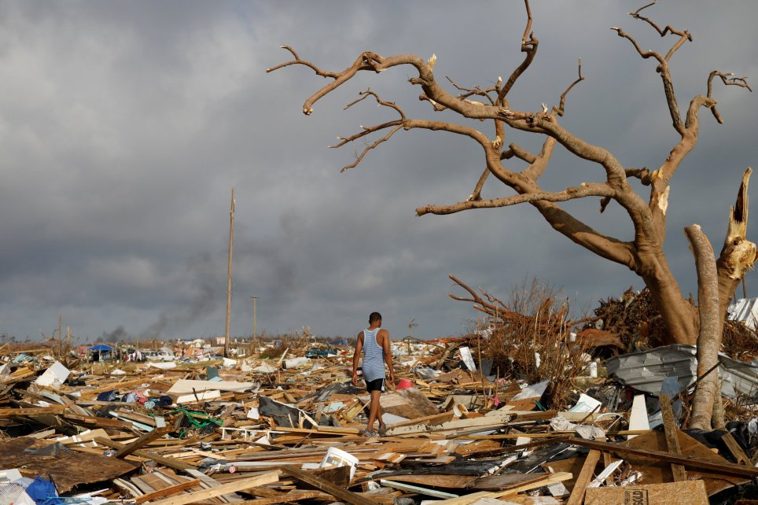
What Is
A Disaster?
A serious disruption of the functioning of a community or a society.
Widespread effect that could last for a long period of time.
Any effect that may exceed the capacity of a community or society to cope using its own resources.
Notes:
A serious disruption of the functioning of a community or a society at any scale due to hazardous events interacting with conditions of exposure, vulnerability and capacity, leading to one or more of the following: human, material, economic and environmental losses and impacts.
Pic source Read more: https://metro.co.uk/2019/09/09/will-devastating-hurricane-dorian-hit-uk-week-10708668/?ito=cbshare
Twitter: https://twitter.com/MetroUK | Facebook: https://www.facebook.com/MetroUK/
Annotations: The effect of the disaster can be immediate and localized, but is often widespread and could last for a long period of time. The effect may test or exceed the capacity of a community or society to cope using its own resources, and therefore may require assistance from external sources, which could include neighbouring jurisdictions, or those at the national or international levels.

Slide 4
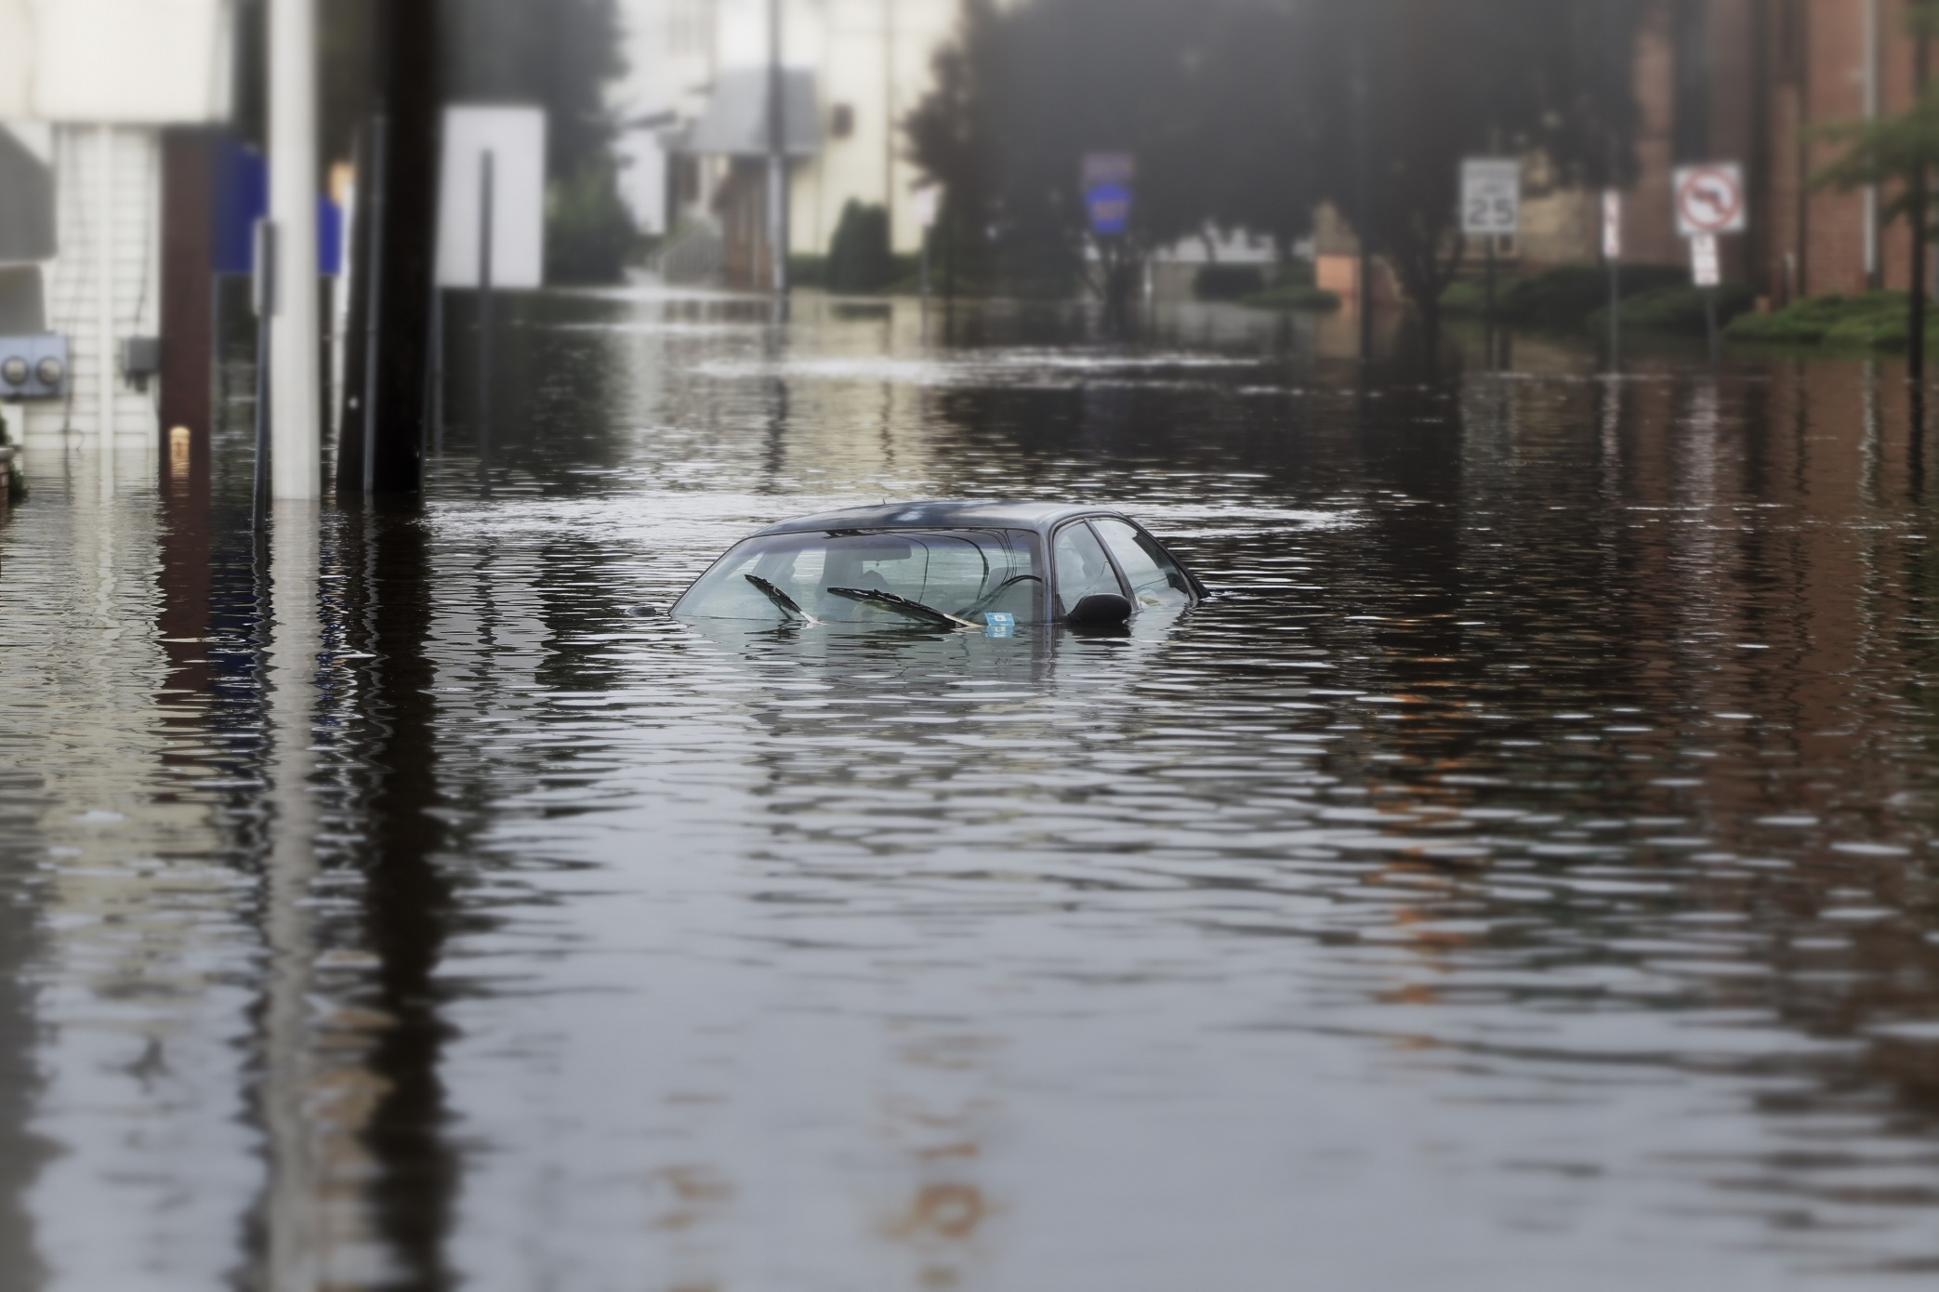
What Is
A Hazard?
A dangerous event,
substance, human activity or condition that causes loss.
Notes:
“A dangerous phenomenon, substance, human activity or condition that may cause loss of life, injury or other health impacts, property damage, loss of livelihoods and services, social and economic disruption, or environmental damage” Definition (UNDRR)
Pic. Mashable.Com IMAGE: @MACHEL MONTANO ON INSTAGRAM

Slide 5
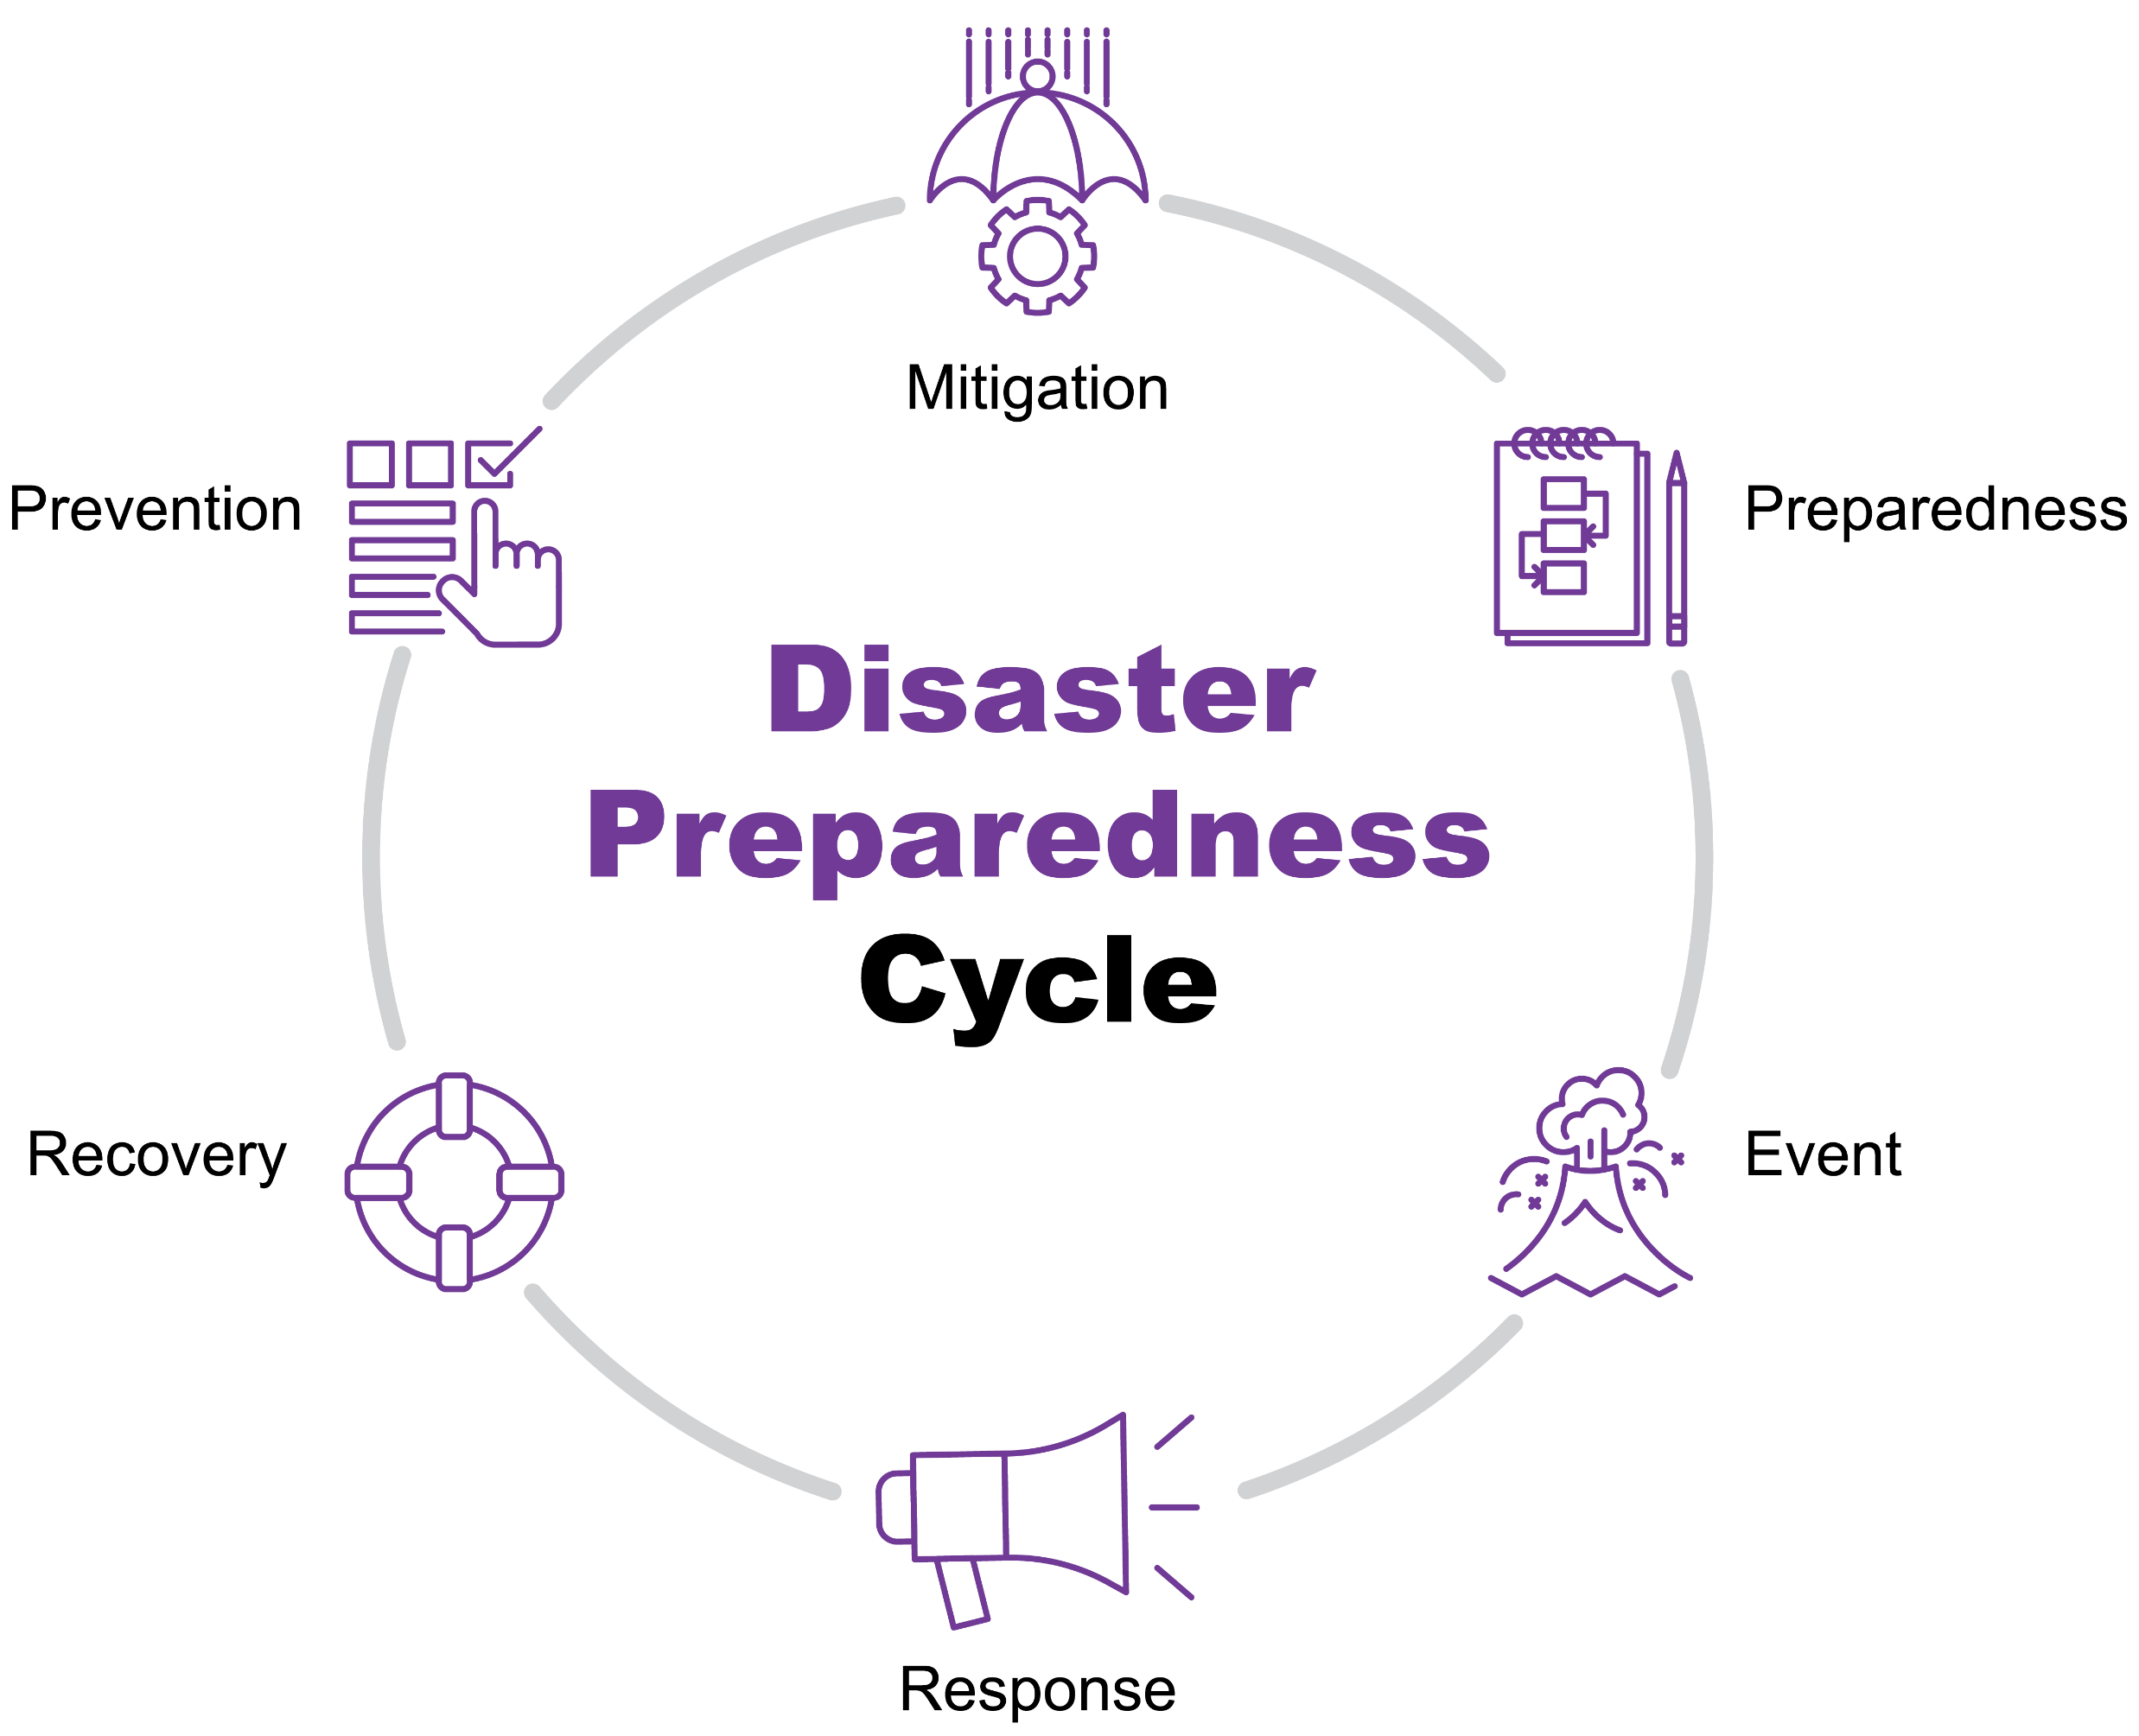
Disaster Management Cycle
Notes:
Mitigation preparedness and prevention are continuous processes
Preparedness
The knowledge and capacities developed by governments, response and recovery organizations, communities and individuals to effectively anticipate, respond to and recover from the impacts of likely, imminent or current disasters.
Annotation: Preparedness action is carried out within the context of disaster risk management and aims to build the capacities needed to efficiently manage all types of emergencies and achieve orderly transitions from response to sustained recovery.
Preparedness is based on a sound analysis of disaster risks and good linkages with early warning systems, and includes such activities as contingency planning, the stockpiling of equipment and supplies, the development of arrangements for coordination, evacuation and public information, and associated training and field exercises. These must be supported by formal institutional, legal and budgetary capacities. The related term “readiness” describes the ability to quickly and appropriately respond when required.
A preparedness plan establishes arrangements in advance to enable timely, effective and appropriate responses to specific potential hazardous events or emerging disaster situations that might threaten society or the environment.
02 Feb 2017
Prevention
Activities and measures to avoid existing and new disaster risks.
Annotations: Prevention (i.e., disaster prevention) expresses the concept and intention to completely avoid potential adverse impacts of hazardous events. While certain disaster risks cannot be eliminated, prevention aims at reducing vulnerability and exposure in such contexts where, as a result, the risk of disaster is removed. Examples include dams or embankments that eliminate flood risks, land-use regulations that do not permit any settlement in high-risk zones, seismic engineering designs that ensure the survival and function of a critical building in any likely earthquake and immunization against vaccine-preventable diseases. Prevention measures can also be taken during or after a hazardous event or disaster to prevent secondary hazards or their consequences, such as measures to prevent the contamination of water.
16 Feb 2017
Reconstruction
The medium- and long-term rebuilding and sustainable restoration of resilient critical infrastructures, services, housing, facilities and livelihoods required for the full functioning of a community or a society affected by a disaster, aligning with the principles of sustainable development and “build back better”, to avoid or reduce future disaster risk.
02 Feb 2017
Recovery
The restoring or improving of livelihoods and health, as well as economic, physical, social, cultural and environmental assets, systems and activities, of a disaster-affected community or society, aligning with the principles of sustainable development and “build back better”, to avoid or reduce future disaster risk.
02 Feb 2017
Rehabilitation
The restoration of basic services and facilities for the functioning of a community or a society affected by a disaster.
02 Feb 2017 UNISDR.org

Slide 6
Earthquakes
Tsunamis
Thunderstorms
Volcanoes
Hazard
Examples
Hurricanes & Storms
Fires
Storms Surge
Civil Disturbances
Floods
Hazardous Materials

Slide 7
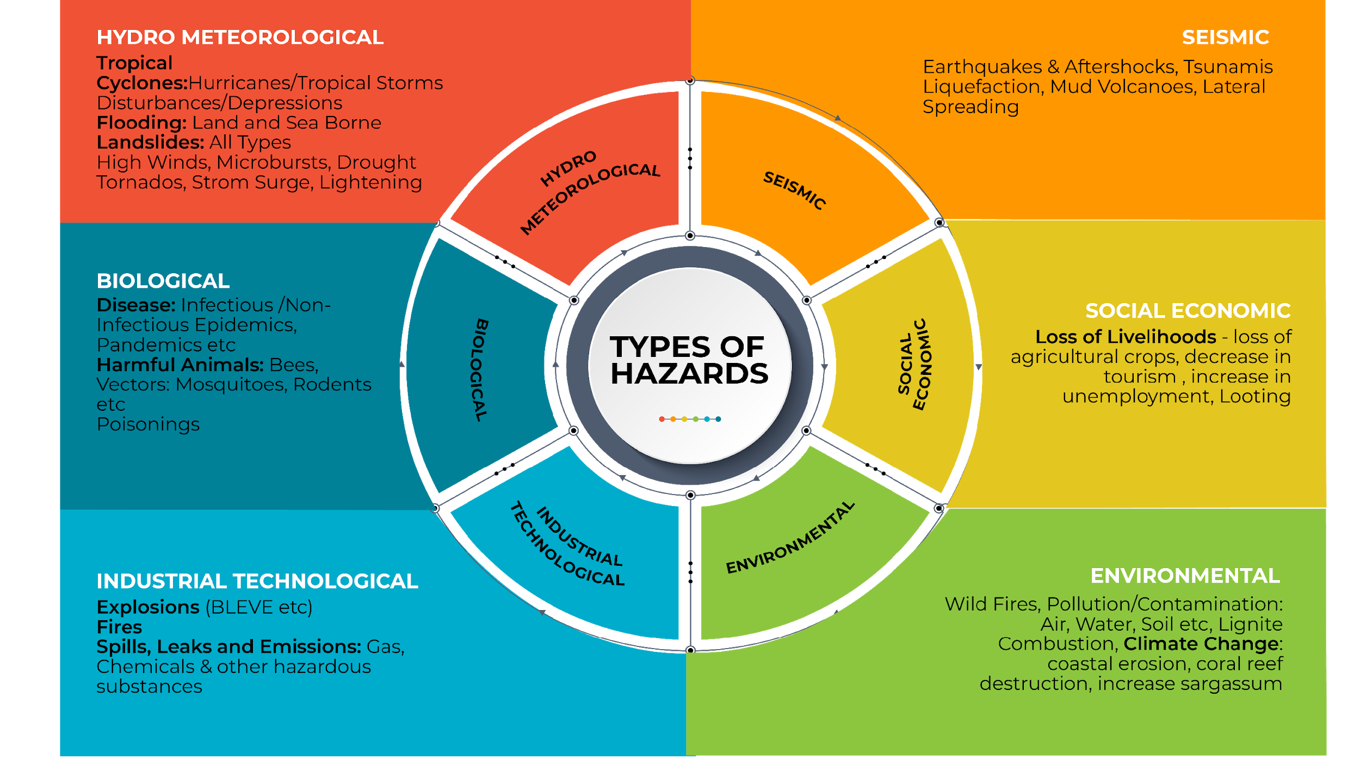
Types of
Hazards

Slide 8
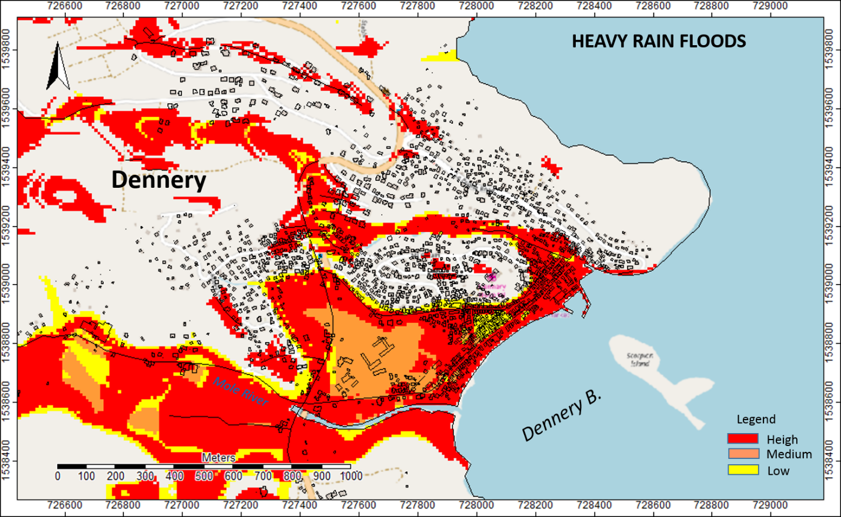
Volcano Effects

Slide 9
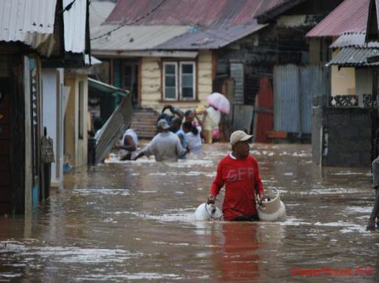
What Is
Vulnerability?
Conditions that increase risk to hazard impacts.
Notes:
The conditions determined by physical, social, economic and environmental factors or processes which increase the susceptibility of an individual, a community, assets or systems to the impacts of hazards.
Annotation: For positive factors which increase the ability of people to cope with hazards, see also the definitions of “Capacity” and “Coping capacity”. UNISDR
Photo http://www.sofreshandsogreen.com/wp-content/uploads/2010/10/st-lucia-flood-thumb-2.jpg

Slide 10


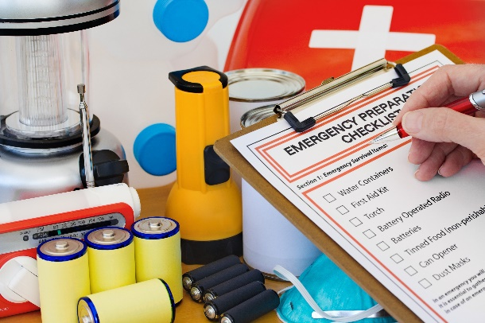
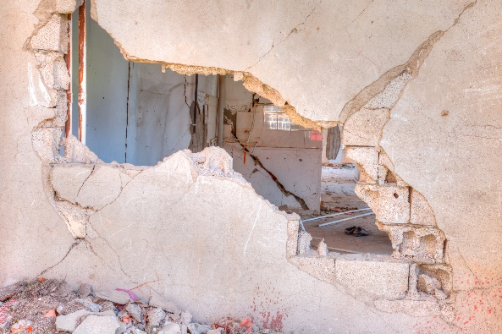
Types of Vulnerability
Social Vulnerability
Environmental Vulnerability
Economic Vulnerability
Physical Vulnerability
Notes:
The conditions determined by physical, social, economic and environmental factors or processes which increase the susceptibility of an individual, a community, assets or systems to the impacts of hazards.
Annotation: For positive factors which increase the ability of people to cope with hazards, see also the definitions of “Capacity” and “Coping capacity”.
What makes us vulnerable?
Physical Vulnerability:
1) Location of our homes slopes – volcanoes/landslides, flood plains or coastal –storm surge; homes can generally built to reduce the risk of these (except perhaps volcanoes)
2) Construction standard – against earthquakes and hurricanes reinforce walls and roof – detailing. Against floods – raise house
Social Vulnerability:
Poor Health and disabilities - mobility, ability to earn
Customs and beliefs
Economic Vulnerability: economic opportunity and state – poverty, many dependents.
Environmental Vulnerability: poor farming practices, deforestation activities.

Slide 11
The Science
Of Risk
Risk = Hazard * Exposure *Vulnerability
Capacity to Cope
The probability/chance of harmful consequences or expected losses.
Notes:
The probability of harmful consequences, or expected losses (deaths, injuries, property, livelihoods, economic activity disrupted or environment damaged) resulting from interactions between natural or human-induced hazards and vulnerable conditions.
Conventionally risk is expressed by the notation
Some disciplines also include the concept of exposure to refer particularly to the physical aspects of vulnerability.
Beyond expressing a possibility of physical harm, it is crucial to recognize that risks are inherent or can be created or exist within social systems. It is important to consider the social contexts in which risks occur and that people therefore do not necessarily share the same perceptions of risk and their underlying causes

Slide 12
Accept-able
Reduce
Mitigate
Risk:
The Choices/ Options
Risk
Avoid
Transfer
Re-locate
Don’t go there
Insurance
Notes:
You can do something to reduce your risk to hazards
Accept risk = the speed you drive your car, smoking, where you live – sometimes we just have to accept risk
We can reduce risk – slower driving speed, don’t smoke, build a house above the flood height, remove mosquito breeding sites – lower our exposure
We can avoid risk – relocate to a safer spot – difficult,
If it can’t be avoided we prepare for the risk by transferring the risk to someone else; usually by insurance
These risk choices apply not only to communities but also to the work we do, medicine and health care as well as money matters

Slide 13
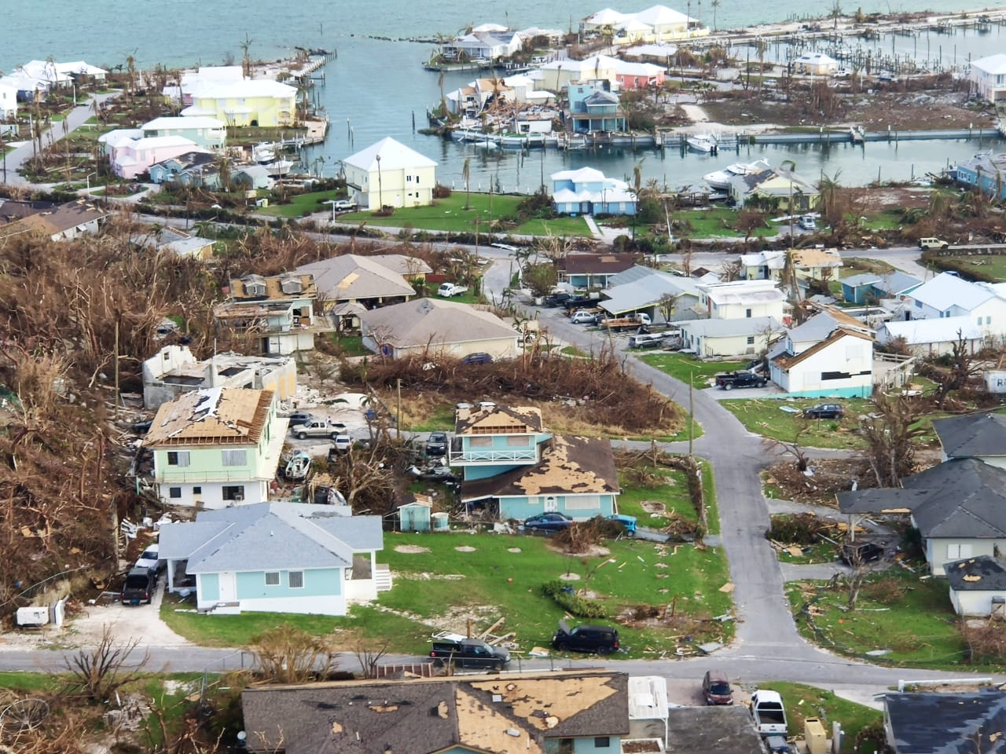
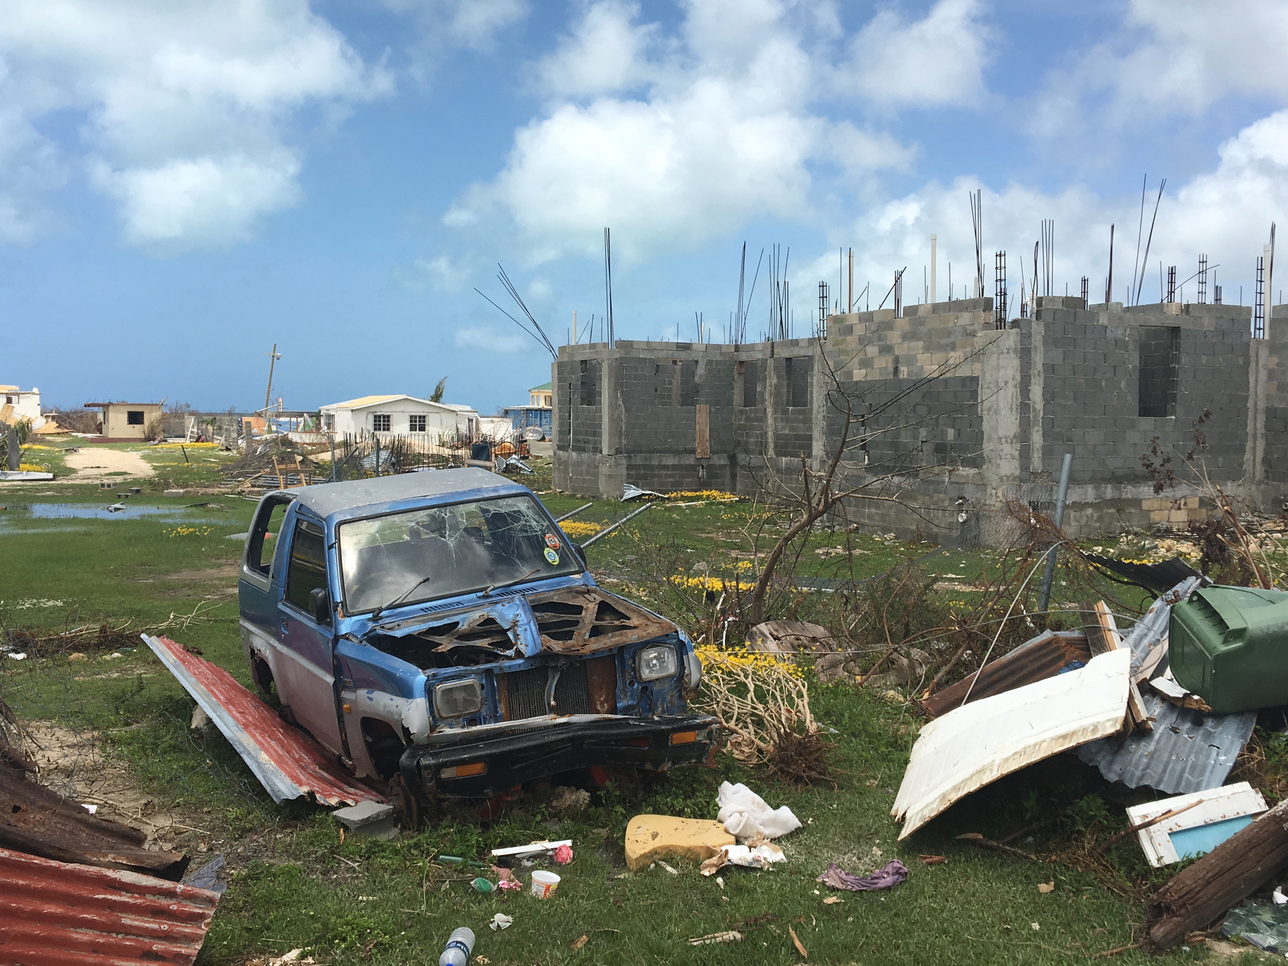
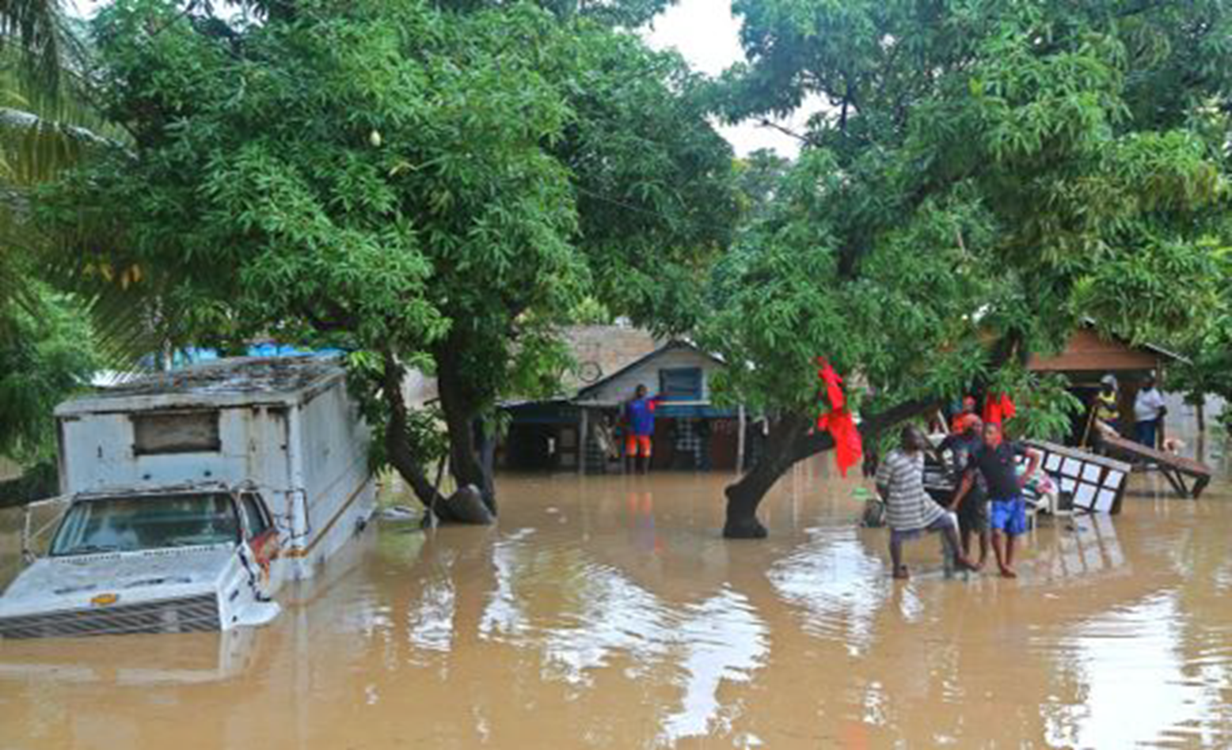
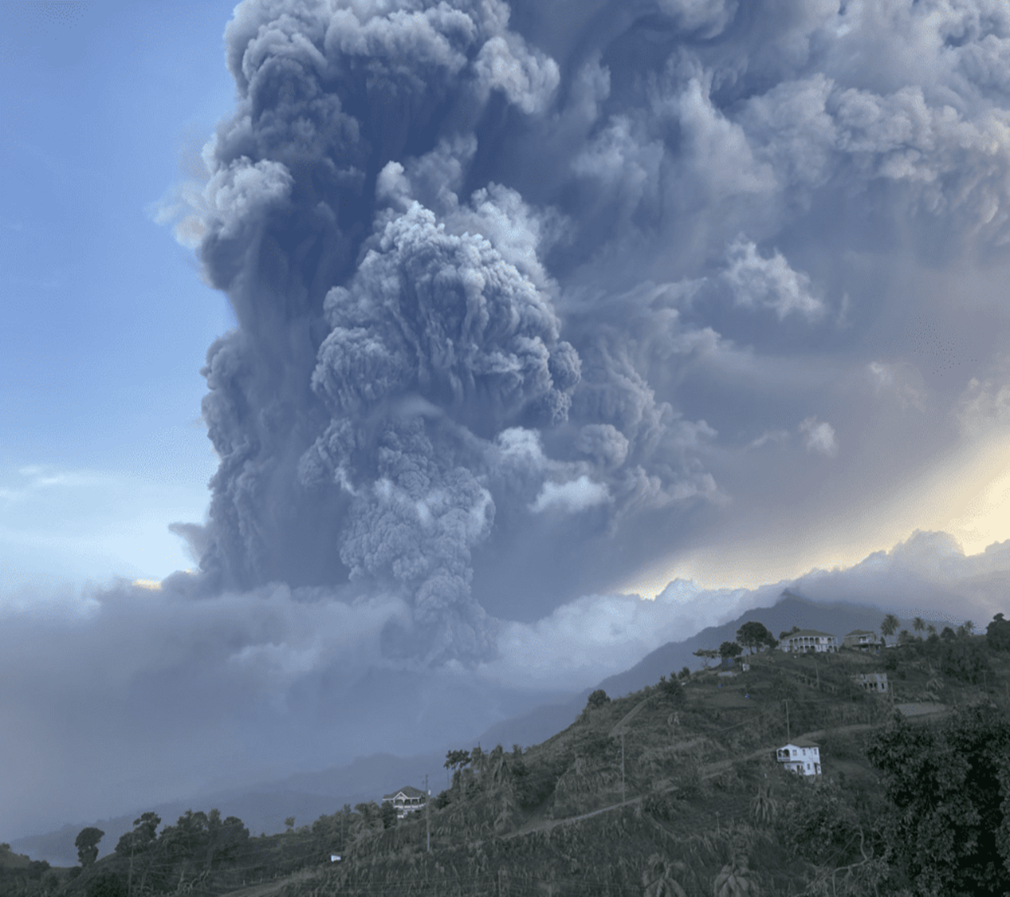
The Hazards
Notes:
Recall hazards are dangerous phenomenon/events
as compared to the disaster which is the impact of the hazard, widespread disruption of services, loss (people, property & services) and being negatively impacted beyond your local resources to cope.

Slide 14
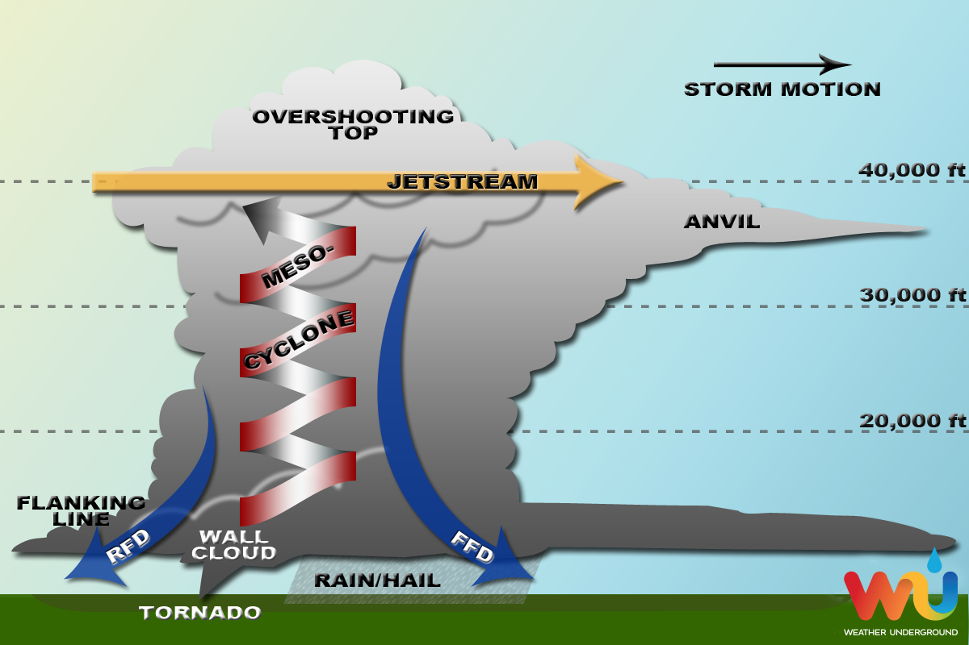
Thunderstorms
(floods & wind)
Notes:
A (cumulus/bubble) cloud that grows very high and large (cumulionimbus / anvil head cloud) to produce thunder and lightning. Usually preceded by strong gusts of wind and then rainfall. Each thunderstorm cell is very localized about 10km across. If very unstable it produces heavy rainfall over a short period of time – intense rainfall with wind gust of 30-50Km/hr . In extreme events such as the diagram above it can create hail and tornadoes – super cell.
Diagram https://www.wunderground.com/prepare/supercell While each storm is different, most supercells usually have the following parts:
Mesocyclone - Strong, rotating updraft
Forward-Flank Downdraft - Cold, dense air descending through the front of the storm
Rear-Flank Downdraft - Cold, dense air descending through the back of the storm
Flanking Line - A line of towering cumulonimbus connected to and extending outward from the rear of the supercell
Rain Shaft - The area in which rain and/or hail falls to the ground
Overshooting Top - The area of clouds that "punch through" the jet stream into the lower stratosphere (occurs when updraft is particularly strong)
Anvil - The flat layer of high cirrus clouds at the top of the storm that is shaped like an anvil, formed as the jet stream shears the updraft clouds away from the core of the storm

Slide 15
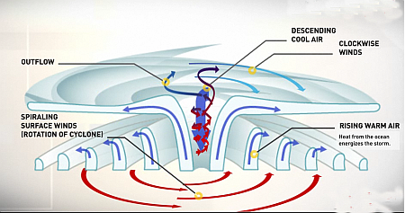
Hurricane
(Thousands of thunderstorms circulating)
Notes:
Hurricanes are violent areas of low pressure forming in the tropical Atlantic Ocean from June to November. Hurricanes have sustained winds of at least 119 kilometers per hour and are accompanied by torrential rains and along coastal regions storm surge. Hurricanes cause millions of dollars in damage in the Caribbean every year
Pic http://www.aquaticsportsadventures.com/Articles/Nature/Hurricanes/Hurricanes.html
Can we predict hurricanes?
We do have ways to predict hurricanes but our ability to forecast and
track storm movements and landfall is still not up to scratch. Generally,
hurricanes travel across the Caribbean from the east to the north-west,
the windward coastlines of countries tend to feel the first effects.
The United States National Weather Service publishes regular updates
and forecasts on current weather systems in the Atlantic on their website:
www.nhc.noaa.gov.

Slide 16
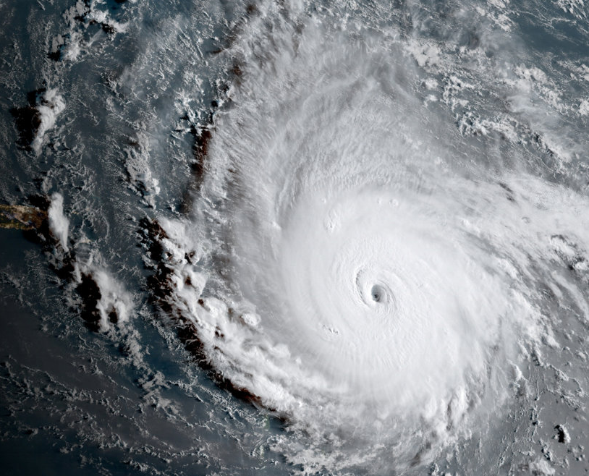
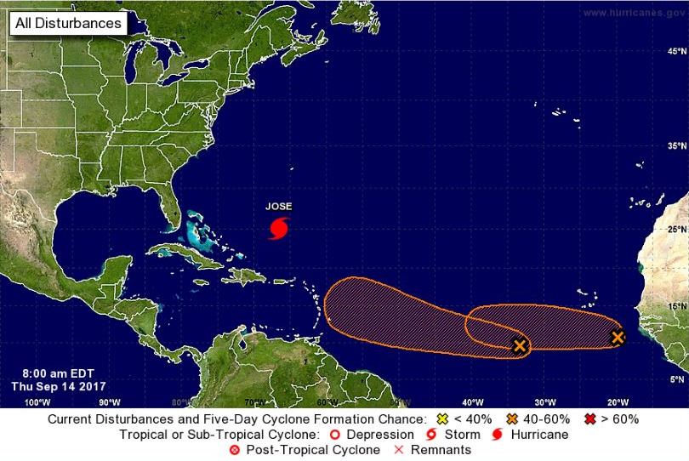
Violent areas of very low pressure forming in the tropical Atlantic Ocean from June to November.
Hurricane

Slide 17
Hurricanes and Tropical Cyclones
Tropical Disturbance
Tropical Depression
Tropical Storm
Hurricane
Notes:
A Tropical Disturbance is a discrete weather system of apparently organized convection, originating in the tropics or subtropics and existing for a period of over 24 hours. Disturbances are characteristically approximately 200-600 km in diameter.
A Tropical Depression is a tropical cyclone displaying a closed circulation pattern, in which the maximum sustained wind speed reaches up to but does not exceed 17m/s. freeicons.png
A Tropical Storm is also a tropical cyclone, but with faster winds speeds. Tropical cyclones are classified as tropical storms when the maximum sustained surface wind speed ranges between 17.5 m/s and 32.5 m/s.
A Hurricane occurs when a tropical cyclone reaches or exceeds maximum sustained wind speeds of 33 m/s.

Slide 18
Category | Speed | Height | Examples
Minimal | 74-95 mph | 4-5 ft | Shary 2010,Claudette 2003
Moderate | 96-110 mph | 6-8 ft | Ernesto 2012, Tomas 2010
Extensive | 111-130 mph | 9-12 ft | Sandy 2012, Irene 2011
Extreme | 131-155 mph | 13-18 ft | Omar 2008, Dennis 2005, Charley 2004
Catastrophic | > 155 mph | > 18 ft | Irma & Maria 2017 Dorian 2019
Hurricanes

Slide 19
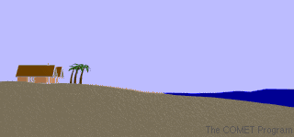
Storm Surge
e.g Dorian Bahamas 2019
Notes:
http://www.aquaticsportsadventures.com/Articles/Nature/Hurricanes/Hurricanes.html
NOAA
Storm surge is an abnormal rise of water generated by a storm, over and above the predicted astronomical tides. Storm surge should not be confused with storm tide, which is defined as the water level rise due to the combination of storm surge and the astronomical tide. This rise in water level can cause extreme flooding in coastal areas particularly when storm surge coincides with normal high tide, resulting in storm tides reaching up to 20 feet or more in some cases.
Storm Surge vs. Storm Tide
Factors Impacting Surge
Storm surge is produced by water being pushed toward the shore by the force of the winds moving cyclonically around the storm. The impact on surge of the low pressure associated with intense storms is minimal in comparison to the water being forced toward the shore by the wind.

Slide 20
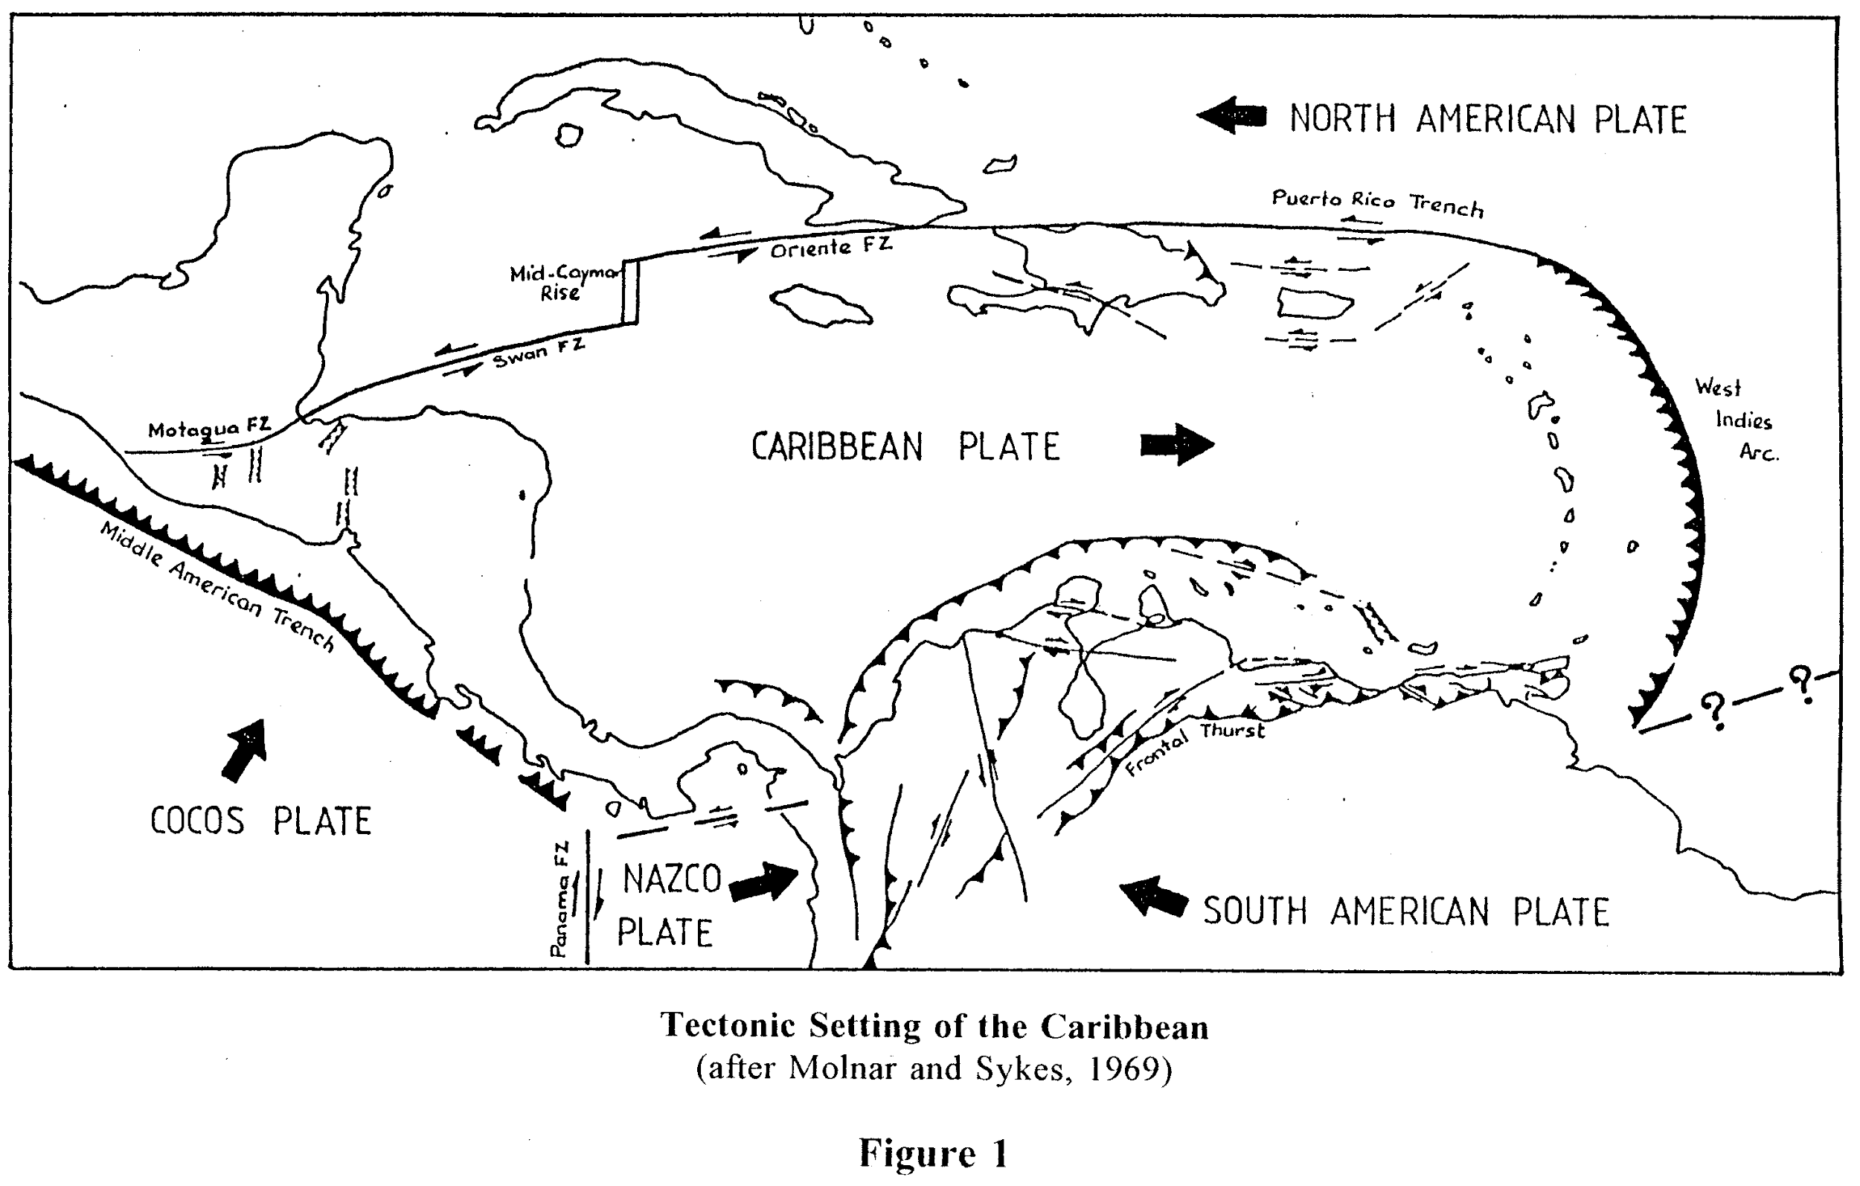
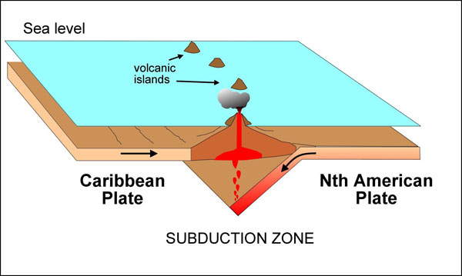
Earthquakes
Notes:
Earthquakes are the vibration of the rocks of the earths surface/ These can be mild – tremors or violent e.g. Haiti 2010. Earthquakes are measured by magnitude M1-4 mild; M5 moderate; M6 and above severe. Where in the earth’s crust the EQ occurs is called the epicenter. This can be shallow or deep.
Build 3 D subduction zone model or strike slip model using block of wood cut at 45 degrees. For liquefaction create a mud pie and place a stone on it then shake and watch the stone sink as the mud turns liquid
These are plate tectonic earthquakes – large scale events
http://uwiseismic.com/General.aspx?id=85 Earthquakes are caused by the movement of plates (huge slabs of rock) making up the surface of the Earth. The region where two or more plates meet is called a plate boundary. The plates are constantly moving but this plate movement is neither smooth nor continuous, rather the plates often lock together at plate boundaries causing a build-up of energy. When the plates eventually move out of this locked position the energy that is released may be felt as an earthquake. Much of the world’s earthquake and volcanic activity takes place along plate boundaries, the area where plates meet. Countries located along plate boundaries, such as the Eastern Caribbean islands, Japan, Chile and the USA (California) are likely to experience earthquakes. At these plate boundaries the plates interact with each other in different ways; some of them slide past each other, others spread apart and others move toward each other with crumpling or with one dipping beneath the other. This last type of plate boundary is called a subduction zone which is the main type of plate interaction occurring in the Eastern Caribbean.

Slide 21
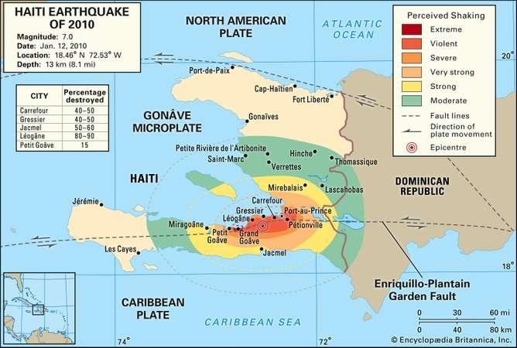
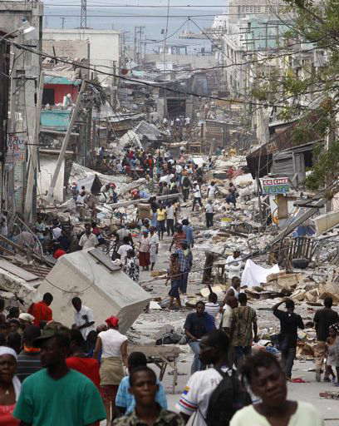
EXAMPLE OF AN EARTHQUAKE
Haiti , 2010 M7

Slide 22

Earthquakes
Earthquakes strike without warning
Any time of the year, day or night.
Aftershocks may be as strong the original earthquake.

Slide 23
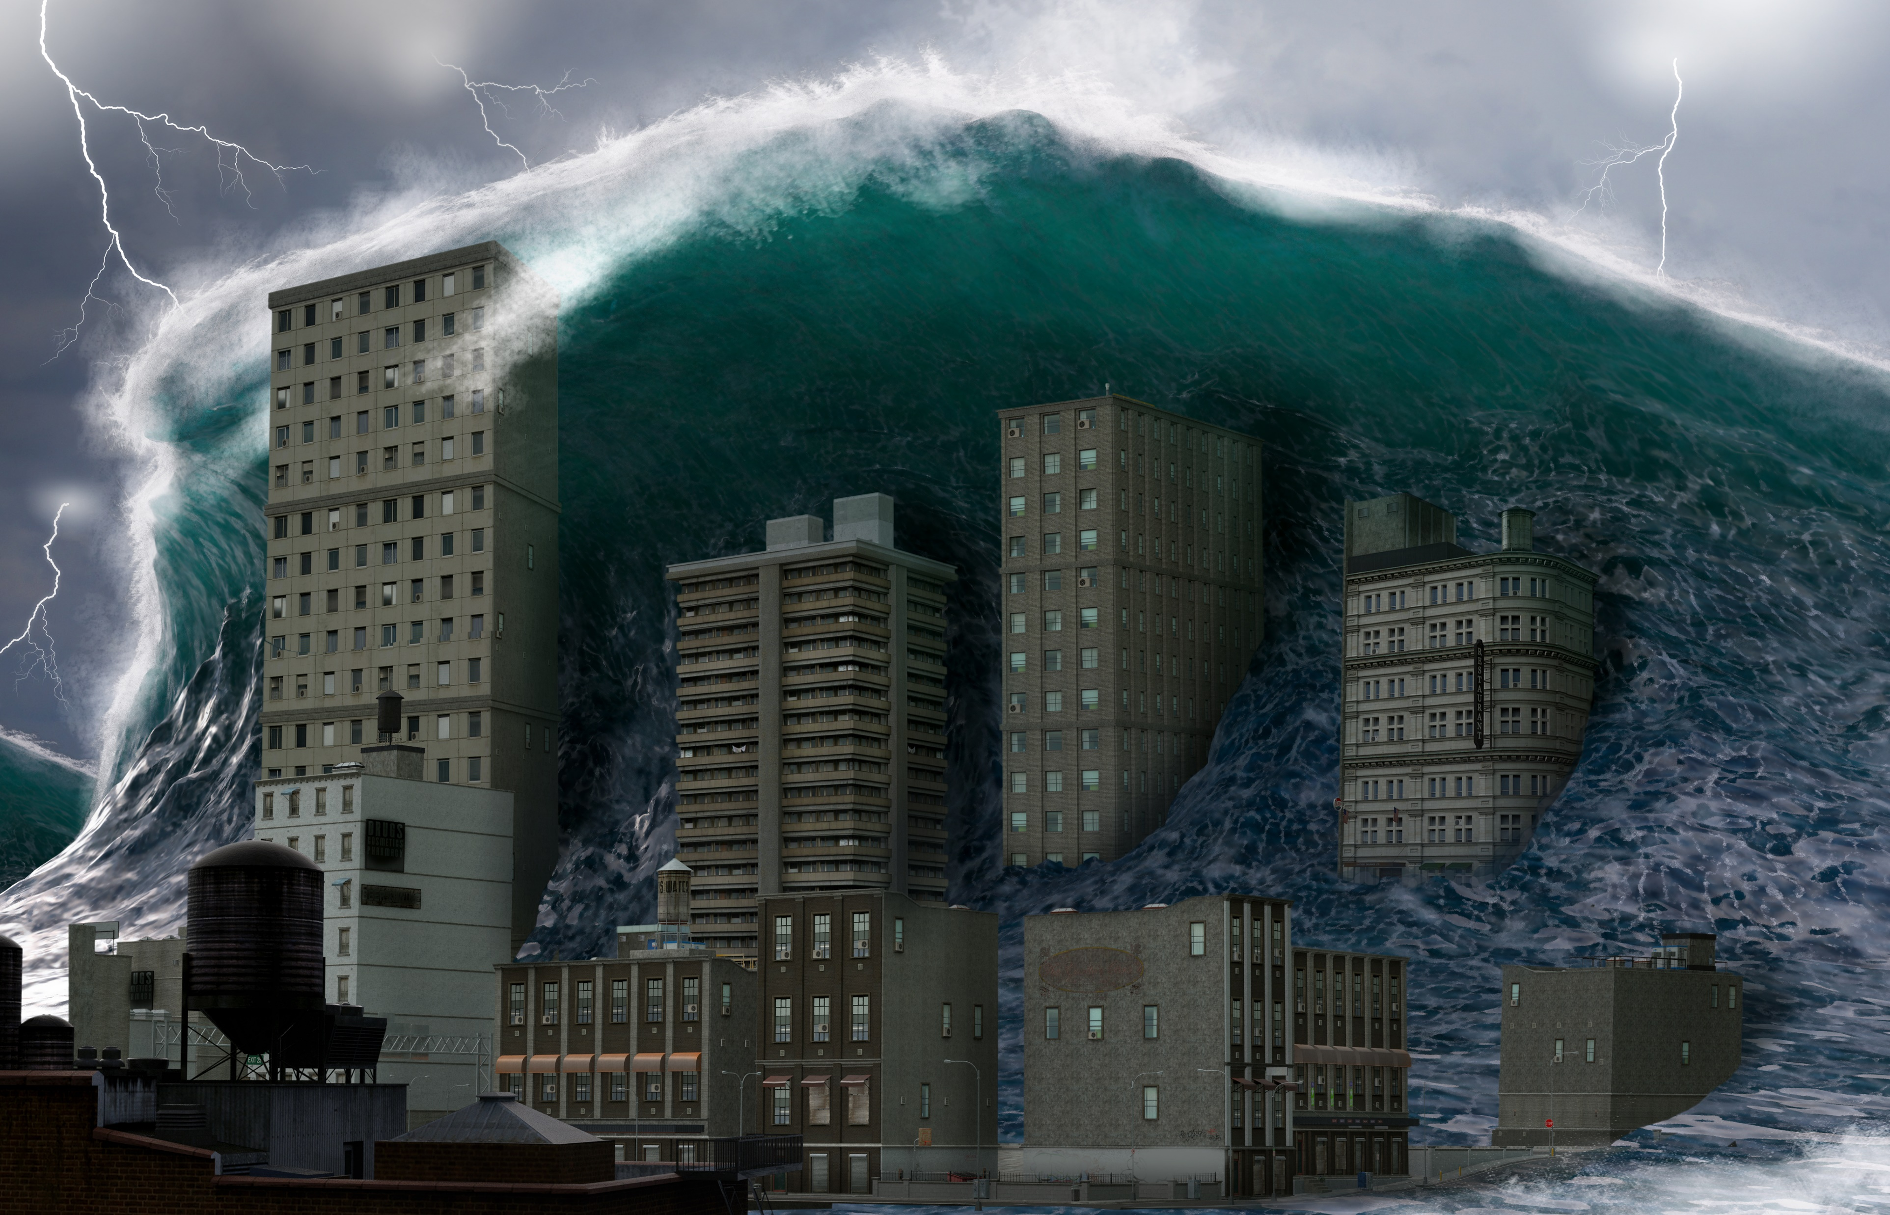
Tsunami
Tsunamis are long-period waves generated by disturbances such as earthquakes, volcanic activity, and submarine landslides.

Slide 24
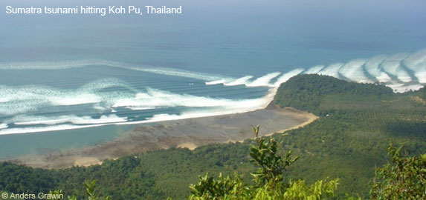
Multiple
Waves
Approaching Waves
Beach Water Receds
Tsunami
Approaching

Slide 25
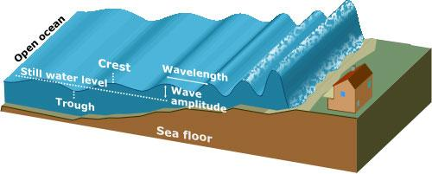
Long Ocean Waves.
A massive wall of water builds up near coast.
Tsunamis
Notes:
Tsunamis are long-period waves generated by disturbances such as earthquakes, volcanic activity, and submarine landslides.
Characteristics
Wave lengths commonly exceeding 100 km
Deep-ocean velocities of up to 700 km/hour
A tsunami is often seen as a massive wall of water approaching land.
There is usually more than one wave and the first is often not the largest.
Tsunami waves are powerful and often contain dangerous debris – e.g. boats, cars & trees etc.

Slide 26
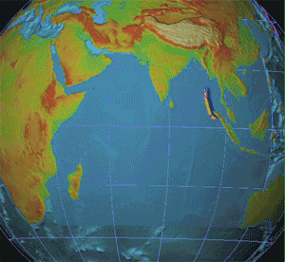
Fast Moving Waves
700 km/hr

Slide 27
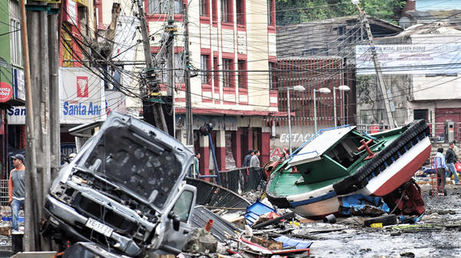
Effects of
A Tsunami
Tsunami effects in Chile

Slide 28
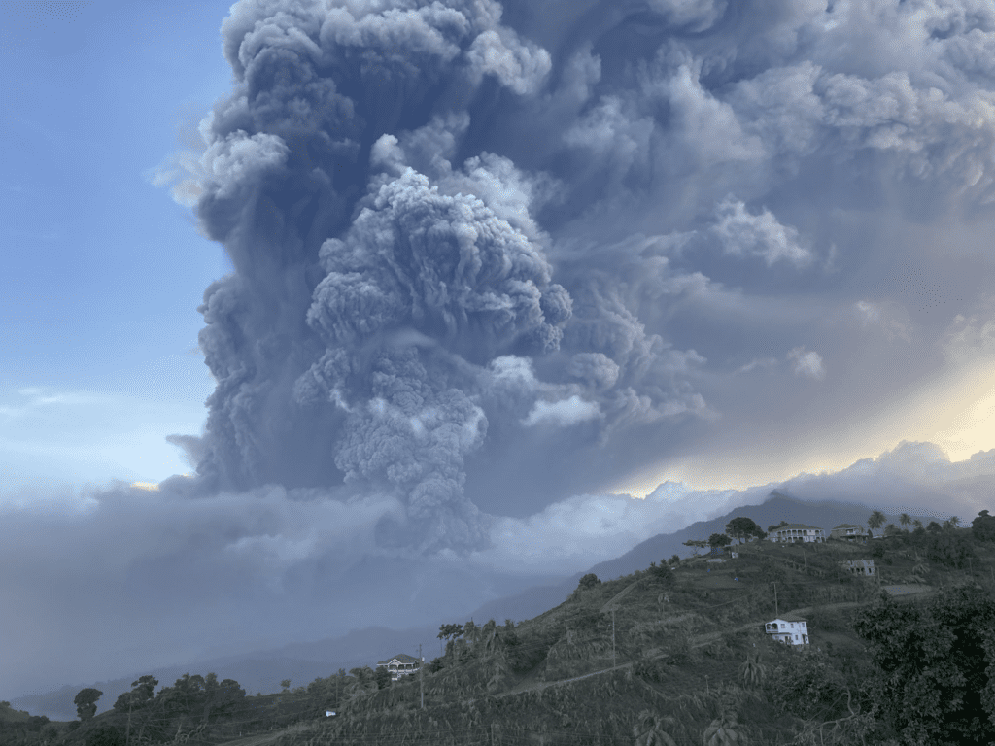
Volcanoes
Volcanoes are vents or openings in the Earth's crust through which, hot, molten rock (called magma) and gases from the interior of the Earth are released.
Source: @VincieRichie/twitter

Slide 29
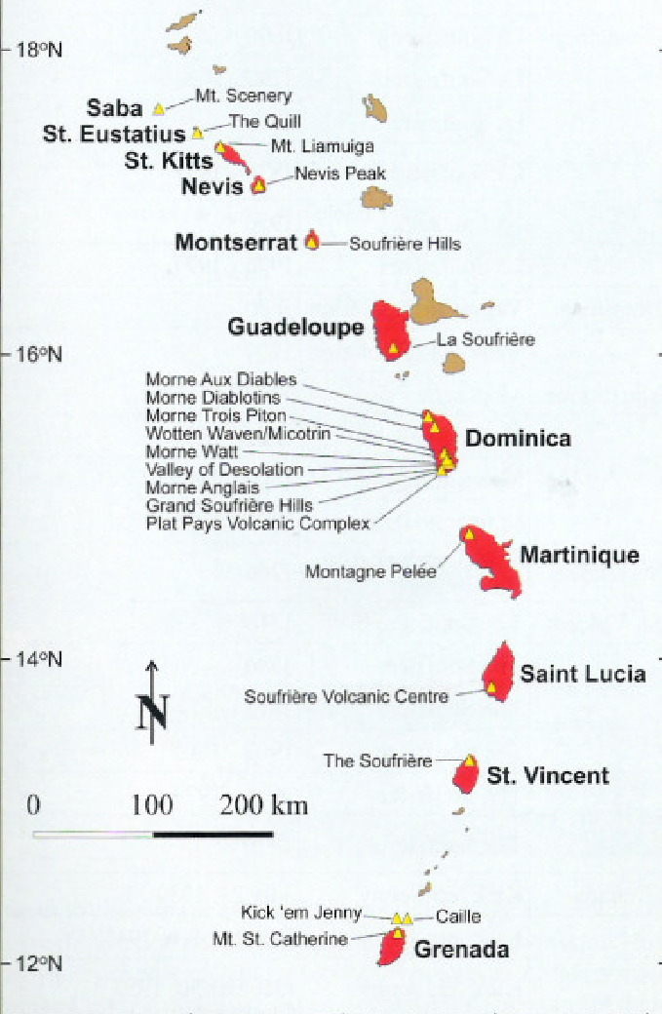
Volcanoes
Map of the Lesser Antilles showing the islands of the ‘Volcanic Caribbee` in red & those of the `Limestone Caribbees` in brown.
Live Volcanoes are represented by yellow triangles.

Slide 30
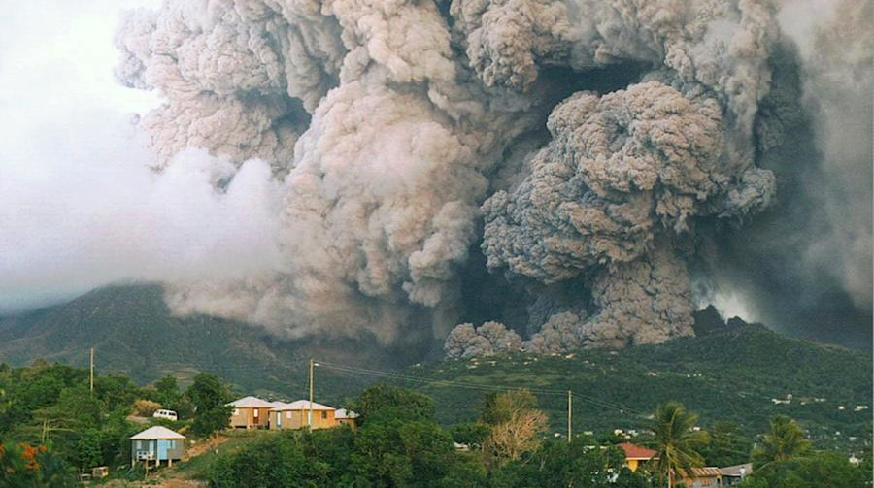
Vent
Volcanoes
Effects
Pyroclastic flow
hot, fast moving mix of ash, rocks and gas

Slide 31
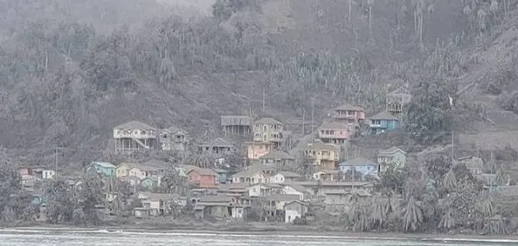
Heavy ashfall in St. Vincent 2021
Source: @Jacquiecharles

Slide 32
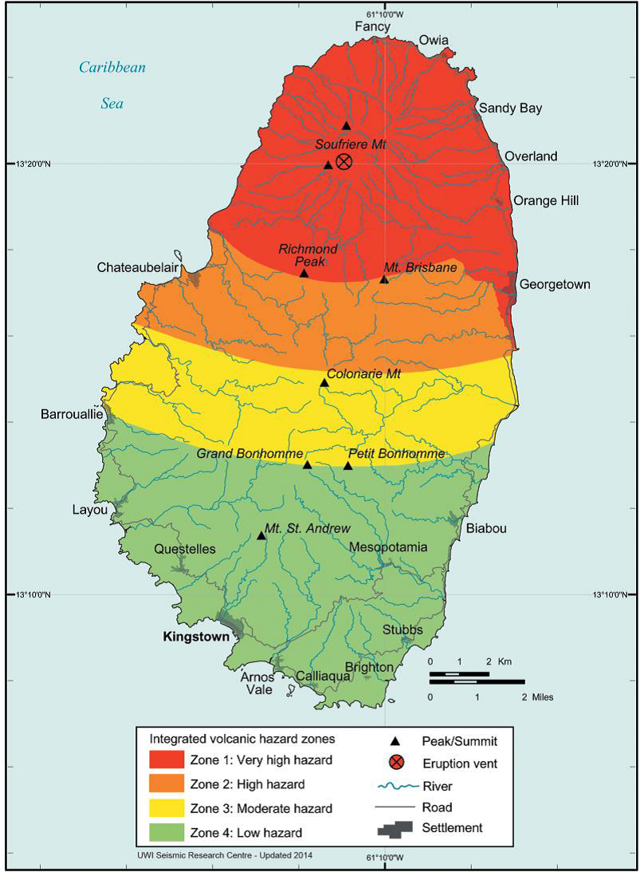
Volcano
Hazard Map
St. Vincent and the Grenadines Volcano Hazard Map
*Note the red evacuation zones
Source: NEMO

Slide 33

Floods

Slide 34
Flash Floods
River Floods
Short Intense burst
of Rainfall
Prolonged Moderate
to Heavy Rainfall
Flood Types
Ponding
Pluvial
Low Lying Areas
Overwhelmed Drainage
Coastal
Storm Surge / Tsunami

Slide 35
Intense (Heavy) Rainfall
Tropical Storms Erika / Tomas / Christmas Floods
Prolonged (Hours of) Rainfall
Example: Guy & Sur
Causes of Flooding
Poor Drainage
Not enough for the amount water
Ponding
Low lying Anse La Raye, Green Bay Antigua, Barrackpore
Restriction / Blockage Barriers
High Tide, Clogged Drains

Slide 36
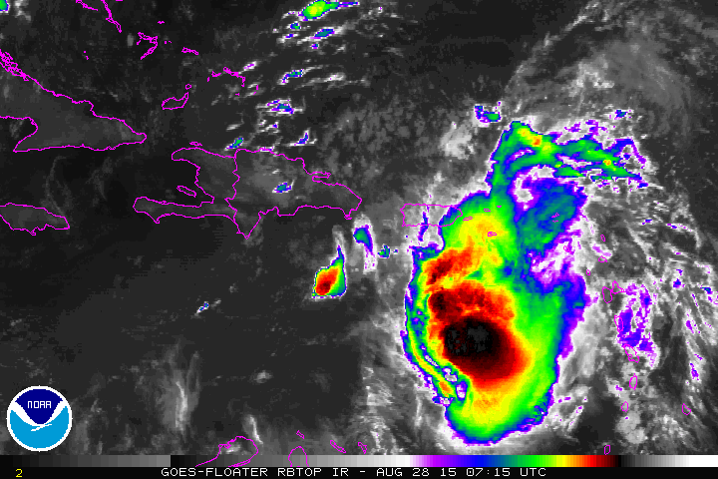
Causes of Flooding
Prolonged (hours) rainfall
e.g. 1 hr of TS Erika or
ITCZ Guy & Sur

Slide 37
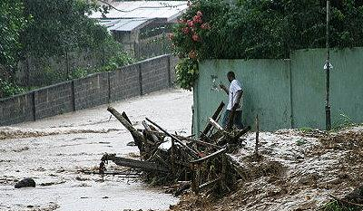
Inadequate/blocked drain
Inadequate or Blocked Drains
Too small for the amount
of water.
Restriction / Blockage

Slide 38

COVID-19 can spread from person-to-person through small droplets from the nose or mouth which are spread when a person with the virus exhales or coughs. These droplets land on objects and surfaces. Persons can catch COVID-19 by touching where the droplets are and then touching their eyes, nose or mouth. They can also catch COVID-19 if they breathe the droplets from a person who is sick.
Coronavirus (Covid-19)
The Coronavirus disease is a highly contagious respiratory disease that can be spread from person to person.

Slide 39
Fever
Tiredness
Symptoms
of Covid-19
The Coronavirus disease is a highly contagious respiratory disease that can be spread from person to person.
Dry Cough
Aches & Pains
Nasal Congestion
Runny nose
Sore Throat
Diarrhea
(In some cases)

Slide 40
Frequently clean hands by using soap and water as well as alcohol-based hand sanitizer that contains 60 – 80% alcohol.
Protecting
Yourself
Against
Covid-19
When coughing and sneezing cover your mouth and nose with a flexed elbow or tissue. Throw tissue away immediately and wash hands
Practice physical distancing.
Avoid handshakes and hugs.
Avoid close contact with anyone that has
fever and cough.

Slide 41
Disaster Impacts On Community Resources
 | Effects
Transportation | ■ Inability to get emergency service personnel into the affected area.  Inability to transport victims away from the area.
Electrical | ■ Increased risk of fire and electrical shock.  Possible disruption to transportation system if downed lines are across roads.
Telephone | ■ Lost contact between victims, service providers, and family members.  System overload due to calls from or to friends or relatives.
Water | ■ Disruption of service to homes, businesses, and medical providers.  Inadequate water supply for firefighting.  Increased risk to public health if there is extensive damage to the water supply or if it becomes contaminated.

Slide 42
Disaster Impacts On Community Resources
Type Of Damage | Effect On Disaster Services
Road | ■ Inability to assess damage accurately.  Ambulances prevented from reaching victims and/or victims prevented from reaching emergency medical services.  Police prevented from reaching areas of civil unrest.  Fire departments prevented from getting to fires.  Flow of needed supplies is interrupted.
Structural | ■ Damaged hospitals unable to receive patients.  Increased risk of injury from falling debris.
Disrupted Communication | ■ Victims unable to call for help.  Coordination of services is hampered.
Fuel Line Damage | ■ Fire and paramedic services overburdened.
Disrupted Water Service | ■ Firefighting capabilities restricted.  Medical facilities hampered.

Slide 43
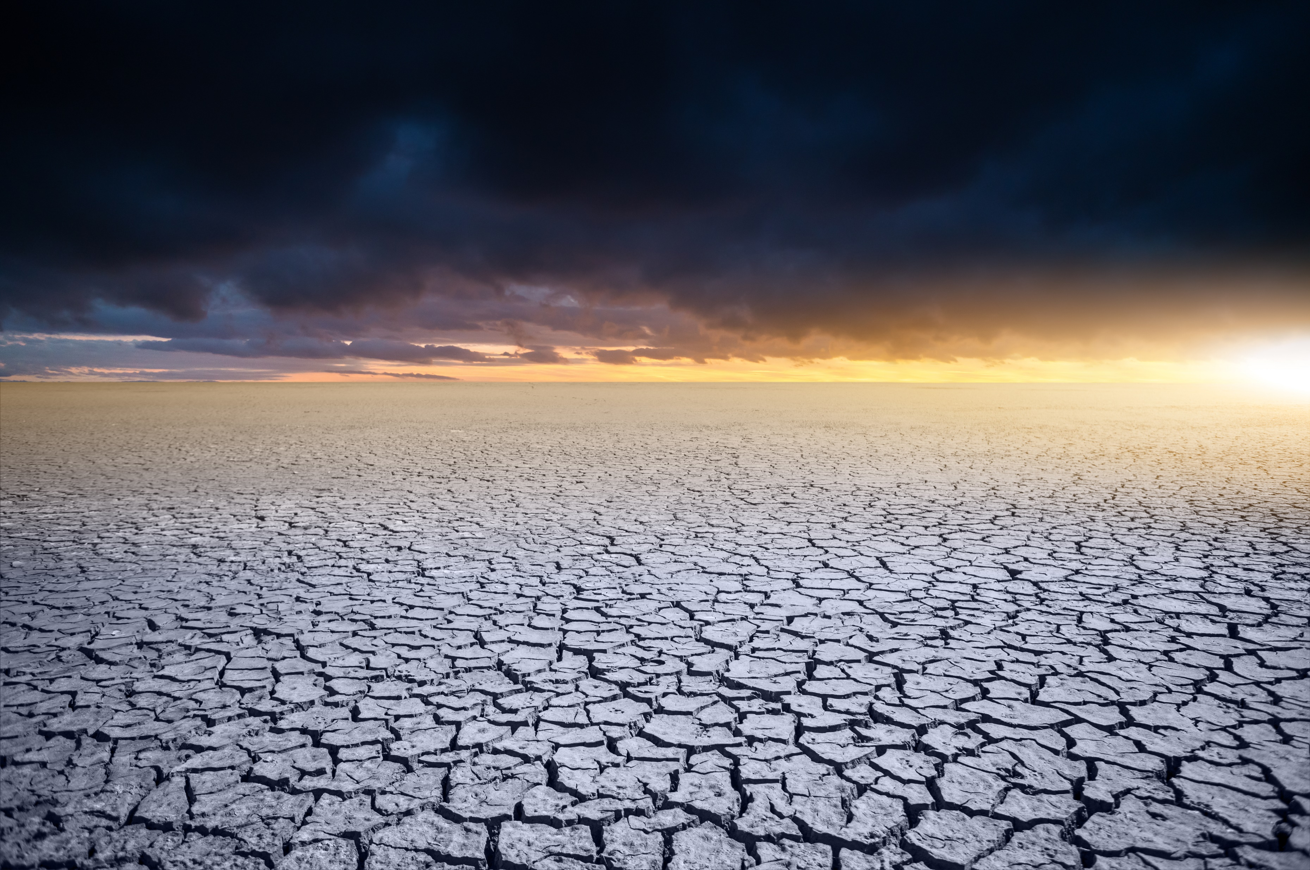
What Is
Climate
Change?
Climate change is a long-term change in the average weather patterns that have come to define local, regional and global climates.
Notes:
These changes come as a result of the burning of fossil fuels, deforestation and other harmful practices that increase the concentration of greenhouse gases (carbon dioxide, methane and nitrous oxide etc.) in the atmosphere.

Slide 44
Effects of
Climate Change
Increase In Temperature
Changes In Precipitation Patterns
More Droughts
& Heat Waves
Stronger And More Intense Hurricanes
Sea Level Rise
Increase Ocean Acidification

Slide 45
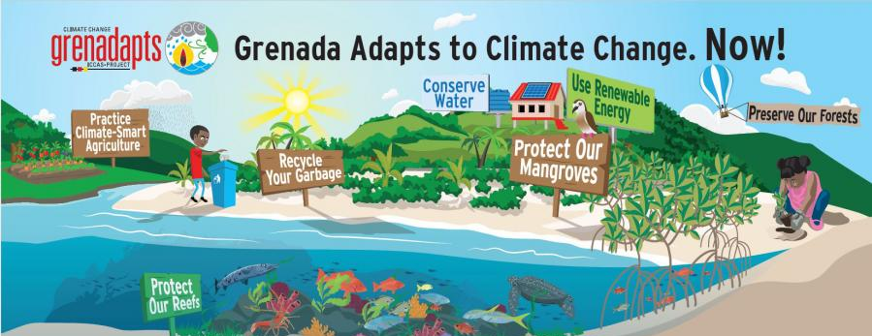
Climate change adaptation involves reducing the risk and vulnerabilities by putting measures in place or by building the capacity of cities, communities and individuals to cope with adverse climate impacts.
Climate Change
Adaptation

Slide 46
Volunteer, Donate, Join Us In Partnership, or share
our appeals and stories on social media. Find out more about IFRC, and learn how to contact your National Red Cross or Red Crescent Society, at www.ifrc.org
Get Involved
There are many ways of becoming a part of the world’s largest humanitarian network
P.O. Box 303
CH-1211 Geneva 19
Switzerland
Telephone: +41 22 730 4222
Fax: +41 22 730 4200
Email: secretariat@ifrc.org
Website: www.ifrc.org

