Slide 1
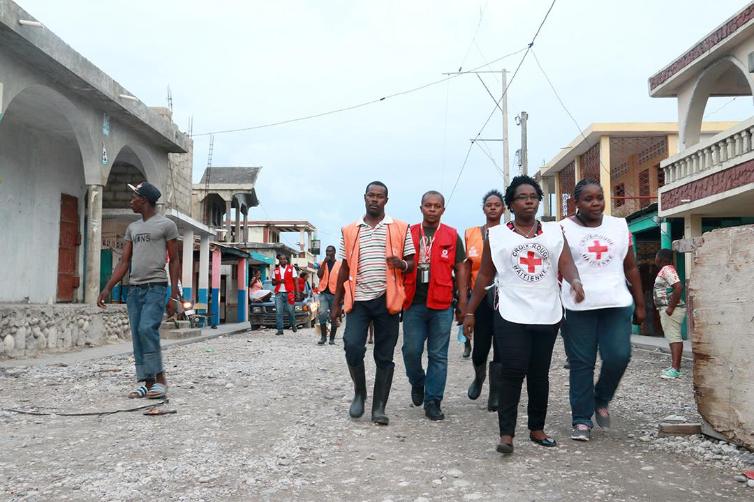


CDRTs & Disaster Preparedness
For Community Response Teams

Slide 2
Objectives
Understand What Is Preparedness
Learn about Home & Community Preparedness
Learn about the CDRTs Role
Learn about actions to take before during & after Disasters

Slide 3
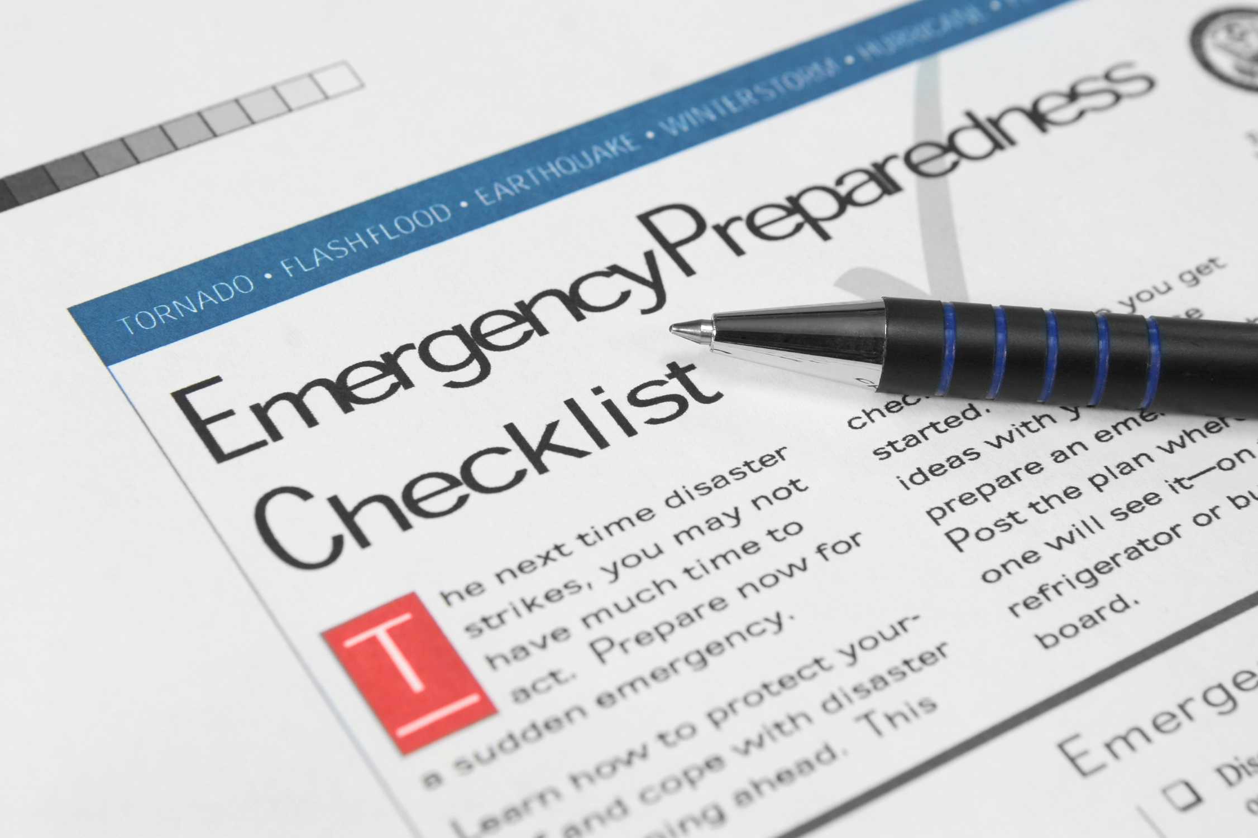
What Is
Preparedness?
Activities and measures taken in advance to ensure effective response to the impact of hazards, including the issuance of timely & effective early warnings and the temporary evacuation of people and property from threatened locations.
Source: UNISDR

Slide 4
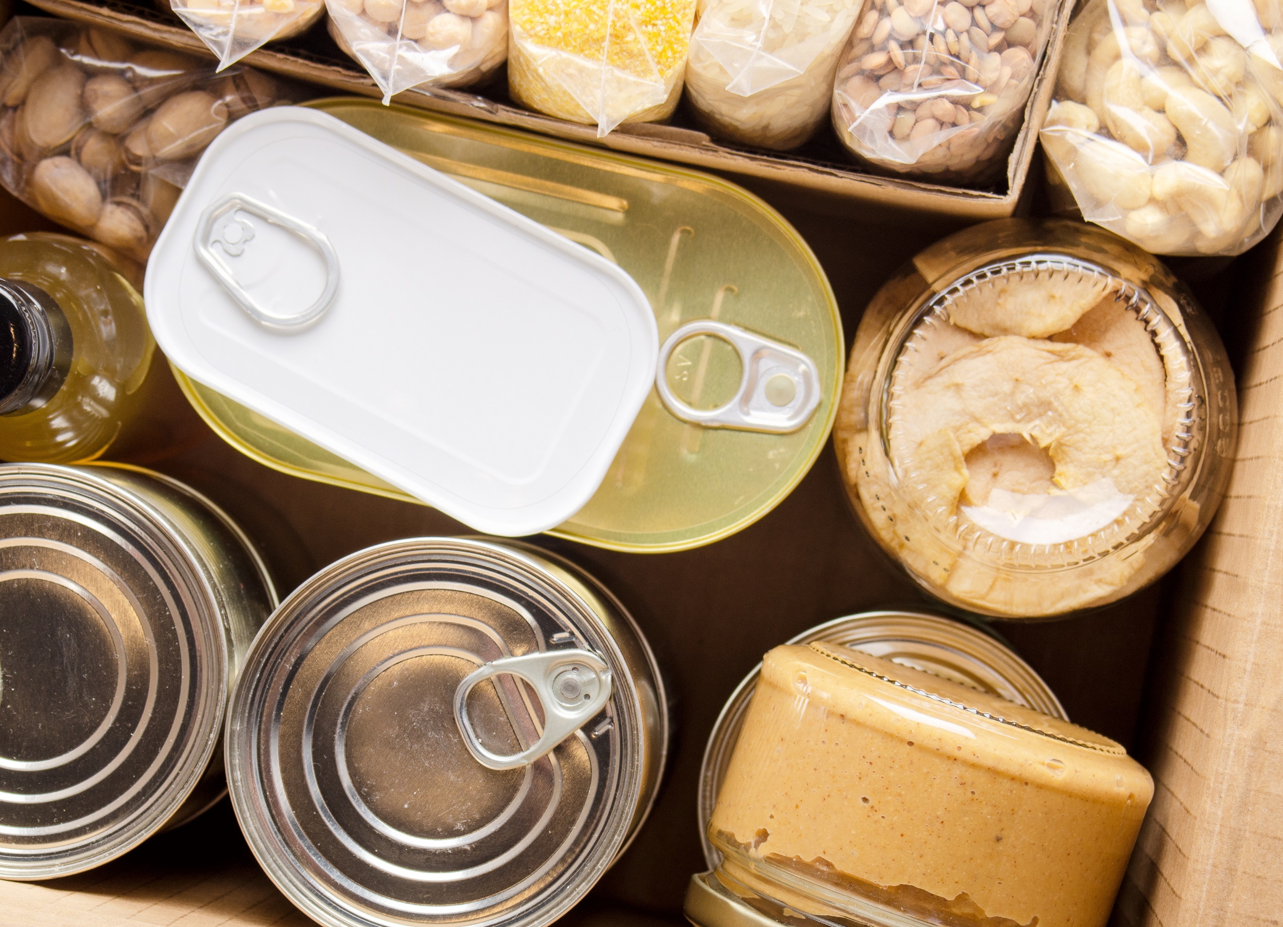
Why Prepare?

Slide 5
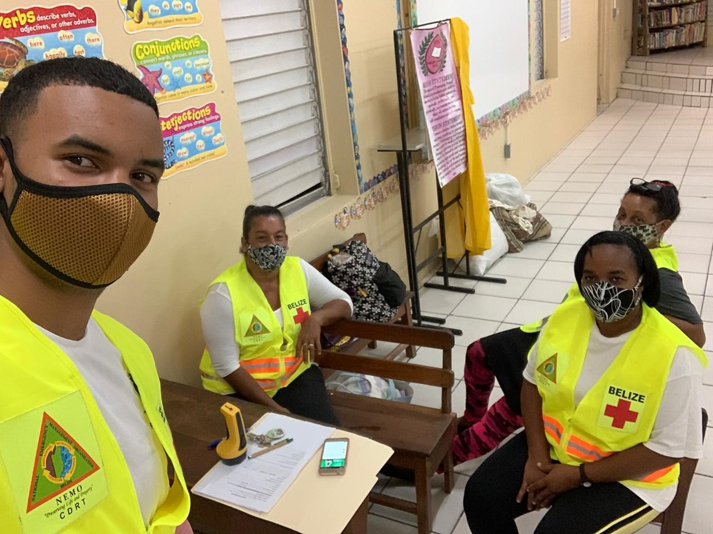
CRDTs Role
Education and training
Development of Disaster Plans
Evacuation
Early Warning
Practice and Testing

Slide 6

What Is
Preparedness
Community preparedness is sharing the information with your community and making sure people understand what could happen and what they can do.
Your community is made up of different types of people, from different backgrounds, with different attitudes and beliefs but everyone needs to be prepared. And you need the cooperation and participation of everyone
Notes:
When talking about past events, it is important to identify previous situations of violence, internal crisis, or any other social disruption

Slide 7

Engaging The
Community
In engaging the community, it is important to know the facts, have evidence to support the need for community preparedness
Talk about past events and impact.
Highlight the climate related changes that are visible.
Your creativity and innovate to get people’s interest. It’s important to reach all the groups in your area.

Slide 8
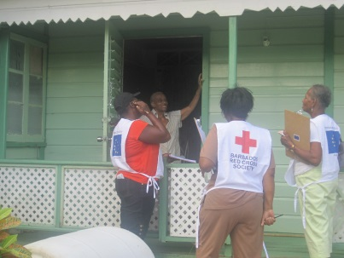
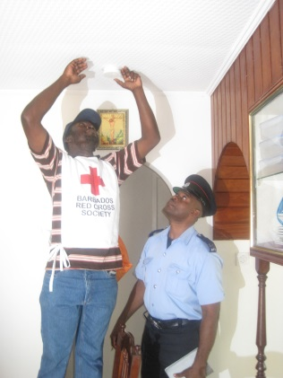
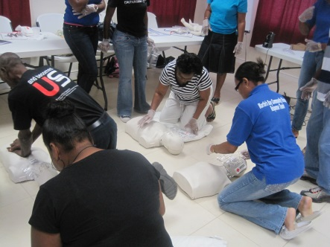
Preparedness
Activities
Notes:
What type of plans would CDRTs need to create?

Slide 9
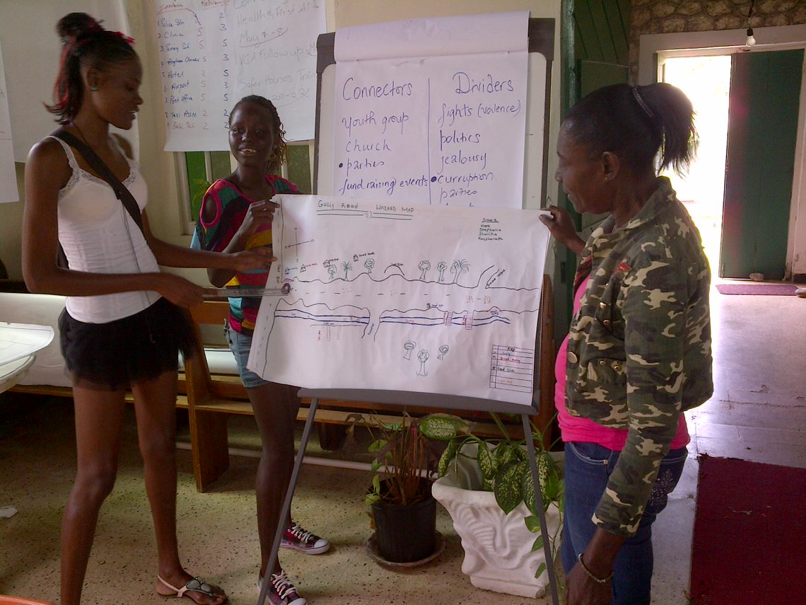
Disaster Plans
A disaster plan is a systematic way of capturing the hazards and vulnerabilities in your community, it presents strategies for mitigating and reducing their impact, it also outlines the what steps are to be taken before, during and after, the responsibilities and roles of all involved as well as the mechanism for testing and evaluation.

Slide 10
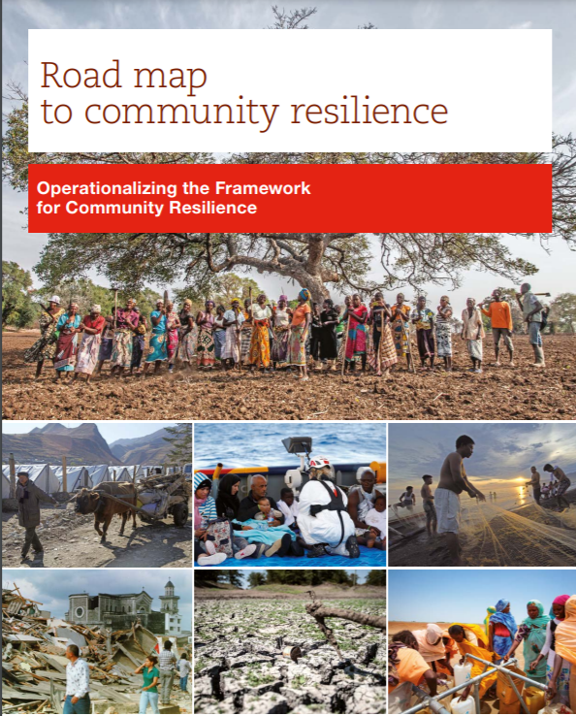
Community Mapping
Use the Roadmap to Resilience Approach.
This is a community driven process that allows the community to identify their hazards, vulnerabilities, threats and capacities which are then measured against 6 resilience characteristics.

Slide 11
Six Resilience
Characteristics
1
Knowledgeable and healthy and can meet their basic needs.
2
Is socially cohesive
3
4
Well maintained and accessible infrastructure and services
Economic opportunities
5
Can manage its natural resources
6
Is connected
Notes:
1- Knowledgeable and healthy and can meet their basic needs: Persons are aware of the various risks and vulnerabilities and their capacity to take actions to increase their resilience. Persons can meet their food, water and shelter needs.
2- Socially cohesive: The existence of social groups within the community and the lack of major conflicts within the community.
3- Economic opportunities: Persons have access to livelihood opportunities and can cover their health, education and nutrition needs daily.
4- Well maintained and accessible infrastructure and services: Access to healthcare and education facilities and emergency services.
5- Can manage its natural assets: Natural forests, vegetation and wetlands are maintained.
6- Is connected: persons are aware of relevant policies and laws and how those can affect the community.

Slide 12
Community Mapping
Risk, Threats and Vulnerability
A CDRT should engage the community to determine:
What are the major threats and hazards that could affect the community?
Identify Who and What would be affected.
What are the areas in the community most like to be impacted?
Who are the vulnerable persons (pay close attention to children, elderly especially those who live alone, pregnant women, persons with disabilities).

Slide 13
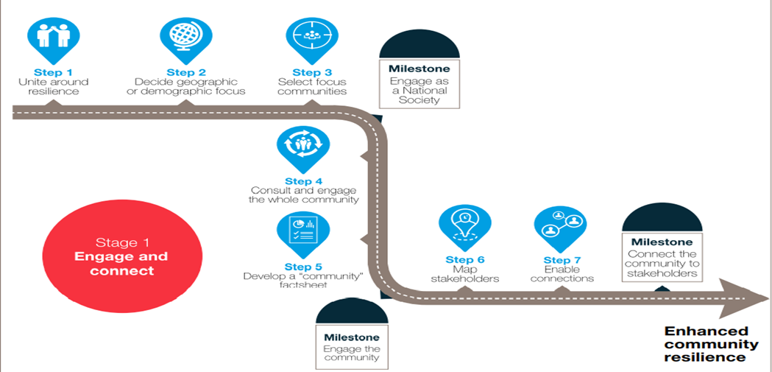
Roadmap to Resilience
Step 1

Slide 14
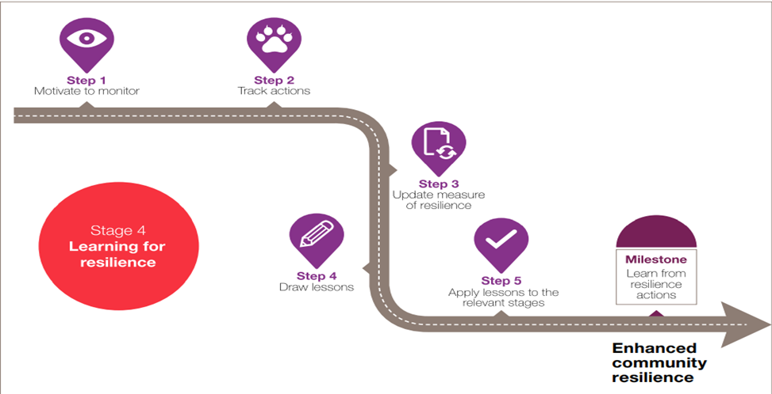
Roadmap to Resilience
Step 2

Slide 15
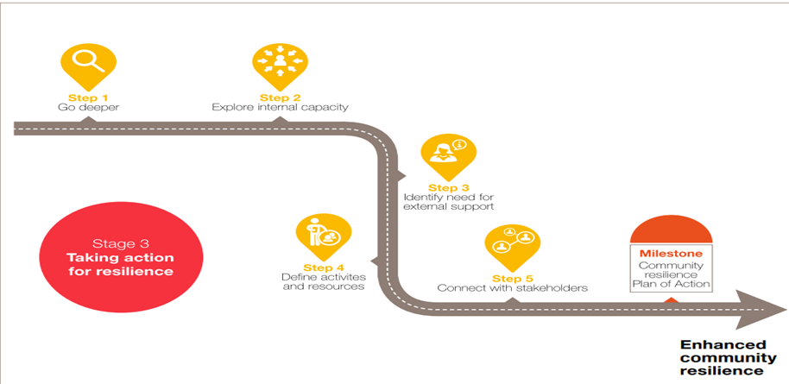
Roadmap to Resilience
Step 3

Slide 16
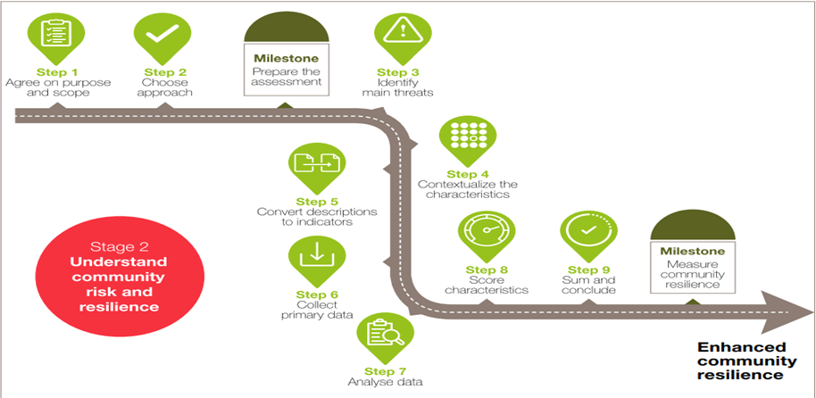
Roadmap to Resilience
Step 4

Slide 17
Community Mapping
Resources and Capabilities
What are the things that your community has that can help it to be prepared or to response to a disaster? Make a list of them. These could be persons with skills, a shelter, equipment and so on.
Identify Who and What would be affected.
What are the areas in the community most like to be impacted?
Who are the vulnerable persons (pay close attention to children, elderly especially those who live alone, pregnant women, persons with disabilities).
Notes:
Explain that CDRTs must be impartial and have the capacity to identify the most vulnerable populations considering: who takes the decisions, who are the ones that have access to the resources, who are the ones that have the control over resources in the community, who works outside, who is responsible for the duties at home, who are the ones that receive most violence, who are the ones that are always left out of decisions or community meetings.
Resources and Capacities
What are the things that your community has that can help it to be prepared or to response to a disaster. Make a list of them. These could be persons with skills, a shelter, equipment and so on.
What are they?
Where are they located?
Who has access to them?
Where the protection organizations (responsible for defending human right, including the most vulnerable people in the community
are located?

Slide 18
Family Disaster Plans
Each CDRT member should ensure that his or her family has a plan in place. You will want to make sure that your family is taken care of before you can respond to the needs of others.
Be sure to discuss the role and responsibility of each family member, children can also assist with preparation activities.
Meet with the family.
Discuss the types of disasters that could occur.
Explain how to prepare and respond.
Notes:
In terms of a positive approach, it is important to give to all the family members a responsibility even if they have special needs or special considerations. This enhance their coping mechanisms and create a sense of trust between the family members

Slide 19
Family Disaster Plans
Discuss what to do if advised to evacuate.
What will you do if you cannot leave home?
Practice what you have discussed.
Help the family plan how it will stay in contact if separated by disaster.
Pick two meeting places

Slide 20
Family Disaster Plans
A location a safe distance from your home in case of fire.
A place outside your neighbourhood in case you can’t return home.
Choose an out-of-area family member or friend as a “check-in contact” for everyone to call.
Remember to plan for family members with special needs and pets.
Notes:
Help families to think about those members with special needs, for example persons living with chronic lifestyle diseases such as asthma, diabetics, children, differently abled persons etc.
Family will also have to make plans for their pets.

Slide 21
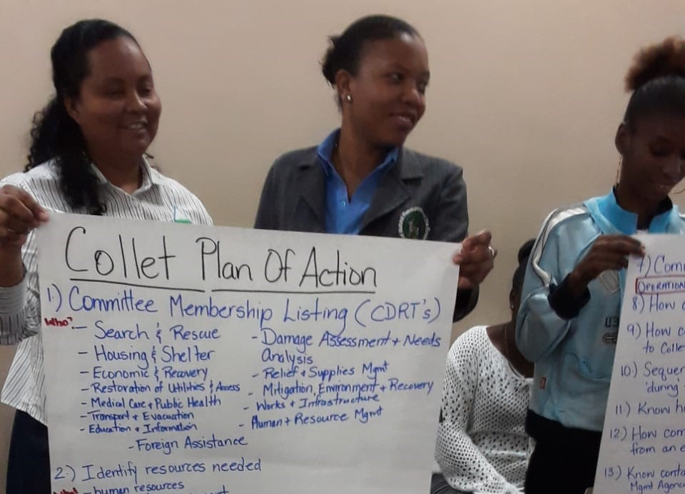
Community Disaster Plan
A document that outlines how the community will deal with a disaster.
Main hazards.
Outline the actions that the community will take before, during and after.
Notes:
Communities that plan before a disaster what they will do are more likely to be able to respond effectively to a disaster. So how can a CDRT help its community in doing this? First of all it is important to know what a disaster plan is. Put simply a disaster plan is a document that outlines how the community will deal with a disaster. It might look at the main hazards that are likely to affect that community and outline the actions that the community will take before, during and after
this threat. Plans must be tested and evaluated to know if they work and how well they work.
As with the Family Plan, it would be important to mention into the different actions that the community will take in terms of: 1) protecting children, single women, and other people with vulnerabilities, 2) Determine responsibilities of evacuation for people with disabilities and elderly.

Slide 22
Key
Considerations
Hazards & Vulnerability
Preparedness, Mitigation & Prevention Activities
Equipment Listing
Evacuation Plan
Early Warning Systems
Roles & Responsibilities

Slide 23
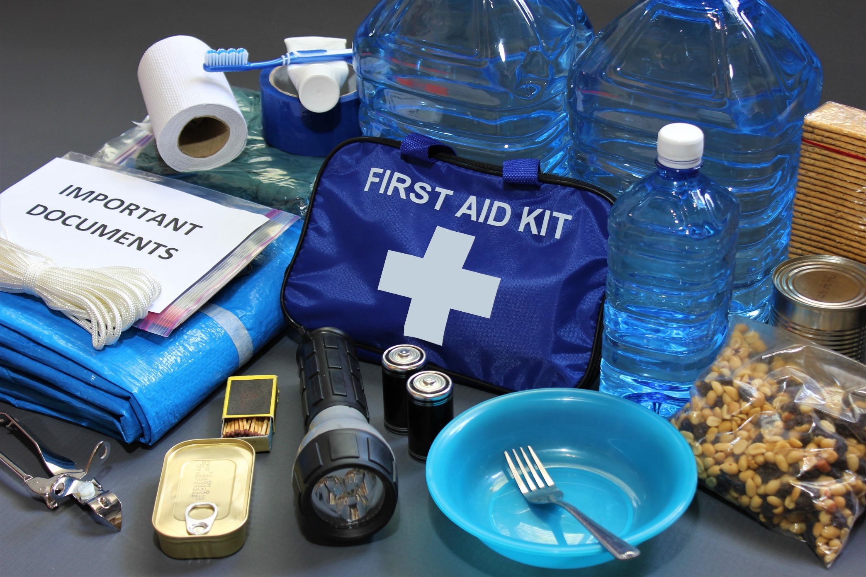
Disaster Supplies Kit
Notes:
Emergency preparedness manual*Battery-operated radio and extra batteries*Flashlight and extra batteries*Cash, Can opener, utility knife, Pliers, hammer, saw, cutlass/machete, nails (lg) Tape, rope Raincoat, boots, gloves, Matches in a waterproof container Plastic storage containers Paper, pencil Toilet paper, Soap Feminine supplies* Sanitation Personal hygiene items* toiletries Plastic garbage bags, ties Plastic bucket with tight lid Disinfectant Household chlorine bleach Sturdy shoes or work boots*Rain gear*Blankets Hat and working gloves Sheet or blanket
For Baby* Formula Diapers Bottles Powdered milk Medications For Adults* Heart and high blood pressure medication Insulin Prescription drugs Denture needs Extra eye glasses Important Family Documents Keep these records in a waterproof, portable container. Will, insurance policies, contracts, deeds Passports, immunization records Bank cards and account numbers important telephone numbers Family records (birth, marriage, death)

Slide 24
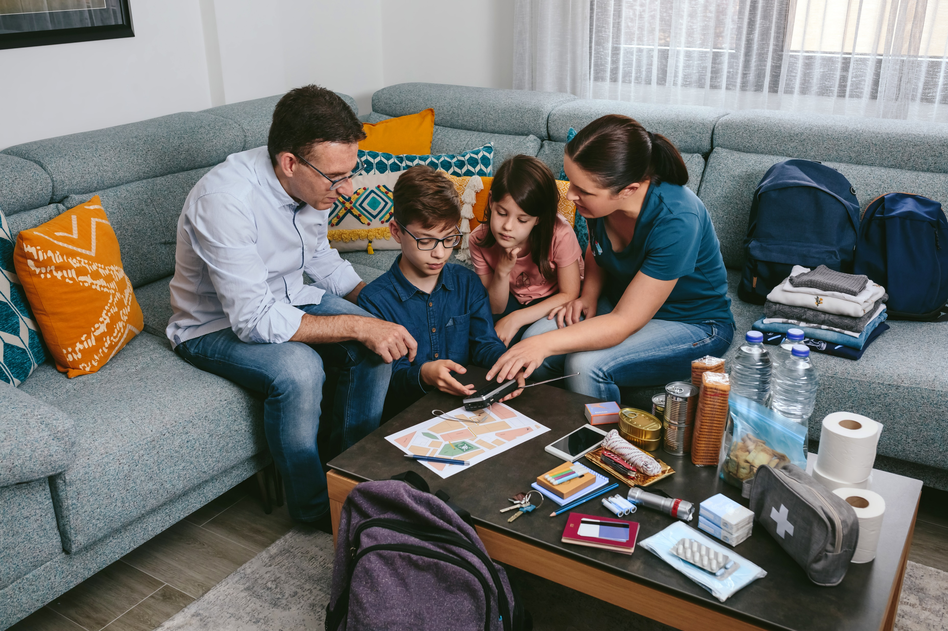
Evacuation Plans
An evacuation involves moving persons who are threatened by a hazard to a safer location. It also include moving persons back to their respective homes once the threat has passed.
Notes:
considerations of access and security: where to evacuate people with physical impairments and other disabilities, where to locate signs in multiple locations, where to put safety considerations so anyone is at risk of any situation of violence

Slide 25
Early Warning Systems
Risk Knowledge
Good knowledge of the risk
Strong knowledge of hazard and community.
Monitoring
A reliable, consistent, systematic way of predicting the event
Warning Communication
The warning or message that informs the community
Response Action
Response capacity
Practiced actions to protect lives and property

Slide 26
Early Warning Systems
Community should know & practice community plan
Identify safe areas based on hazard
Identify & mark Shelters
Best escape routes from different sections of the community to safe area/areas.
Ensure that where possible people walk with their family kits, food, water, special medication etc.
Decide on means of transportation
Secure homes as best as possible
Notes:
The most important thing is that early warning should lead to actions that save lives and reduce damage. Your community must be empowered to act once it is warned. Warning messages should be clear and logical and should be from a source that people respect and will respond to. It is about reaching the vulnerable in a timely manner and putting systems in place before so that people know what to do
Early Warning System
Activity: Using all the information you have collected so far work with your community to develop an early warning system for your area keeping in mind the key risk that exist. Be sure to think about the following:
How will you monitor the event (think about, local agencies, regional and international bodies, as well as your personal monitoring) What information is available?
What warnings or messages will you use (consider the limitations of a disaster situation and the resources you have)
How will you get the message to the persons who need to know
Who will be responsible for the different areas
Make sure you consider fast and slow unset disasters and multiply hazards.

Slide 27
Ensuring Inclusivity In All Disaster Plans
Identify who these persons are within the community and get their contact information.
Include them when conducting assessments.
Determine what type of assistance they might need in an emergency, which include assistance needed during an evacuation.
Determine their preferred mode of communication to receive information so that information can be relayed to them before, during and after an emergency.
Discuss ways to prepare and respond.
Notes:
When developing any plans always engage with and take into consideration any requirements of persons within vulnerable groups. Vulnerable groups include women and girls, low-income households, minority/marginalized groups, people loving with disabilities, migrants and the elderly.

Slide 28
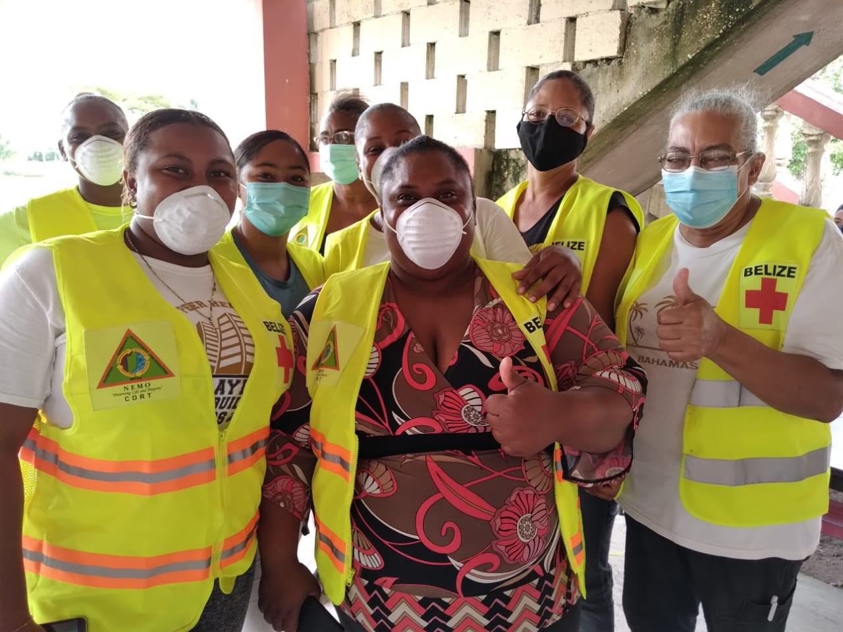
Knowing What To Do
As part of the CDRT’s Role in Preparedness, CDRTs can share the following tips of what to do before, during and after disasters.

Slide 29
Earthquake
Safety Tips

Slide 30
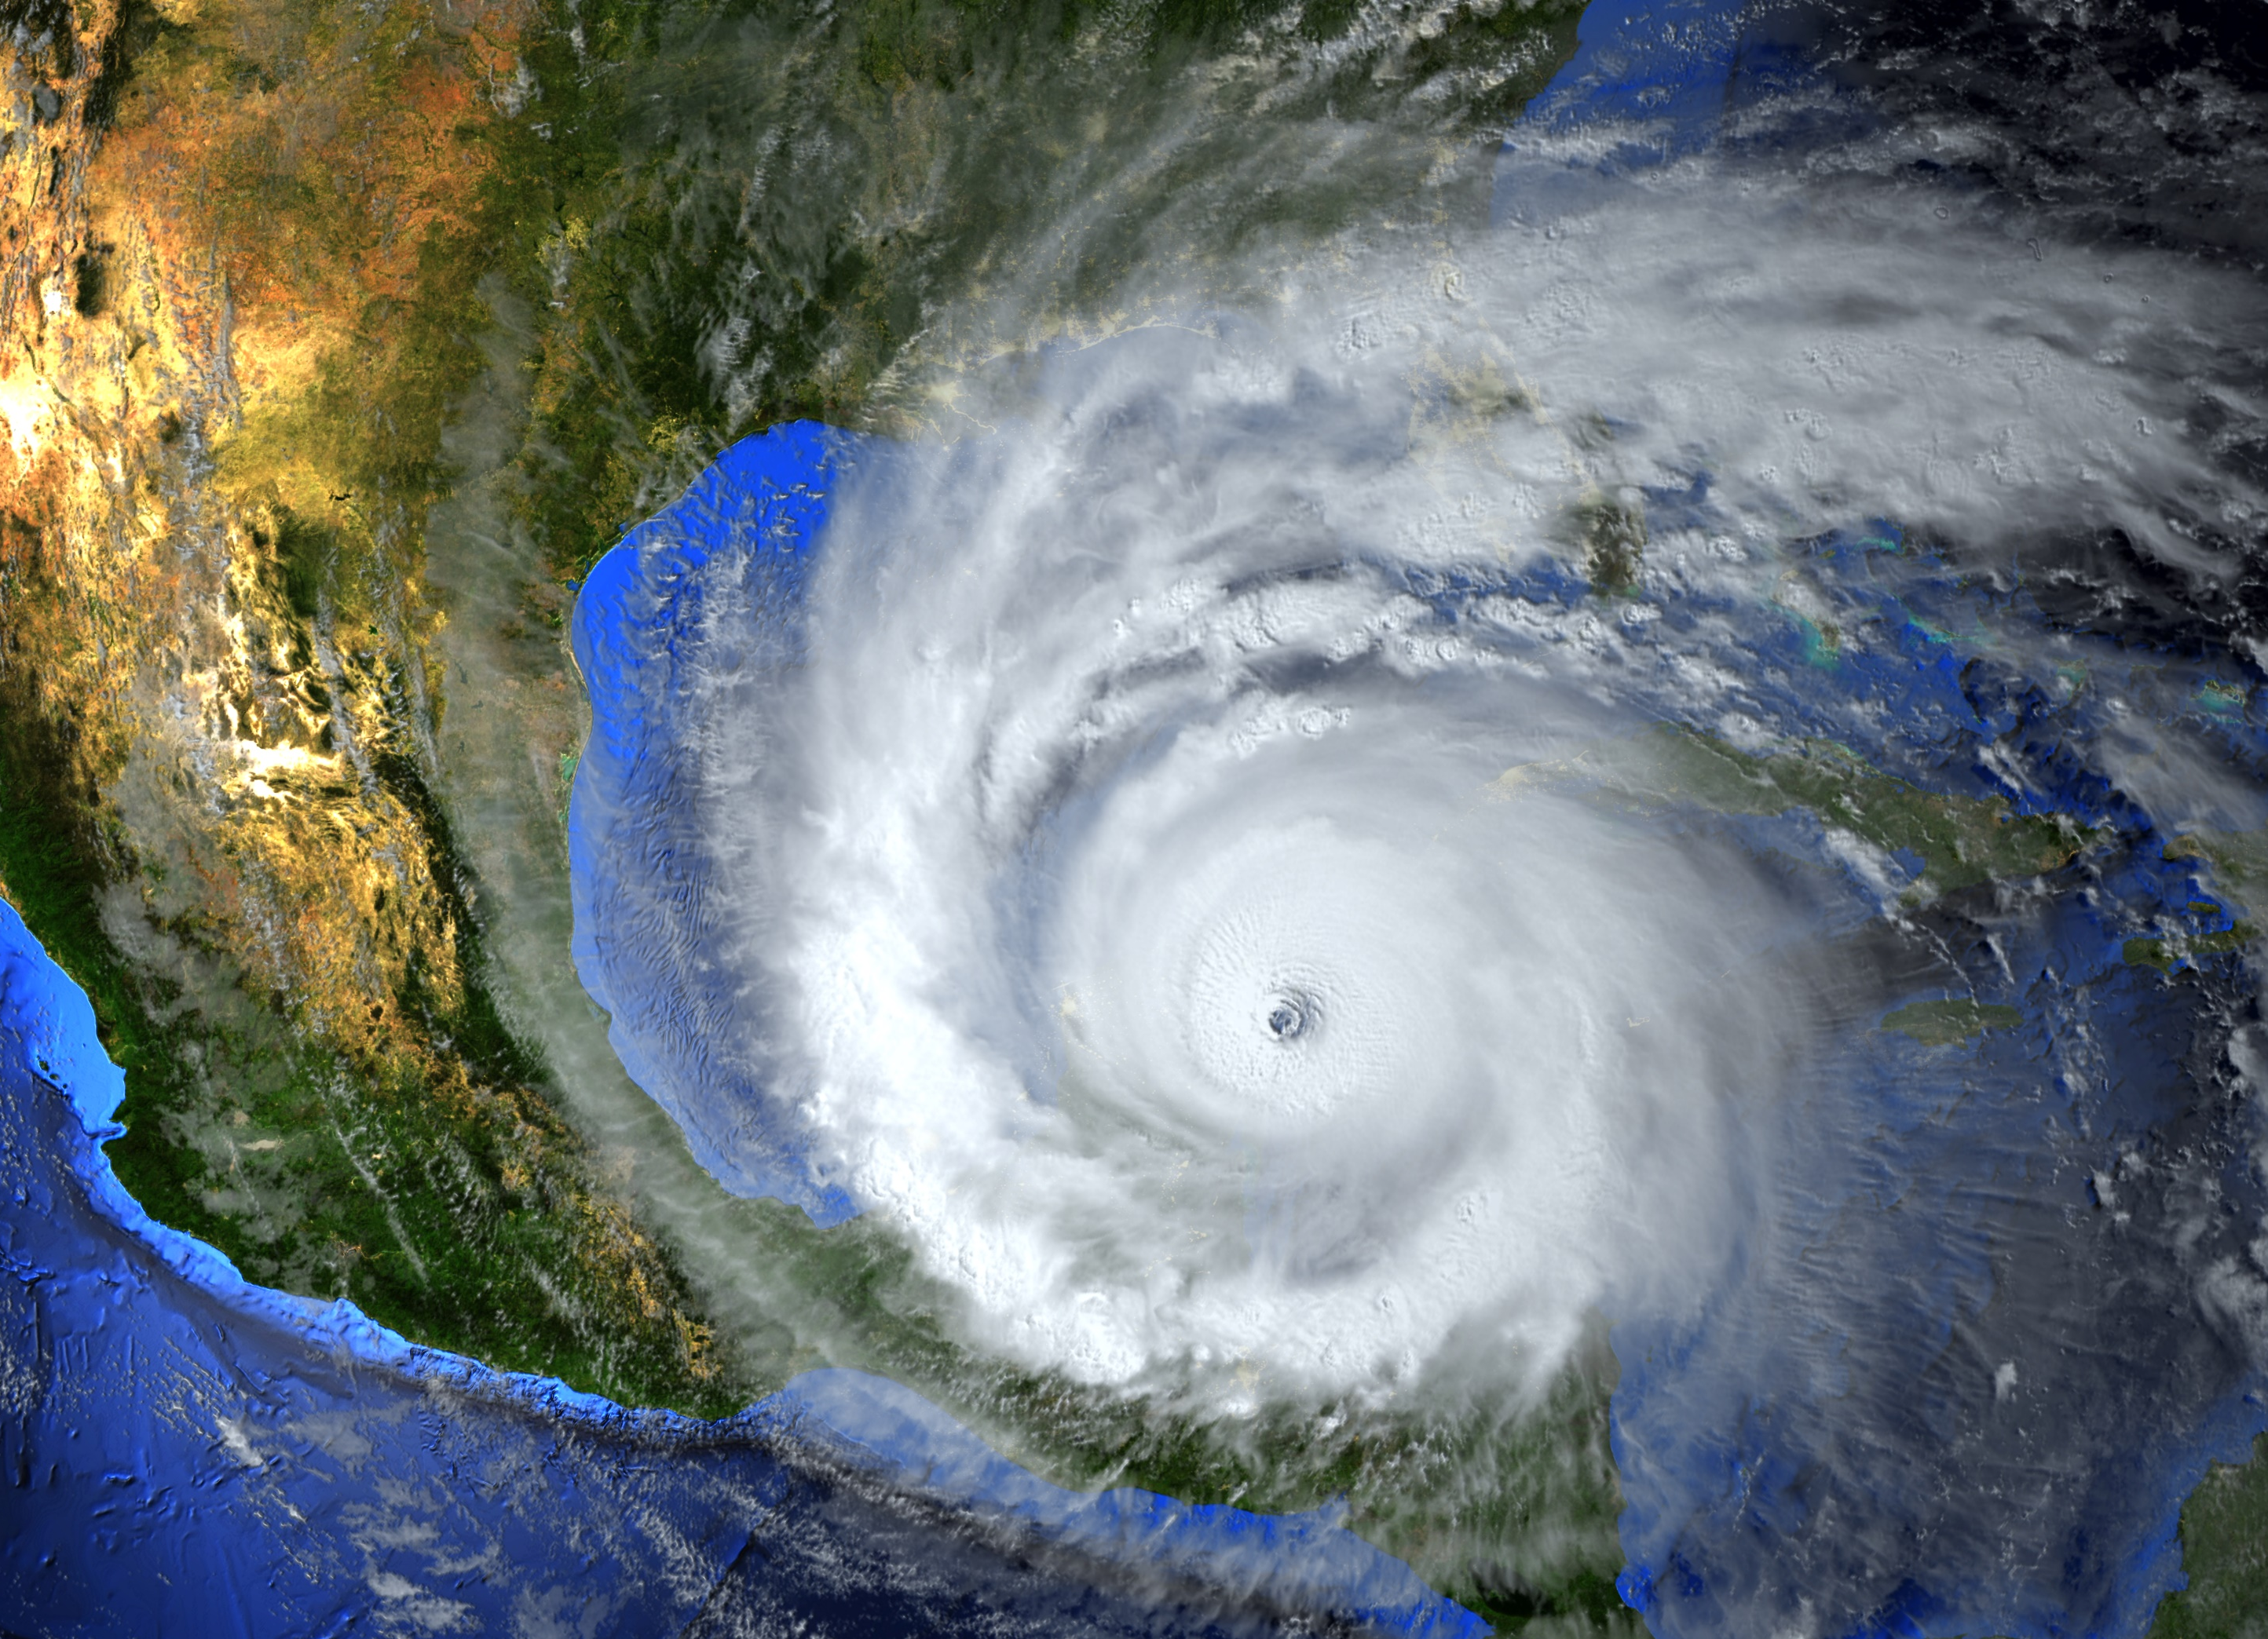
Hurricanes

Slide 31
Hurricanes:
Before
Know what are a hurricane watch (hurricane conditions within 48 hours) and a hurricane warning (hurricane conditions within 36 hours).
Have a disaster kit which includes a portable radio and flashlight.
Ensure you have enough nonperishable food and water stored to last you up to 2 weeks.
Floodproof your home.
Keep trees and shrubbery trimmed.

Slide 32
Hurricanes:
During The Watch &
Warning Phase
Board up all windows
Check batteries and stock up on canned food, medical supplies, and drinking water.
Bring in outside objects (e.g., garbage cans, lawn furniture, bicycles).
Listen to the advice of local officials and evacuate if told to do so.

Slide 33
Hurricanes:
During
If you are not advised to evacuate, stay indoors and away from windows.
Stay away from flood waters; never drive through them.
Be aware of the calm “eye”; the storm is not over.

Slide 34
Hurricanes:
After
Wait until an area is declared safe before entering.
Use a flashlight to inspect for damage including gas, water, and electrical lines and appliances
Stay away from downed power lines.
If you smell gas of if there is a fire, turn off the main gas valve. Switch off individual circuit breakers (or unscrew individual fuses), then switch off the main circuit breaker (or unscrew the main fuse)
Use a portable radio for information from officials.
Stay out of flood waters.

Slide 35
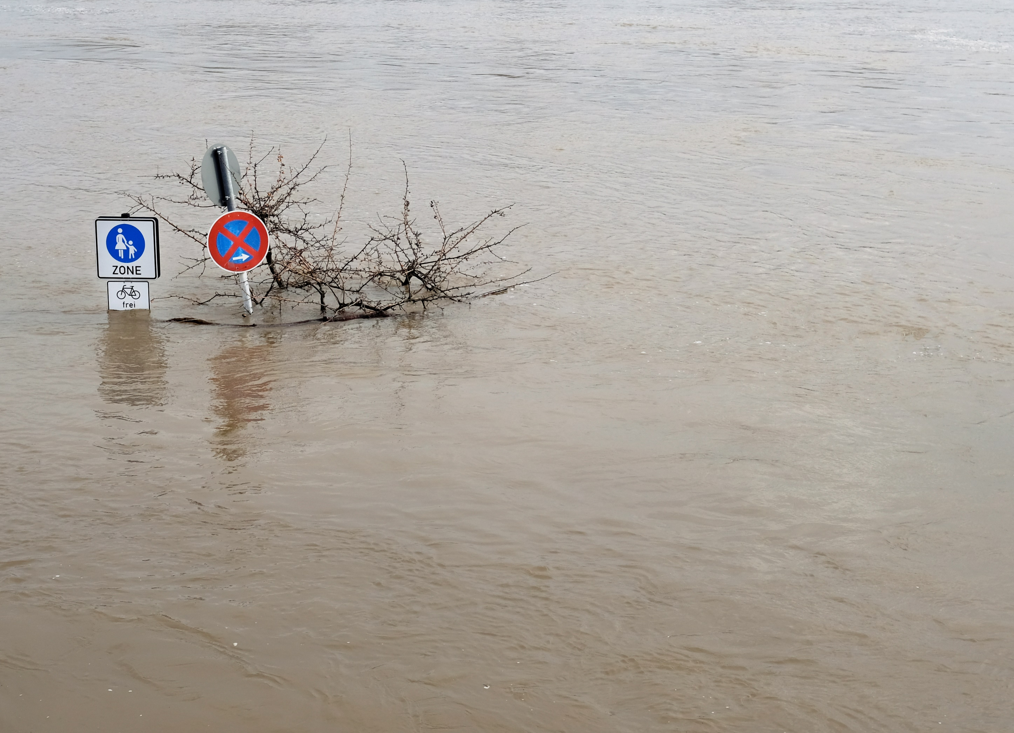
Floods

Slide 36
Floods:
Before
Know the flood risk and the elevation of the area.
Prepare a home flood evacuation or escape plan.
Keep insurance papers, important documents, and other valuables in a safe-deposit box or in a waterproof bag.
Have a family plan and choose a safe area in advance.
Have a portable radio, flashlight, and emergency supplies.
Stock up on sandbags.
Move furniture and other items to higher levels.
Listen to radio or TV for up-to-the-minute information from officials.

Slide 37
Floods:
During
Use telephones only for life-threatening emergencies.
Evacuate, if necessary, and follow instructions.
Do not walk or drive through flood waters.
Stay off bridges where water is covering them.
Heed barricades blocking roads.
Keep away from waterways during heavy rain. If you are in a valley area and hear a warning, get to high ground immediately.
Keep out of storm drains and gullies.

Slide 38
Floods:
After
Listen to a portable radio for information from officials.
Boil drinking water before using (rolling boil for 10 minutes).
Use a flashlight to check for damage including gas, water, and electrical lines and appliances.
If you smell gas or if there is a fire, turn off the main gas valve. Switch off individual circuit breakers (or unscrew individual fuses), then switch off the main circuit breaker (or unscrew the main fuse).
Stay out of the disaster area.

Slide 39
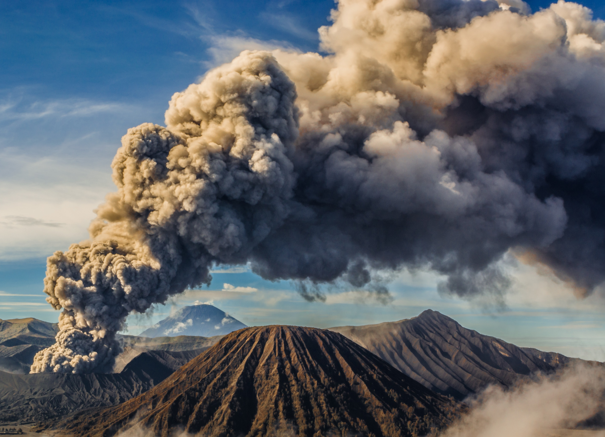
Volcanoes

Slide 40
Volcanoes
Before
Prepare a home evacuation or escape plan.
Keep insurance papers, important documents, and other valuables in a safe-deposit box or in a waterproof bag.
Have a family plan and choose a safe area in advance.
Have a portable radio, flashlight, and emergency supplies.
Listen to radio or TV for up-to-the-minute information from officials.

Slide 41
Keep listening to the radio or TV for information from officials.
Follow any evacuation orders issued by authorities.
Activate your family emergency plan.
If asked to stay indoors, ensure that all windows and doors are kept closed.
In the event of ashfall, seal your windows and door frames with wet rags.
Avoid low-lying areas
Bring all animals and livestock in closed shelters.
Put all machinery inside a garage or cover them with large tarps.
Cover water tanks and other deposits so they do not become contaminated by ash.
If you have to go out, use mouth guards, long sleeve clothes, protective glasses and a cap.
Volcanoes:
During

Slide 42
Volcanoes:
After
Listen to a portable radio or TV for information from officials.
Let friends and family know that you are safe.
If evacuated, do not return to your home unless authorities say it is safe to do so.
Stay out of the disaster area.
Do not use telephones except in emergencies.

Slide 43
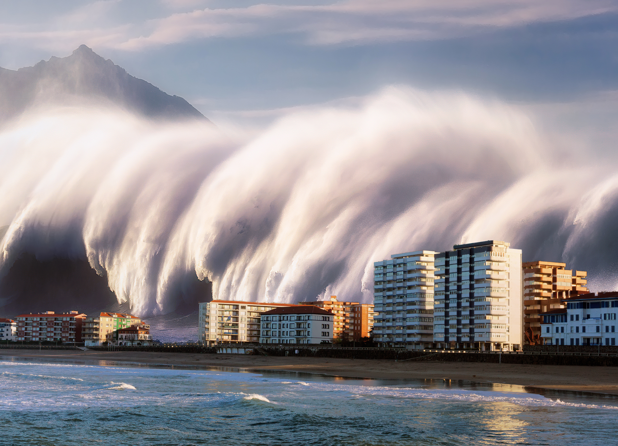
Tsunamis

Slide 44
Tsunamis:
Before
Learn the three tsunami warning signs
Learn the difference between a tsunami warning and a tsunami watch and find out which local authority is responsible for sending out alerts.
Find out if there are any early warning systems in place.
Have a family emergency and evacuation plan in place.

Slide 45
Tsunamis:
During
If you are at the coast and you experience any of the warning signs, leave the area immediately.
Follow any evacuation orders issued by authorities and get to higher ground as soon as possible.
Take your animals with you if you can.
When at a safe place listen to the radio or TV for further updates and information.

Slide 46
Tsunamis:
After
Listen to a portable radio or TV for information.
Let friends and family know that you are safe.
If evacuated, do not return to your home unless authorities say it is safe to do so.
Be aware of any secondary effects such as contaminated water, mudflows, damaged buildings and roads etc.
Avoid any areas that may have been impacted.

Slide 47
Volunteer, Donate, Join Us In Partnership, or share
our appeals and stories on social media. Find out more about IFRC, and learn how to contact your National Red Cross or Red Crescent Society, at www.ifrc.org
Get Involved
There are many ways of becoming a part of the world’s largest humanitarian network
P.O. Box 303
CH-1211 Geneva 19
Switzerland
Telephone: +41 22 730 4222
Fax: +41 22 730 4200
Email: secretariat@ifrc.org
Website: www.ifrc.org

