Slide 1
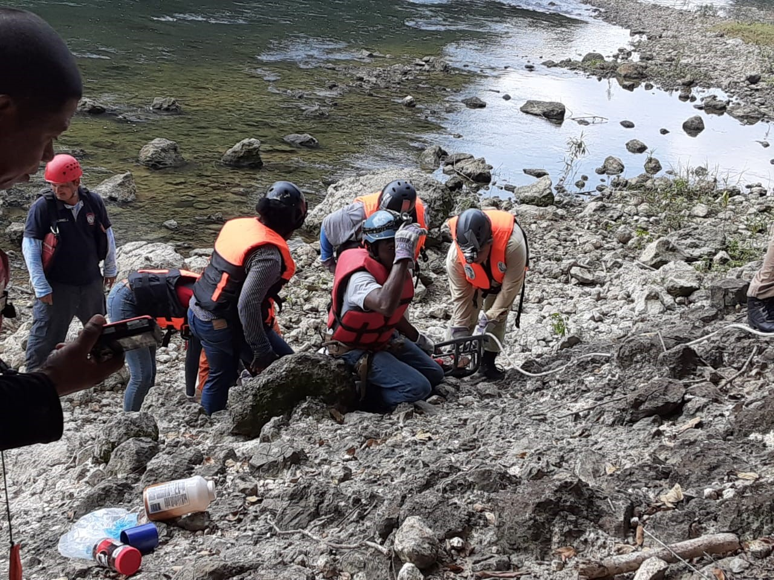


CDRTs & Search and Rescue
For Community Response Teams

Slide 2
Objectives
Understand what is meant by Light Search and Rescue.
Learn safety precautions to be undertaken.
Understand what is meant by the term “Sizeup” and the Nine-Step Sizeup model.
Understand how to conduct a rescue operation.

Slide 3
What Is Search & Rescue
Search and rescue is a process that consists of three separate operations:
Sizeup:
Assess the situation and determine a safe action plan using the nine-step sizeup model.
Search:
Locate victims and document their location. Search can include techniques and procedures aimed at determining the locations of victims in voids within the collapsed structure.
Rescue:
Procedures and methods required to extricate victims.
Notes:
Size Up is the terminology used by Search and Rescue persons, explain that it does sound odd but it is the proper terminology used.

Slide 4
Unsafe Conditions
Situation faced by a rescuer that poses a threat to his physical integrity.
Unsafe Conditions Include:
Contaminated Air & Water
Poor Conditions Of Tools & Equipment
Adverse Weather Conditions
Unstable Structures
Presence Of Threats
Notes:
Unsafe situations likely to be encountered by rescuers include
Contaminated air and water
Operating tools and equipment in poor condition
Lots of weight lifting, excessive fatigue and stress
Adverse weather conditions
Unknown work scenarios
Working in small, confined spaces
Unstable structures
Presents of hazardous materials
Excessive noise. Dust, smoke and fire
Earthquake aftershocks

Slide 5
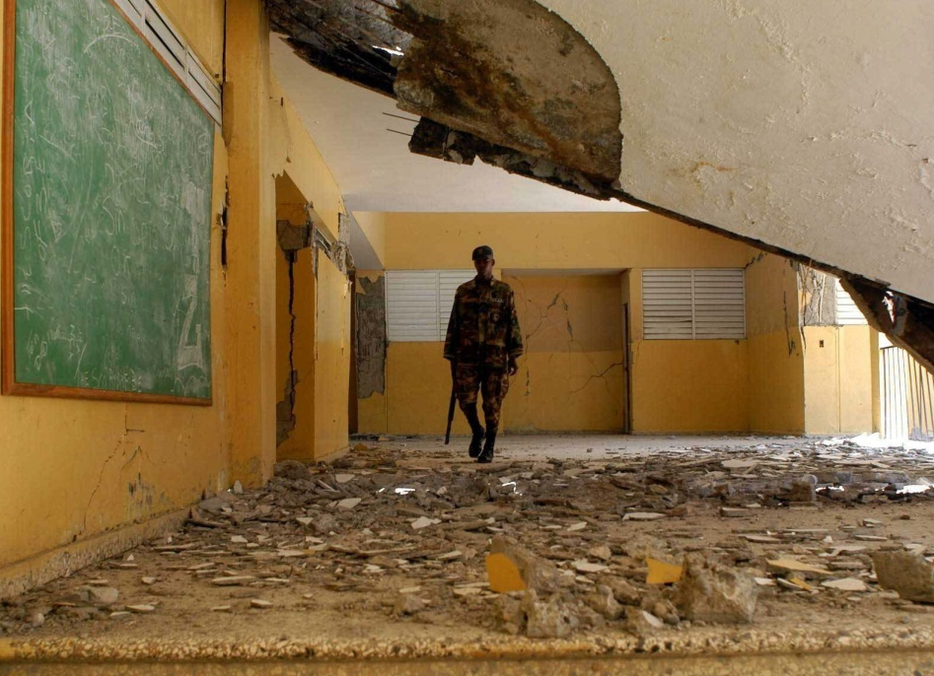
Unsafe Actions
Act or task carried out by a rescuer without following the rules established for his protection

Slide 6
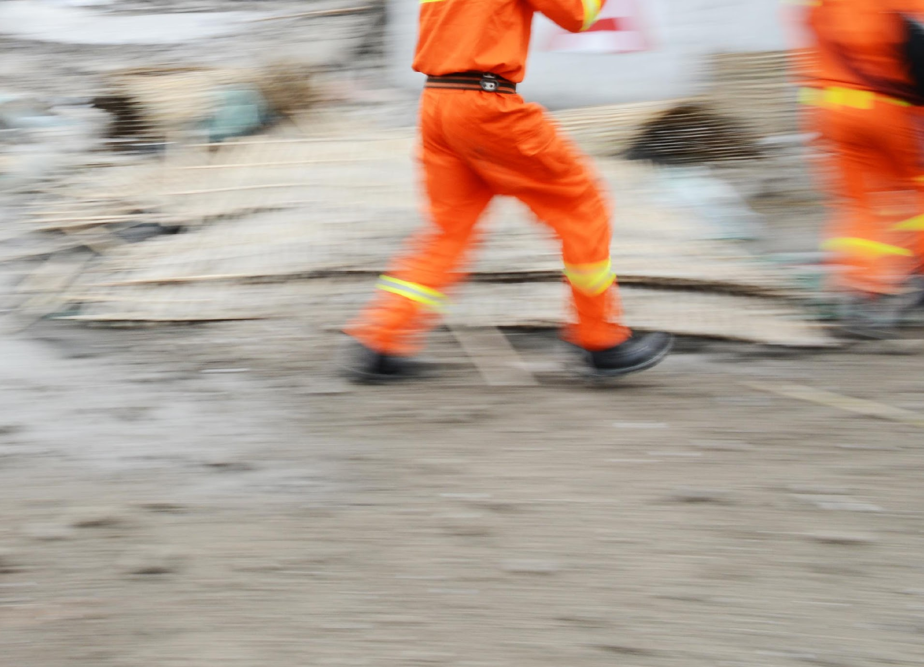
Safety
Remember: The safety of CDRT members is always the first priority and will dictate some of your other priorities
“When in danger or doubt, Let the Fireman take them out!”
Notes:
Rescuers are likely to encounter many unsafe situations and they can also engage in many unsafe actions. It is important to take steps as CDRT to reduce danger from both for your teams.
EMPHASIZE: CDRT Members should endeavour not to put themselves in undue danger or do anything that could further endanger those they are trying to help.

Slide 7
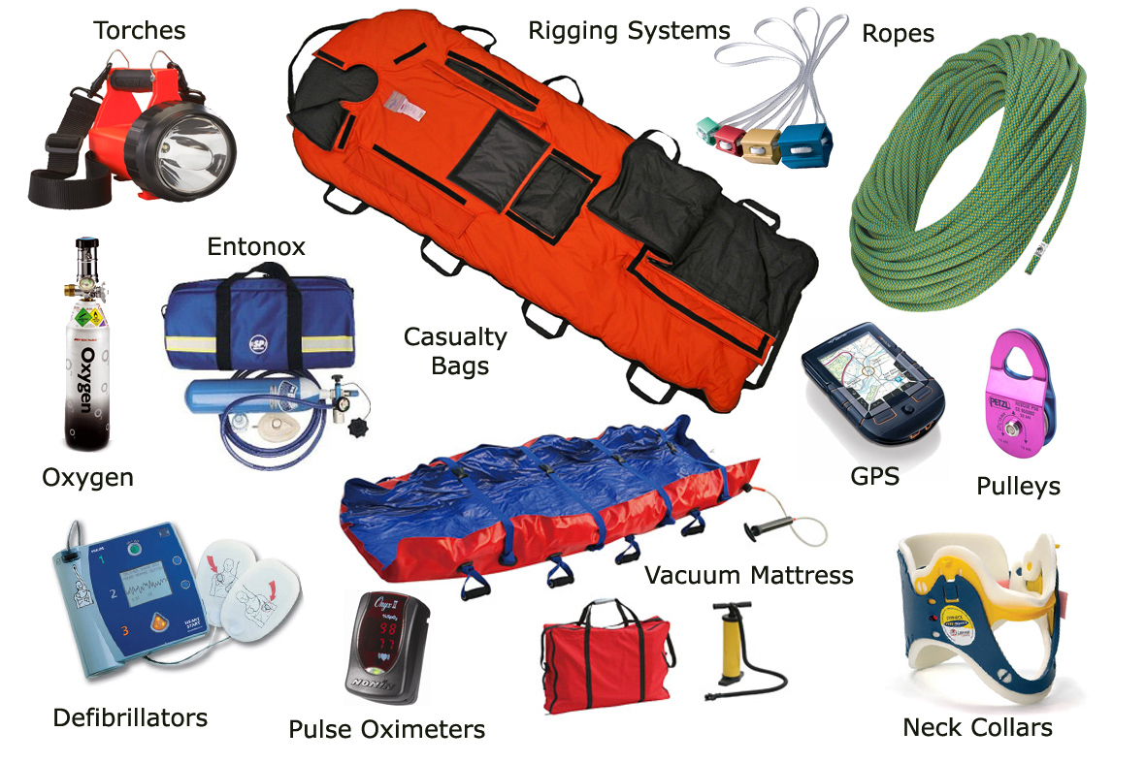
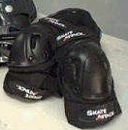
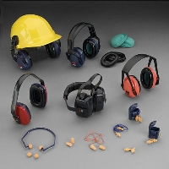

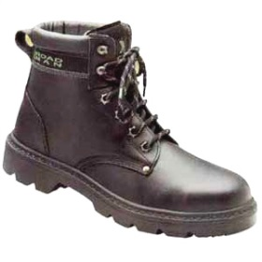
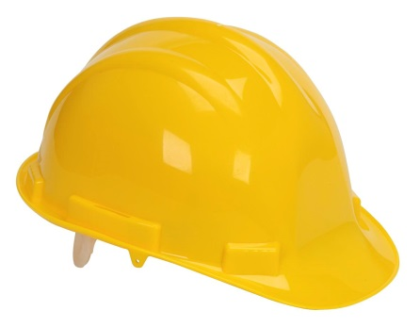
Safety Gear
Notes:
Facilitator needs to stress here SAFETY, just because CDRTs have equipment does not mean that they should risk their lives if they are not properly trained to rescue an individual. Identify the authorised agency to conduct Search and Rescue and link their support role to this agency, making sure they understand what their specific role in light search and rescue situations. Also mention CERTs if applicable in your country and how they can become properly certified.
is it safe, should be the catch phrase. INITIAL SAFETY ASSESSMENT is critical

Slide 8
Gather Facts: Consider time of day, type of terrain and any hazards.
Assess & Communicate: Consider the extent of the damage, document findings to share with responding agencies.
Consider Probabilities: Consider what-if scenarios.
Assess your situation: Consider the resources, manpower and skills needed.
Establish Priorities: Consider what should be done
Make Decisions
Plan of Action: Based on priorities and decisions made. Documentation is important to share with responding agencies.
Take Action
Evaluate Progress: Consider information gained as this will help with future decision making.
Size Up
This involves assessing the situation and determining a safe action plan: The nine-steps in the sizeup model are:

Slide 9
Step 1:
Gather Facts
When Gathering Facts, Consider:
Time Of Day & Day Of The Week
Weather
Type Of Structure
Hazards
Construction Type
Notes:
- Time of Day - At night, more people will be in their homes, so the greatest need for search and rescue will be in residential settings. During the day, people will be at work, so the need will be in commercial buildings. Some emergency services are not available—or not available in the same numbers—during the evenings or on weekends
The type of structure - The purpose for which the structure was designed may indicate the likely number of victims, and their location.
Construction type – Some types of construction is more susceptible than others.
Weather: Severe weather will have an effect on victims and rescuers alike and will certainly hamper rescue efforts.
- Hazards: Knowledge of other potential hazards in the general and immediate areas is important to search and rescue efforts.

Slide 10
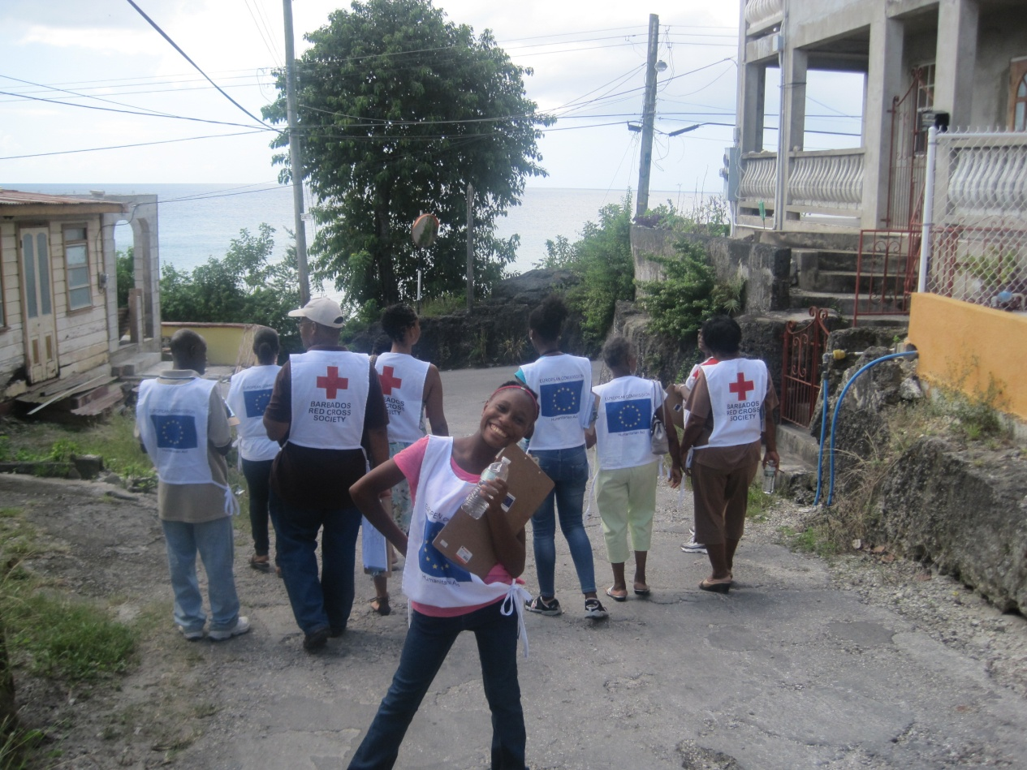
Activity:
Split into groups and Gather Facts

Slide 11
Step 2:
Assess and Communicate Damage
Determine the extent of damage to the building.
Take a lap around the building and examine the exterior.
Observe the ground around the building.
Examine the safety of non-structural elements.
Watch for the presence of THREATS
Explain to occupants whether they can remain in the building or whether they should evacuate
Document the result of the assessment to be shared with responder agencies.

Slide 12
Assessment Of Damaged Structures | Degree Of Damage | Should Rescue Be Attempted?
Partial or total collapse of walls and/or ceilings; obvious structural instability; tilting; off foundation; heavy smoke or fire; gas leaks; hazardous materials inside; rising or moving water | Heavy | No. Too dangerous to enter. Secure the perimeter and control access into the structure. Warn people to stay away
Visible signs of minor structural damage; decorative work that is damaged or fallen; many visible cracks in plaster; building still attached to foundation; major damage is to contents of building | Moderate | Perform only quick and safe removals; limit onsite medical care to checking for breathing, stopping major bleeding, and treating for shock. Minimize the number of rescuers inside the building.
Superficial damage, broken windows, fallen plaster, major damage is to contents of building | Light | Yes. Locate, triage, and prioritize removal of victims to the designated treatment area.
Is It Safe To Attempt This Rescue?

Slide 13
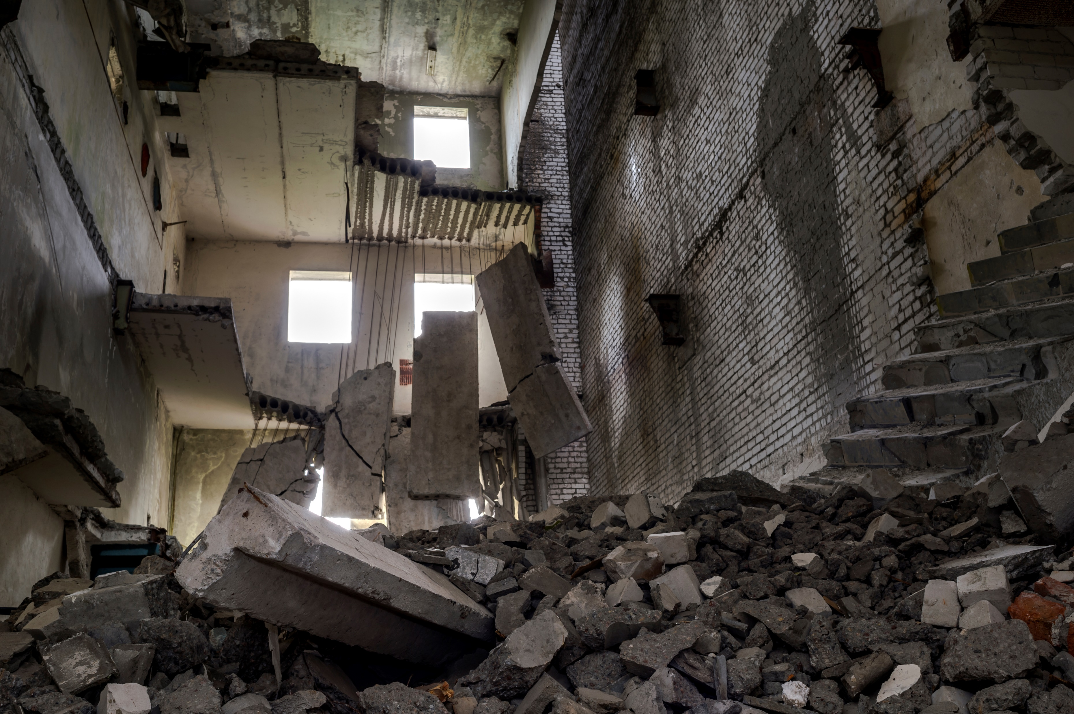
Remember:
Do not enter any structure that is heavily damaged. The safety of CDRT members is always the first priority!
If the structure is moderately damaged, perform only quick and safe removals. Follow the guidance provided by Emergency Personnel.
Always Consider
Safety

Slide 14
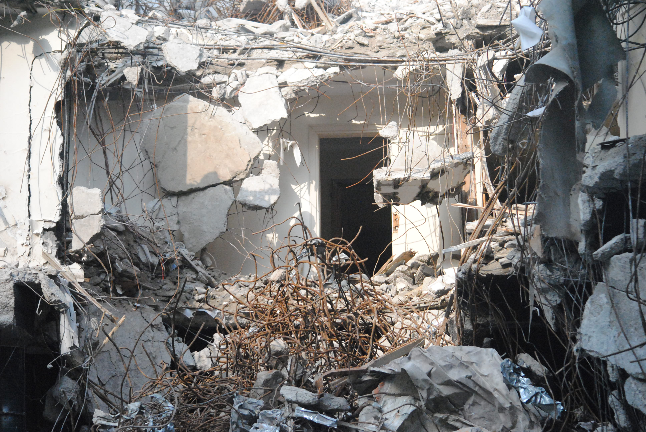
Step 3: Consider Probabilities
Ask yourself the following questions:
How stable is the situation?
What could happen?
What else could go wrong?
What can I do to reduce the probabilities or potential issues identified?

Slide 15
Step 4: Assess Your Situation
When assessing the situation, think of personnel, equipment and tool. Determine:
Who lives or work in the area that can help?
Who has the skills that be helpful in this situation?
What equipment is available and where is it located?
Can it be accessed?
What tools are available for lifting, moving or cutting debris?
As a CDRT you will want to determine this information before and share it with your National Disaster Office and local National Society.

Slide 16
Steps 5 and 6: Establish Priorities and Make Decisions
Decide what should be done and in what order
When making decisions always consider:
The safety of CDRT members.
Life safety for victims and others.
Protection of the environment.
Protection of property.

Slide 17
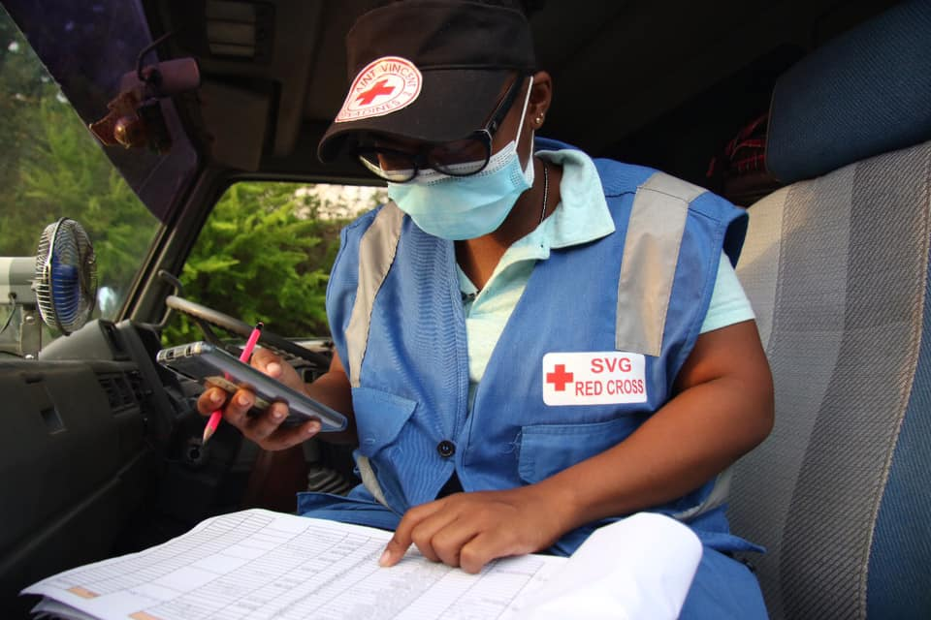
Step 7:
Develop Plans of Action
Emergency personnel will decide how the team will conduct its operation considering the highest priority first.
Where possible, document the plan as this can help to focus the operation on established priorities as well as be shared with authorities when they arrive.

Slide 18
Step 8:
Take Action
Use the following guideline when taking action:
Use a buddy system. Always work in pairs, with a third person acting as a runner.
Be alert for hazards Never attempt to search an area where water is present.
Use safety equipment. Always wear safety gear before attempting to rescue someone.
Only act when guidance is provided by emergency personnel or if you have more advanced training. DO NOT PUT YOURSELF IN DANGER

Slide 19
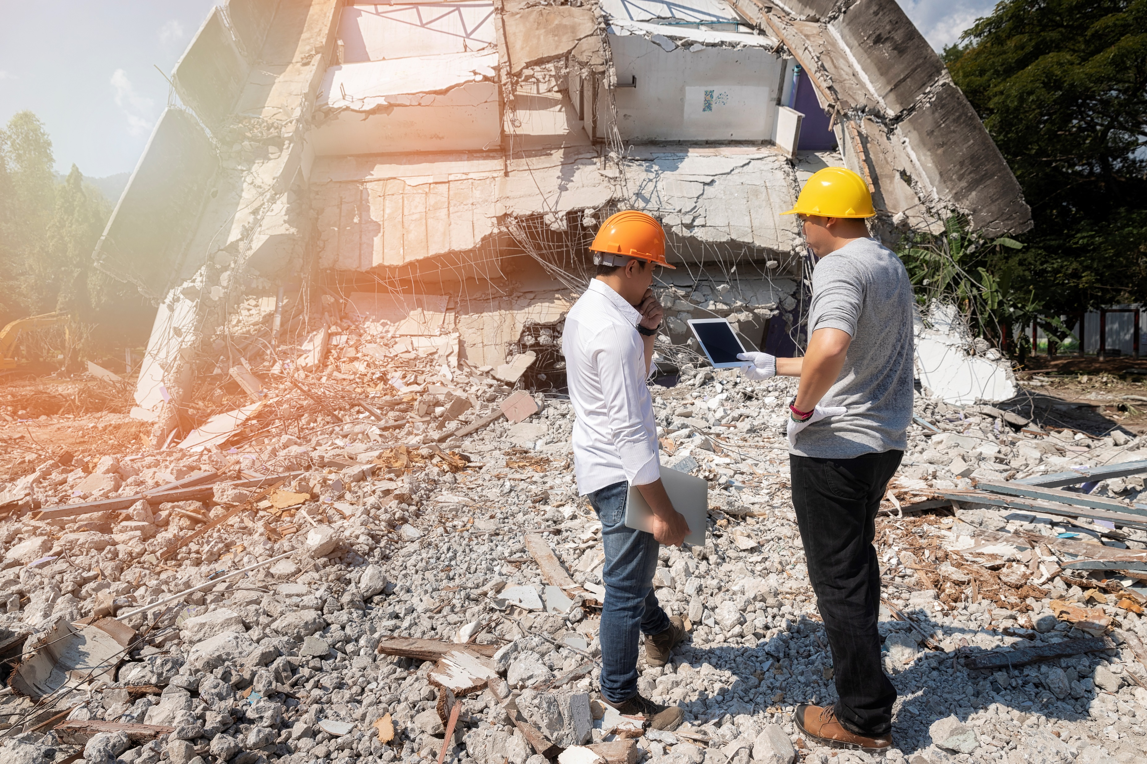
Step 9:
Evaluate
Evaluate what works as this would affect future decision making.
Remember sizeup is a continuous process.

Slide 20
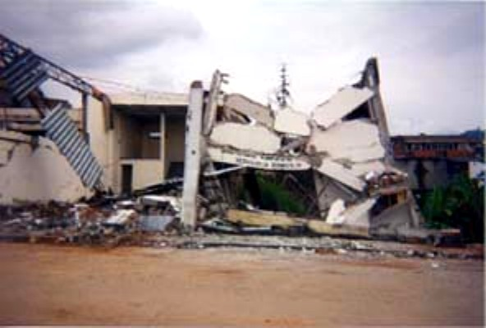
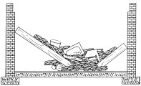
Types Of Collapse
& Voids
V-shaped

Slide 21
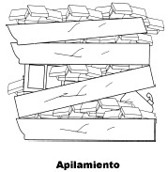
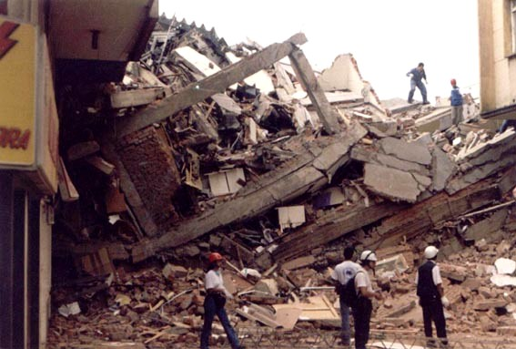
Types Of Collapse
& Voids
Pancake

Slide 22
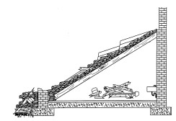
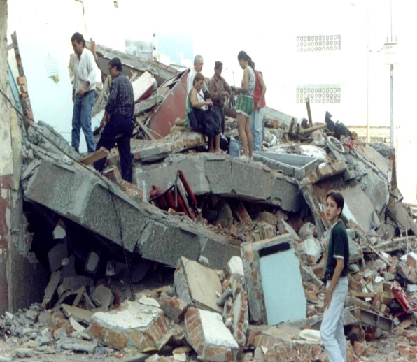
Types Of Collapse
& Voids
Lean To

Slide 23
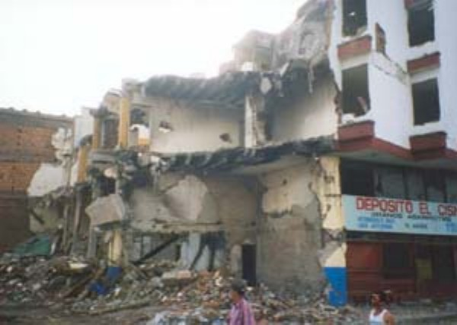
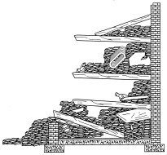
Types Of Collapse
& Voids
Suspended

Slide 24
Search
& Rescue
Before you commence your search, decide on a systematic search pattern and ensure that all areas of the building are covered.
Examples of systematic search patterns to use include:
Bottom-up/top-down.
Right wall/left wall.
Parallel

Slide 25
Search
& Rescue
When you begin your search:.
Call out to victims.
Stop frequently to listen
Triangulate areas from where sounds could be heard
Mark search areas and document results
Report results to responding agencies

Slide 26
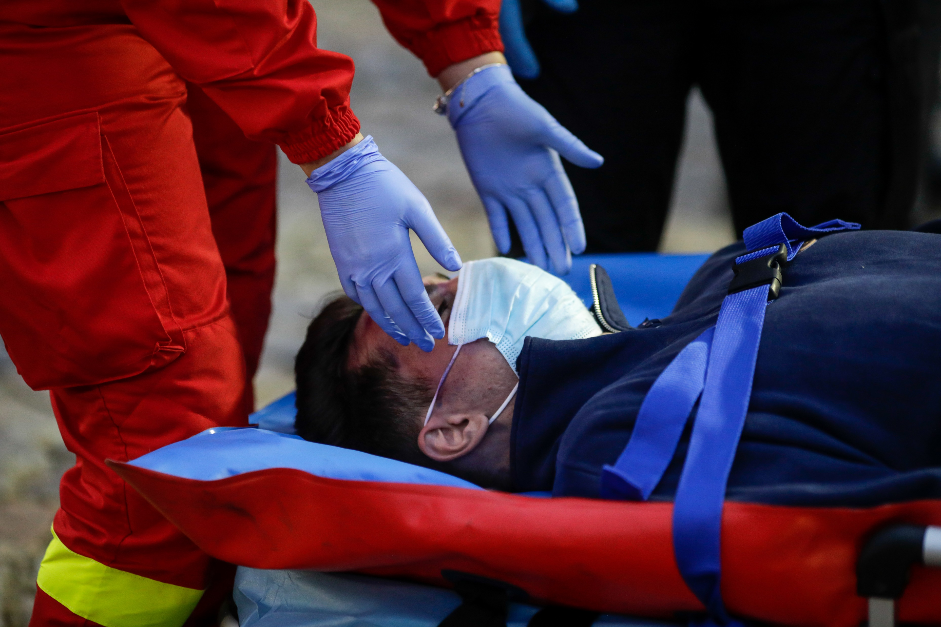
Many volunteers have been injured or killed during rescue operations because they did not pay attention to their own physical and mental limitations.
Do not attempt any search and rescue operations that you are not trained for. Having safety equipment is not enough to protect you, search and rescue requires proper training.
Know Your Limitations

Slide 27
Safety
Safety Precautions For All Search & Rescue Operations
Emergency Signals: Decide on signals that can be used to communicate and ensure signals are understood by all.
Escape Routes & Safe Areas: Always establish safe areas and a safe route of escape in case of emergency. Before you enter any structure be sure you have a safe way out.
Assignment Of A Safety Officer: Assign someone the responsibility to look out for the safety of the team.
Use Of Identification Vests

Slide 28
Rescue
Communicating With The Victim
Removing
The Victim
Treating
Injuries
Reporting

Slide 29
Communicating With Victims
Identify yourself and project your voice calmly.
Obtain the person’s data.
Always address the person by name.
When speaking urge the person to keep positive.
Inform the person if you must leave even for short periods of time.
Inform the person of the progress of the rescue operation.
Do not promise anything you can’t deliver.
Be positive in your comments.

Slide 30
Possible Injuries To Victims
Crush And/ Or Compression
Falls
Extreme Temperatures
Impacts
Contaminated Atmospheres
Lack Of Water And/Or Food
Extended Isolation And Depression
Rodent Attacks

Slide 31
Removing
Victims
The Type Of Extrication Method Selected Should Depend On The:
General stability of the immediate environment.
Number of rescuers available.
Strength and ability of the rescuers.
Condition of the victim.

Slide 32
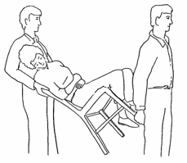
Chair Carry
Video Reference:
https://www.youtube.com/watch?v=bXfHp4Sj8wM
Notes:
The victim is placed in a chair and tilted backward as rescuers lift the victim. This carry requires two rescuers:
Rescuer 1: Facing the back of the chair, grasp the back uprights.
Rescuer 2: Facing away from the victim, reach back and grasp the two front legs of the chair.
Both rescuers: Tilt the chair back, lift, and walk out. One-Person Arm Carry
The rescuer holds the victim around the victim’s back and under the knees.
Get the group to practice these other lifts
One-Person Pack-Strap Carry
The rescuer places the victim’s arms over his or her shoulder and grabs the victim’s hands over his or her chest, then hoists the victim by bending over slightly.
Two-Person Carry
Rescuer 1 squats at the victim’s head and grasps the victim from behind at the midsection. Rescuer 2 squats between the victim’s knees, grasping the outside of the knees. Both rescuers rise to a standing position

Slide 33
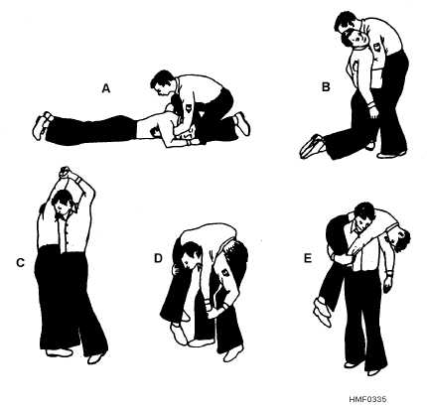
Fireman’s Carry
Video Reference:
https://www.youtube.com/watch?v=daqrpilCOHc
Notes:
Blanket carry
This method requires at least six rescuers to ensure stability for the victim and that one rescuer must be designated the lead person:
Step 1: Lay a blanket next to the victim.
Step 2: Tuck the blanket under the victim, and roll the victim into the center of the blanket.
Step 3: With three rescuers squatting on each side and grasping a "handle," the lead person checks the team for even weight distribution and correct lifting position.
Step 4: The lead person calls out, "Ready to lift on the count of three: One, two, three, lift."
Step 5: The team lifts and stands in unison— keeping the victim level—and carries the victim feet first.
The team must also lower the victim together, using the following steps:
Step 1: The lead person calls out, "Ready to lower on the count of three: One, two, three, lower."
Step 2: The team lowers the victim in unison, exercising caution to keep the victim level.
Blanket Drag
The victim is wrapped in a blanket with the rescuer squatting at the victim’s head. The rescuer grasps the blanket behind the victim’s head and drags him or her clear of the hazard.

Slide 34
Reporting
Keep complete records both of removed victims and of victims who remain trapped or are dead.
Report this information to emergency services personnel when they arrive at the scene.

Slide 35
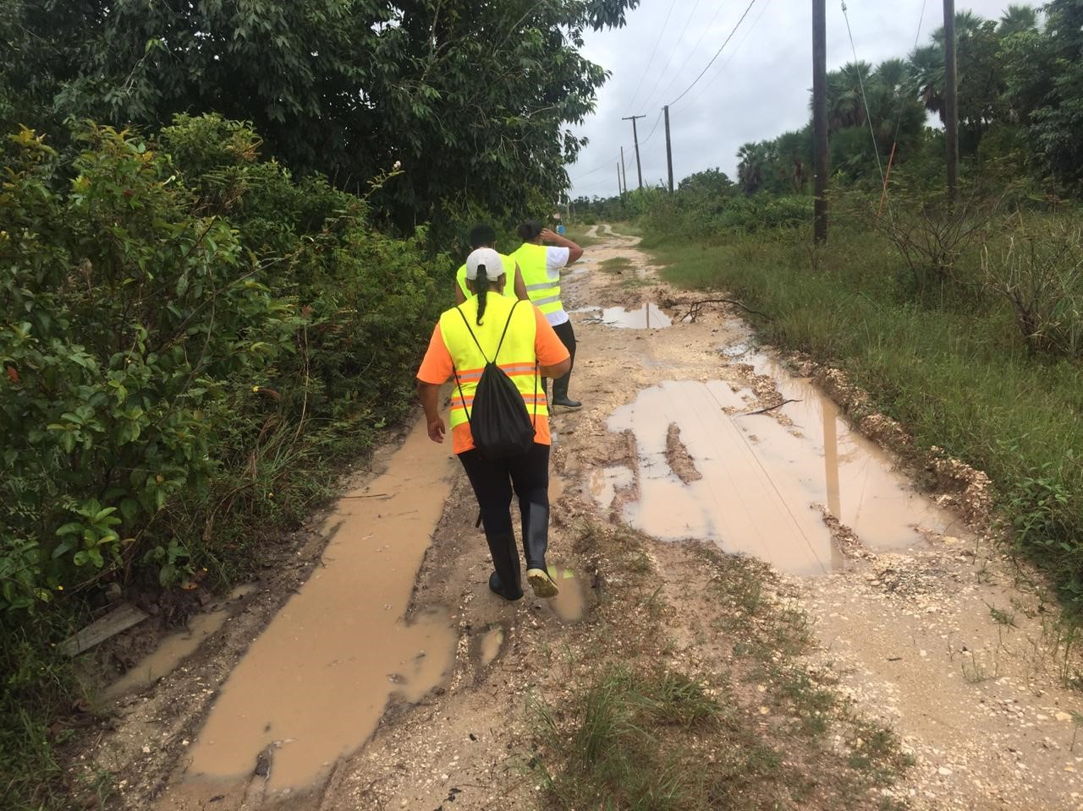
Always Remember
Safety
Remember: Safety of your team comes first!
If you have assessed the situation and it is unsafe to act, wait on the authorities.

Slide 36
Volunteer, Donate, Join Us In Partnership, or share
our appeals and stories on social media. Find out more about IFRC, and learn how to contact your National Red Cross or Red Crescent Society, at www.ifrc.org
Get Involved
There are many ways of becoming a part of the world’s largest humanitarian network
P.O. Box 303
CH-1211 Geneva 19
Switzerland
Telephone: +41 22 730 4222
Fax: +41 22 730 4200
Email: secretariat@ifrc.org
Website: www.ifrc.org

